Slide 1
Conductors, Semiconductors, and Insulators
A Presentation
By
M. Shahmeer Khan
Notes:
Introduce the topic and explain that this presentation will cover differences, properties, and applications of conductors, semiconductors, and insulators.

Slide 2
Introduction
Conductance:
Conductance is the measure how easily electric current passes though a material or a circuit.
Conductors:
• Conductors allow easy flow of electrons. Due to excess of free electrons.
Examples are Copper Iron etc.
Semi conductors:
• Semiconductors have moderate conductivity.
• Insulators resist the flow of electricity. Examples are silicon germanium etc.
Notes:
Explain that electrical conductivity determines how materials are classified. Mention that these materials play key roles in electrical and electronic devices.

Slide 3
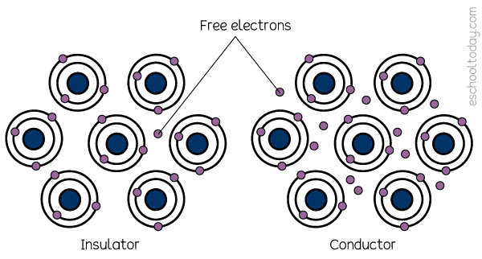
Insulators:
Insulators do not allow any current to pass through it. Due to them having almost no free electrons. Examples are rubber, wood, plastic etc.

Slide 4
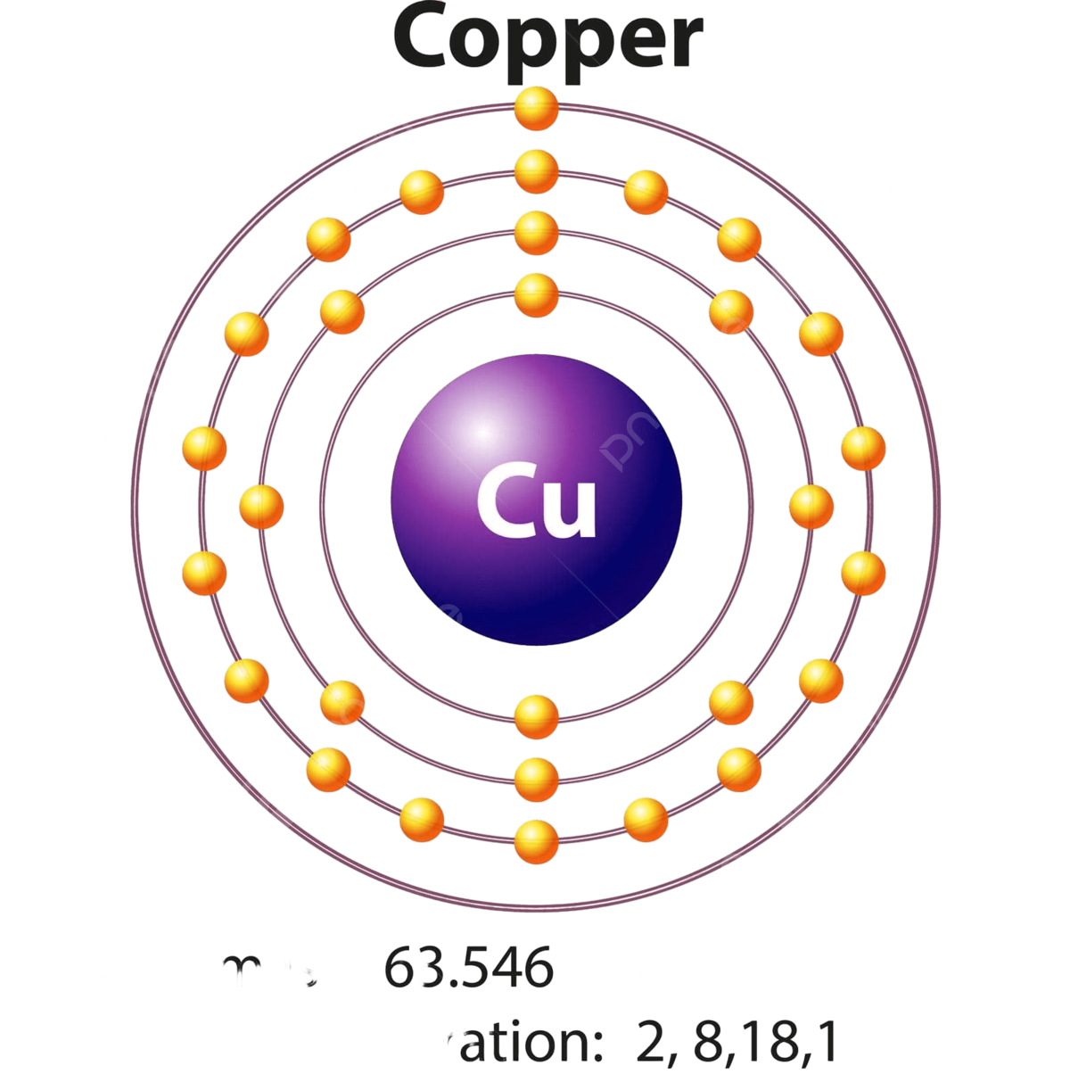
Conductors
• High electrical conductivity.
• Free electrons move easily through them.
• Examples: Copper, Aluminum, Silver.
• Used in wires and cables.
Notes:
Describe that conductors have very low resistance and are used for efficient current flow in circuits.

Slide 5
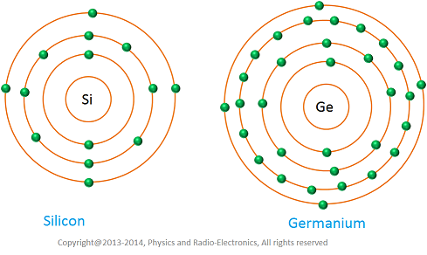
Semiconductors
• Conductivity lies between conductors and insulators.
• Conductivity increases with temperature.
• Examples: Silicon, Germanium.
• Basis of modern electronics (diodes, transistors, ICs).
Notes:
Mention that semiconductors are key in electronics. Explain how doping and temperature affect their conductivity.

Slide 6
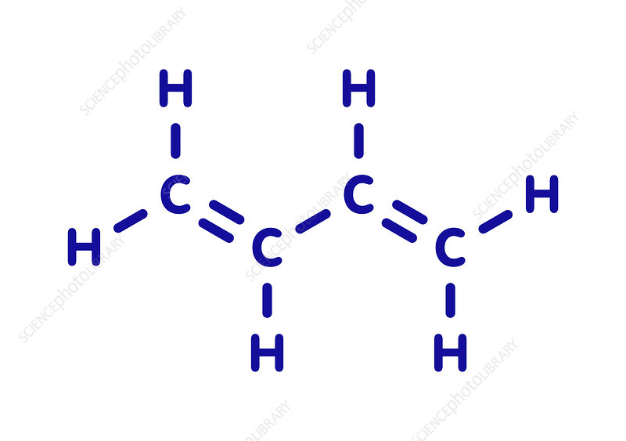
Insulators
• Very low electrical conductivity.
• Electrons are tightly bound.
• Examples: Rubber, Glass, Plastic, Wood.
• Used to prevent electric shock.
Notes:
Explain that insulators are essential for safety and isolation in electrical systems.

Slide 7
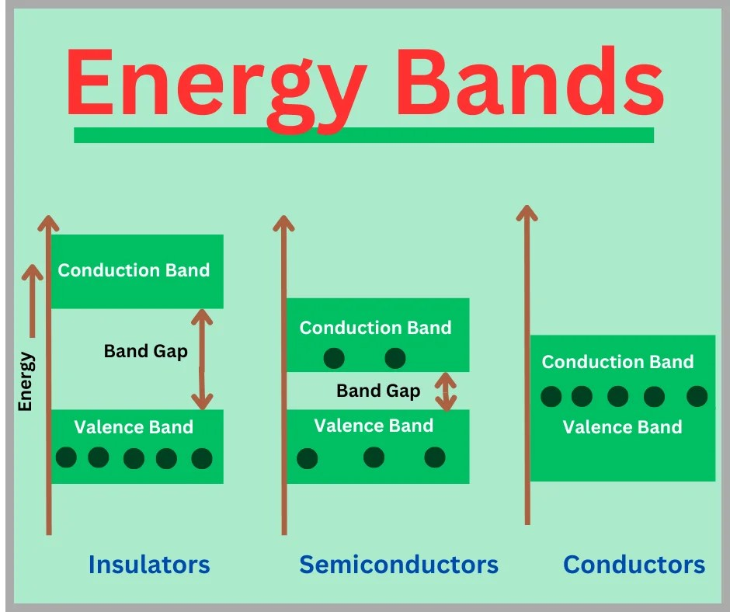
Comparison of Properties
Things than can affect conductivity: | Conductor | Semi Conductor | Insulator
Increase in Temperature: | Decreases | Increases | Increases
Decrease in Temperature: | Increase | Decrease | Decrease
Energy gap: | Very Small | Moderate | Large
Notes:
Use this slide to summarize the key differences. Emphasize conductivity, energy gap, and applications.

Slide 8
Applications
• Conductors: Electrical wiring, power transmission.
• Semiconductors: Computers, mobile phones, LEDs.
• Insulators: Cable coating, safety gear, electronic packaging.
Notes:
Explain that these materials are used across industries—from construction to electronics.

Slide 9
Conclusion
• Conductors, semiconductors, and insulators differ in electron movement.
• Their properties define their practical uses.
• All three are vital for modern technology.
Notes:
Wrap up by emphasizing how understanding these materials helps in designing better electrical and electronic systems.

