Slide 1

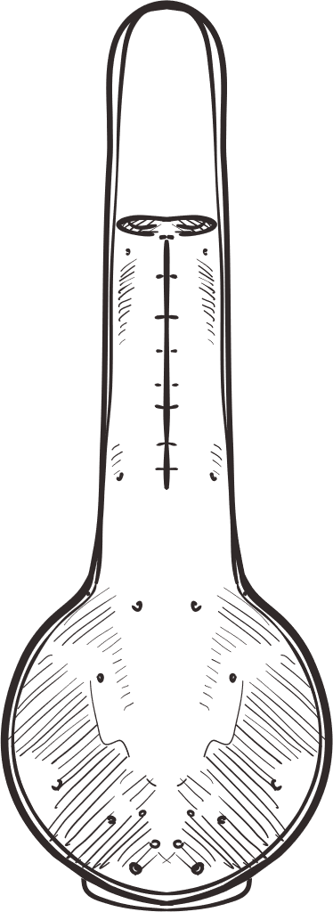

RESISTER AND THEIR COMBINATION
NAME:AATEKA HASSAN
ROLL NO CY-25-64

Slide 2


Resister is an electronic component that opposes the flow of current in a circuit.
RESISTER

Slide 3
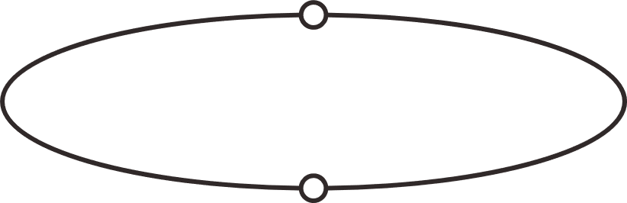
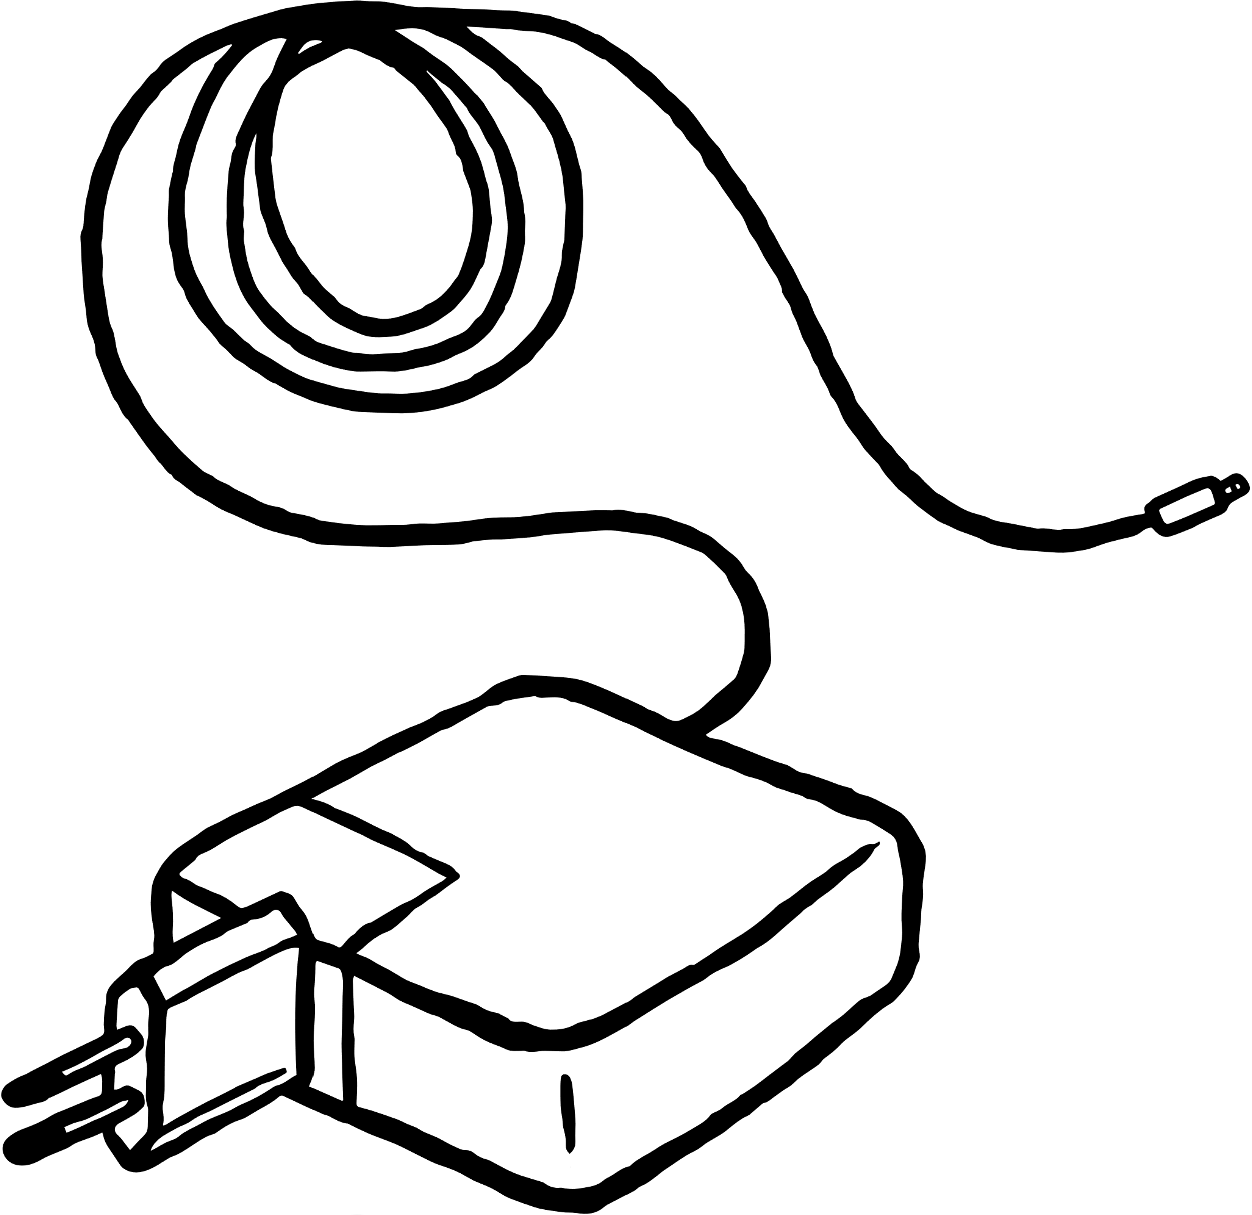
EXAMPLE
In a mobile charger, resistors control how much electric current flows to your phone.They make sure your phone gets the right amount of power not too much or too little.This protects the phone’s battery from overheating or damage while charging.

Slide 4


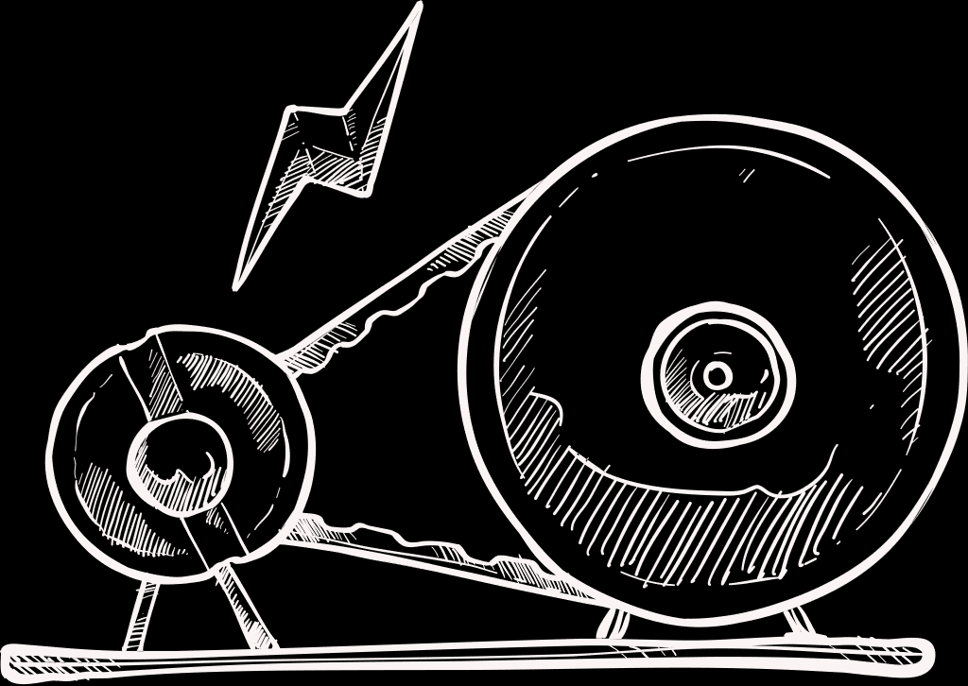
FORMULA AND UNIT
Formula of resistor is R=V/I
Unit of resistor is ohm

Slide 5


COMBINATION OF RESISTER
When two or more resistors are connected together in a circuit to get the required resistance, this arrangement is called a combination of resistors.
There are two main types:
1. Series Combination
2. Parallel Combination

Slide 6
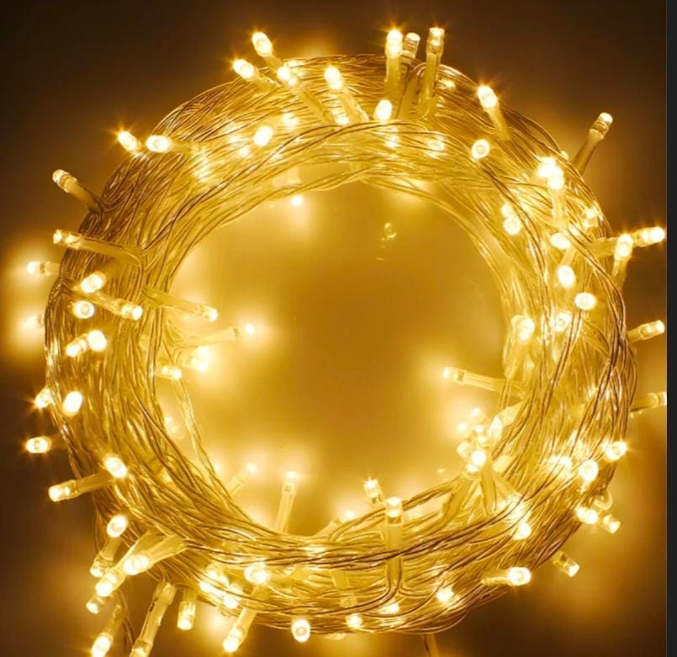
SERIES COMBINATION:
When resistors are connected end-to-end so that the same current flows through each resistor, they are said to be in series.
For Example:
In old fairy lights, all bulbs are connected in series so if one bulb fuses, the whole string stops working

Slide 7
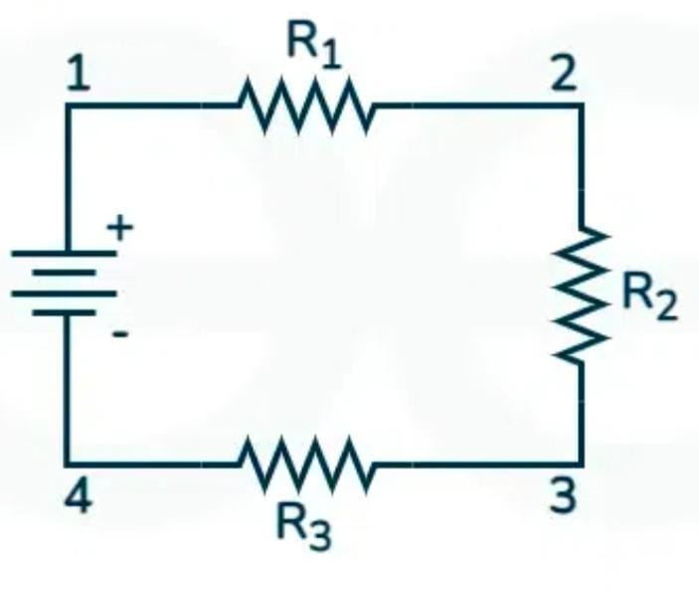
FORMULA:
R=R1+R2+R3
Key Points:
1. Current is same in all resistors.
2. Voltage is divided across resistors.
3. Total resistance increases.

Slide 8
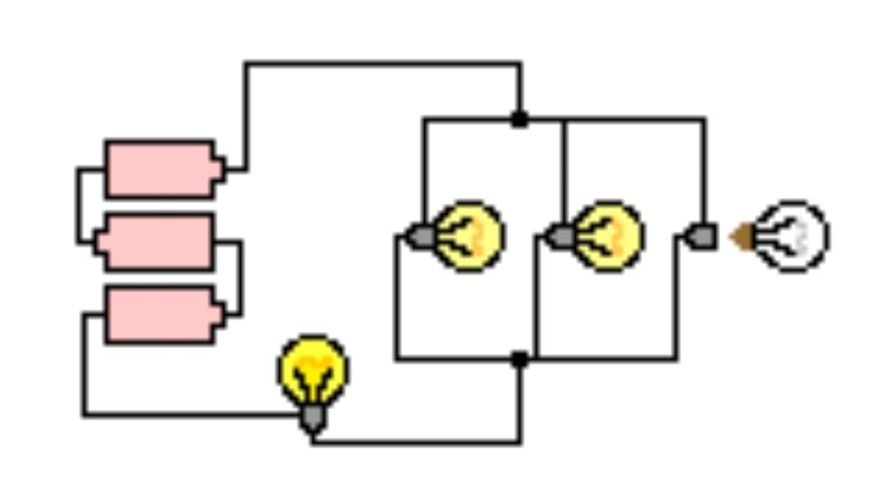
PARALLEL COMBINATION:
When two or more resister are connected side by side so the same volage is applied to each resister but current is divided among them all this connection is called parallel combination.
For Example:
In home wiring, bulbs and fans are connected in parallel combination, so if one bulb fuses, others still work. 💡

Slide 9
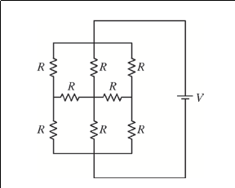
FORMULA:
R=1/R1+1/R2+1/R3
Key Points:
1. Current is divided between resistors.
2. Voltage is same between resistors.
3. Total resistance decreases.

Slide 10

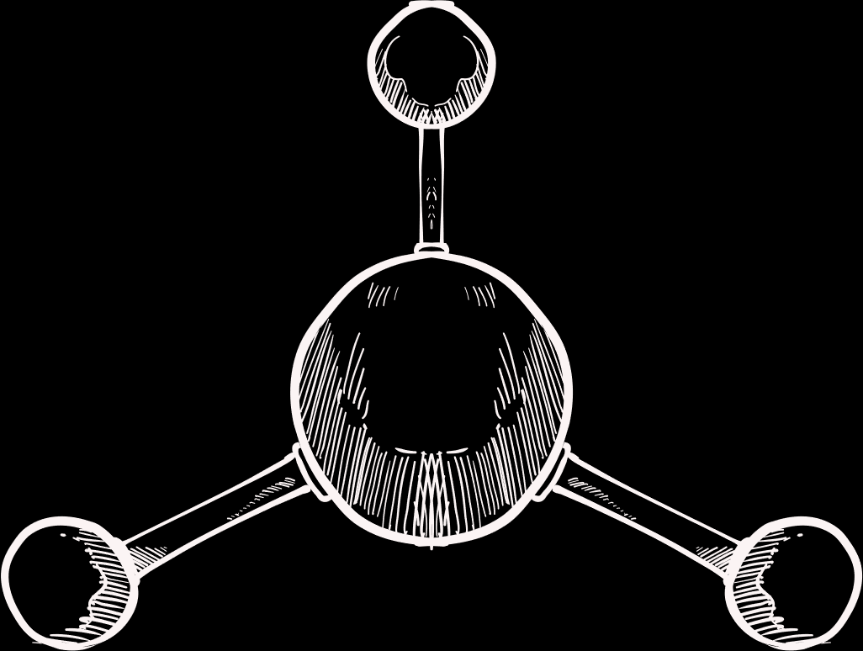
USES OF RESISTER
To control current in an electric circuit
To protect devices from high current
In heaters and electric irons to produce heat
In LED circuits to control brightness
In radios and TVs for volume and signal control

Slide 11
IMPACTS OF RESISTER
Control the flow of electric current
Prevent damage to component
Convert electric energy into heat
Help divide voltage in a circuit

Slide 12
THANK YOU

