Slide 1
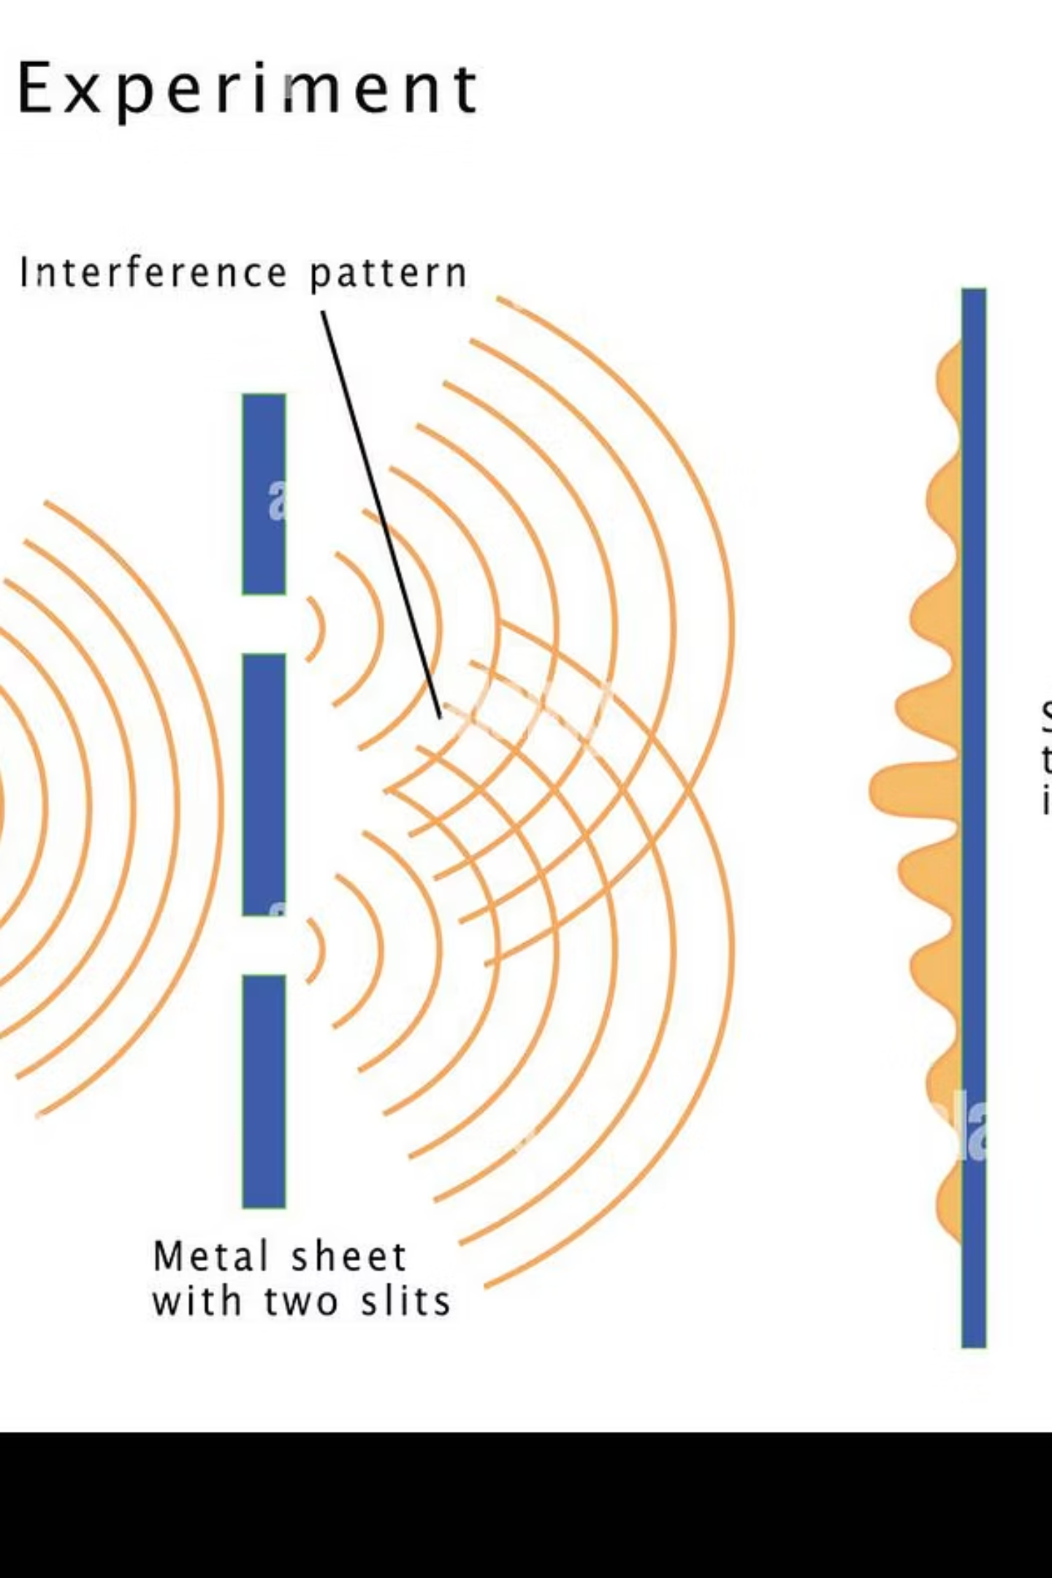
Young's Double Slit Experiment
Demonstrating the Wave Nature of Light
Demonstrating the Wave Nature of Light
Muhammad Rehan
25F-CY-102

Slide 2
Introduction
Pioneering Work
Wave Hypothesis
Interference Unveiled
Conducted by Thomas Young in 1801, this experiment marked a pivotal moment in the understanding of light.
Its primary aim was to provide conclusive evidence that light exhibits wave-like behavior.
It delivered the first direct observational proof of the interference of light, a phenomenon characteristic of waves.

Slide 3






Aim of the Experiment
Interference Study
To meticulously examine and understand the intricate patterns formed by interfering light waves.
Wave Nature
To definitively demonstrate that light propagates as a wave, not just particles.
Fringe Relationship
To mathematically derive how fringe width relates to the light's wavelength and experimental setup.

Slide 4
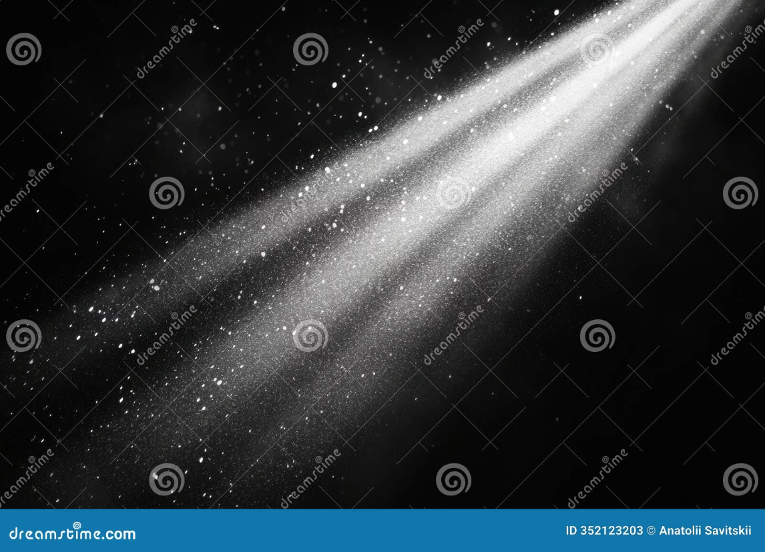
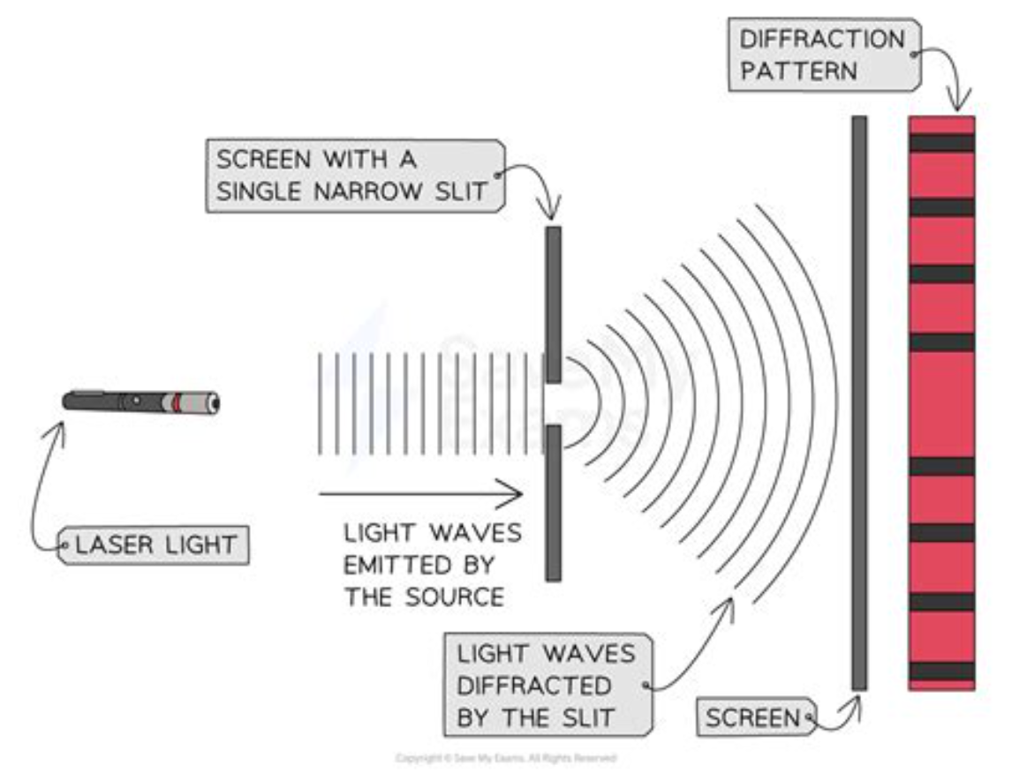
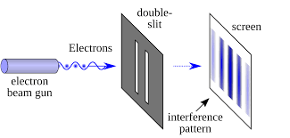
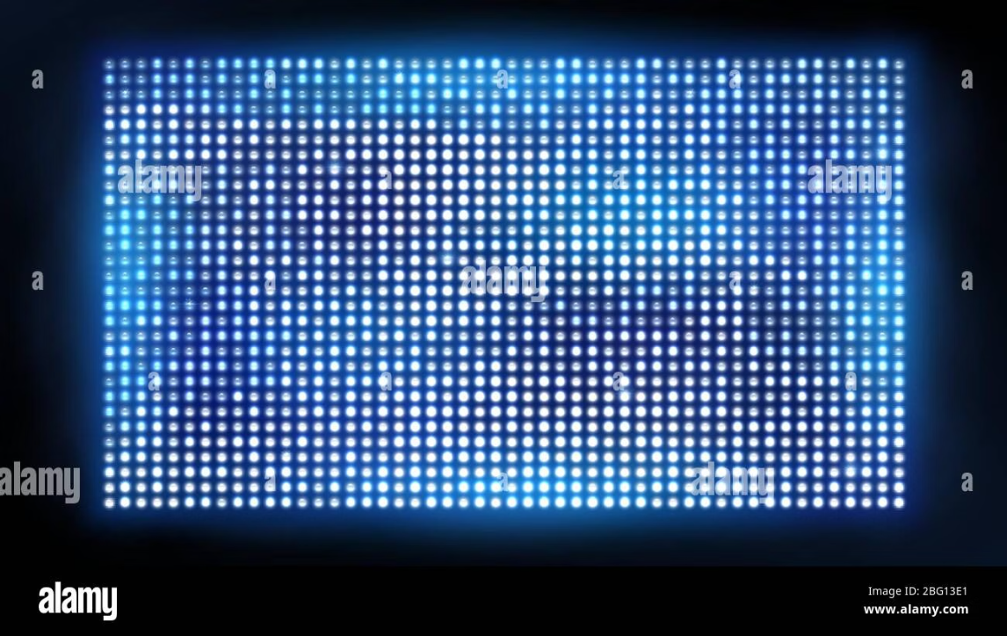
Experimental Setup
Monochromatic Light Source
Single Slit (S0)
Initially, sunlight passed through a single pinhole, acting as a coherent light source.
Ensures that light waves are coherent and in phase before reaching the double slits.
Double Slits(S1, S2)
Observation Screen
Placed a distance away, it captures the resulting interference pattern.

Slide 5
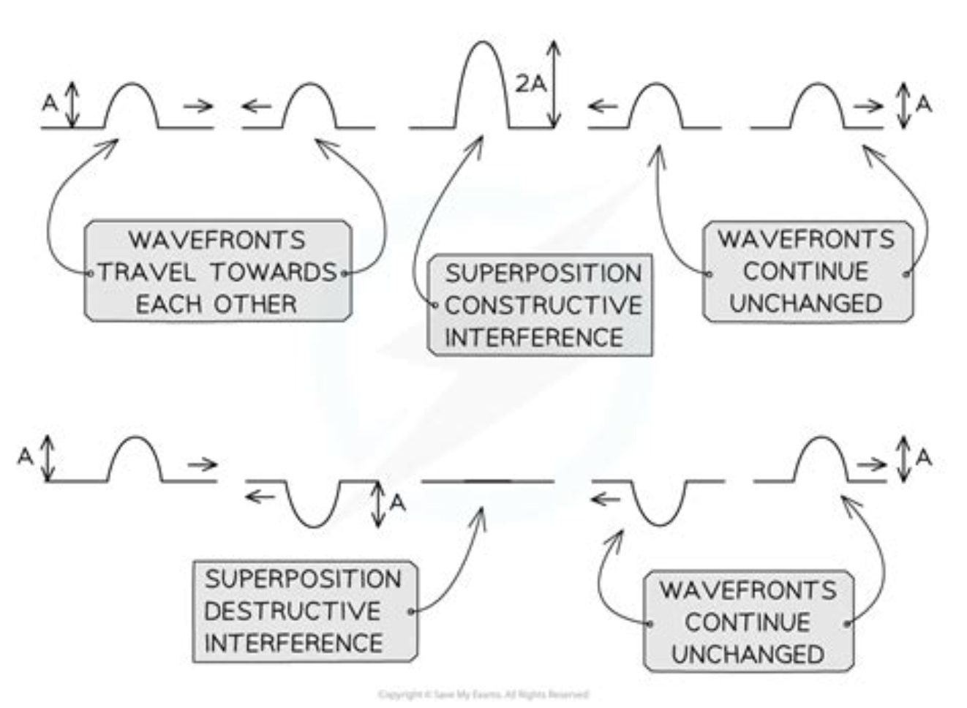
Working Principle
Coherent Sources
1
Light emerging from slits S1 and S2 behaves like two synchronized wave sources.
Wave Superposition
2
These waves overlap and interact as they travel towards the screen.
Constructive Interference
3
When crests meet crests (or troughs meet troughs), they reinforce each other, creating bright fringes.
Destructive Interference
4
When crests meet troughs, they cancel each other out, resulting in dark fringes.

Slide 6



Wave Behavior & Interference
Wave Properties
1
The alternating pattern is undeniable proof of light's wave nature.
Bright Fringes
2
Occur where crest meets crest, leading to amplified light intensity.
Dark Fringes
3
Occur where crest meets trough, resulting in cancellation and darkness.

Slide 7
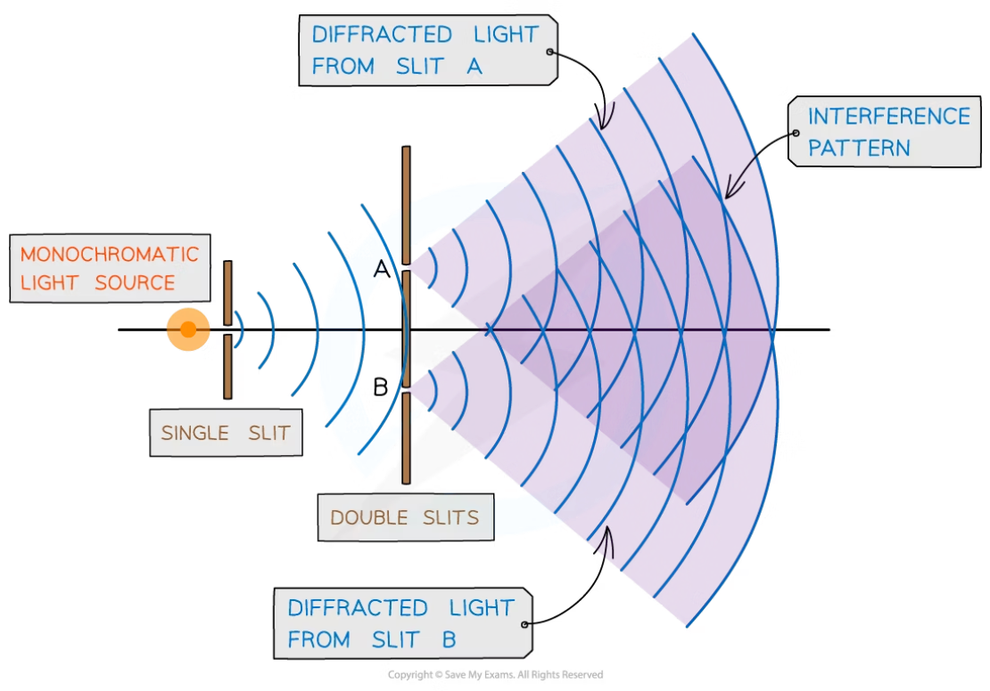
Mathematical Derivation
The core of understanding the interference pattern lies in the path difference between the two light waves reaching a point on the screen.
Path Difference
Where 'd' is the distance between the slits and '\theta' is the angle to a point on the screen.
Constructive Interference
For bright fringes, the path difference must be an integer multiple of the wavelength (\lambda):
Where 'n' is an integer (0, 1, 2, ...).
Destructive Interference
For dark fringes, the path difference must be an odd multiple of half the wavelength:
Where 'n' is an integer (0, 1, 2, ...).

Slide 8



Fringe Width Formula
Distance to Screen (D)
Slit Separation (d)
Wavelength (λ)
The distance from the double slits to the observation screen.
The precise distance between the centers of the two narrow slits.
The wavelength of the monochromatic light source used in the experiment.
The fringe width (β), which is the separation between consecutive bright or dark fringes, is given by:

Slide 9

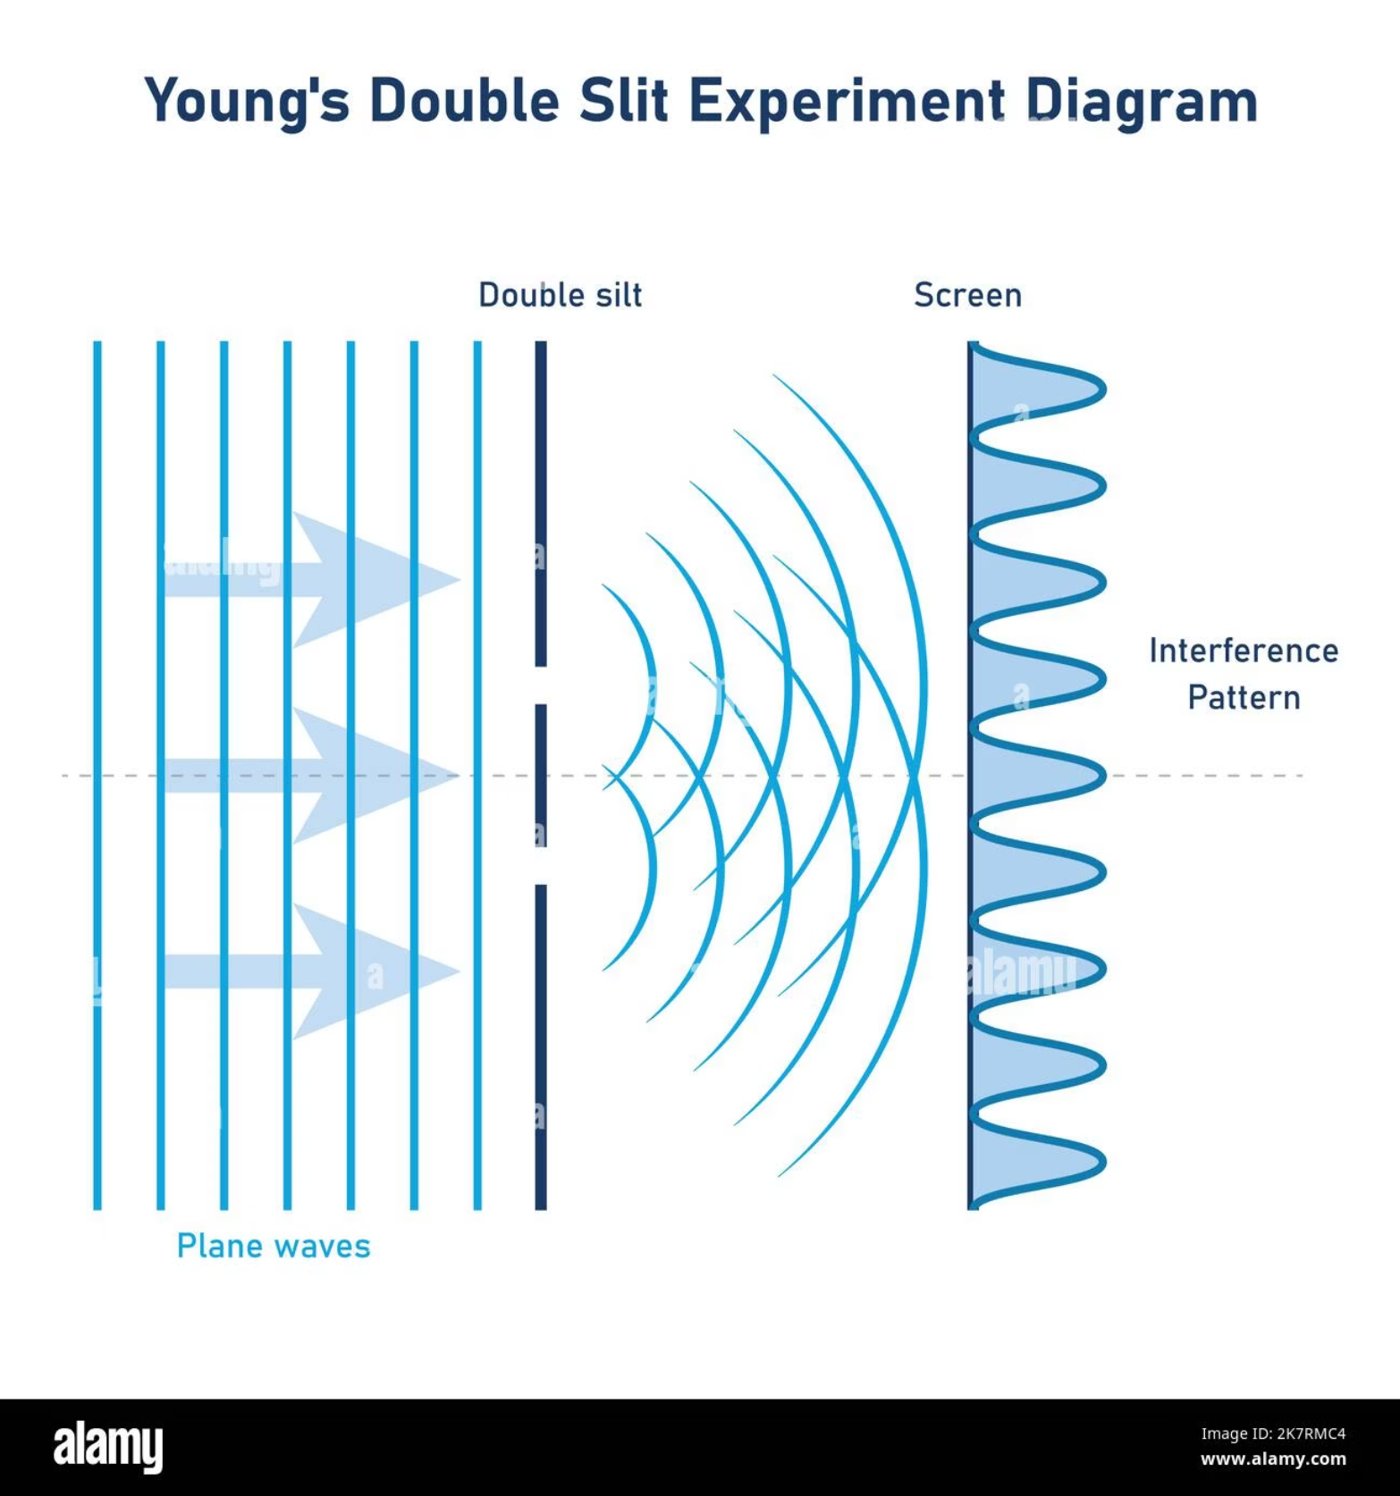
Observations
Alternating Fringes
The screen displayed a beautiful, regular pattern of alternating bright and dark bands.
Central Maximum
A prominent, brightest fringe was observed precisely at the center of the pattern.
Symmetrical Pattern
The entire interference pattern was perfectly symmetrical around the central bright fringe.
Constant Fringe Width
The spacing between any two adjacent bright fringes (or dark fringes) remained uniform.

Slide 10
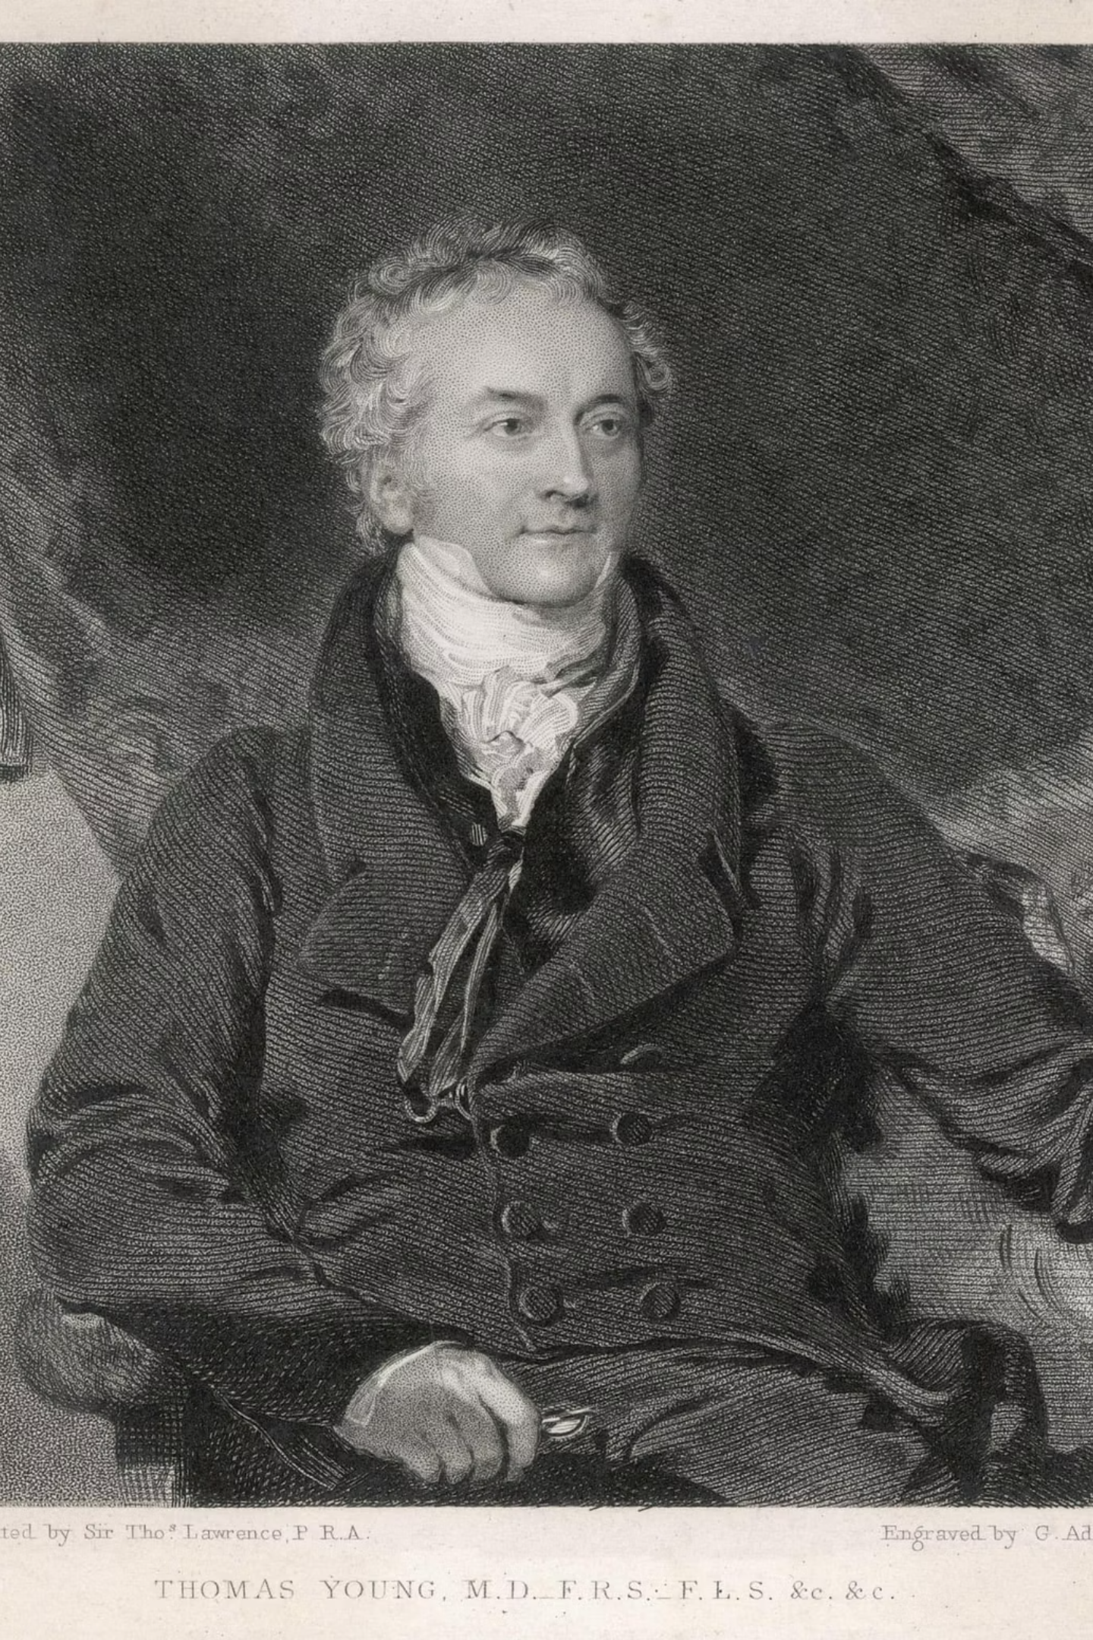



Conclusion
Light as a Wave
Interference Explained
Young's experiment provided irrefutable evidence, settling the long-standing debate and confirming light's wave nature.
The observed interference phenomena could only be coherently explained through the principles of wave theory, not particle theory.
Foundation of Optics
This groundbreaking work laid the essential groundwork for the field of modern wave optics, profoundly influencing future scientific discoveries.

