Slide 1
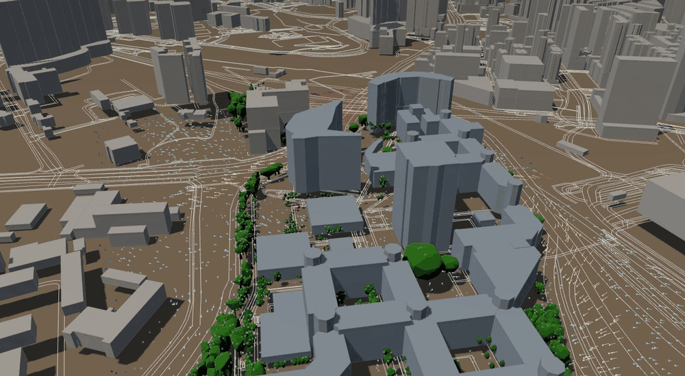
Application — Pedestrian Wind Ventilation
Campus-scale CFD wind field at ~1.5 m AGL · hourly HKO King's Park inlet
3D orbit — 1.5 m AGL tracers · campus digital twin
Objectives
• Identify sheltered walking routes and seating under typical afternoon wind.
• Flag channelled acceleration between tall blocks.
• Quantify canopy drag effects on pedestrian-level speed.
• Cover PolyU core and Block Z north pad.
• Couple to hourly King's Park wind (HKO) without a full re-solve.
• Support outdoor-event and wayfinding planning.
Colour = speed (m/s) · orbiting camera · LAZ crowns · LandsD buildings

Slide 2
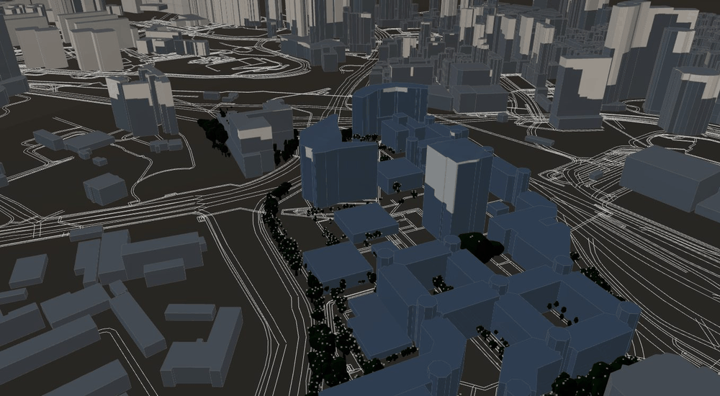
Application — Building & Tree Shade
Direct-beam solar occlusion · measured LiDAR crowns · time-resolved HKT sun path
3D full-day shade — sunrise→sunset · orbiting camera
Objectives
• Locate outdoor areas shaded by buildings and/or real tree crowns.
• Assess summer afternoon usability for heat-sensitive users.
• Scrub any HKT date/time; sun direction updates shadows.
• Use measured LiDAR geometry (not generic billboard trees).
• Apply ShadeMap-class ray–occluder tests.
• Combine with wind comfort for dual outdoor planning.
Direct-beam occlusion · LandsD buildings + LAZ crowns · HKT sun path (15 Jul 2026)

Slide 3
Pilot Use Cases
Two science layers on one PolyU digital twin
Wind-aware campus comfort
Pedestrian-level CFD tracers for route and plaza screening.
• 1.5 m AGL tracers (turbo speed scale)
• Hourly HKO King's Park remap
• Tree LAD drag + building wakes
Shade-aware outdoor planning
Geometric building + tree shadows for any HKT timestamp.
• SunCalc solar position (PolyU lat/lon)
• LAZ solid crowns as occluders
• Daylight time slider / play-day loop

Slide 4
Technical Highlights
1
2
3
Multi-source campus twin
• CSDI / LandsD footprints + heights
• OSM + LandsD 3D pedestrian network
• Segmented LAZ tree crowns
• CFD UVW package + HKO inlet remap
Science-based outdoor layers
• Wind: urban CFD at pedestrian height
• Shade: direct-sun geometric occlusion
• Shared 3D scene for both layers
• Transparent equations for review
Hong Kong–ready deployment
• PolyU + Block Z domain focus
• HKO King's Park hourly Actions update
• Live dashboard (GitHub Pages)
• Methods documented for academic review

Slide 5
Data Inventory
Inputs currently integrated into the twin
Available datasets
• LandsD / CSDI building footprints + heights (~1.5 km context)
• Pedestrian / road network (OSM + LandsD 3D Ped Network)
• Segmented individual-tree LAZ crowns (solid GLB + points)
• CFD wind UVW package (seed135 + Z-core air pad)
• Hourly HKO King's Park inlet remap (GitHub Actions)
• SunCalc solar ephemeris for PolyU (φ, λ, HKT)
Priority gaps (concise): LAI / species validation for crown transmittance · ground-truth wind probes · optional full OpenFOAM re-solve for expanded domains.

Slide 6
Method — Wind Ventilation
Urban CFD field + pedestrian tracers · not a black-box heatmap
1. Domain
PolyU buildings + trees
Block Z north air pad
2. Physics
RANS / canopy drag (LAD)
Steady inlet wind
3. Inlet
HKO King's Park
rotate + scale UVW hourly
4. Output
Tracers at 1.5 m AGL
speed colour (turbo)
Hourly update (no full re-solve)
UVW′ = R(Δθ) · UVW · (U_new / U_old) with Δθ = θ_HKO − θ_package
R = horizontal rotation from wind-from change; scale clipped for stability. Buildings and trees remain fixed geometry.

Slide 7
Method — Building & Tree Shade
ShadeMap-class direct-sun geometric occlusion (clear-sky beam; not thermal CFD)
Governing relations
Solar position (SunCalc / SPA-class)
sin α = sin φ sin δ + cos φ cos δ cos H
→ altitude α, azimuth A at PolyU (HKT)
Shade test for ground point P
P shaded ⇔ ray P + t ŝ (t > 0) intersects an occluder
ŝ = unit vector toward the sun
GPU shadow maps approximate the ray test in the dashboard.
Layer inputs
• Tree occluders: LAZ → solid crowns (GLB)
• Building occluders: LandsD footprint + height
• Receiver: campus ground plane
• Time control: HKT date + minute / play-day
• Site: φ = 22.3045°N, λ = 114.1795°E
• Scope: direct beam only (clear-sky geometry)

Slide 8
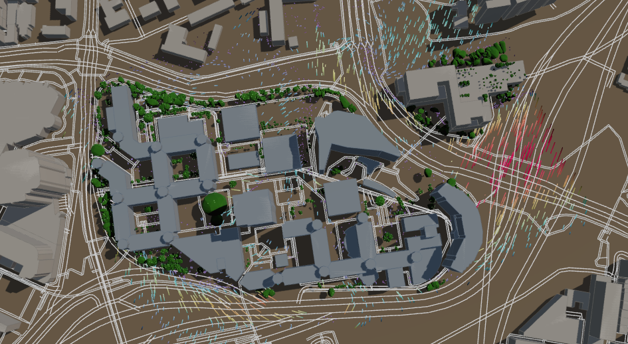
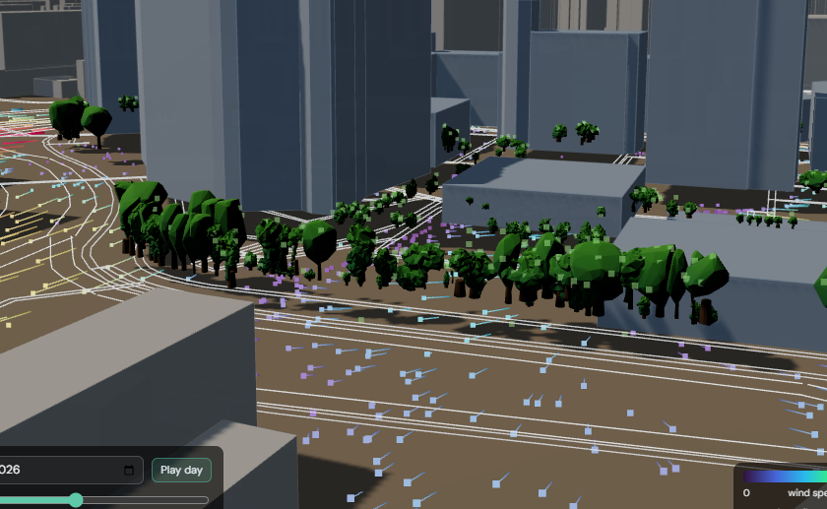
Integrated Pipeline & Live Dashboard
Updated dashboard visualizations — wind tracers + time-resolved shade
Plan view — wind field + building/tree shade
Oblique view — pedestrian tracers & canopy occlusion
1. Ingest buildings, roads, LAZ crowns
2. Load CFD UVW + HKO hourly remap
3. Compute sun direction (HKT)
4. Render tracers + cast shadows
5. Publish via GitHub Pages
Outcome: two science-based outdoor layers — wind ventilation and sun shade — on one PolyU digital twin, with transparent equations, measured trees, and live weather coupling.

