Slide 1
IEC 61850 Substation Automation
End-to-end GOOSE/MMS protection pipeline — fault detection, relay-breaker automation, and live monitoring
Muhammad Shahzaib | Electrical Engineer (Power)
github.com/muhammadshahzaibshahzaib92-dev

Slide 2
Objective
Build a working substation protection pipeline demonstrating how fault detection, IEC 61850 GOOSE messaging, and live monitoring integrate in a digital substation.
Model a 132kV/11kV substation and calculate 3-phase fault currents
Implement GOOSE publisher-subscriber communication between relay and breaker
Automatically trigger a trip when fault current exceeds threshold
Measure end-to-end fault-to-trip timing
Visualize status, events, and fault current live in a browser

Slide 3
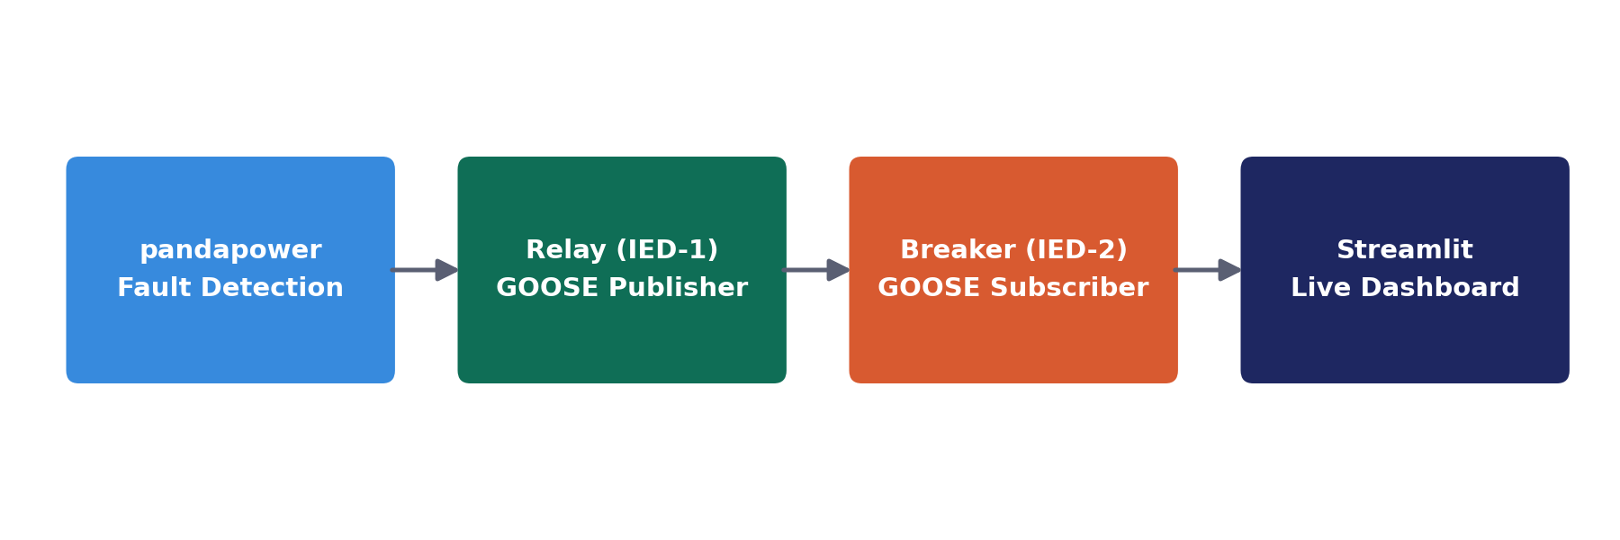
System Architecture
Fault detected (pandapower) → Relay publishes GOOSE trip → Breaker receives & trips → Dashboard updates

Slide 4
Methodology
1. Model & Detect
2. Publish (Relay)
3. Subscribe (Breaker)
4. Visualize
pandapower substation model; 3-phase short-circuit study calculates fault current at each bus
GOOSE publisher (libiec61850/Python) sends a trip message when fault current exceeds threshold
GOOSE subscriber listens for the message and trips in real time on receipt
Streamlit dashboard shows status, event log, and fault current graph

Slide 5
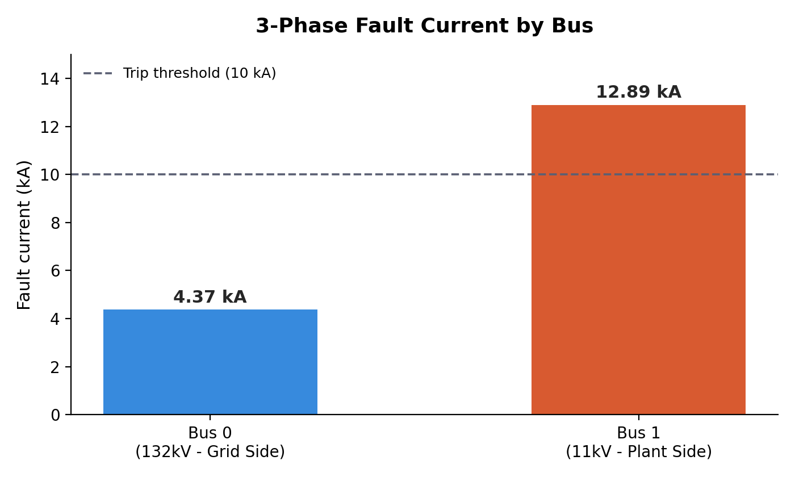
Result: Fault Current by Bus

Slide 6
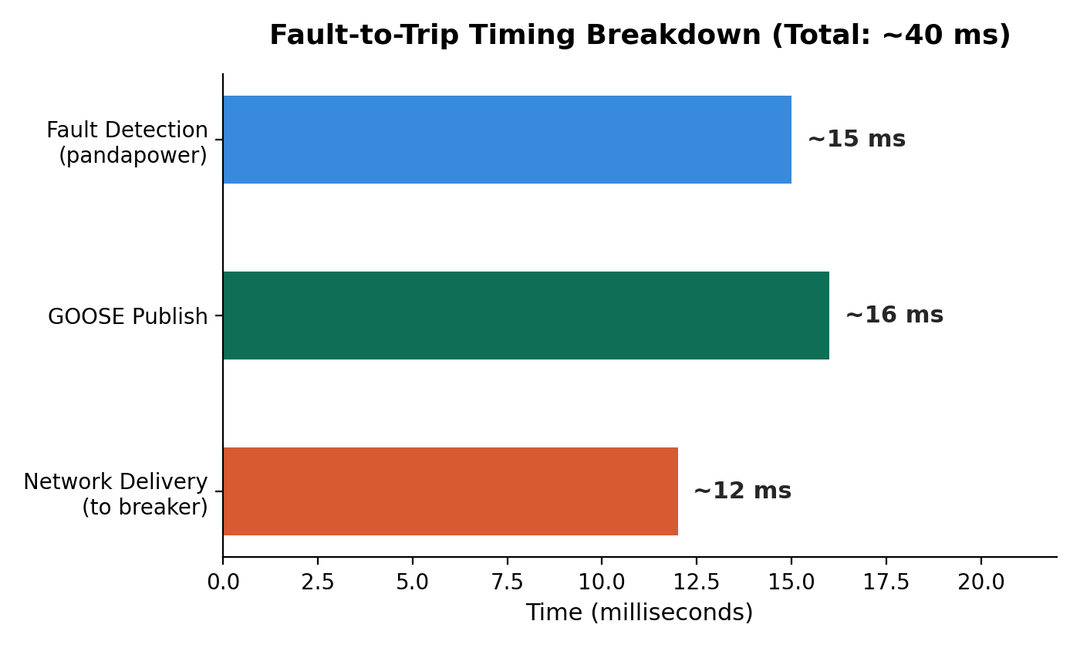
Result: Fault-to-Trip Timing

Slide 7
Challenges & Learnings
libiec61850 required enabling a disabled R-GOOSE flag and patching the SWIG interface to fix linker errors
Same-host GOOSE delivery failed over WSL2's virtual 'eth0' — diagnosed with Wireshark, solved using the loopback interface
Migrated GitHub authentication from passwords to Personal Access Tokens
Structured the codebase as 3 independently documented repos, mirroring real protection/automation/monitoring subsystems

Slide 8
Conclusion
A working, end-to-end substation protection pipeline — from power system fault analysis through IEC 61850 GOOSE messaging to real-time visualization — demonstrating hands-on grid automation engineering skills.
Capstone: github.com/muhammadshahzaibshahzaib92-dev/iec61850-substation-automation
GOOSE Relay-Breaker Communication: .../goose-relay-breaker
Fault-to-GOOSE Protection Logic: .../fault-to-goose-integration
Substation Live Monitoring Dashboard: .../substation-monitoring-dashboard

