Slide 1
ECO346 · DATA VISUALIZATION
Education Spending and Literacy in Urban Punjab
MY ASSIGNED VARIANT
Variant 1
Punjab Urban
Today I will share key insights from the Pakistan Social and Living Standards Measurement (PSLM) 2019–20 survey.
Calculated as the remainder of 109 divided by 8. All calculations use household survey weights to represent the true population.
Presenter Roll No
Software Tools
Target Population
Ages 10 to 64
FA24-BEDS-109
R (ggplot2) & Python

Slide 2

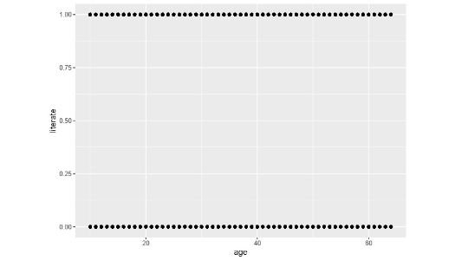
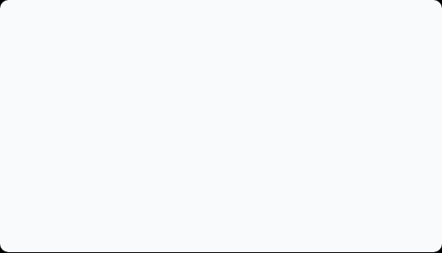
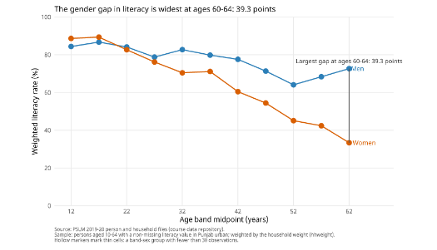
CHART MAKEOVER (BEFORE & AFTER)
Why We Turned the Default Scatterplot into a Trend Line
Here is how we redesigned R's raw output to tell a clear and accurate story.
1. Before: The Default Plot
Hard to Read
2. After: Redesigned with Age Bands
Clear & Informative
Thousands of dots sit directly on top of each other at 0 and 1. We cannot see any trend across ages.
We grouped people into 5-year age bands and calculated the weighted literacy percentage for men and women.
Solved Overplotting
Easy to Compare
Direct Labels
Averages replace thousands of overlapping dots.
Line heights allow instant comparison between sexes.
Labels are right on the lines, so no legend is needed.

Slide 3
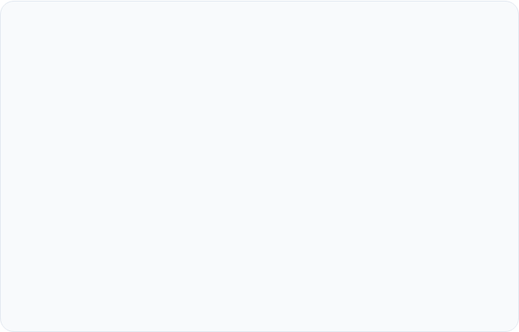
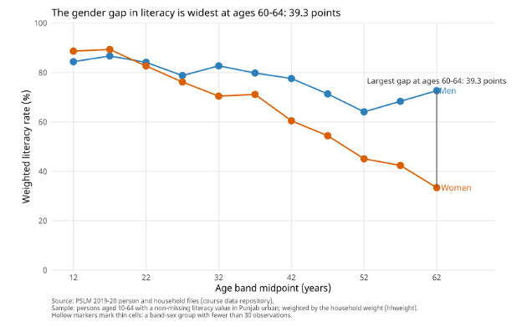
MAIN FINDING · THE BIG STORY
Younger Women Have Closed the Literacy Gap
While older generations face huge gender gaps, younger youth show remarkable educational equality.
WIDEST GENDER GAP (AGES 60–64)
39.2
points
Among people aged 60 to 64, male literacy is 72.8% while female literacy is only 33.6%.
YOUTH (AGES 15–19)
OLDER (AGES 55–59)
Gap is Gone
22.7 pt Gap
Women lead at 90.0% compared to men at 87.7%.
Men are at 68.6% while women are at 45.9%.
Presenter note: This chart reflects past progress over decades (cohort differences), not older people losing literacy.
PSLM 2019–20 data · Sample size: 13,873 individuals across 11 age bands.

Slide 4
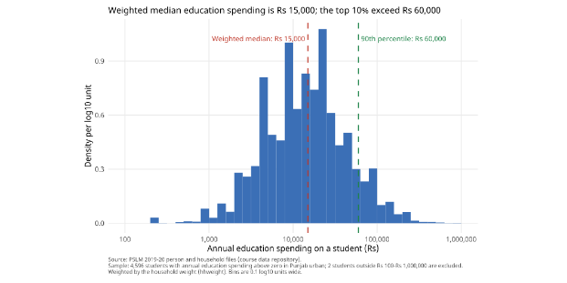
DATA REPRODUCIBILITY & SPENDING
Spending Is Highly Unequal, and Our Code Matches Exactly
Here are the exact figures required by Questions 2 and 5 of the assignment.
Annual Spending per Student (Histogram)
Plotted on a log scale with dashed lines at median and top 10%
QUESTION 2 · SPENDING STATISTICS
Weighted Median
Rs 15,200
Unweighted Median
Rs 15,000
10th Percentile (P10)
Rs 2,000
90th Percentile (P90)
Rs 75,000
P90 / P10 Ratio
37.50x
QUESTION 5 · R & PYTHON VERIFICATION
Women 15–19 (R):
90.0%
Women 15–19 (Python):
90.0%
Both scripts yield the exact same table across all 11 age bands.
7,080 students analysed. The top 10% spend over Rs 75,000, which is 37.5 times more than the bottom 10%.
All code and figures run offline from local CSV files. Thank you!
FA24-BEDS-109

