Slide 1
Cloud Project Report
Assessment 3: EC2, S3 & Cloud Comparison
Presented by [Your Name] • November 2025

Slide 2
Project Overview
Deploy an EC2 instance and S3 bucket on AWS
Demonstrate secure connection between EC2 and S3
Compare AWS with Microsoft Azure cloud services
Highlight core cloud computing concepts and models

Slide 3
Cloud Computing Concepts
On-demand self-service and scalability
Infrastructure as a Service (IaaS) model
Virtualisation and resource pooling principles
Public cloud deployment model (AWS ownership)

Slide 4
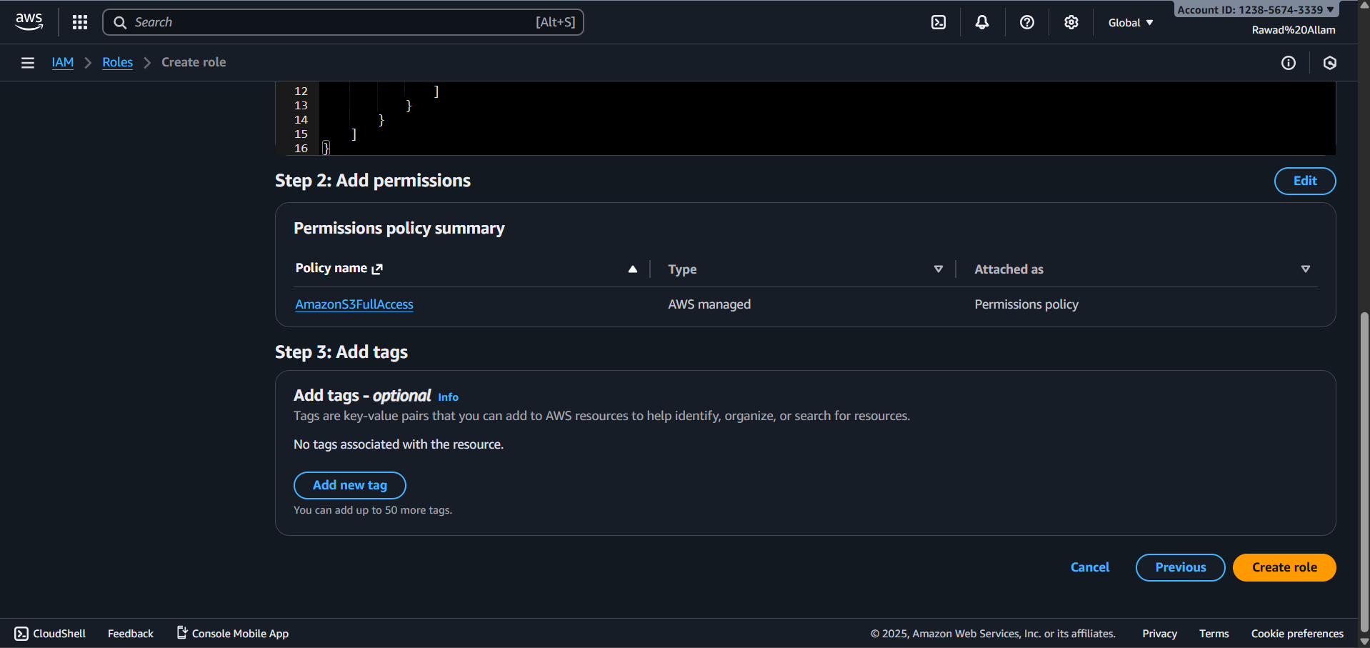
EC2 Instance Deployment
Launched EC2 instance using Amazon Linux 2023 AMI
t3.micro type, free tier, balanced CPU/memory
Secure SSH access with key pair & security groups
Configured storage and started instance
[EC2 Instance Console Screenshot]

Slide 5
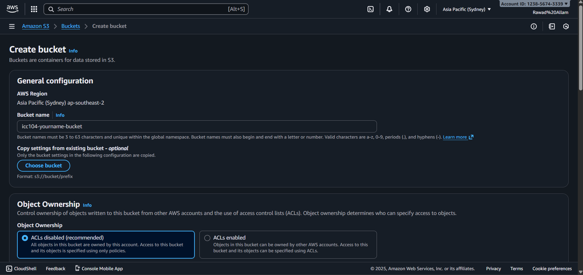
S3 Bucket Configuration
[S3 Bucket Settings Screenshot]
Created S3 bucket in matching region (Sydney)
Enabled versioning, encryption (SSE-S3)
Configured tags, logging, and private access
Object-based storage with high durability

Slide 6
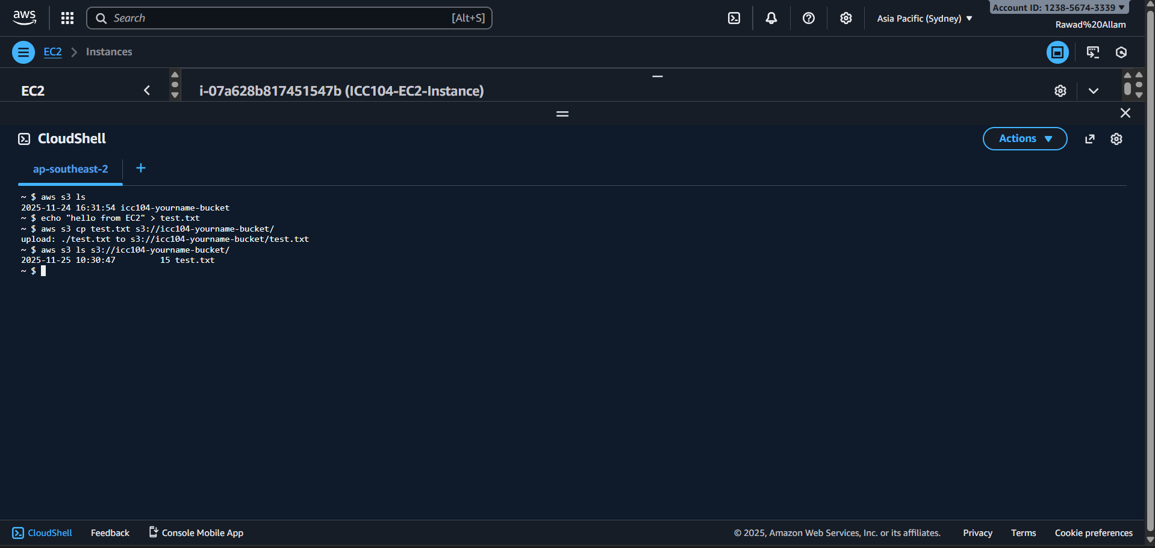
EC2–S3 Integration
IAM role created (AmazonS3FullAccess) for EC2
Connected EC2 to S3 with AWS CLI (secure method)
Test file upload and listing confirmed integration
Role-based permissions for cloud security
[AWS CLI Test Output Screenshot]

Slide 7
AWS vs Azure: Comparison
AWS EC2 offers more instance choices than Azure VM
Azure excels at Windows integration, enterprise identity
S3 and Blob Storage both have strong durability, but Azure is cheaper per GB
AWS IAM simpler for cloud-native, Azure AAD is advanced for enterprise

Slide 8
Service Model & Features
AWS Strengths
Largest global footprint
Developer-focused tools
Linux & web application integration
Azure Strengths
Hybrid cloud deployment
Enterprise identity (AAD, RBAC)
Windows & business app integration

Slide 9
Recommendations
For academic projects and Linux apps, AWS excels in simplicity and performance
For enterprise Windows and hybrid identity needs, Azure offers superior solutions
Both providers suitable for scalable, secure cloud deployments
Choose based on integration demand, strategic goals

Slide 10
Conclusion
The deployment of EC2 and S3 demonstrates cloud principles of scalability, security, and flexibility. AWS and Azure both provide robust platforms; selection should match user needs and integration context.
Thank you for your attention!

