Slide 1

Notes:
StackSleuth

Slide 2
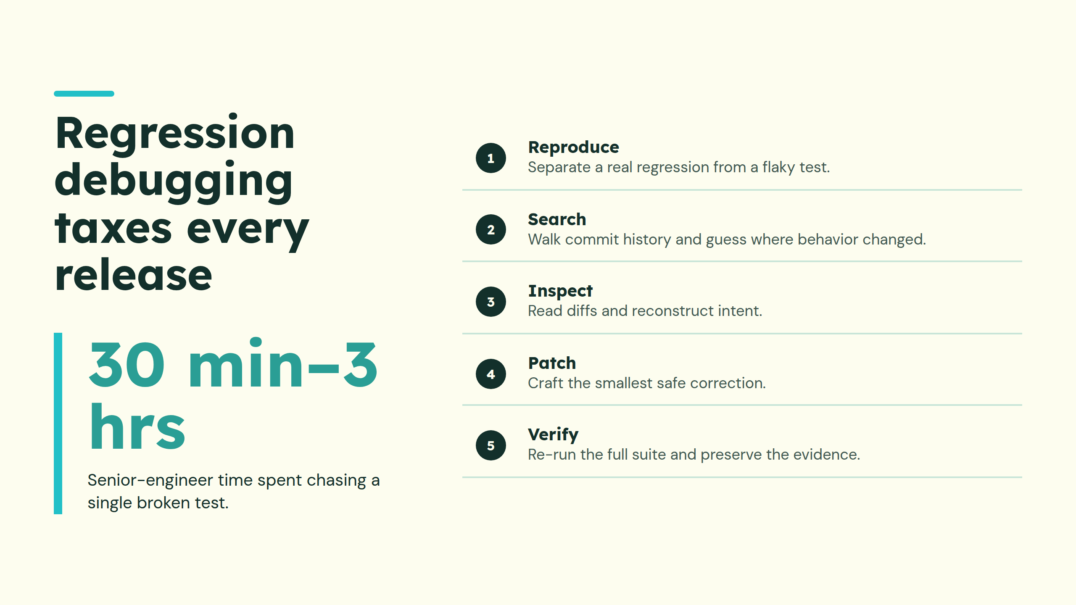
Notes:
Regression debugging taxes every release

Slide 3
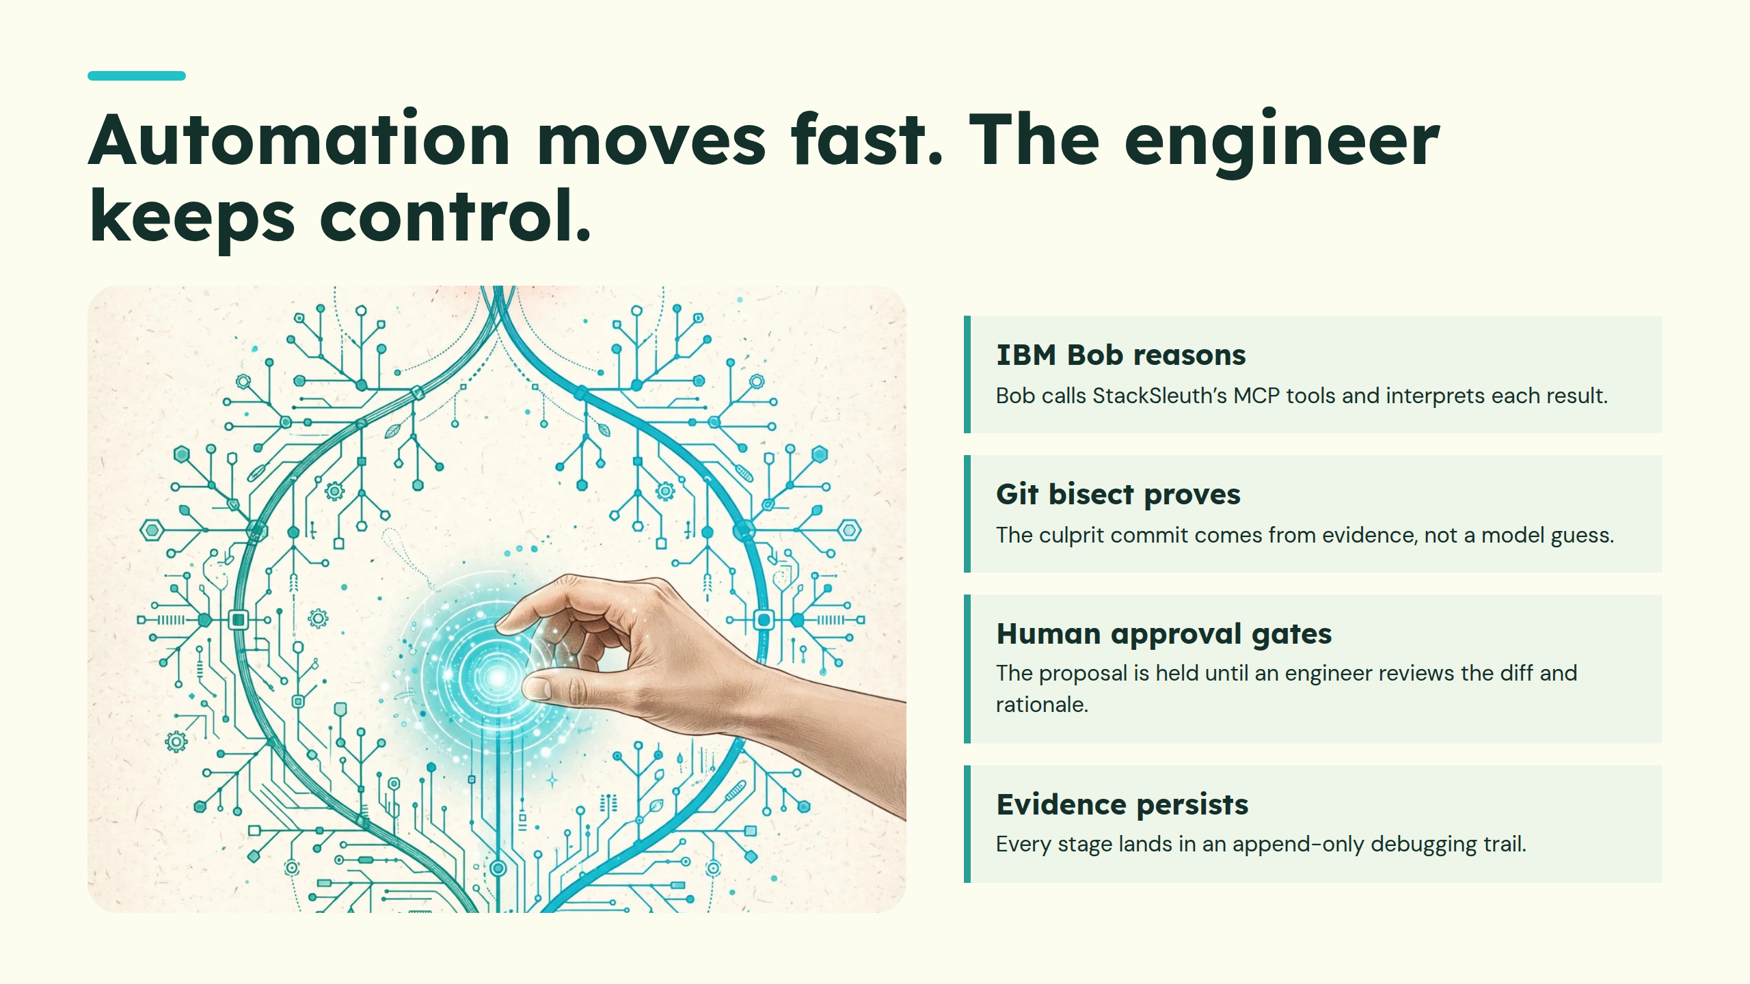
Notes:
Automation moves fast. The engineer keeps control.

Slide 4
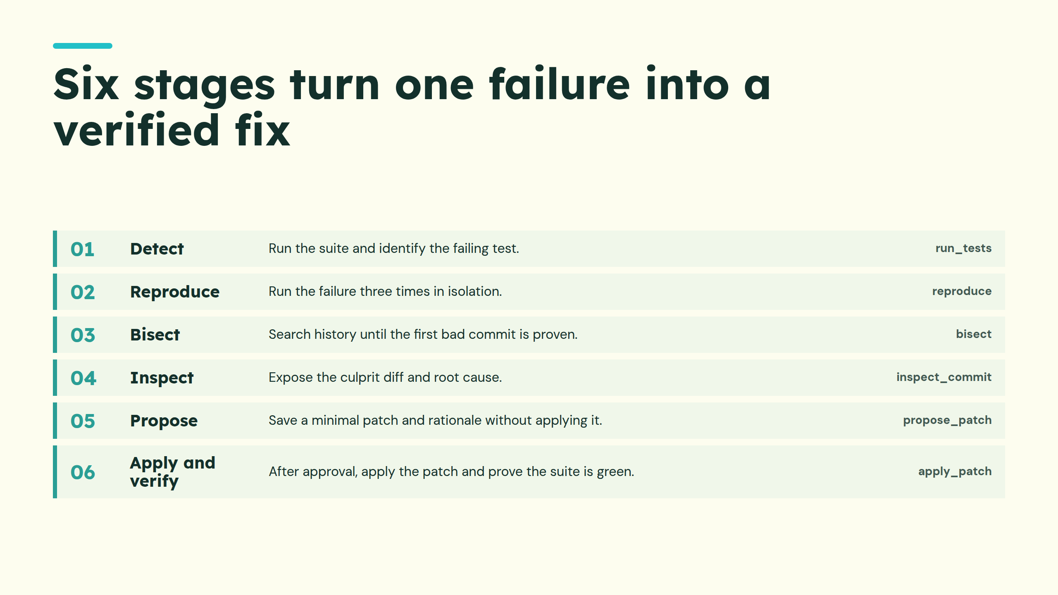
Notes:
Six stages turn one failure into a verified fix

Slide 5
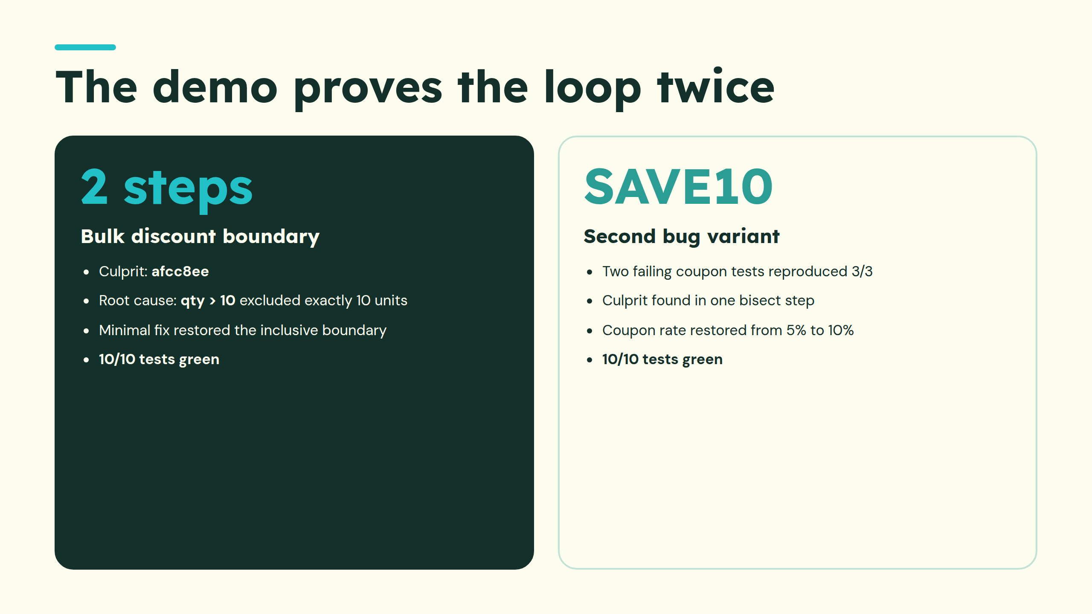
Notes:
The demo proves the loop twice

Slide 6
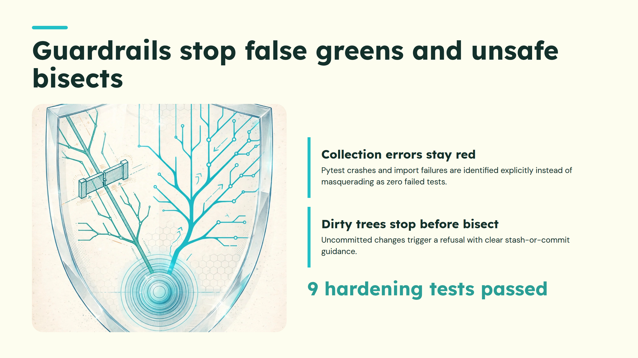
Notes:
Guardrails stop false greens and unsafe bisects

Slide 7
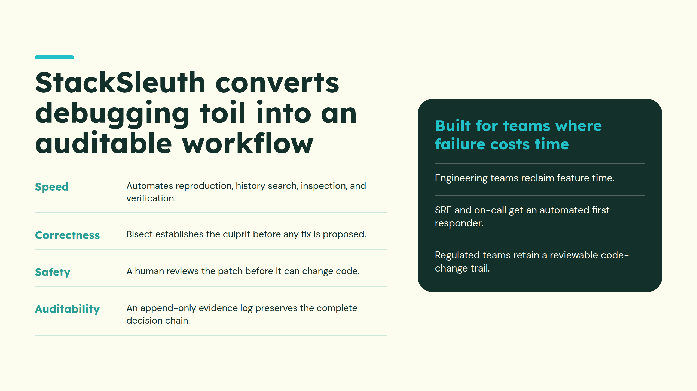
Notes:
StackSleuth converts debugging toil into an auditable workflow

Slide 8
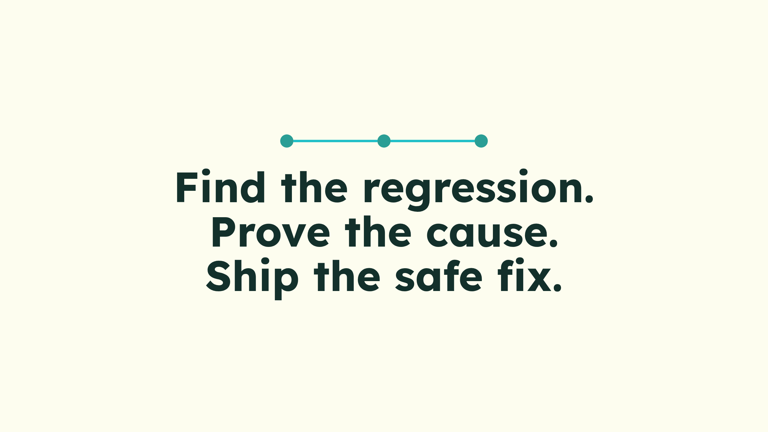
Notes:
Find the regression.Prove the cause.Ship the safe fix.

