Slide 1

swimming performance evaluation system

Slide 2
introduction
The objective of the system is to choose the swimming style and suitable race for the swimmer based on the physical structure of the swimmer's body shape and provide some suggestions for the training to improve the swimmer's performance

Slide 3
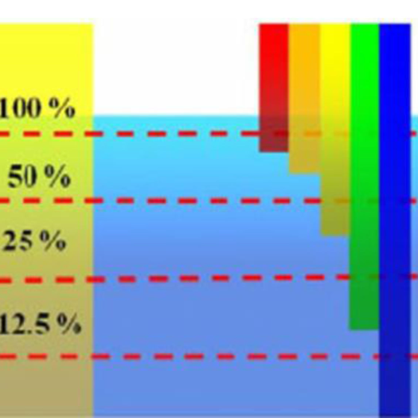
Key challenges
Capture images underwater is different from capturing in the air due to scattering, diffraction, colour absorption and distortion since we try to capture images of swimming object (swimmer) the motion blurring occurs

Slide 4
Used sensors
Use high-resolution cameras placed at different angles where they have to be on rail and synchronized in capturing images at the same time and motion
One of the other sensors that can be used is IMU to measure the acceleration and angular velocity of the swimmer and synchronized with the cameras

Slide 5
Dataset creation
As much as we want to make precise calculations, we have to get realistic data as much as possible including images and IMU readings
From domain experts like coaches or professional swimmers we have take there knowledge to help us in data annotation
For example, given a full motion of butterfly he has to tell us what is position of the arms and are the arms and the legs synchronized together or not ETC.

