Slide 1
Chapter 10
Introduction to Machine Learning

Slide 2
Chapter 10 Contents (1)
Training
Rote Learning
Concept Learning
Hypotheses

Slide 3
Chapter 10 Contents (2)
Inductive Bias
Decision Tree Induction
Overfitting
The Nearest Neighbor Algorithm
Neural Networks
Supervised Learning
Unsupervised Learning
Reinforcement Learning

Slide 4
Training
Learning problems usually involve classifying inputs into a set of of classifications.
Learning is only possible if there is a relationship between the data and the classifications.
Training involves providing the system with data which has been manually classified.
Learning systems use the training data to learn to classify unseen data.

Slide 5
Rote Learning
A very simple learning method.
Simply involves memorizing the classifications of the training data.
Can only classify previously seen data – unseen data cannot be classified by a rote learner.

Slide 6
Concept Learning
Concept learning involves determining a mapping from a set of input variables to a Boolean value.
Such methods are known as inductive learning methods.
If a function can be found which maps training data to correct classifications, then it will also work well for unseen data – hopefully!
This process is known as generalization.

Slide 7
Hypotheses
A hypothesis is a vector of variables:
  <5, slow, red, 10, 100>
In concept learning, a training hypothesis is either a positive or negative (true or false).
A ? is used to indicate that any value will be suitable.
A Ø is used to indicate that no value will be suitable.

Slide 8
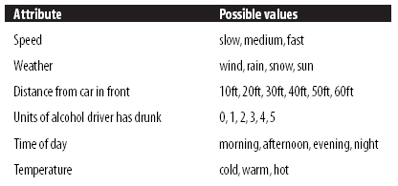
Hypotheses - Example
Each hypothesis represents a set of driving conditions.
If a hypothesis is positive, then it represents a safe scenario.
For example:
<fast, rain, 10ft, 2, ?, ?>
This represents the hypothesis that it is safe to drive fast in rain 10ft behind the next car having drunk 2 units of alcohol.
This would be a negative training example, as clearly it is not safe!

Slide 9
Inductive Bias
All learning methods have an inductive bias.
The inductive bias of a learning method is the set of restrictions on the learning method.
Without inductive bias, a learning method could not learn to generalize.
Occam’s razor is an example of an inductive bias: The best hypothesis to select is the simplest one.

Slide 10
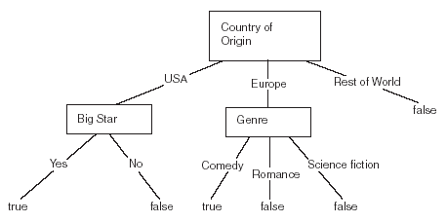
Decision Tree Induction (1)
A decision tree takes an input and gives a Boolean output.
A decision tree takes an input and gives a Boolean output.
Decision trees can represent more complex scenarios than version spaces.

Slide 11
Decision Tree Induction (2)
Decision tree induction involves creating a decision tree from a set of training data that can be used to correctly classify the training data.
ID3 is an example of a decision tree learning algorithm.
ID3 builds the decision tree from the top down, selecting the features from the training data that provide the most information at each stage.

Slide 12
Decision Tree Induction (3)
ID3 selects attributes based on information gain.
Information gain is the reduction in entropy caused by a decision.
Entropy is defined as:
  H(S) = - p₁ log₂ p₁ - p₀ log₂ p₀
p₁ is the proportion of the training data which are positive examples
p₀ is the proportion which are negative examples
The entropy of S is zero when all the examples are positive, or when all the examples are negative.
The entropy reaches its maximum value of 1 when exactly half of the examples are positive, and half are negative.

Slide 13
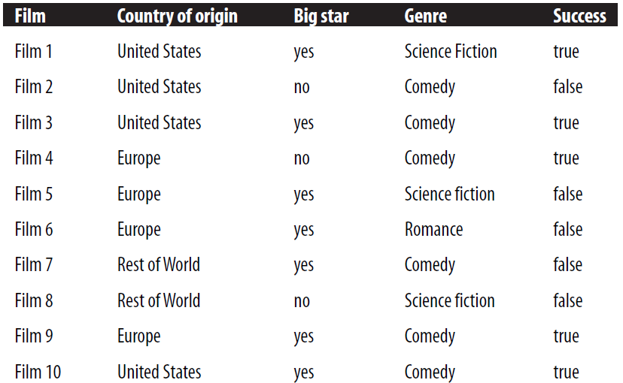
Decision Tree Induction Example

Slide 14
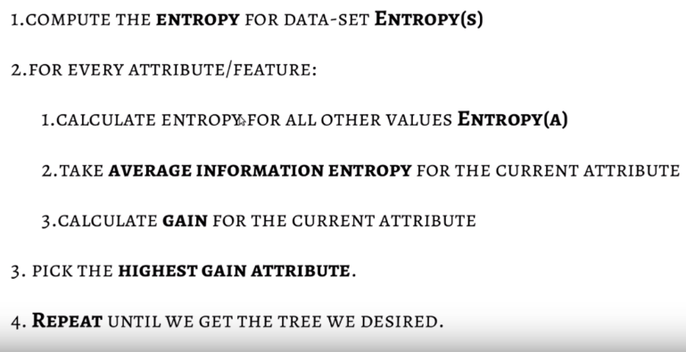
Steps

Slide 15
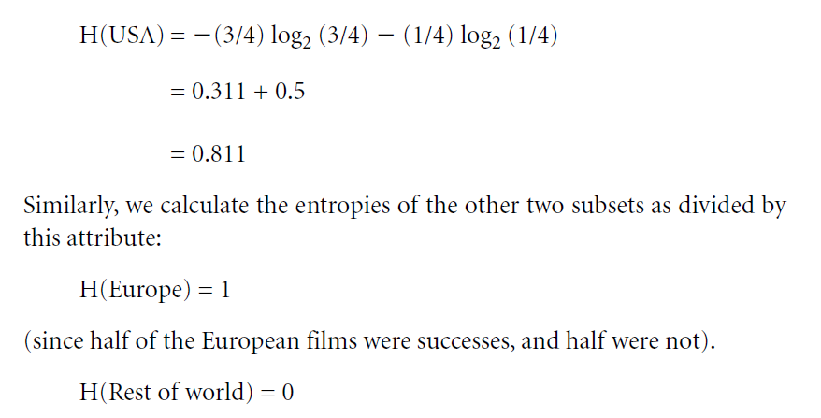
Example

Slide 16
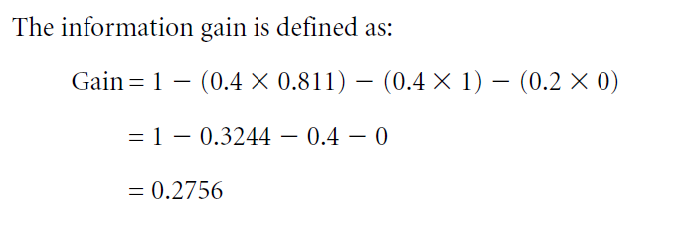
IG

Slide 17
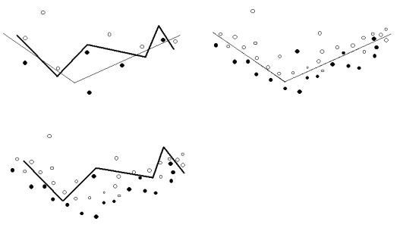
The Problem of Overfitting
Black dots represent positive examples, white dots negative.
The two lines represent two different hypotheses.
In the first diagram, there are just a few items of training data, correctly classified by the hypothesis represented by the darker line.
In the second and third diagrams we see the complete set of data, and that the simpler hypothesis which matched the training data less well matches the rest of the data better than the more complex hypothesis, which overfits.

Slide 18
The Nearest Neighbor Algorithm (1)
This is an example of instance based learning.
Instance based learning involves storing training data and using it to attempt to classify new data as it arrives.
The nearest neighbor algorithm works with data that consists of vectors of numeric attributes.
Each vector represents a point in n-dimensional space.

Slide 19

The Nearest Neighbor Algorithm (2)
When an unseen data item is to be classified, the Euclidean distance is calculated between this item and all training data.
the distance between <x₁, y₁> and <x₂, y₂> is:
The classification for the unseen data is usually selected as the one that is most common amongst the few nearest neighbors.
Shepard’s method involves allowing all training data to contribute to the classification with their contribution being proportional to their distance from the data item to be classified.

Slide 20
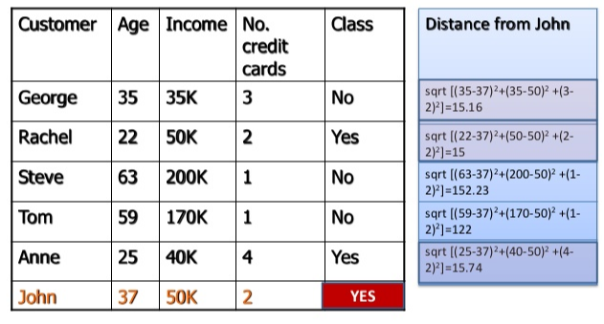
Example KNN

Slide 21
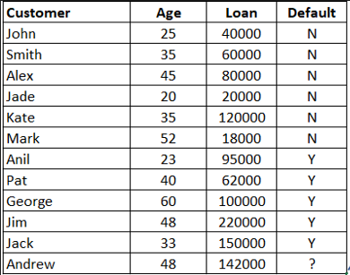
Example-2 KNN

Slide 22
Neural Networks (1)
An neural network is a network of artificial neurons, which is based on the operation of the human brain.
Neural networks usually have their nodes arranged in layers.
One layer is the input layer, and another is an output layer.
There are one or more hidden layers between these two.

Slide 23
Neural Networks (2)
The connections between nodes have weights associated with them, which determine the behavior of the network.
Input data is applied to the input layer.
Neurons fire if their inputs are above a certain level.
If one neuron is connected to another the firing of one may cause the firing of the next.

Slide 24
Supervised Learning
Many neural networks use supervised learning.
Pre-classified training data is provided to the network before it is presented with unseen data.
The training data causes the weights in the network to be set to levels such that unseen data can be classified correctly.
Neural networks are able to learn to classify extremely complex functions.

Slide 25
Unsupervised Learning
Unsupervised learning networks learn without requiring human intervention.
No training data is required.
The system learns to cluster input data into a set of classifications that are not previously defined.
Example: Kohonen Maps.

Slide 26
Reinforcement Learning
Systems that learn using reinforcement learning are given a positive feedback when they classify data correctly, and negative feedback when they classify data incorrectly.
Credit assignment is needed to reward nodes in a network correctly.

