Slide 1
Chapter 3
Knowledge Representation

Slide 2
Chapter 3 Contents
The need for a good representation
Semantic nets
Inheritance
Frames
Object oriented programming
Search trees
Combinatorial explosion
Problem reduction

Slide 3
The Need for a Good Representation
A computer needs a representation of a problem in order to solve it.
A representation must be:
  Efficient – not wasteful in time or resources.
  Useful – allows the computer to solve the problem.
  Meaningful – really relates to the problem.
Notes:
The variables it uses, and the operators it applies
to those variables can make the difference between an efficient algorithm
and an algorithm that doesn’t work at all. This is true of all Artificial Intelligence
problems,
Imagine that you are looking for a contact lens that you dropped on a football
field. You will probably use some knowledge about where you were on
the field to help you look for it. One representation might be to have the
computer divide the field into four equal squares and ask the oracle for each square,
“Is the lens in this square?”
The more difficult problem is to determine the data structure that will be
used to represent the problem we are exploring.

Slide 4
Semantic Nets
A graph with nodes, connected by edges.
The nodes represent objects or properties.
The edges represent relationships between the objects.

Slide 5
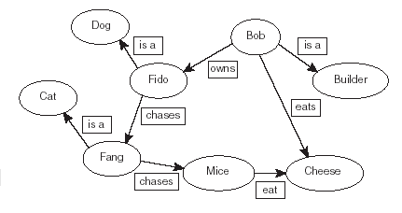
A Simple Semantic Net
Notes:
they have a direction.
The data in semantic nets can be reasoned about in order to produce systems that have
knowledge about a particular domain.
Semantic nets do have limitations,
such as the inability to represent negations: “Fido is not a cat.
The specific objects are generally
referred to as instances of a particular class. Fido is an instance of the class
dog. Bob is an instance of the class Builder.
the system might have a rule that says “any object that does not have an ‘is-a’ relationship to a
class is considered to represent a class of objects.”

Slide 6
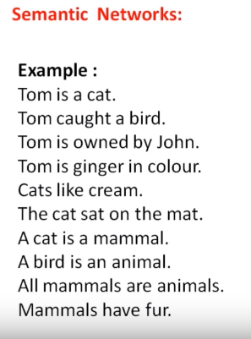
Exercise

Slide 7
Inheritance
Inheritance is the process by which a subclass inherits properties from a superclass.
Example:
  Mammals give birth to live young.
  Fido is a mammal.
  Therefore fido gives birth to live young.
In some cases, as in the example above, inherited values may need to be overridden. (Fido may be a mammal, but if he’s male then he probably won’t give birth).

Slide 8
Frames
A frame system consists of a number of frames, connected by edges, like a semantic net.
Class frames describe classes.
Instance frames describe instances.
Each frame has a number of slots.
Each slot can be assigned a slot value.
Notes:
A development of semantic nets and allows us to express the idea of inheritance.

Slide 9
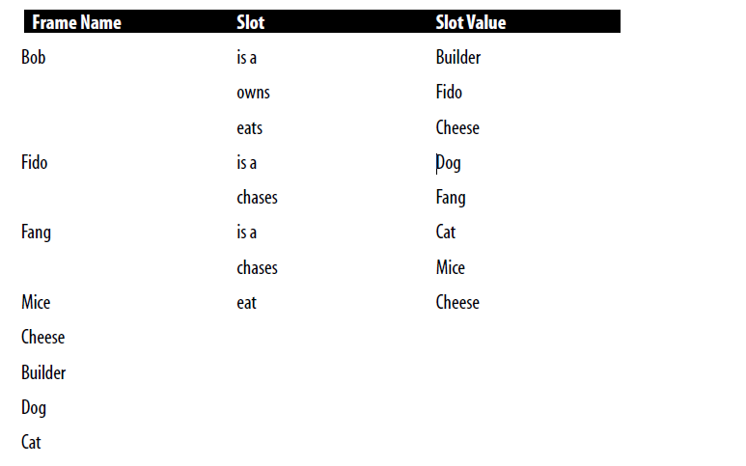
Frames

Slide 10
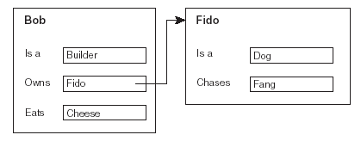
Frames: A Simple Example
Notes:
Frames can be used as a data structure by Expert Systems over
the rule-based approach.

Slide 11
Procedures and Demons
A procedure is a set of instructions associated with a frame (or a slot).
The procedure can be run upon request.
A demon is a procedure that is run automatically, usually triggered by an event such as when a value is:
  Read
  Written
  Created
  Changed

Slide 12
Object Oriented Programming
Object oriented programming languages such as Java, C++.
Use ideas such as:
  inheritance
  multiple inheritance
  overriding default values
  procedures and demons
Languages such as IBM’s APL2 use a frame based data structure.
Notes:
Multiple Inheritance
Conflicts?

Slide 13
Search Trees
Semantic trees – a type of semantic net.
Used to represent search spaces.
Root node has no predecessor.
Leaf nodes have no successors.
Goal nodes (of which there may be more than one) represent solutions to a problem.
Notes:
A search space is a representation of the set of possible
choices in a given problem,
one or more of which are the solution to
the problem.
For example, find a particular word in a dictionary with 100
pages, a search space will consist of each of the 100 pages.
The page that is being searched for is called a goal

Slide 14
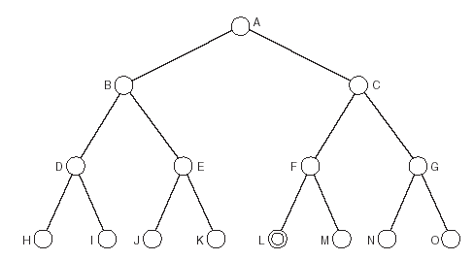
Search Trees: An Example
A is the root node.
M is the goal node.
H, I, J, K, M, N and O are leaf nodes.
There is only one complete path:
  A, C, F, M
Notes:
A path that leads from the root node to a goal node is called a complete
path.
A path that leads from the root node to a leaf node that is not a
goal node is called a partial path.

Slide 15
Example: Missionaries and Cannibals
Three missionaries and three cannibals
Want to cross a river using one canoe.
Canoe can hold up to two people.
Can never be more cannibals than missionaries on either side of the river.
Aim: To get all safely across the river without any missionaries being eaten.

Slide 16
A Representation
The first step in solving the problem is to choose a suitable representation.
We will show number of cannibals, missionaries and canoes on each side of the river.
Start state is therefore:
  3,3,1 0,0,0

Slide 17
A Simpler Representation
In fact, since the system is closed, we only need to represent one side of the river, as we can deduce the other side.
We will represent the finishing side of the river, and omit the starting side.
So start state is:
  0,0,0

Slide 18
Operators
Now we have to choose suitable operators that can be applied:
  Move one cannibal across the river.
  Move two cannibals across the river.
  Move one missionary across the river.
  Move two missionaries across the river.
  Move one missionary and one cannibal.

Slide 19
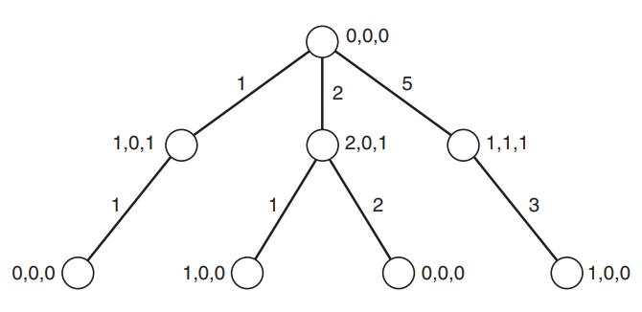
Partial search tree for problem
Cycle

Slide 20
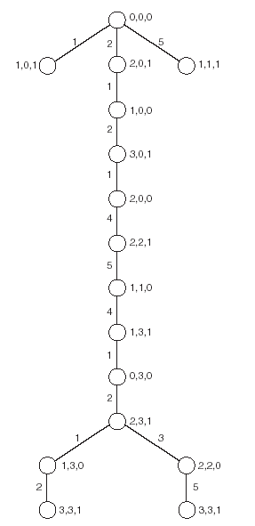
The Search Tree
Cycles have been removed.
Nodes represent states, edges represent operators.
There are two shortest paths that lead to the solution.

Slide 21
The Traveling Salesman Problem
A salesman must visit each of a set of cities and then return home.
The aim of the problem is to find the shortest path that lets the salesman visit each city.
Let us imagine that our salesman is touring the following American cities:
A -Atlanta
B -Boston
C -Chicago
D -Dallas
E -El Paso

Slide 22
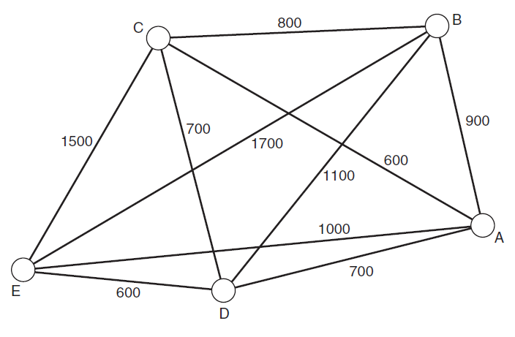
The Traveling Salesman Problem

Slide 23
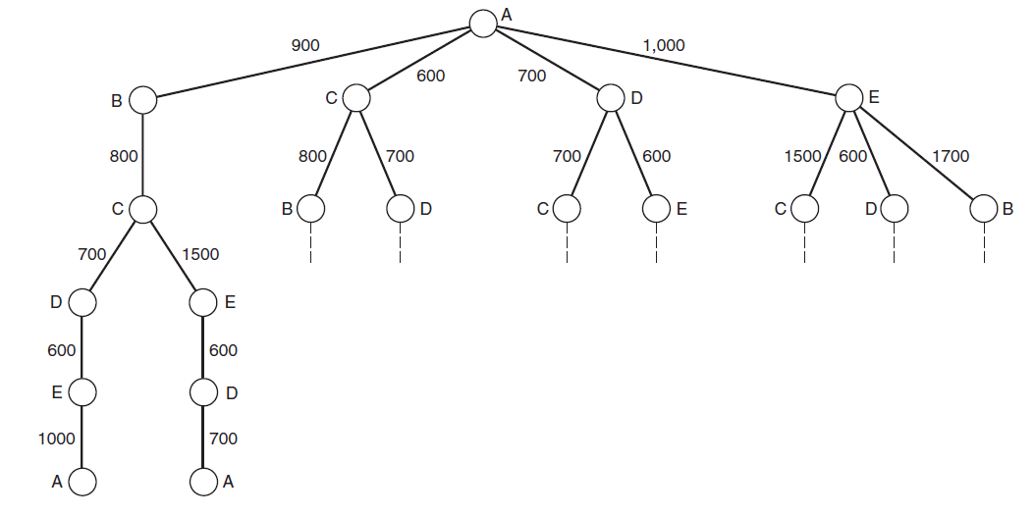

Solution

Slide 24
The Traveling Salesman (1)
The Traveling Salesman problem is another classic problem in Artificial Intelligence and is NP-Complete.
Meaning that for large instances of the problem, it can be very difficult for a computer program to solve in a reasonable period of time.
A problem is defined as being in the class P if it can be solved in polynomial time.

Slide 25
NP
Problems that are NP can be solved non-deterministically in polynomial time.
This means that if a possible solution to the problem is presented to the computer, it will be able to determine whether it is a solution or not in polynomial time.

Slide 26
NP Hard, NP Complete
Take two problems A and B both are NP problems.
Reducibility - If we can convert one instance of a problem A into problem B (NP problem) then it means that A is reducible to B. Example
NP-hard - Now suppose we found that A is reducible to B, then it means that B is at least as hard as A.
NP-Complete - The group of problems which are both in NP and NP-hard are known as NP-Complete problem."
Notes:
Example: Map Coloring to graph

Slide 27
Describe and Match
Identify objects is to describe it and then search for the same description in a database, which will identify the object.
Alice is looking out of her window and can see a bird in the garden. She does not know much about birds but has a friend, Bob, who does. She calls Bob and describes the bird to him. From her description, he is able to tell her that the bird is a penguin.

Slide 28
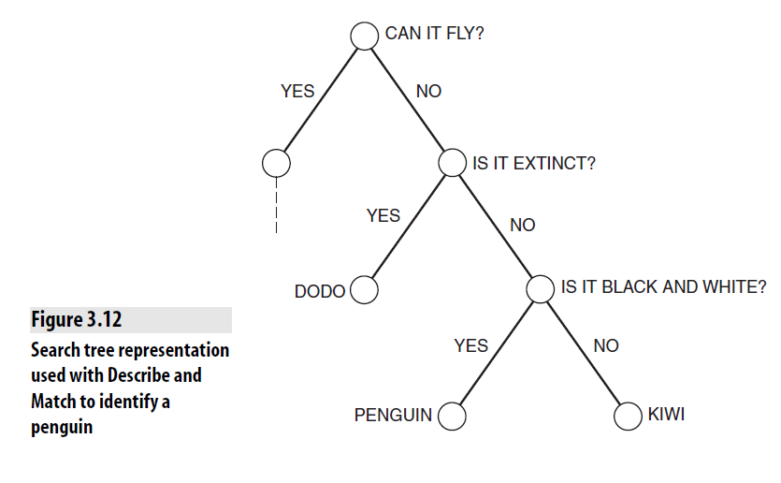
Decision tree
This kind of tree is called a decision tree

Slide 29
Combinatorial Explosion
Problems that involve assigning values to a set of variables can grow exponentially with the number of variables.
This is the problem of combinatorial explosion.
Some such problems can be extremely hard to solve (NP-Complete, NP-Hard).
Selecting the correct representation can help to reduce this, as can using heuristics (see chapter 4).

Slide 30
Problem Reduction
Breaking a problem down into smaller sub-problems (or sub-goals).
Can be represented using goal trees (or and-or trees).
Nodes in the tree represent sub-problems.
The root node represents the overall problem.
Some nodes are and nodes, meaning all their children must be solved.

Slide 31
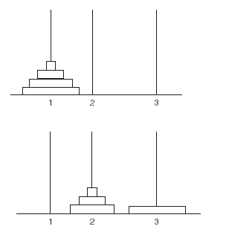
Problem Reduction: Example
E.g. to solve the Towers of Hanoi problem with 4 disks, you can first solve the same problem with 3 disks.
The solution is thus to get from the first diagram on the left, to the second, and then to apply the solution recursively.

Slide 32
The Towers of Hanoi problem
We are allowed to move one disk at a time.
A disk only can be moved if it is the uppermost disk on the stack.
No disk may be placed on the top of a smaller disk.

Slide 33
Goal Trees
A goal tree (also called an and-or tree) is a form of semantic tree used to represent problems that can be broken down in this way. We say that the solution to the problem is the goal, and each individual step along the way is a sub-goal.
Towers of Hanoi

Slide 34
Top Down or Bottom Up
A top-down approach involves first breaking down the main problem into smaller goals and then recursively breaking down those goals into smaller goals, and so on, until leaf nodes, or success nodes, are reached, which can be solved.

Slide 35
Top Down or Bottom Up (1)
A bottom-up approach involves first determining all of the sub-goals that are necessary to solve the entire problem, and then starting by solving the success nodes, and working up until the complete solution is found.

