Slide 1
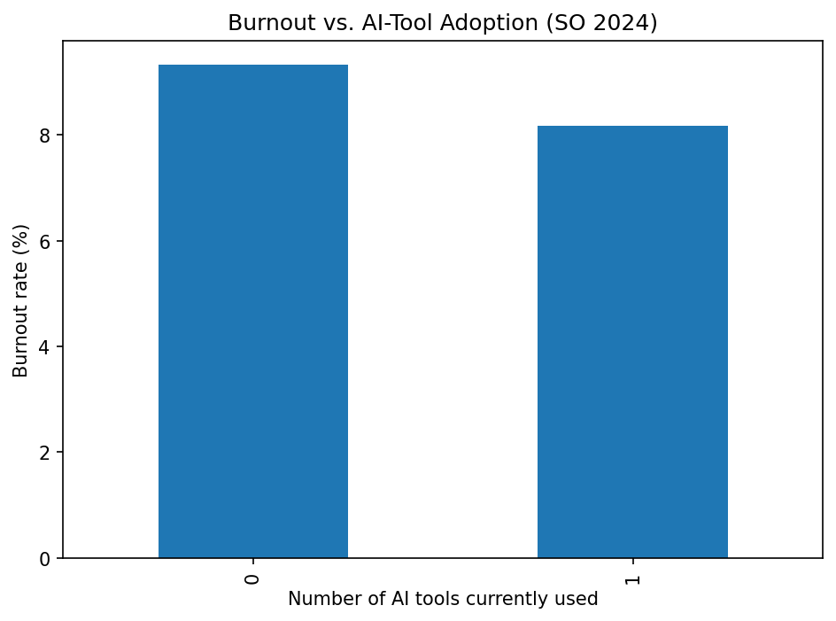
AI Tools & Developer Burnout (SO 2024)
Full-time developers · 39 K responses
Using ≥1 AI tool coincides with ~1 pp lower burnout

Slide 2
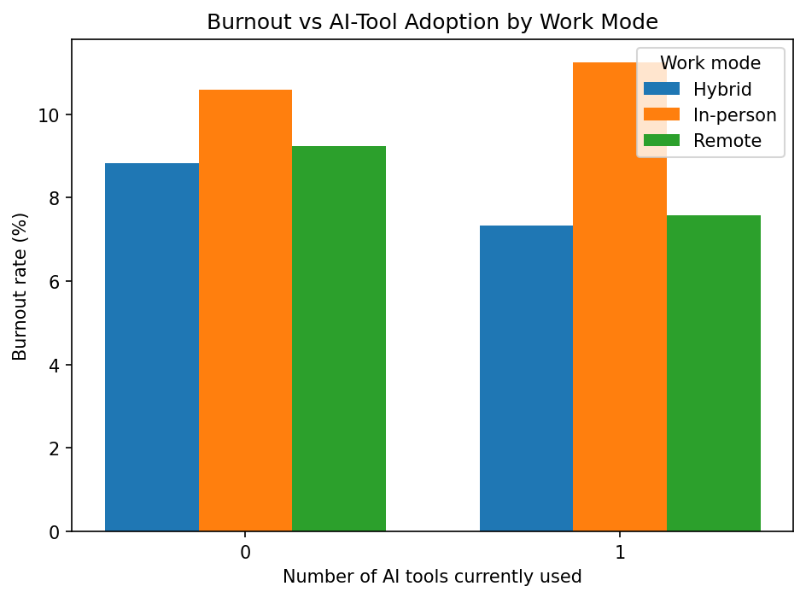
Remote & Hybrid See the Benefit
Remote/hybrid: −1½ pp burnout
In-office: slight ↑ (+0.6 pp)

Slide 3
In-Office Developers – Who Benefits?
18 – 24 yrs: 16.5 % ➔ 14.6 % (−1.9 pp)
45 – 54 yrs: 9.5 % ➔ 7.0 % (−2.5 pp)
25 – 44 yrs: no clear benefit

