Slide 1
DATA ANALYTICS PORTFOLIO PROJECT
Country-Wise Worker
Remittance Dashboard
A Power BI analysis of Pakistan's worker remittances across 34 countries, FY 1972 – FY 2026 (55 years)
Source: State Bank of Pakistan (SBP) — Country-wise Workers' Remittances

Slide 2
Project Overview
An interactive Power BI dashboard consolidating 55 years of country-wise worker remittance data into a single, decision-ready view — built to demonstrate data modelling, DAX, and dashboard storytelling.
At a Glance
34
Countries covered
Consolidate 55 years of remittance data into one view
55
Identify top & bottom performing countries
Years of data (FY72–FY26)
Reveal monthly / seasonal remittance patterns
1,136,884.20 M
Enable self-serve analysis via Country, Month & Year slicers
Total remittance
51.60
Average remittance

Slide 3
Data Source & Scope
Source
Year Slicer Format
State Bank of Pakistan (SBP)
99
→ 1999
Country-wise Workers' Remittances — Zone Smart dataset
00
→ 2000
“Base card built on data, not opinion.”
01
→ 2001
Coverage
FY July-72 to FY Jun-26 • 55 fiscal years • 34 countries
…
→ and so on
Enter the last two digits of the fiscal year to filter the dashboard.

Slide 4
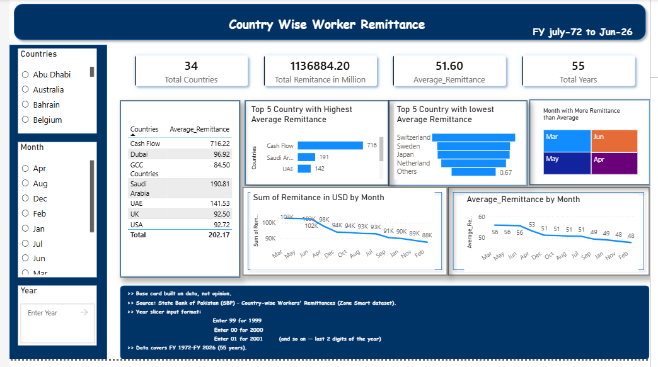
The Dashboard
Filters, KPI cards, ranked visuals, and monthly trend lines in one view

Slide 5
Key Metrics
34
1,136,884.20
51.60
55
Total Countries
Total Remittance (Million)
Average Remittance
Total Years
Across 34 countries and 55 fiscal years, Pakistan received a cumulative 1,136,884.20 million in worker remittances — an average of 51.60 per country/category tracked.

Slide 6
Highest vs. Lowest Average Remittance
Top 5 — Highest Average
Top 5 — Lowest Average

Slide 7
Seasonal Remittance Pattern
Remittances peak in March and taper toward Jan–Feb — four months (Mar, Jun, May, Apr) run above the yearly average.
Months Above Average
Mar
Jun
May
Apr
The Mar–Jun window likely reflects seasonal transfers tied to religious and cultural occasions, when overseas workers increase remittances home.

Slide 8
Tools & Skills Applied
Power BI
Data modelling, DAX measures, interactive slicers and dashboard layout.
1
Government Data Integration
Working with a 55-year official SBP dataset end-to-end.
2
KPI & Visual Design
Card visuals, ranked tables, bar charts, and trend lines.
3
Data Storytelling
Structuring visuals to answer who, when, and how much at a glance.
4

Slide 9
Conclusion
This dashboard turns 55 years of official remittance data into a clear, interactive analytical tool — demonstrating strong Power BI fundamentals and genuine business insight: inflows are concentrated in a few corridors (Cash Flow, Saudi Arabia, UAE) with a clear seasonal peak from March to June.
Next Steps
Year-over-year growth measures
Currency-adjusted (real) remittance trends
Forecasting future fiscal years

