Slide 1
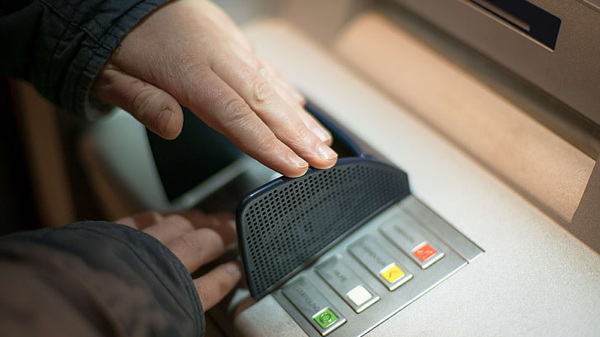
ATM - Based Bank System

Slide 2
Team Names
Std. Code | Bn | Sec | Name
9191341 | 10 | 2 | خالد خليفة
9190269 | 13 | 3 | عمر ايمن عبد المتعال عبد الحليم
9191109 | 32 | 3 | محمد احمد محمد ابوسعدة
9190075 | 34 | 3 | محمد ايمن عبدالعليم احمد
9191280 | 42 | 3 | محمد عادل كامل
9190538 | 35 | 4 | مينا حنا فايز وهبة

Slide 3
System Architecture
System Architecture
clk
rst
IC
credit number
Control Unit
(FSM)
Server
“Data-Base”
Behavioral
model
Credit number
destination number
Credit pass update
Card accepted flag
option
Credit balance update
Account balance
en_amount money
en_password
Insufficient flag
new_password
Credit found flag
States flags
keyboard
Credit Pass
enter
Credit balance
MT

Slide 4
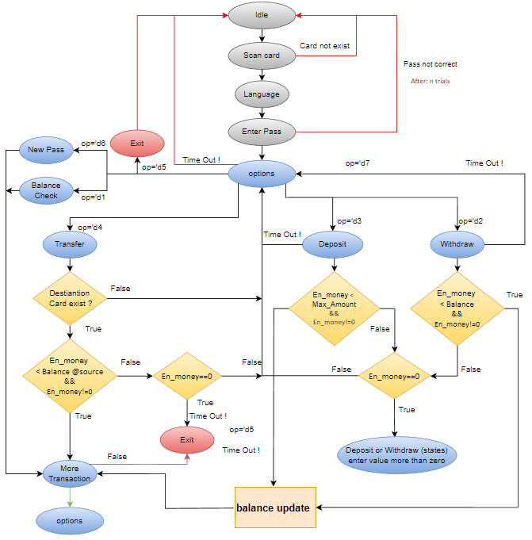
FSM

Slide 5
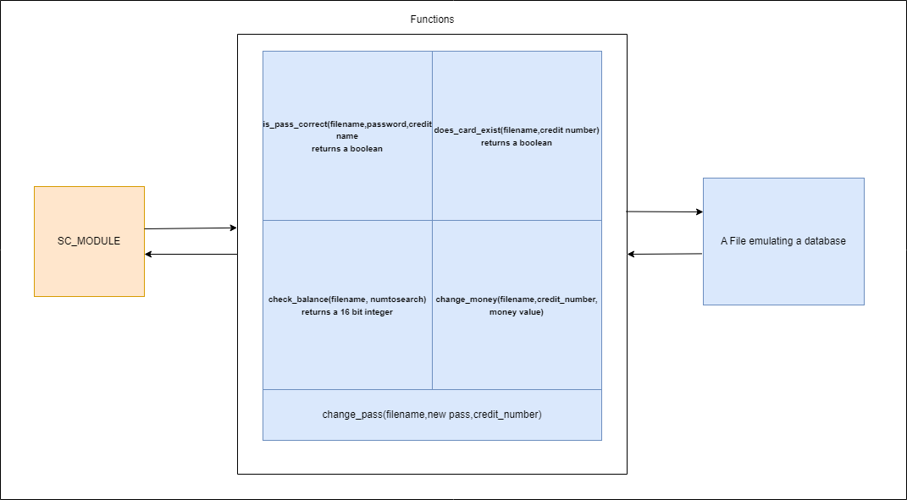
High level model using C++
-Using SystemC library, we made a high level model using C++ and which is a lot faster, can use all of c++ capabilities.

Slide 6
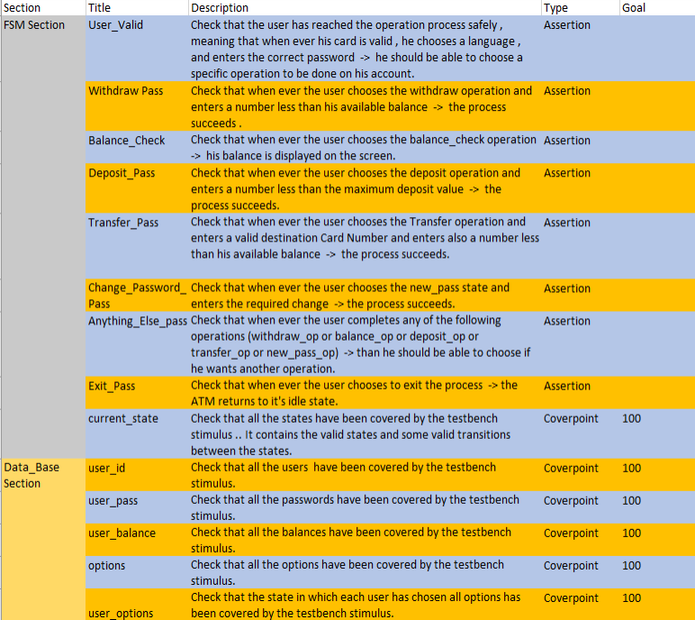
Verification Plan

Slide 7
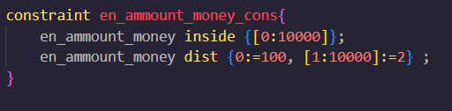
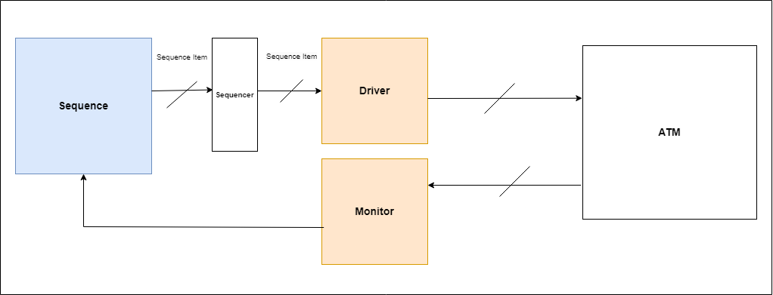
Verification Techniques
Constraint Randomization with Direct testing is used to get us to a high coverage precent
Some inputs are constraint, some are not, some even have a different probability for some values
Signal | Type | Constraints
rst | Input - direct only | No constraints
ic | Input - direct only | No constraints
enter | Input - direct only | No constraints
mt | Input- Randomized | No constraints
credit_number, destination_number | Input - Randomized | Constraints inside a given array of Credit Numbers
en_password | Input - Randomized | Constraints inside a given array of passwords with probability of success higher
new_password | Input - Randomized | No constraints
en_ammount_money | Input – Randomized | Constraints to be less than 10,000 EGP
option | Input - Randomized | No constraints
keyboard | Input – Randomized | No constraints

Slide 8



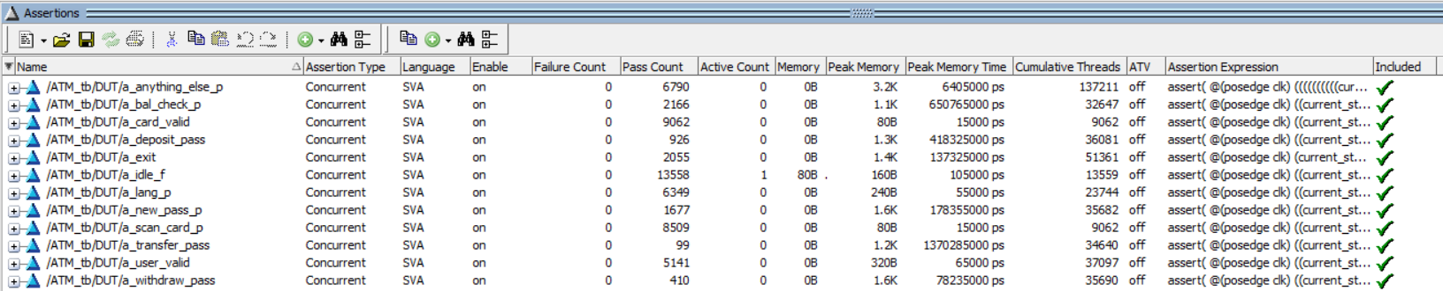
Verification Results
Coverage
Assertions

