Slide 1

Telecommunication Customer Churn analysis
Muhammad Wajeeh Arif

Slide 2

What is Churn?
Customer churn is the percentage of customers that stopped using your company's product or service during a certain time frame. You can calculate churn rate by dividing the number of customers you lost during that time period -- say a quarter -- by the number of customers you had at the beginning of that time period.
For example, if you start your quarter with 400 customers and end with 380, your churn rate is 5% because you lost 5% of your customers.

Slide 3


Telecom Customer churn data
Churn data for a fictional Telecommunications company that provides phone and internet services to 7,043 customers in California, and includes details about customer demographics, location, services, and current status. Customers' data has only two quarters with no data/monthly data.
Tools which I used during the project are: Python (Pandas, Matplotlib, Seaborn & Plotly)
Stakeholder: Executive Committee

Slide 4
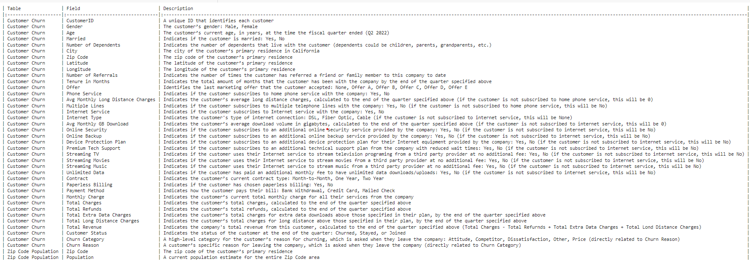
Data Dictionary

Slide 5
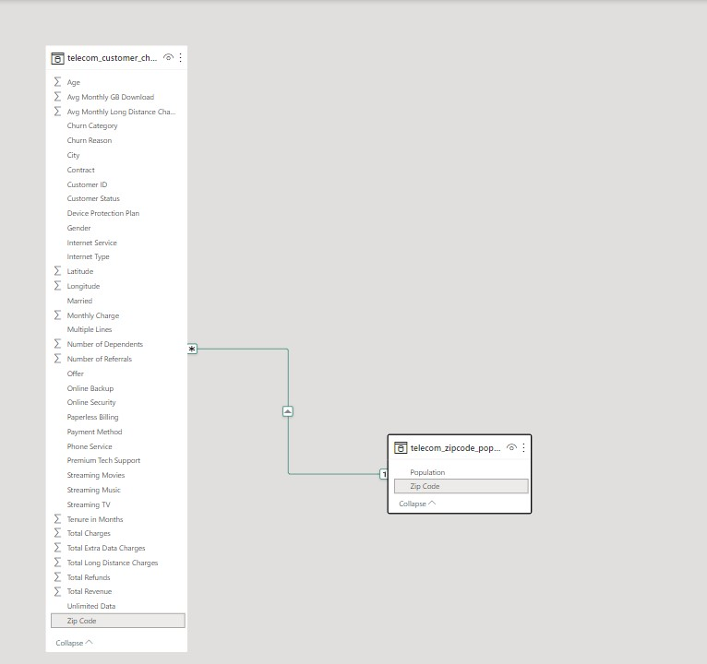
ERD Diagram
Both the tables were connected with key “Zip_Codes”

Slide 6
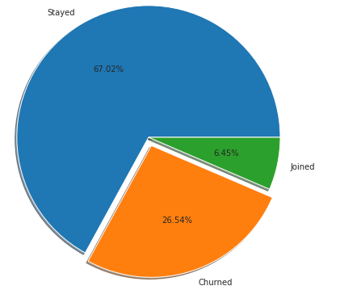
Business problems
What were the customer churn & retention rates?
We note that a big proportion of our clients did not abandon the services. Therefore, only 26.54% (1869) of the customers was churned.
Churn Rate= 1869/7043 = 26.54%
Retention Rate = 1 - Churn Rate = 100 - 26.54 = 73.46%

Slide 7
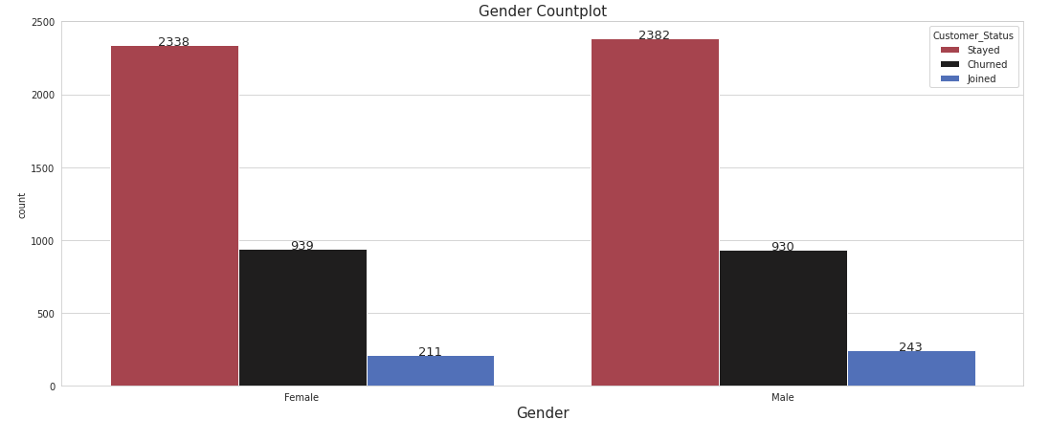
Business problems
2. What was the customer churn pattern according to Gender?
From the chart we can surely depict that same number of both genders were moved toward attrition. So there are equal numbers of genders contributing toward churn.

Slide 8
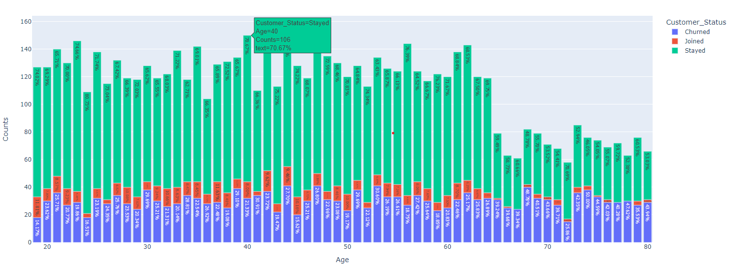
Business problems
3. What was the behavior of churn customers with age?
According to the graph, interest in telecommunications services declines after the age of 65, and California has a high attrition rate across the board.

Slide 9
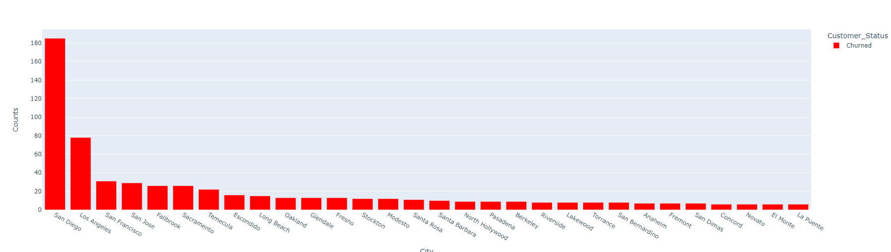
Business problems
4. Which city has the most and least churn rate in California state?
We can surely depicted that San Diego is the most prominent churned city. Around 777 are the most low churn cities.

Slide 10
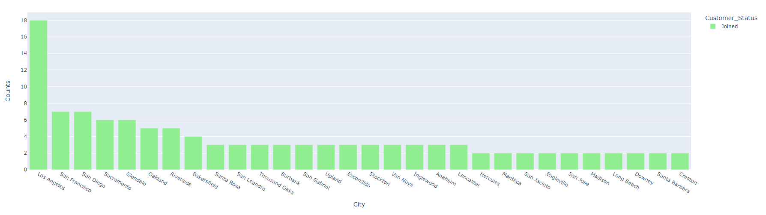
Business problems
5. How many new clients did the business welcome in the most recent quarter? How much more from there?
It is shown that Los Angeles is the most demanding city where new customers are newly joined. On the other side second one is San Francisco and San Diego.

Slide 11
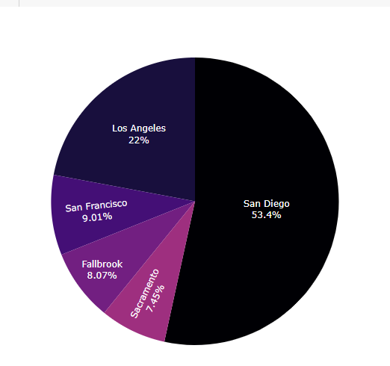
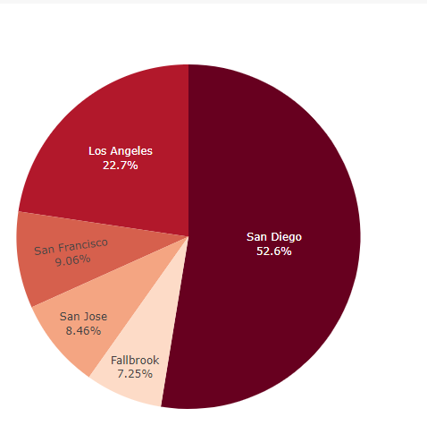
Business problems
6. Which city has the most and least phone/internet churn rate in California state?
Both San Diego and Los Angeles provide their customers both services, whether we are talking about the best or the worst. Least phone/ internet churn counts are 736/740

Slide 12
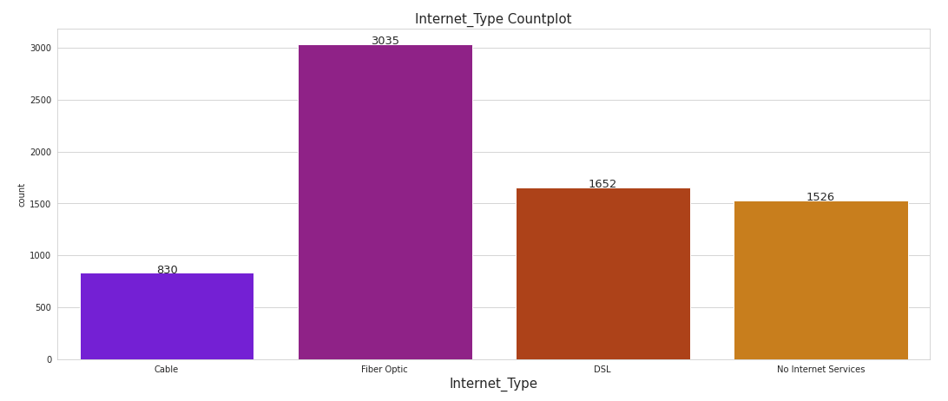
Business problems
7. Which internet services are people utilizing the most frequently? Where?
Fiber Optic is the leading internet service around 41% (3035 customers) of the revenue is generated by this service, where as churn rate is almost equal to that.

Slide 13
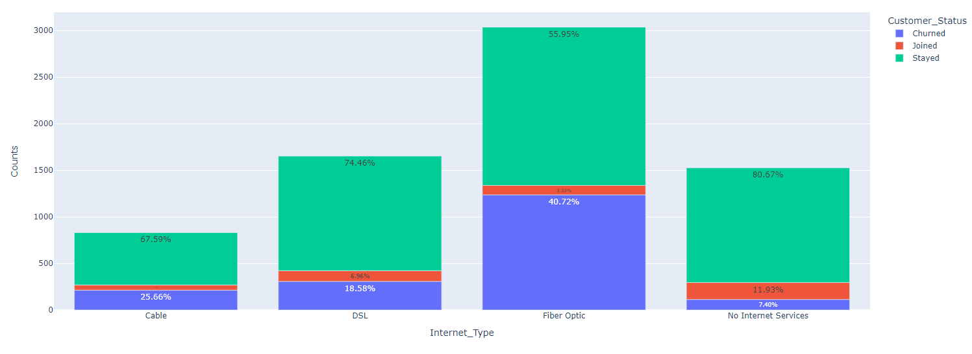
Business problems
7. Which internet services are people utilizing the most frequently? Where?
Fiber Optic is the leading internet service around 41% (3035 customers) of the revenue is generated by this service, where as churn rate is almost equal to that.

Slide 14
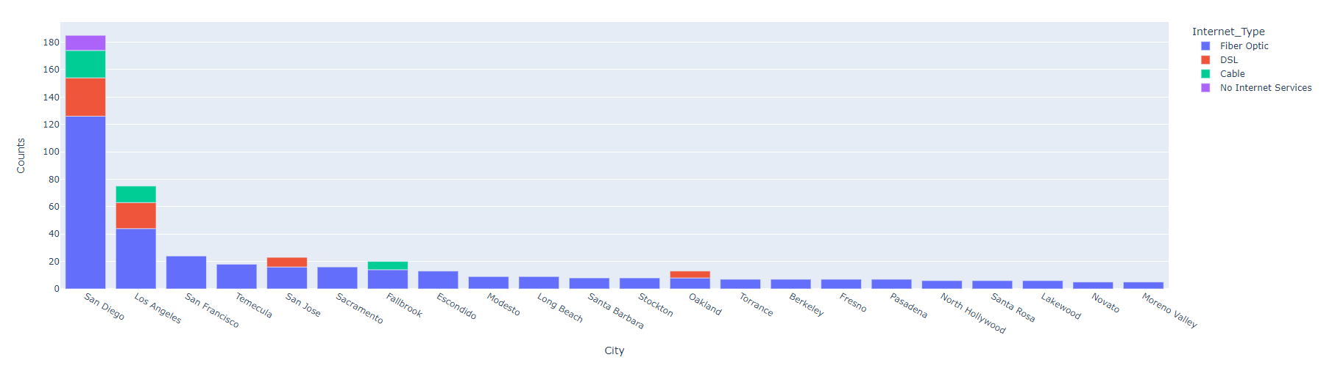
Business problems
7. Which internet services are people utilizing the most frequently? Where?
Fiber Optic is the leading internet service around 41% (3035 customers) of the revenue is generated by this service, where as churn rate is almost equal to that.. Fiber Optics is making a name for itself in San Diego and Los Angeles.

Slide 15
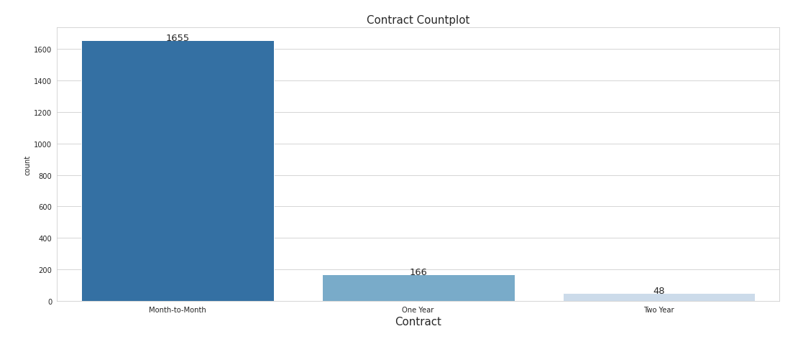
Business problems
8. What are the type of contracts that contributes the customer churn? And which city are up on the board?
Customers can conveniently pay their costs under month-to-month contracts. A large percent of customers with monthly subscription have left when compared to customers with one or two years.

Slide 16
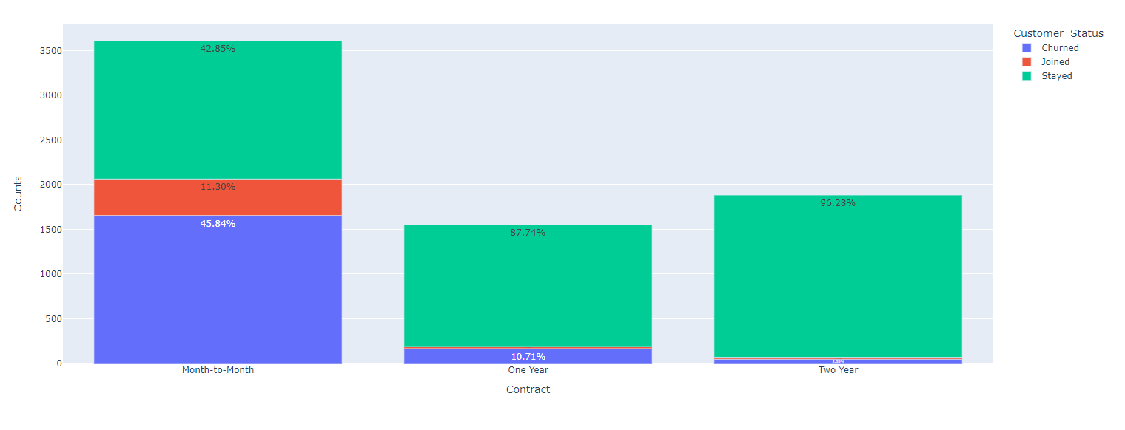
Business problems
8. What are the type of contracts that contributes the customer churn? And which city are up on the board?
Customers can conveniently pay their costs under month-to-month contracts. A large percent of customers with monthly subscription have left when compared to customers with one or two years.

Slide 17
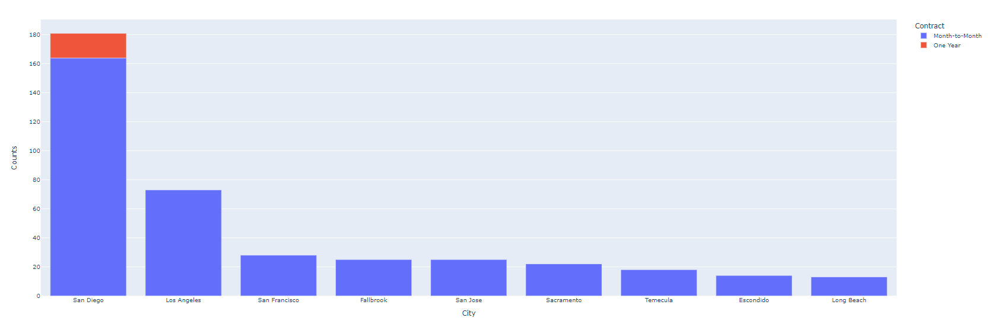
Business problems
8. What are the type of contracts that contributes the customer churn? And which city are up on the board?
Customers can conveniently pay their costs under month-to-month contracts. A large percent of customers with monthly subscription have left when compared to customers with one or two years. The most churn is occurring in large cities.

Slide 18
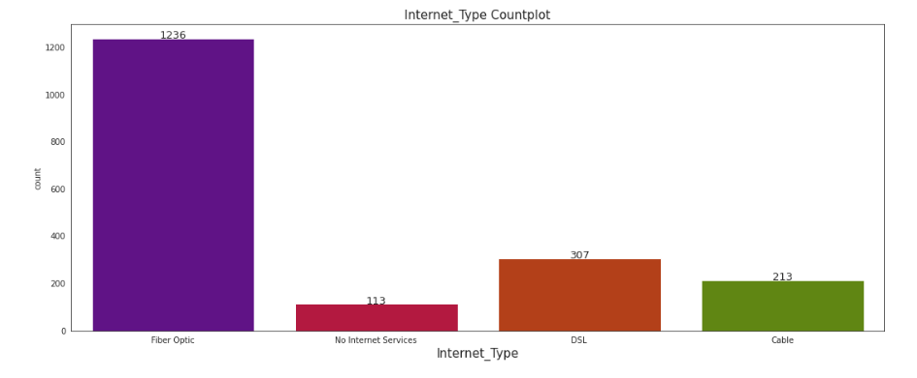
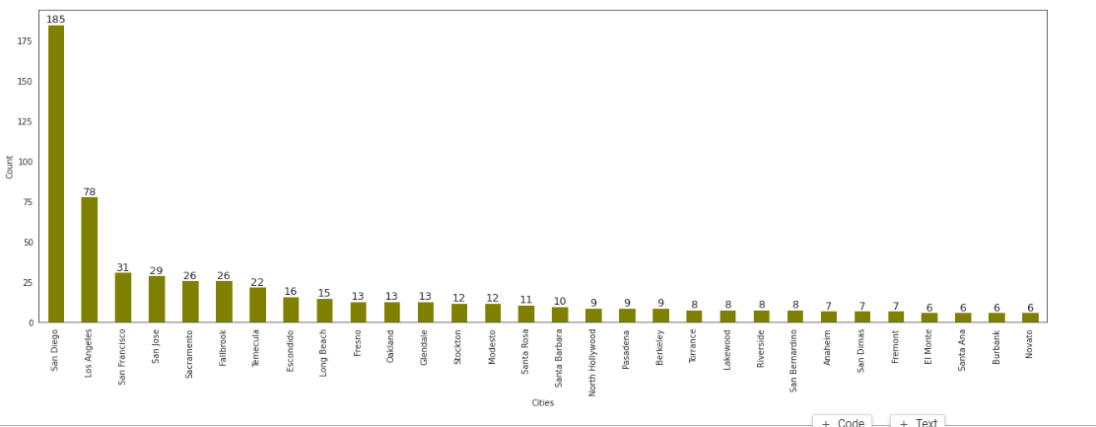
Business problems
9. What seems to be the key drivers of customer churn?

Slide 19
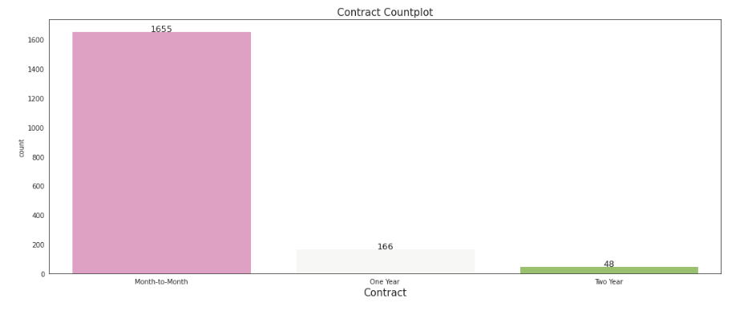
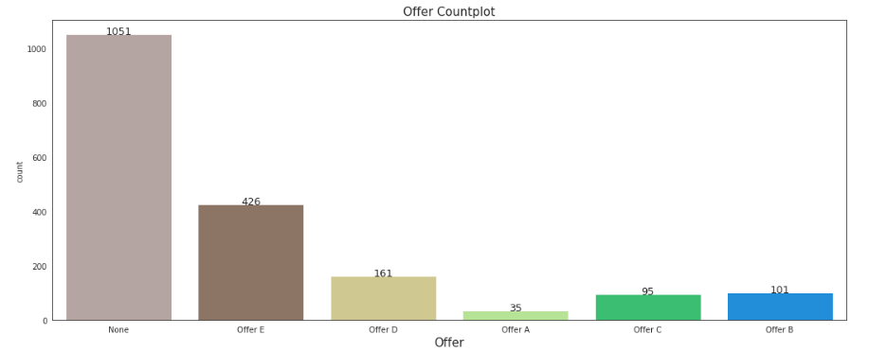
Business problems
9. What seems to be the key drivers of customer churn?

Slide 20
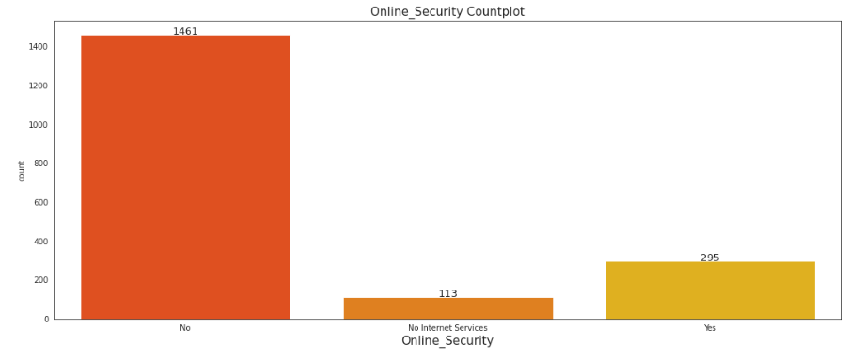
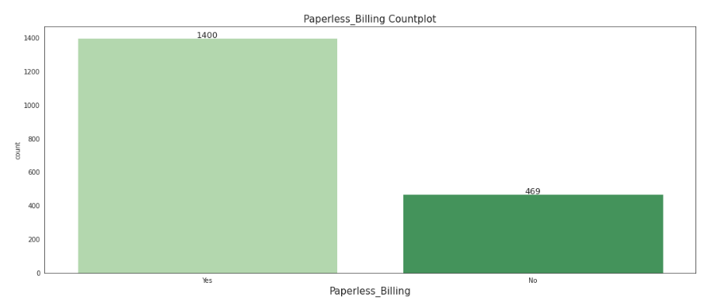
Business problems
9. What seems to be the key drivers of customer churn?

Slide 21
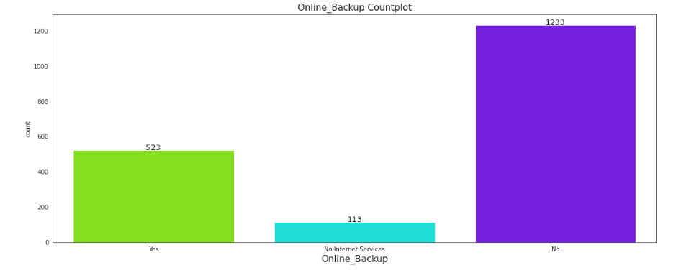
Business problems
9. What seems to be the key drivers of customer churn?

Slide 22
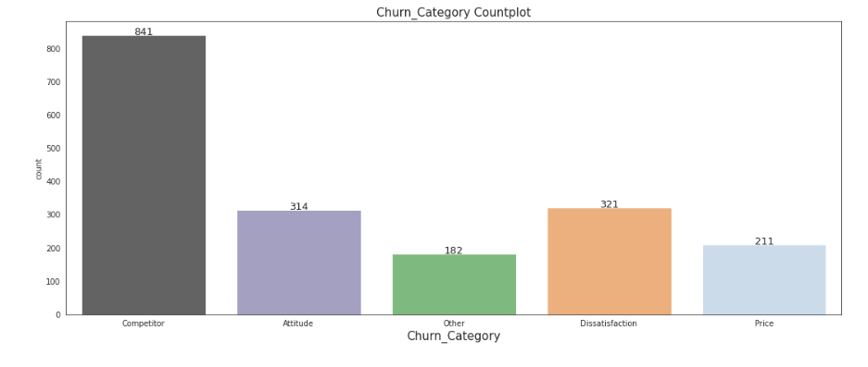
Business problems
10. Which specific factors cause consumers to leave?
The primary cause of churn in the firm is competitors.

Slide 23
Revenue Analysis
31% of total revenue was lost by people who left.
Optical Fiber is responsible for 53% ($16899k) of the monthly revenue, DSL 37% ($11814k)
87% of all monthly revenue lost are caused by customers with Month-to-Month contracts.

Slide 24
Recommendations/Limitations
Target more on young and middle-aged customers since they are more likely to adopt modern technology and have the budget to enjoy.
Offer more discount for the customers who decide to choose the one year or two-year contract so that more customers will be bound with the contract.
The number of observations is decent, but if we could have more columns of features like the customers’ competitor’s information, and other important factors, we could draw more insights from the result.
The nature of our dataset is a cross-sectional dataset. This means that there are no time series factors inside it.

