Slide 1
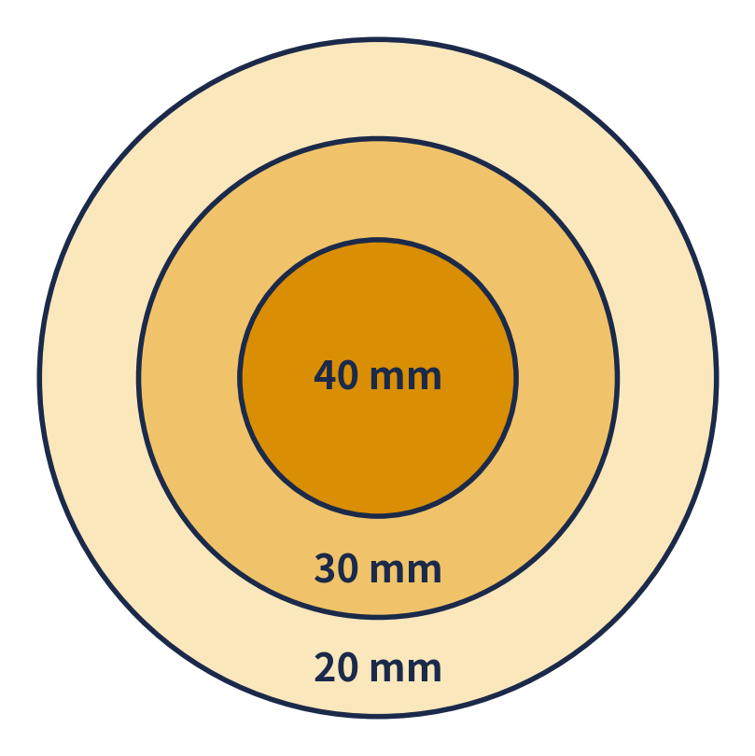
BASIC HYDROLOGY · LECTURE 4
DAD Analysis
강우깊이 – 면적 – 지속기간 해석
Depth 깊이
mm
How much rain?
Area 면적
km²
Over how big a region?
Duration 지속기간
h
In how many hours?
Bigger area → lower average depth
Notes:
SAY: A storm is heaviest at its core. If we average over a bigger area we include the lighter edges, so the average falls. DAD analysis gives the maximum average depth for any area and any duration. We will do it in three steps with one small example.

Slide 2
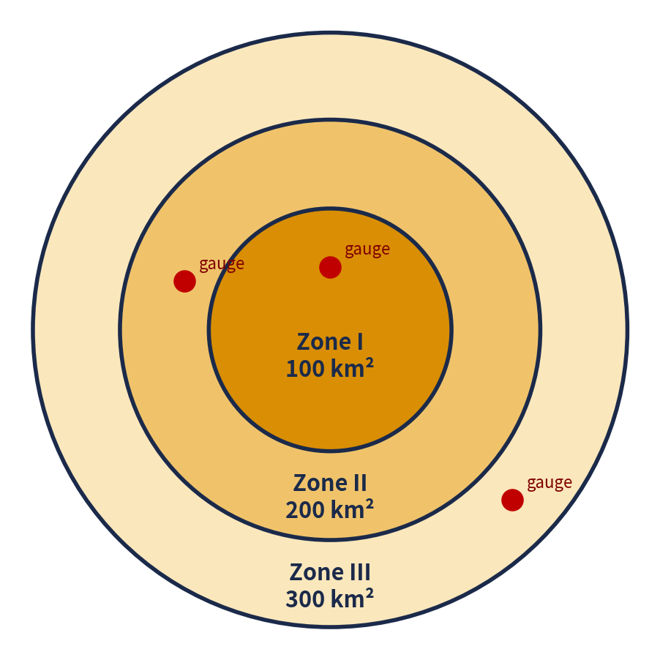
EXAMPLE
One Basin, Three Zones, Three Gauges
유역을 3개 구역으로 나누고 관측소 1개씩
Time (h) | Zone I (100 km²) | Zone II(200 km²) | Zone III(300 km²)
0 | 0 | 0 | 0
1 | 5 | 4 | 3
2 | 15 | 11 | 7
3 | 30 | 22 | 14
4 | 36 | 27 | 17
5 | 39 | 29 | 19
6 | 40 | 30 | 20
Cumulative rainfall (mm) = total since the storm began. 누가우량
Areas
Zone I = 100 km² · Zone II = 200 · Zone III = 300
Notes:
SAY: Each ring is a zone with its own gauge. Areas are 100, 200 and 300 km². The table shows how much rain each gauge has collected so far, hour by hour. Ask students: which zone is wettest? (Zone I, 40 mm.)

Slide 3
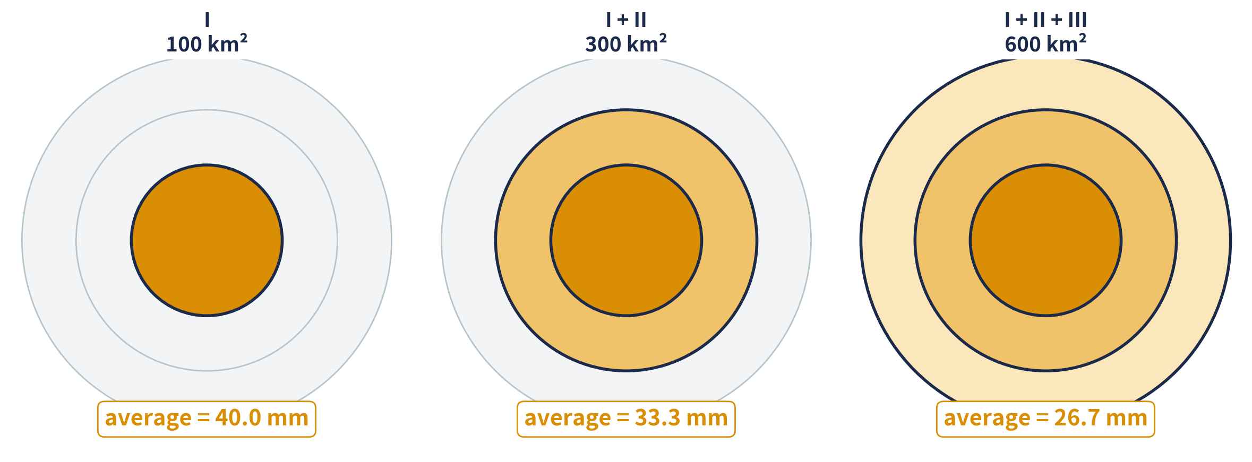
STEP 1
Average Over Growing Areas
점점 넓어지는 면적에 대해 평균을 구한다
Zone I only
Zone I + II
Zone I + II + III
= 40.0 mm
(100×40 + 200×30) ÷ 300 = 33.3
(100×40 + 200×30 + 300×20) ÷ 600 = 26.7
Notes:
SAY: At hour 6, take the rain in each zone and weight it by area. The more zones we include, the lower the average, because we add lighter rain. Repeat this for every hour (Excel does it: column ②).

Slide 4
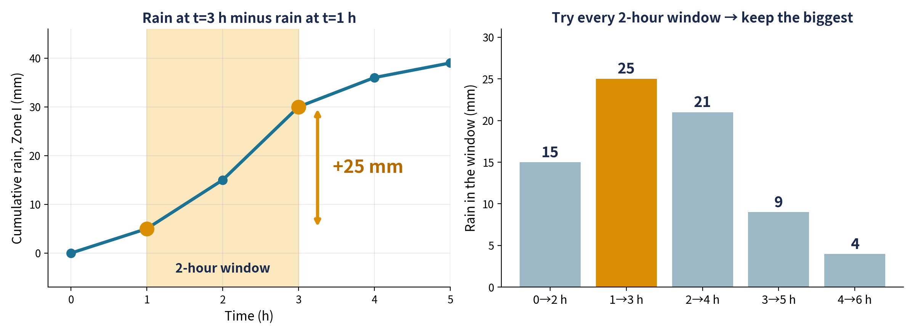
STEP 2
Slide a Window, Keep the Biggest
시간 창을 이동하며 가장 큰 강우량을 찾는다
Rule
Rain in a window = (rain at end) − (rain at start). Try every start time, keep the biggest.
Notes:
SAY: For a 2-hour duration we look at every 2-hour window. From hour 1 to 3 Zone I gains 30 minus 5 = 25 mm, the biggest. So the 2-hour maximum for Zone I is 25 mm. Do the same for 4 h and 6 h, and for I+II and I+II+III.

Slide 5
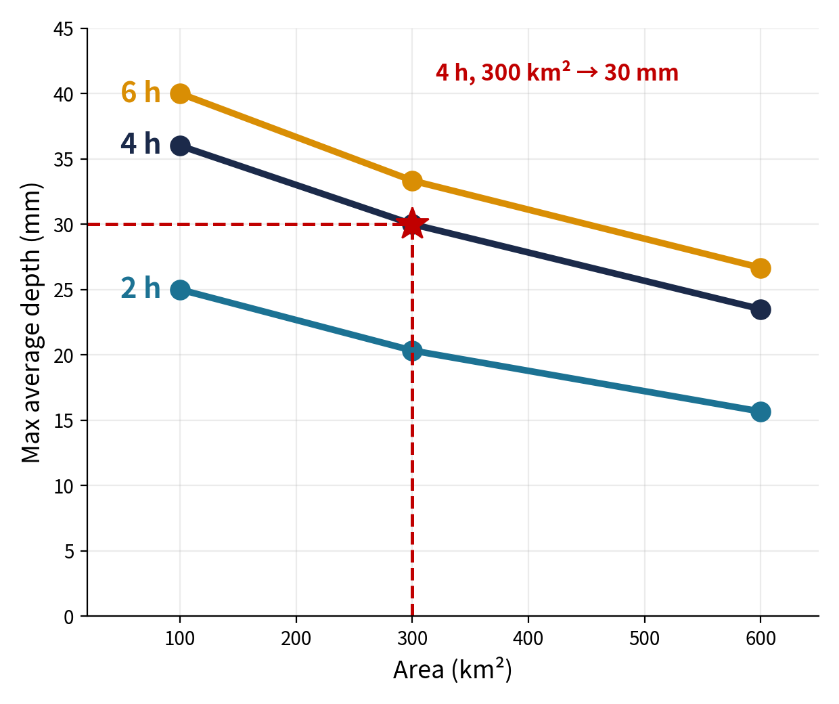
STEP 3
The Result: DAD Table and Curves
결과: DAD 표와 DAD 곡선
Duration | 100 km² (I) | 300 km² (I+II) | 600 km² (all)
2 h | 25.0 | 20.3 | 15.7
4 h | 36.0 | 30.0 | 23.5
6 h | 40.0 | 33.3 | 26.7
Depth in mm
→
Go right (bigger area): numbers get smaller
↓
Go down (longer duration): numbers get bigger
Notes:
SAY: The table is the DAD result and the chart is the DAD curve. To use it: choose a duration and an area, read the depth. Example: 4 hours over 300 km² gives 30 mm. Then open Excel, show the Example sheet, and give the Exercise sheet for practice.

