Slide 1
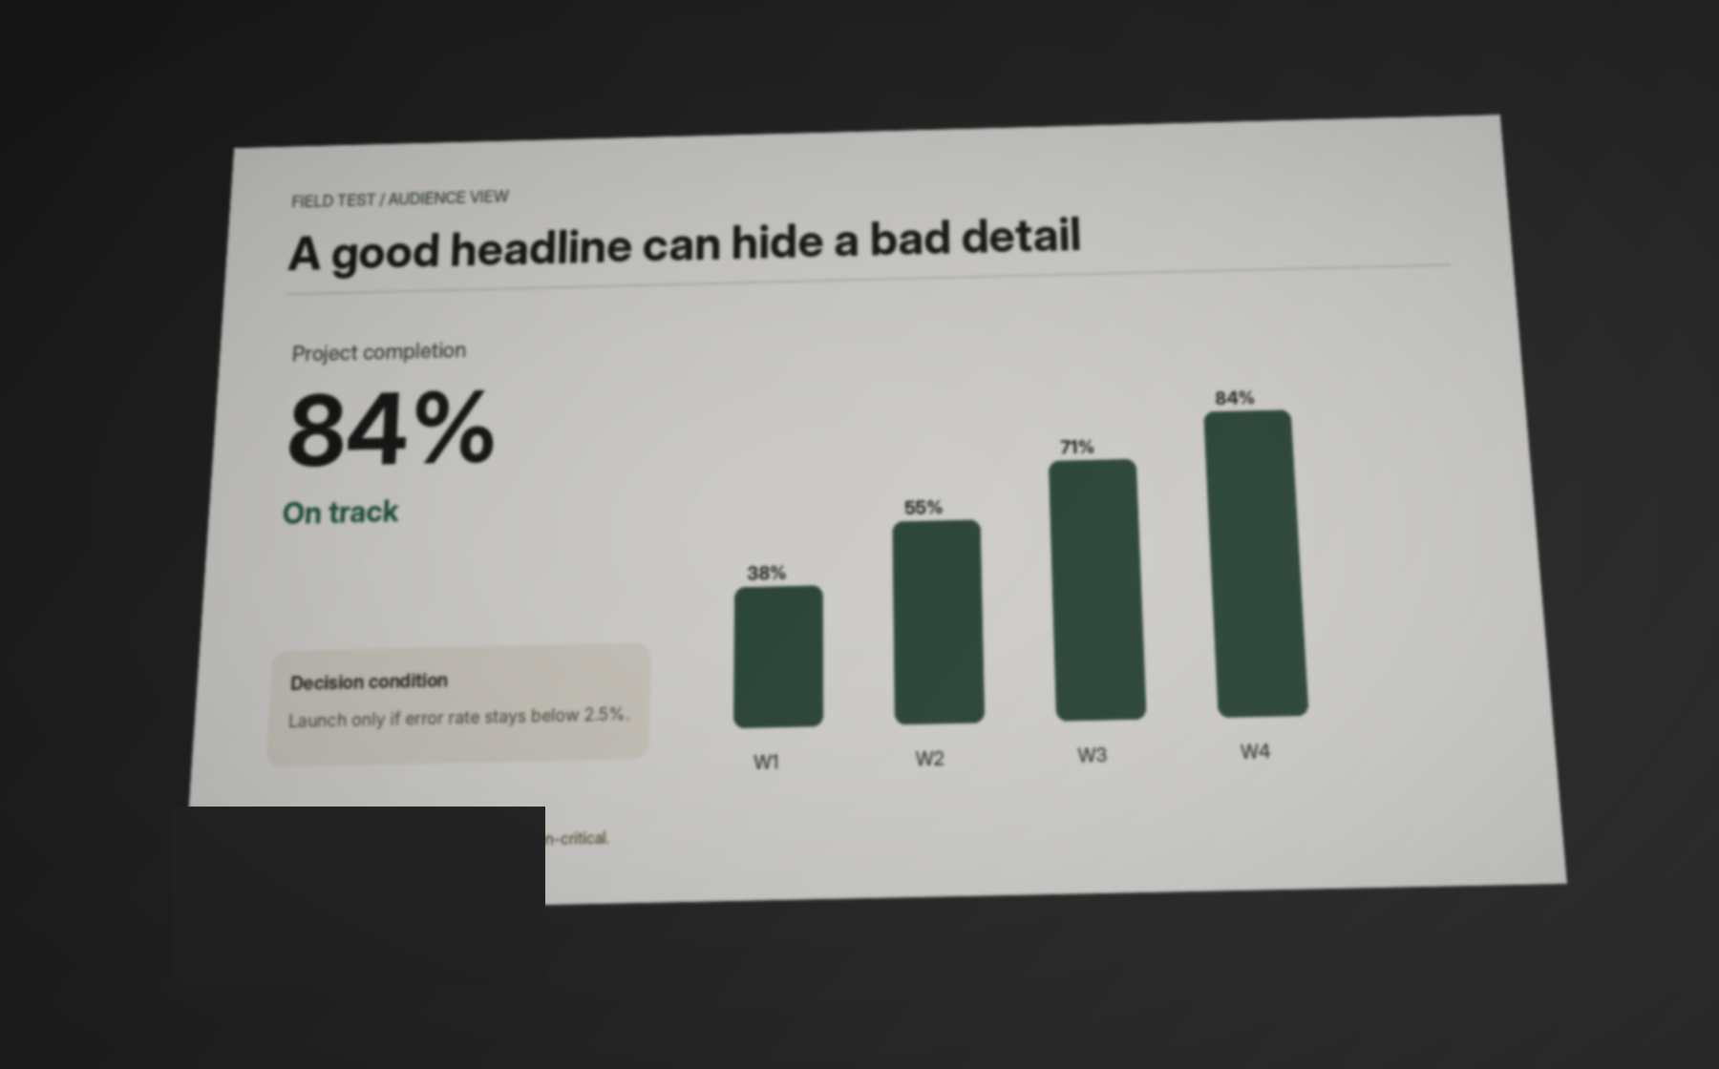
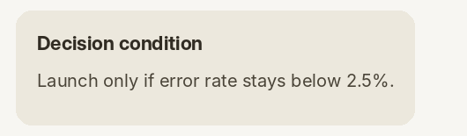
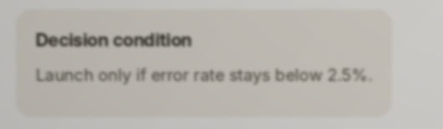
01 / PHYSICAL FAILURE
Can the last row
still read it?
The audience never sees the source file. They see what survives distance, projection, focus, lighting, and perspective.
SOURCE
BACK ROW
AUDIENCE CAPTURE
BACKROW
tests what the room delivered.
AI-integrated website · exact evidence · fix → rescan
2.5%
→
25%
CRITICAL INFORMATION CHANGED

Slide 2
02 / PROBLEM
The failure happens after the slide file.
A source-side checker can miss a problem introduced by the actual display path.
SOURCE FILE
PROJECTOR
ROOM
AUDIENCE POSITION
RECEIVED INFO
→
→
→
→
perfect on laptop
focus / scale
light / washout
distance / angle
what survives
Existing source checks answer: “Is the file designed well?”
BACKROW asks: “What exact information did this audience position actually receive?”
SOURCE ≠ PHYSICAL DELIVERY

Slide 3
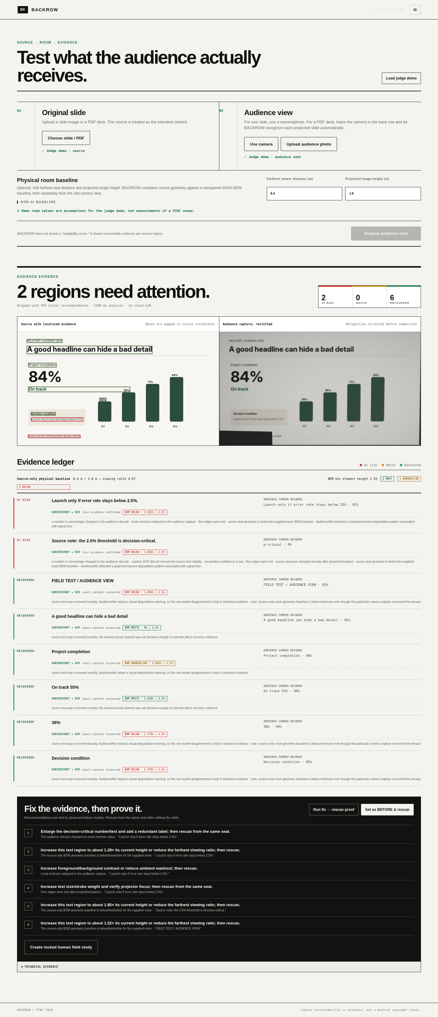
03 / PRODUCT
Presenter stays at the front. The audience phone becomes the back-row observer.
1
LOAD DECK
2
PAIR PHONE
3
CAPTURE
4
MATCH
5
PROVE
6
RESCAN
PDF / slide once
6-digit audience pairing
phone sends audience view
identify + rectify slide
recover / lose exact info
verify the repair
OUTPUT IS EVIDENCE,
NOT A MAGIC SCORE.
source-localized region
exact audience decode
why it failed
repair + same-seat rescan

Slide 4
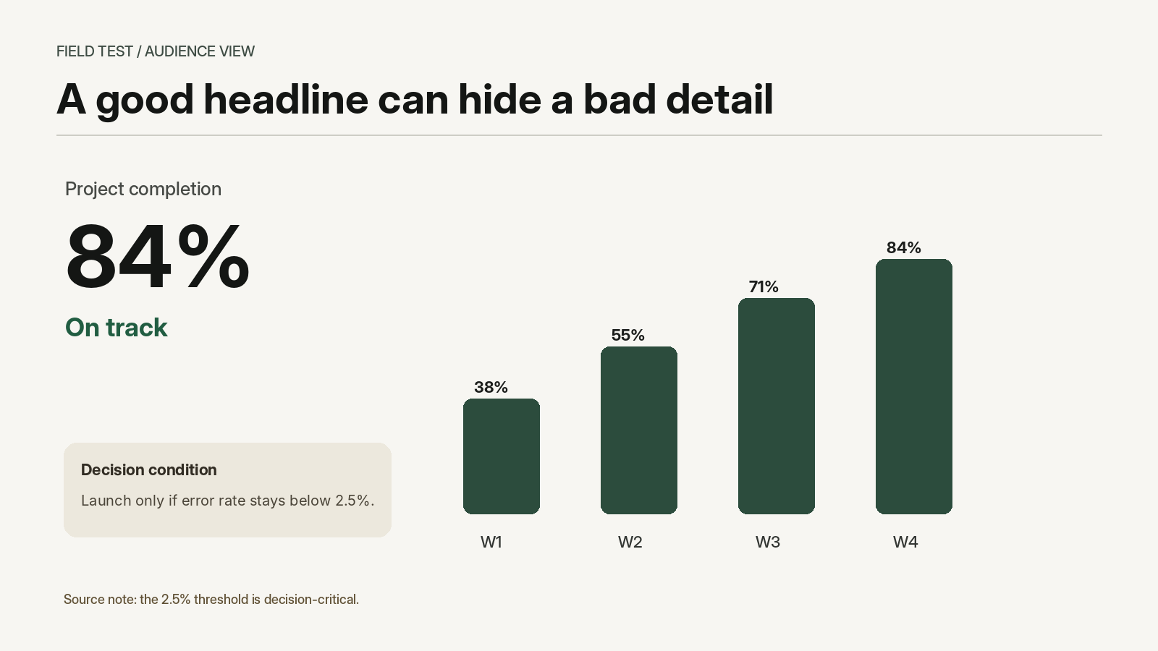
04 / LIVE DEMO
The judge can use a phone from the actual audience position.
SOURCE
AUDIENCE VIEW
AT RISK
2.5% → 25%
exact critical value changed
NO PAGE INDEX GIVEN

Slide 5
05 / ARCHITECTURE
What is AI — and what is not.
The project separates custom learning, pretrained AI, classical vision, and deterministic safety logic.
CUSTOM AI
AudienceNet 2.0
48 → 24 MLP · 16 paired source/camera/room features
PRETRAINED AI
Tesseract 5 LSTM
exact text + numeric recovery · third-party
CLASSICAL CV
ORB + RANSAC + homography
page retrieval · geometric verification · rectification
DETERMINISTIC
numeric guard + evidence fusion
hard contradictions outrank learned uncertainty
The AI is core, but it is not allowed to erase direct evidence.

Slide 6
06 / FAIL-SAFE
Hard evidence outranks model confidence.
1
VERIFIED EXACT LOSS
source 2.5% ≠ audience 25%
↓
2
STRONG OCR / REGION EVIDENCE
content recovered or missing
↓
3
AUDIENCENET
learned survivability evidence
↓
4
WEAK HEURISTICS
blur / contrast / glare support
If slide identity / geometry / evidence is insufficient → NOT ENOUGH EVIDENCE.

Slide 7
07 / PRIOR ART
The claim is narrow on purpose.
Readability is not new. Projector-camera assessment is not new. The workflow integration is the contribution.
2011
LECTURE-HALL LEGIBILITY
Cai · Kim · Green
geometry + text + lighting + observer acuity
2017
PROJECTED-CONTENT QUALITY
Le · Marshall · Doan · Mai · Liu
original + camera capture + rectification + learned quality
2026
SOURCE-FILE READABILITY
SlideSpeak
font size + contrast + density + language complexity
BACKROW
AUDIENCE-PATH QA
this project
auto match + exact loss + repair/rescan + blinded field test
DEFENSIBLE NOVELTY: N3–N4 APPLIED WORKFLOW
No “world first” claim.
Sources: Cai et al. 2011 · Le et al. CRV 2017 · SlideSpeak current checker

Slide 8
08 / ENGINEERING EVIDENCE
The custom model beats simple baselines — on its stated procedural task.
These numbers are not human-readability accuracy.
6/6
signal rules
0.4056
generated alignment cases
geometry
0.4789
3/3
bundled deck matches
AudienceNet 2.0
0.9422
2 → 0
1,440 samples · 48 template families · group-disjoint family split
risk regions after repair

Slide 9
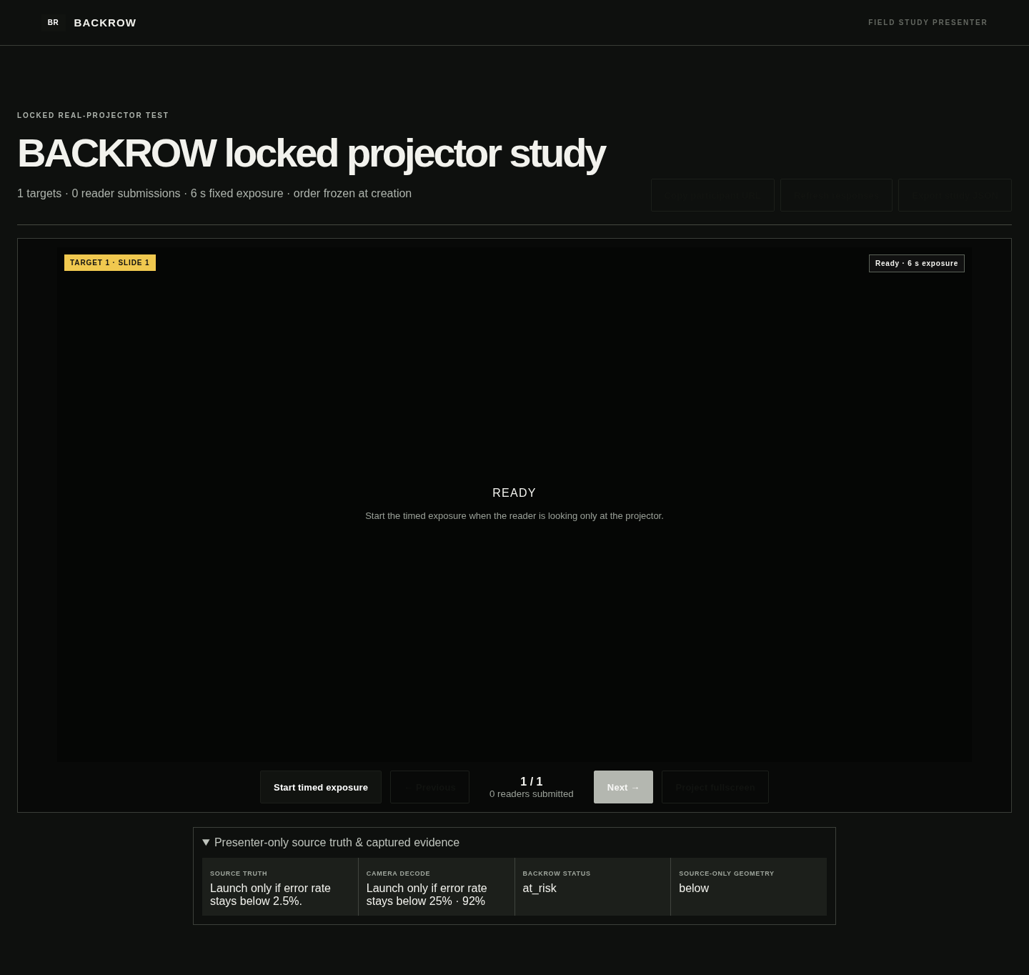
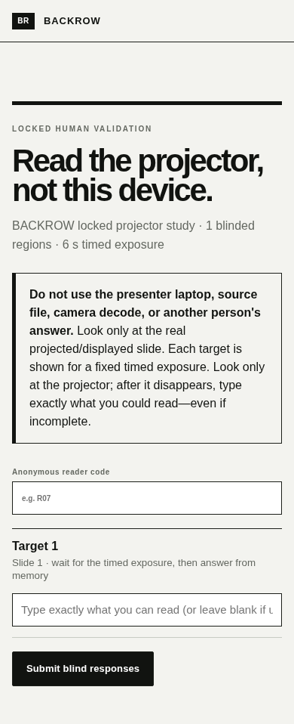
09 / PHYSICAL VALIDATION
The camera-human gap is measured, not hand-waved.
1
2
3
4
5
RANDOMIZE
SHOW 6 s
HIDE
READER TYPES
LOCK RESPONSE
PRESENTER / TRUTH CONTROL
BLINDED READER
Source truth never appears in the participant payload before submission.

Slide 10
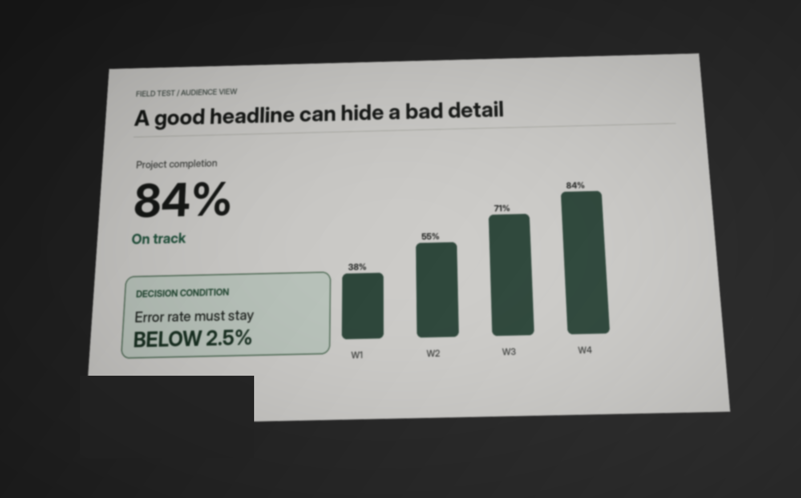
10 / ACTION
Find it. Fix it. Prove it.
BEFORE
AFTER
2 AT RISK
→
0 AT RISK
The product is not a score. It is a verified repair loop.
CHOOSE A SLIDE.

