Slide 1
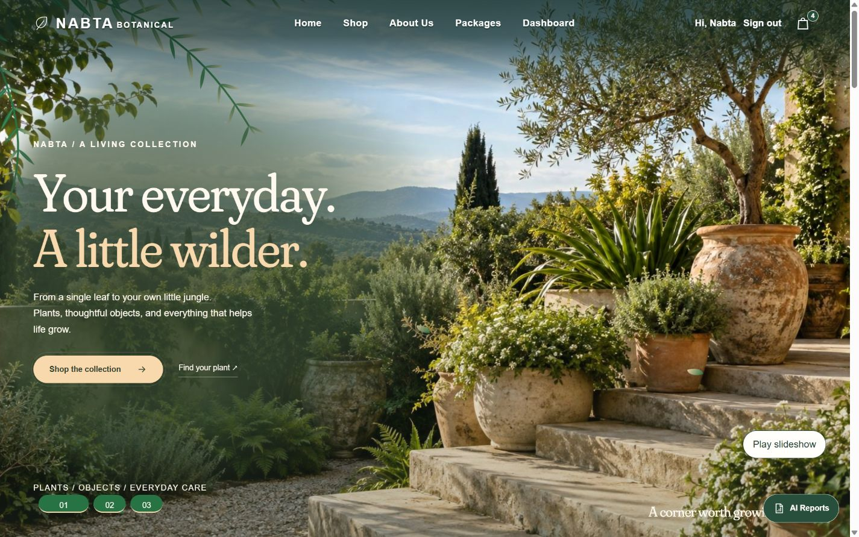
NABTA
BOTANICAL
E-commerce website
Customer experience, store management
and AI-powered reports
A little nature,
closer to home.
10-MINUTE PROJECT PRESENTATION
NABTA BOTANICAL
01 / 13 0:00–0:30
Notes:
Time: 0:00–0:30 (30 seconds)
Welcome to Nabta Botanical, an e-commerce website for plants, pots, tools, seeds and everyday plant-care products. The project brings the customer storefront and the store administration into one system. In the next ten minutes, I will show how a customer discovers products and packages, reviews a basket and requests order confirmation. Then I will explain the admin workspace, AI reporting and the technical structure behind the experience.
Source: Local Nabta implementation and actual screenshots captured on 2 November 2026. public/index.php; app/Views/home.php.

Slide 2
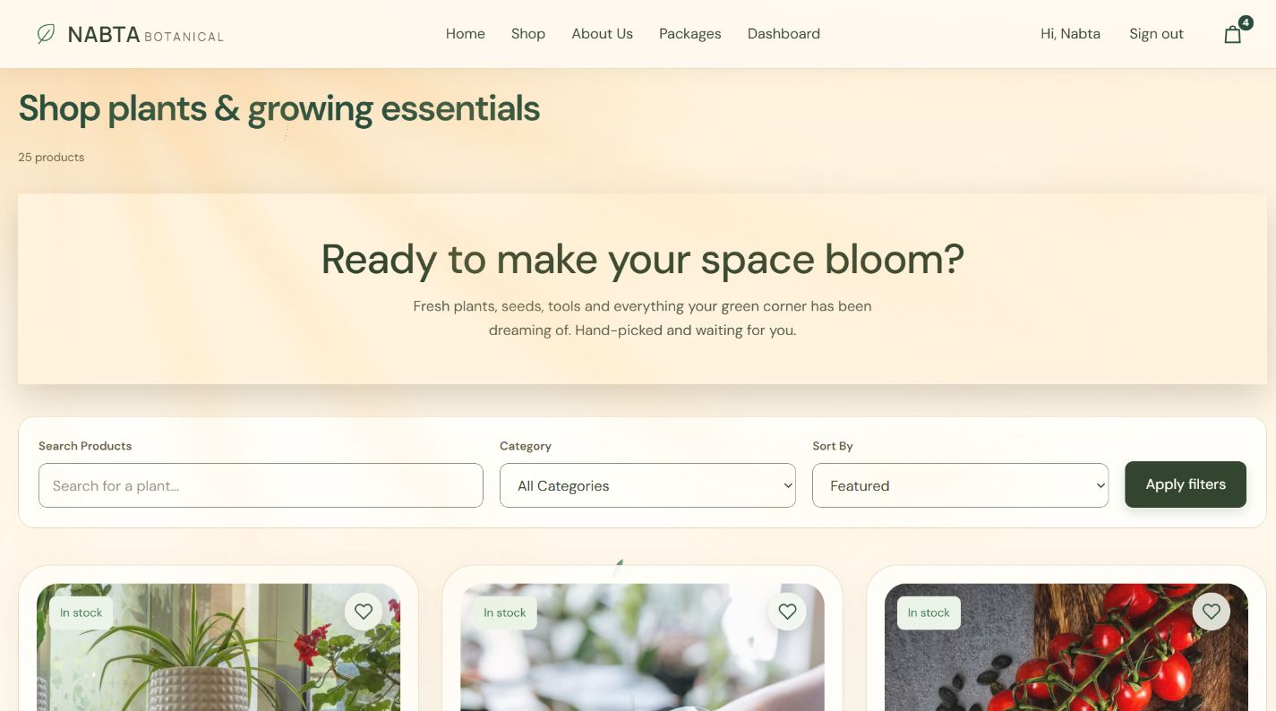
Product discovery
Find a product
Search, category filters and sorting
Compare quickly
Prices and stock status on each card
Keep favorites
Wishlist and a signed-in account
NABTA BOTANICAL
02 / 13 0:30–1:15
Notes:
Time: 0:30–1:15 (45 seconds)
The journey starts on the home page, where the botanical design introduces the brand and links to the shop and packages. In the catalog, customers search by product name, filter by category and sort products by price or name. Product cards show the price, availability and a short description. Pagination keeps a larger catalog manageable. Customers can also save products to a wishlist. Account registration, sign-in and profile pages support the shopping journey, while the About and store information pages explain the business and the current ordering process.
Source: Local Nabta implementation and actual screenshots captured on 2 November 2026. public/index.php?page=products; app/Views/products.php; public/assets/js/products.js; account and information routes.

Slide 3
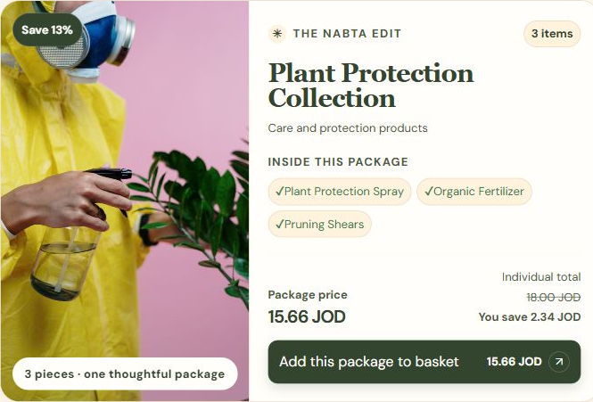
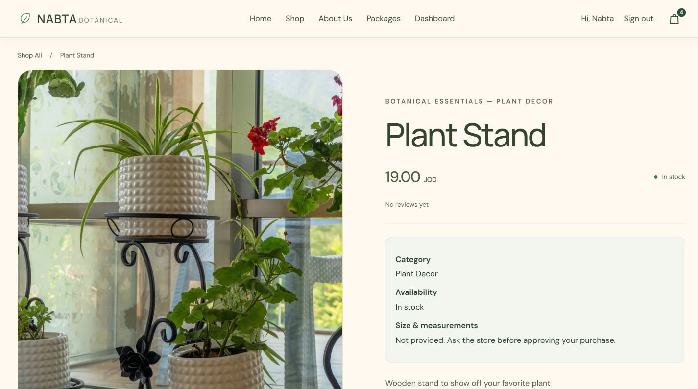
Product details and curated packages
Product information
Package value
Gallery, availability, reviews and basket action
Product quantities, shared discount and full details
NABTA BOTANICAL
03 / 13 1:15–2:00
Notes:
Time: 1:15–2:00 (45 seconds)
A product page brings together the image gallery, description, price, stock information and customer reviews. Customers can add an available product to their basket or keep it in their wishlist. Packages combine multiple products with quantities and a shared percentage discount. The package price is calculated from the included products, and availability depends on the stock required for a complete package. To keep cards compact, a package with more than three product types shows a preview and opens all details through Show more.
Source: Local Nabta implementation and actual screenshots captured on 2 November 2026. public/index.php?page=product&id=30; public/index.php?page=collections; app/Models/Collection.php.

Slide 4
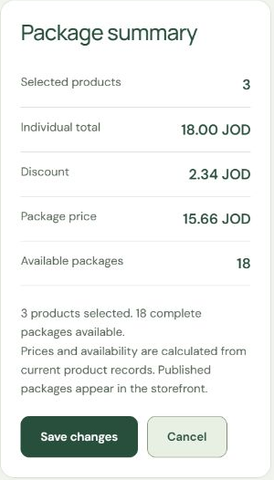
Package pricing and stock logic
Plant Protection Collection
18.00 × 0.87 = 15.66 JOD
Individual total × (1 − discount rate)
Availability follows the limiting component
Available packages = min floor(component stock ÷ required quantity)
Defining a package does not reduce stock
NABTA BOTANICAL
04 / 13 2:00–2:55
Notes:
Time: 2:00–2:55 (55 seconds)
Packages are more than a list of products: the website calculates their price and availability from the selected quantities. In this original Plant Protection package, the separate products total eighteen Jordanian dinars. A thirteen percent discount saves two dinars and thirty-four piastres, giving a package price of fifteen dinars and sixty-six piastres. For stock, the system divides each component stock by the quantity required per package, then uses the smallest whole-number result. That prevents one component from being counted in more complete packages than its stock allows. The admin sees this summary while choosing products. Creating or editing a package definition does not itself reduce inventory.
Source: Actual local website screenshots captured on 2 November 2026. app/Models/Collection.php::pricing; app/Models/AdminCollection.php; admin/collection-edit.php?id=10. Example values are the captured local store state.

Slide 5
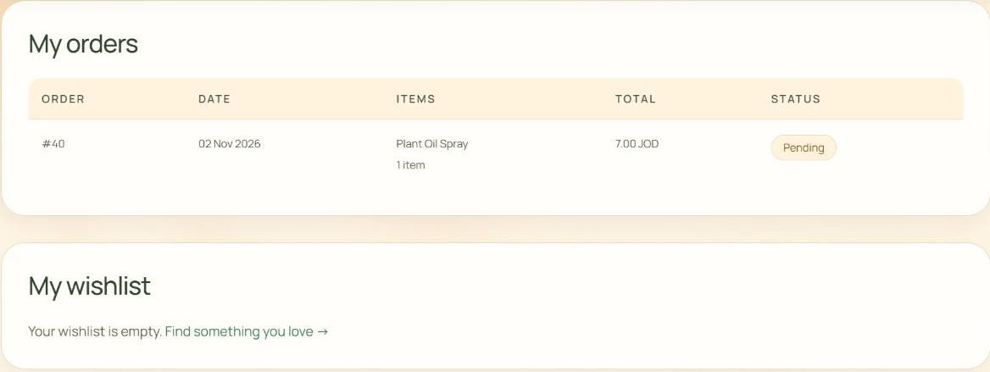
Customer accounts, orders and wishlist
Personal details
Order history
Saved favorites
Profile and password forms
Items, totals, dates and status
Wishlist stays separate from the basket
NABTA BOTANICAL
05 / 13 2:55–3:40
Notes:
Time: 2:55–3:40 (45 seconds)
The account area connects the shopping experience across visits. A signed-in user can review personal information and open the profile form to update it. A separate password form handles credential changes. The My orders section shows the order date, products, total and status, so the customer can distinguish a pending request from a completed order. The wishlist is separate from the basket: it keeps products or packages for a later visit without creating an order. Customers save an item through the wishlist controls and can remove it from their account. The screenshot uses the existing demonstration account, whose wishlist is currently empty.
Source: Actual local website screenshots captured on 2 November 2026. app/Views/account.php; AccountController and Wishlist model; public/index.php?page=profile#orders.

Slide 6
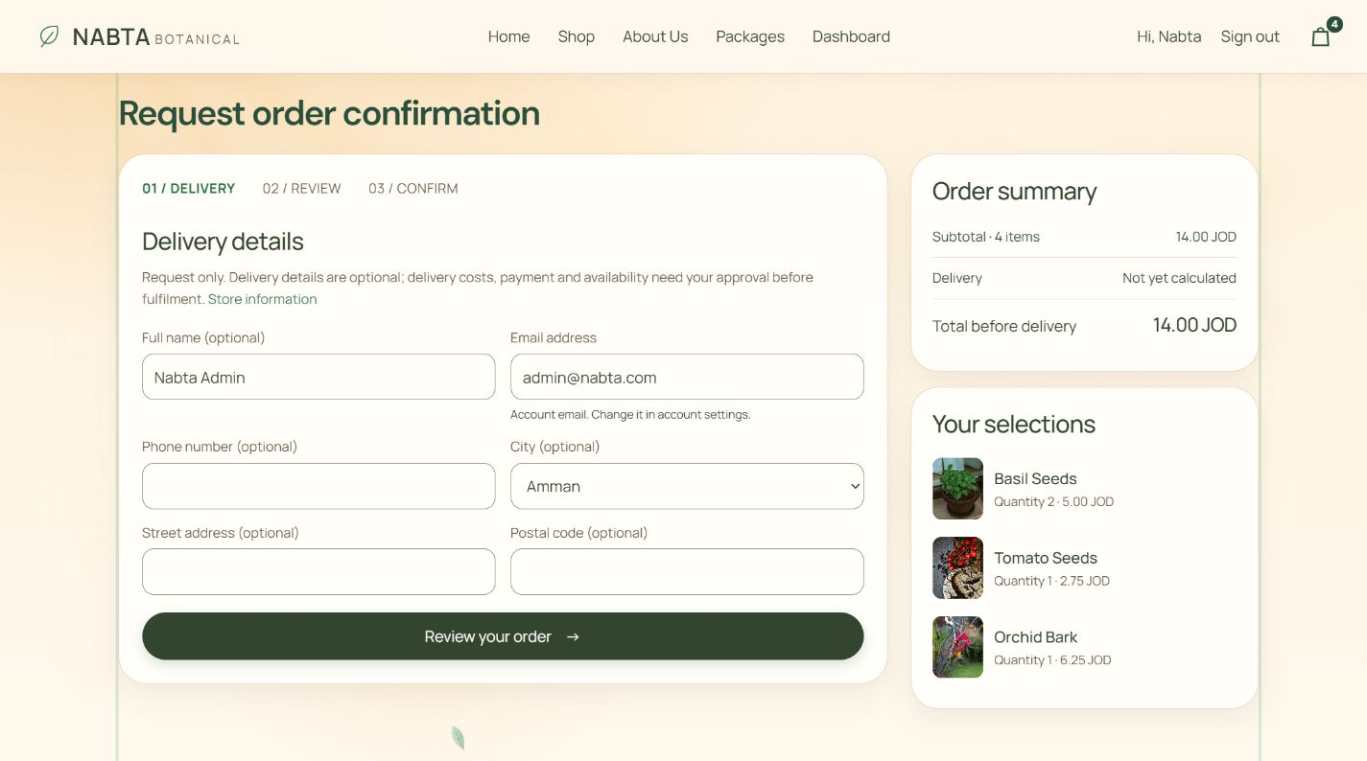
Basket and order confirmation
A compact basket
Three visible items; the full list opens in a popup
Review before sending
Quantities and totals remain visible
Confirmation request
Delivery and payment require later approval
NABTA BOTANICAL
06 / 13 3:40–4:30
Notes:
Time: 3:40–4:30 (50 seconds)
The basket supports quantity changes and item removal. Its compact view shows three product types, while See more opens the complete list in a popup. Checkout brings delivery details, the order summary and selected products into a clear layout. A similar popup provides the full selection and removal controls. Delivery fields are optional at this stage, and the account email identifies the request. Before submitting, the customer reviews the details. This creates a pending confirmation request; it does not take a payment. Delivery costs, availability and payment arrangements still require the customer’s later approval.
Source: Local Nabta implementation and actual screenshots captured on 2 November 2026. public/index.php?page=cart; public/index.php?page=checkout; app/Controllers/OrderController.php; app/Views/checkout.php.

Slide 7
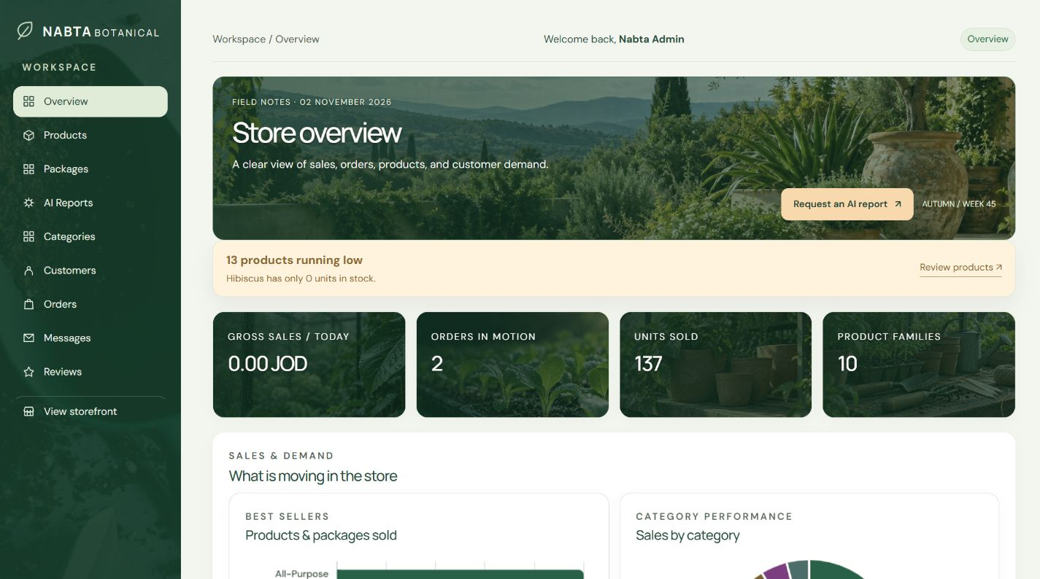
The admin workspace
Store overview
Statistics and visual summaries
Catalog management
Products, images, categories and stock
Role-based access
Admin tools remain restricted
NABTA BOTANICAL
07 / 13 4:30–5:15
Notes:
Time: 4:30–5:15 (45 seconds)
Administrators use a separate workspace with a shared navigation sidebar and a welcome message. The overview brings together sales, orders, products and customer demand. Statistics and charts help the administrator understand store activity. Product management supports searching and filtering, stock visibility, product editing and image management. Category management organizes the catalog. These controls keep the storefront information current without directly editing the database. Admin pages check the signed-in user’s role before granting access. The screenshot shows the actual local store state, so these figures are demonstration data rather than business performance claims.
Source: Local Nabta implementation and actual screenshots captured on 2 November 2026. public/admin/dashboard.php; public/admin/products.php; app/Core/AdminAccess.php; app/Controllers/AdminController.php.

Slide 8
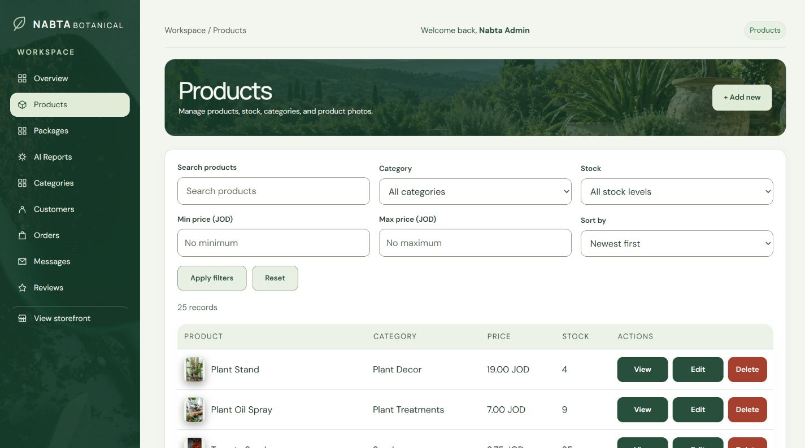
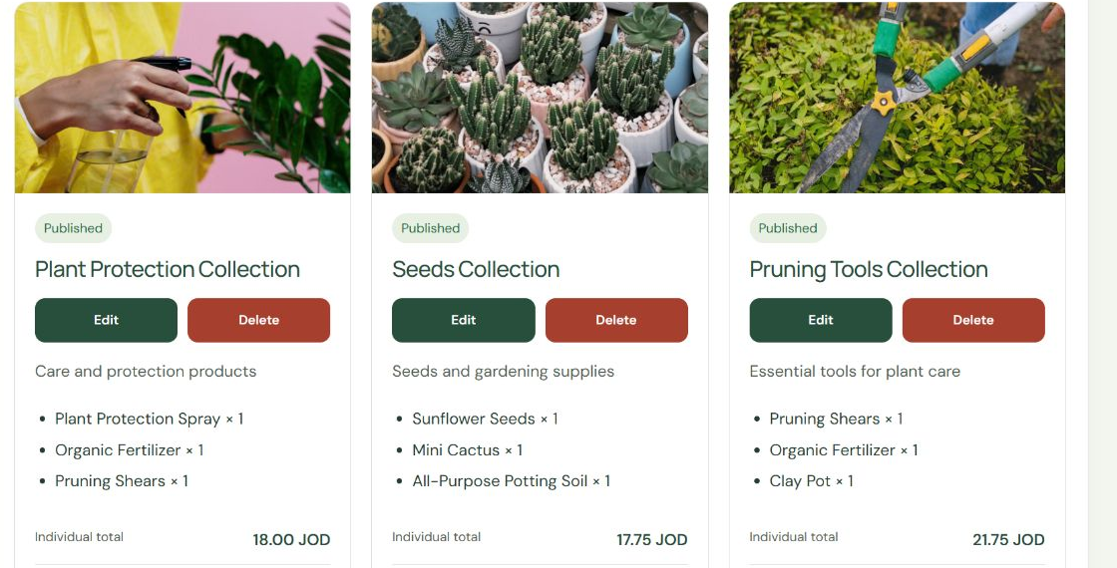
Managing products and store operations
Products and stock
Packages and operations
Search, filters, quantities and image management
Package controls, orders, customers, messages and reviews
NABTA BOTANICAL
08 / 13 5:15–6:00
Notes:
Time: 5:15–6:00 (45 seconds)
The admin product screen provides filters for name, category, stock and price, with sorting to make larger lists easier to manage. Package management allows an administrator to create, edit, publish, hide or remove a package. Its product selector also supports filtering and quantities per package. Removing a package from management preserves historical order records. Other admin pages cover customers, orders, incoming messages and review moderation. Hidden reviews are visually distinguished from published ones. Together, these pages support the daily work of maintaining the catalog, following requests and handling customer feedback.
Source: Local Nabta implementation and actual screenshots captured on 2 November 2026. public/admin/products.php; public/admin/collections.php; public/admin/collection-create.php; app/Models/AdminCollection.php; admin orders/customers/messages/reviews pages.

Slide 9
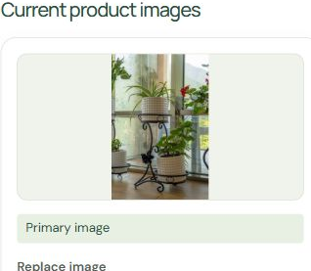
Product image management
Control the gallery
Add, replace, remove and select a primary image
Validate uploads
JPG, PNG and WebP; maximum file size 5 MB
Handle unavailable images
Hide failed thumbnails and refresh the visible count
Original product: Plant Stand
NABTA BOTANICAL
09 / 13 6:00–6:40
Notes:
Time: 6:00–6:40 (40 seconds)
Administrators can manage product photos from the edit-product dialog. They can add images, select the primary image, replace an existing photo or remove one that is no longer needed. The primary image helps the catalog present a consistent product preview. The upload helper checks that the file is a genuine upload, verifies its MIME type and accepts JPG, PNG or WebP files up to five megabytes. Cloudinary hosts the uploaded files. On the storefront, unavailable gallery thumbnails are hidden and the image counter is recalculated, so a failed photo does not remain counted as a visible image.
Source: Actual local website screenshots captured on 2 November 2026. app/Views/admin/products.php; app/Core/CloudinaryUploader.php; public/assets/js/ui.js; public/assets/js/products.js. Screenshot shows the original Plant Stand primary image.

Slide 10
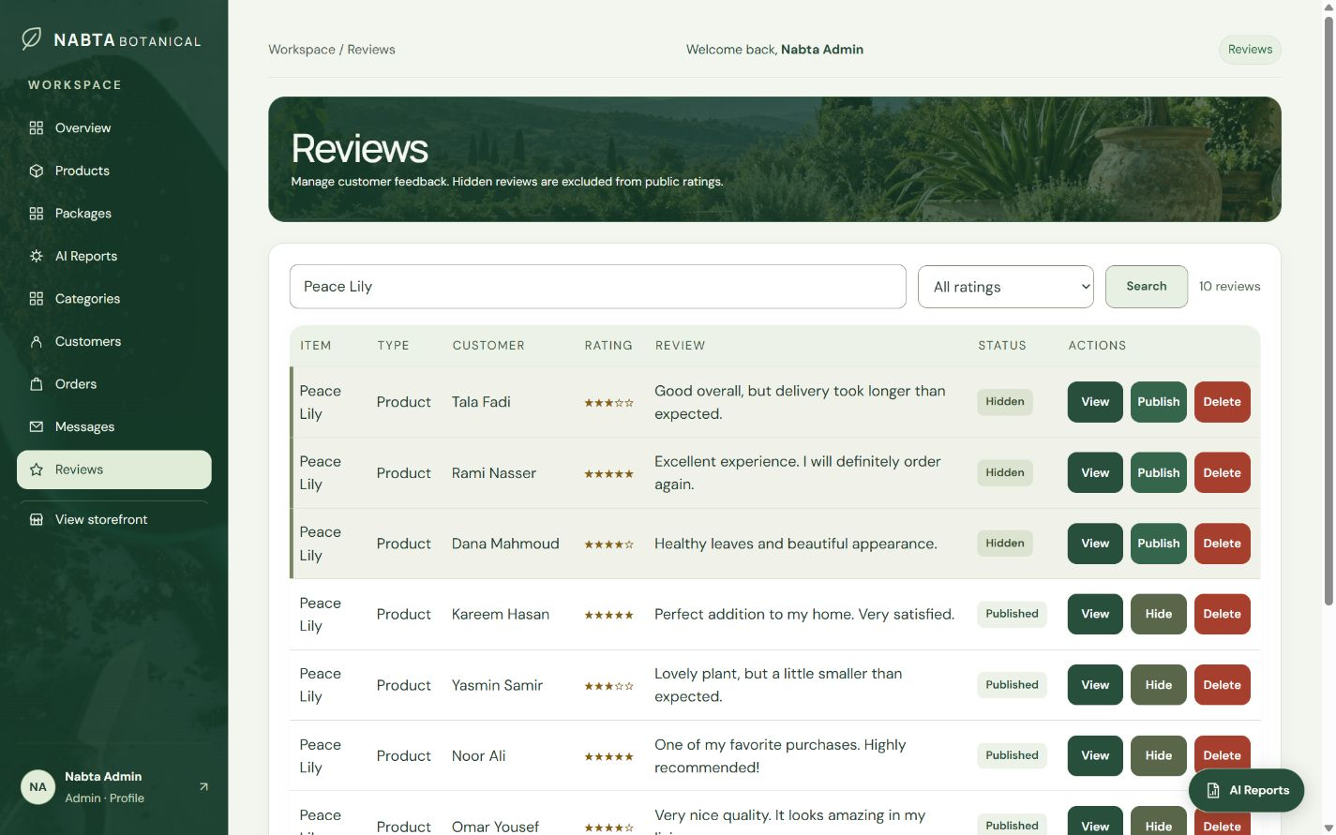
Customer feedback and communication
Review moderation
Search, rating filters and publish/hide controls
A visible status
Hidden feedback is clearly distinguished
Customer inbox
Contact and assistance requests, with resolution tracking
NABTA BOTANICAL
10 / 13 6:40–7:25
Notes:
Time: 6:40–7:25 (45 seconds)
The store includes customer review moderation and a customer-message inbox. In the review screen, an administrator can search for an item, customer or review and filter by rating. Each record shows the review text, score and publication status. Hide and Publish change whether that review appears publicly, and hidden rows receive a distinct visual style. Hidden reviews are excluded from the public ratings. The Messages page collects contact messages and account-access assistance requests, with a resolved or reopened workflow. An assistance request is only a message to the store: it does not prove account ownership or automatically reset a password.
Source: Actual local website screenshots captured on 2 November 2026. app/Views/admin/reviews.php; AdminReview model/controller; app/Views/admin/messages.php; public/admin/messages.php. Screenshot filters original Peace Lily reviews.

Slide 11
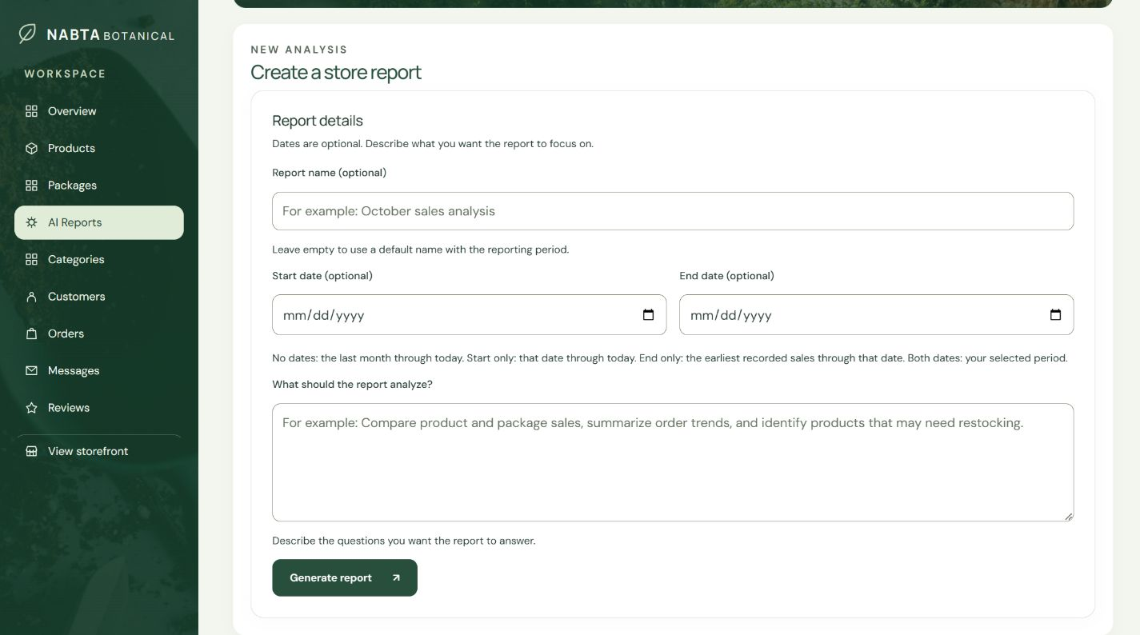
AI reports with flexible reporting periods
No dates
Last month through today
Start date only
Selected start through today
End date only
Earliest sales through selected end
Custom period, PDF export and report history
Failed generations are not saved
NABTA BOTANICAL
11 / 13 7:25–8:25
Notes:
Time: 7:25–8:25 (60 seconds)
AI reports turn the store’s recorded sales data into a written analysis based on the administrator’s question. A report name is optional; a default name uses the reporting period. Leaving both dates empty selects the last month through today. A start date alone runs through today, while an end date alone starts from the earliest recorded sales. Both dates select a custom period. The system calculates sales summaries before sending the data to Gemini. A complete report is saved in history and can be downloaded as a PDF. Connection failures, service errors, empty responses and incomplete reports are rejected before saving.
Source: Local Nabta implementation and actual screenshots captured on 2 November 2026. public/admin/ai_reports.php; app/Core/ReportPeriod.php; app/Core/AIReportResponse.php; app/Models/AIReport.php; app/Controllers/AIReportController.php.

Slide 12
Access controls and usability
Customer access
Admin access
Own account, saved favorites,
basket and order history
Catalog, stock, packages,
orders, reviews and reporting
Implemented safeguards
Password hashing, sessions, role checks, CSRF and input validation
Readable on smaller screens
Responsive layouts, focus-managed dialogs and compact previews
NABTA BOTANICAL
12 / 13 8:25–9:20
Notes:
Time: 8:25–9:20 (55 seconds)
The website separates what a customer can do from what an administrator can manage. Signed-in users access their own basket and account, while admin access checks restrict store-management pages. Passwords are stored using hashing rather than as readable password text. The application also uses session checks, CSRF tokens on state-changing forms and server-side validation. These are implemented safeguards, not a claim that the project has passed a full independent security audit. On the interface side, responsive layouts adapt to smaller screens, modal dialogs manage keyboard focus, and three-item previews keep long lists compact. These details support a clearer experience without hiding access to the complete information.
Source: Actual local website screenshots captured on 2 November 2026. app/Core/Security.php; app/Core/AdminAccess.php; app/Models/User.php; public/assets/js/ui.js; responsive styles and basket/checkout views.

Slide 13
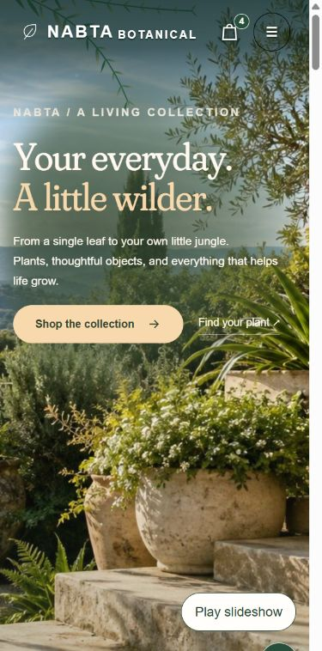
Technical foundation and current scope
Interface
HTML, CSS and JavaScript
Application
PHP controllers and models
Storage and services
MySQL / PDO, Cloudinary and Gemini
Session and role checks · Password hashing · CSRF
Next: delivery pricing, payment integration and approved policies
Responsive storefront
NABTA BOTANICAL
13 / 13 9:20–10:00
Notes:
Time: 9:20–10:00 (40 seconds)
The website uses HTML, CSS and JavaScript for its responsive interface, with PHP controllers and models connected to MySQL through PDO. Cloudinary stores product images, Gemini generates report text, and CommonMark with Dompdf supports report formatting and PDF export. Session checks, password hashing, CSRF protection and role checks support the application’s security. The project covers the customer journey and the admin workflow. Before a full commercial launch, delivery pricing, payment integration and approved store policies still need to be finalized. Thank you.
Source: Local Nabta implementation and actual screenshots captured on 2 November 2026. composer.json; app/Core/Database.php; app/Core/Security.php; app/Models/User.php; app/Core/CloudinaryUploader.php; config integrations; actual mobile home screenshot.

