Slide 1
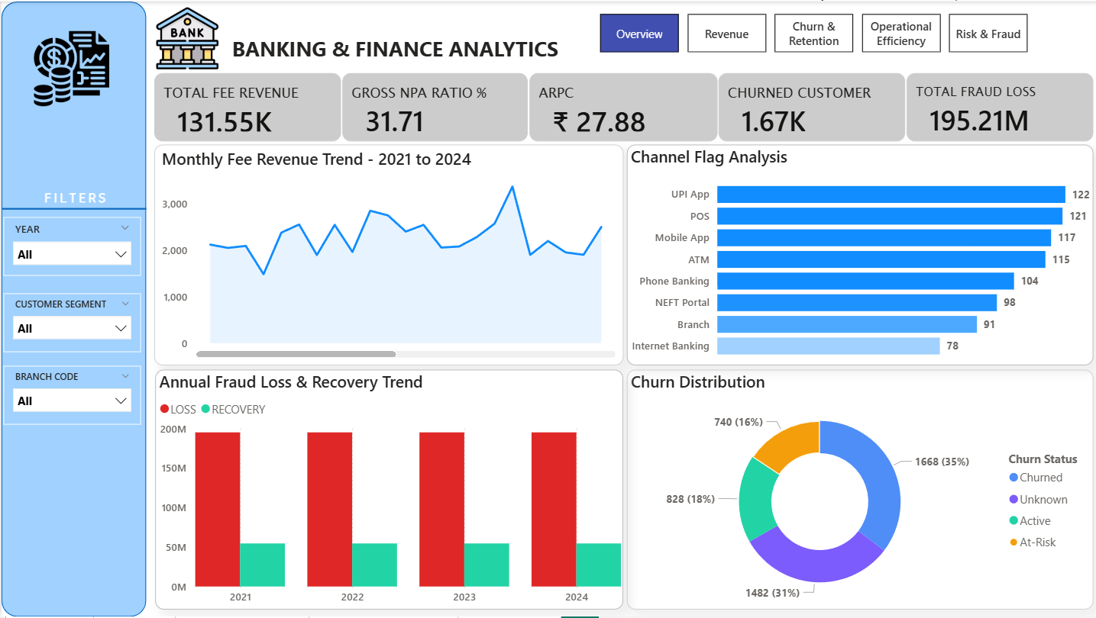
BANKING & FINANCE ANALYTICS DASHBOARD
Power BI End-to-End Data Analytics Project
Data Cleaning • Power Query • Data Modeling • DAX • Dashboard Design • Business Insights

Slide 2
1. Project Overview
Developed an interactive Banking & Finance Analytics Dashboard using Power BI.
Integrated customer, account, transaction, loan, and fraud datasets.
Performed data cleaning and transformation using Power Query.
Created KPI measures and business metrics using DAX.
Designed 5 analytical dashboard pages for executive decision-making.
Focused on Revenue, Churn, Operational Efficiency, and Fraud Analytics.

Slide 3
2. Data Collection & Data Cleaning
Imported multiple datasets: Customers, Accounts, Transactions, Loans, and Fraud Alerts.
Handled missing values using segment-wise median imputation.
Removed duplicate rows using Power Query transformations.
Standardized inconsistent categorical values.
Converted mixed date formats and numeric columns.
Handled invalid records, outliers, and placeholder values.
Key Cleaning Tasks Completed
5965 invalid dates corrected
5803 account status standardizations
250 duplicate transaction rows removed
Numeric conversion for balance and loan values
Fraud severity categories standardized

Slide 4
3. Data Modeling & DAX
Built relationships between all banking datasets.
Created a centralized Date Table for time intelligence analysis.
Developed DAX measures for KPIs and business calculations.
Implemented dynamic slicers for Year, Segment, and Branch filters.
Optimized model performance using calculated measures.
Sample KPIs
• Churn Rate %
• Total Fee Revenue
• Gross NPA Ratio
• Recovery Rate
• ARPC
• Fraud Loss Ratio

Slide 5
4. Overview Dashboard
Provides executive-level summary of banking performance.
Tracks revenue, NPA ratio, churn, fraud loss, and ARPC.
Monthly fee revenue trend helps identify business growth.
Channel flag analysis identifies risky transaction channels.

Slide 6
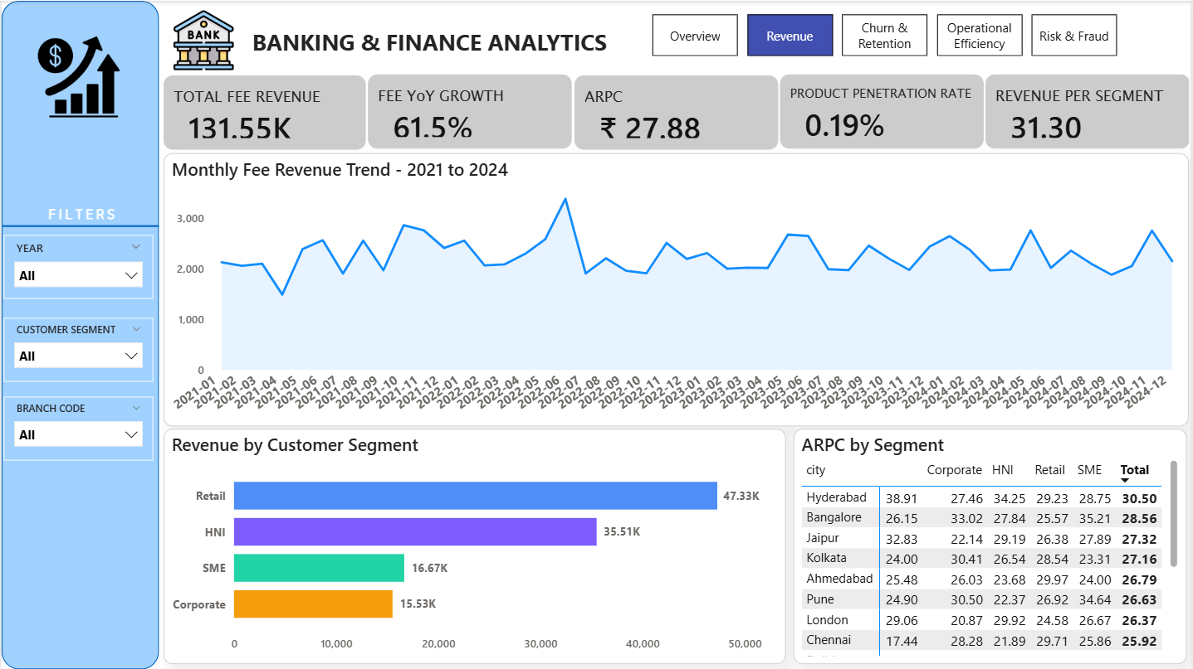
5. Revenue Analytics Dashboard
Analyzed fee revenue trend from 2021 to 2024.
Retail segment generated the highest revenue.
Calculated YoY growth and ARPC metrics.
Identified top-performing customer segments and cities.

Slide 7
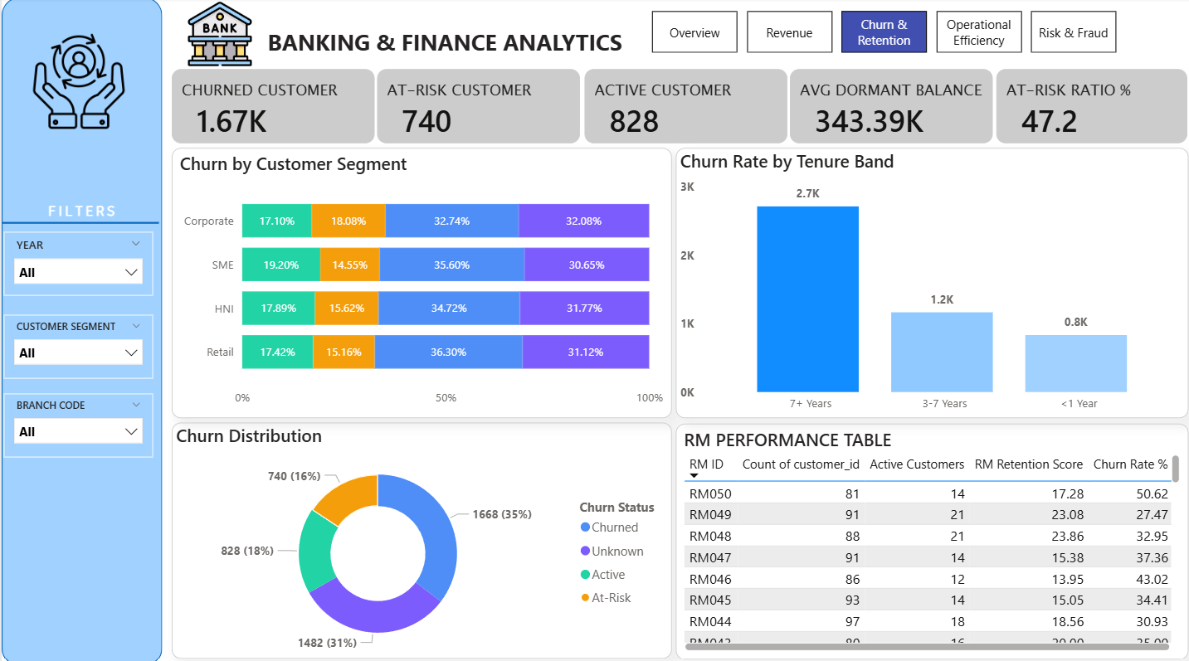
6. Churn & Retention Dashboard
Tracked churned, active, and at-risk customers.
Tenure analysis showed highest churn among long-term customers.
Dormant balance and RM performance were analyzed.
Segment-wise churn distribution supported retention strategies.

Slide 8
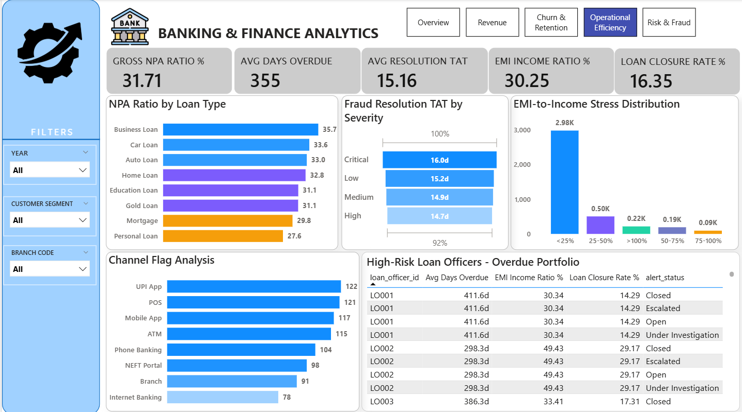
7. Operational Efficiency Dashboard
Measured Gross NPA Ratio and overdue loan metrics.
Analyzed EMI-to-Income stress distribution.
Fraud resolution turnaround time monitored by severity.
Identified high-risk loan officers and overdue portfolios.

Slide 9
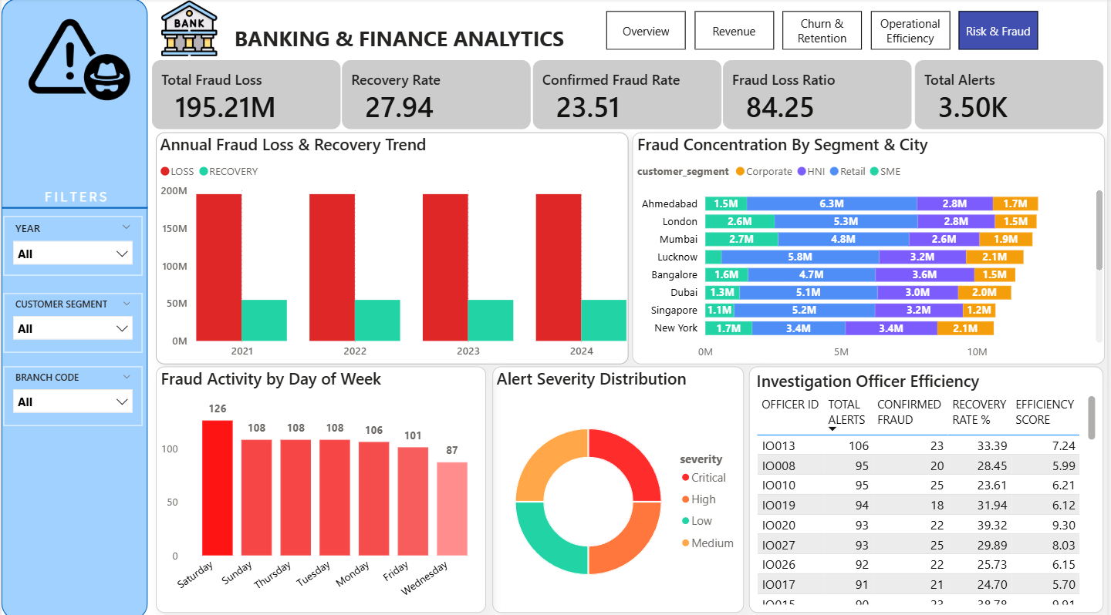
8. Risk & Fraud Dashboard
Monitored fraud loss and recovery trends.
Compared fraud concentration across customer segments.
Tracked alert severity distribution and fraud activity patterns.
Evaluated investigation officer efficiency and recovery rates.

Slide 10
9. Key Business Insights
Gross NPA Ratio reached 31.71%, indicating significant credit risk.
Retail customers contributed the highest fee revenue.
UPI and POS channels showed the highest fraud activity.
Churned customers exceeded active customers, indicating retention issues.
Critical fraud cases required longer resolution time.
Certain loan officers managed highly overdue portfolios.

Slide 11




Critical Alerts
Flags requiring executive attention
NPA Ratio at 31.7% - Regulatory Breach
Exceeds 5% RBI threshold by 6.3×. Business Loan (35.7%) and Car Loan (33.0%) are highest risk. Immediate portfolio review required.
Churn Rate 36.9% - Retention Crisis
1,846 customers churned. 740 At-Risk. Newer customers (<1yr) churn at 42.9% vs 36-37% for mature segments.
Fraud Recovery Rate 27.9%
₹195.2M in fraud losses since 2021. Only ₹51.4M recovered. Recovery declining - 29.4% in 2021 vs 28.1% in 2024.
Avg Overdue 355 Days - 527 Stressed Borrowers
13.2% of loan customers have EMI/Income ratio >50%. UPI App & Mobile App have highest transaction flag rates (>11%).

Slide 12
10. Challenges & Learning Outcomes
Handled mixed date formats and inconsistent data values.
Learned advanced Power Query transformation techniques.
Improved DAX calculation and KPI-building skills.
Enhanced dashboard storytelling and UI design abilities.
Gained experience in financial and banking analytics.

Slide 13
11. Conclusion
Successfully developed a complete Banking Analytics solution in Power BI.
Dashboard enables data-driven decision-making for banking operations.
Project demonstrates skills in Data Cleaning, Modeling, Visualization, and Business Analysis.
Future enhancement: Integrate machine learning-based churn and fraud prediction.
Thank You

