Slide 1
A Strategic Plan for Our Future
A data-driven story of discovery, risks, and opportunity
Presented by: Mohamed Qassem

Slide 2
Setting the Stage
Imagine seeing the invisible threads connecting sales, customers, and global markets.
This report tells that story — a story of discovery and action.

Slide 3
Our Mission
Use deep market insights to:
• Drive revenue growth
• Protect key customers
• Expand globally
• Align with sales rhythms

Slide 4
Problem #1 – Not Dancing with Our Sales Rhythm
• September to November peak, Dec dip
• Spring mini-peak
→ Are we aligned with this pattern?
→ Are we wasting resources?

Slide 5
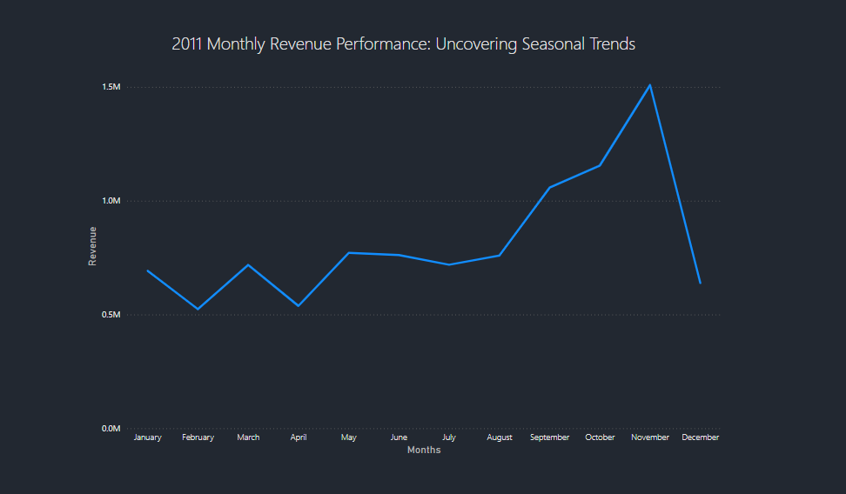
2011 Monthly Revenue

Slide 6
Solution #1 – Ride the Rhythm
• Align teams for September to November
• Launch summer promos
→ Goal: Boost peaks, smooth troughs

Slide 7
Problem #2 – Uneven Performance in Europe
• Netherlands leads
• Ireland matches their revenue
• Germany sells more units
• France earns more per unit
• Other countries underperform
→ Why can’t all perform like Netherlands?

Slide 8
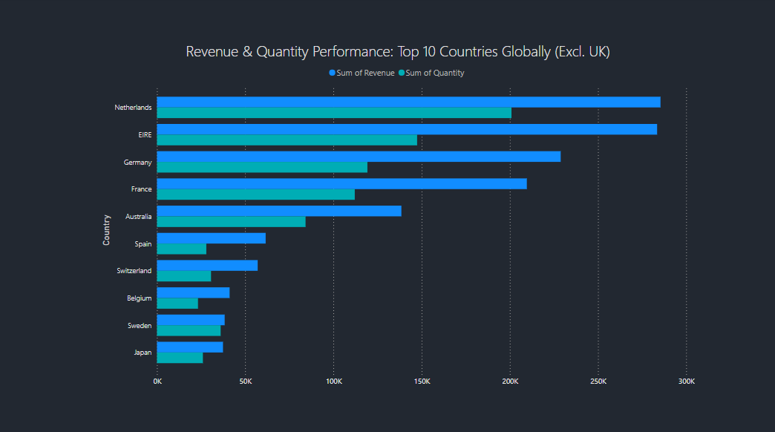
Revenue & Quantity Top Countries

Slide 9
Solution #2 – Replicate What Works
• Study Netherlands strategy
• Apply to Germany and France
• Adjust pricing/product mix in lower-value countries
→ Goal: Maximize value per sale

Slide 10
Problem #3 – One VIP, One Big Risk
• Customers ID-14646 & ID-18102 bring major revenue
• Heavy reliance on a few
→ What if one leaves?
→ Are we seeking similar customers?

Slide 11
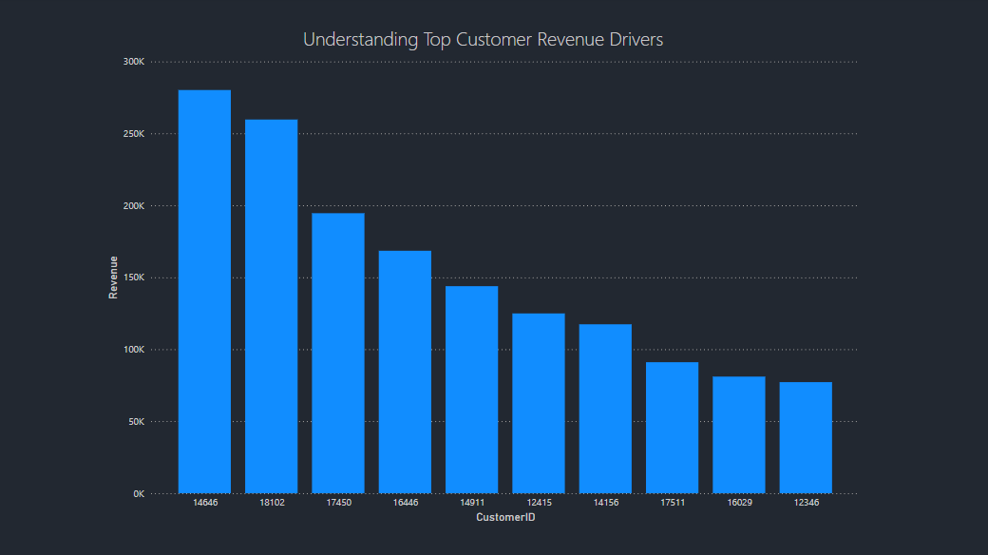
Understanding Top Customer

Slide 12
Solution #3 – Protect & Multiply
• VIP treatment for top customers
• Contingency plans
• Create look-alike profiles
→ Goal: Secure and expand top-tier base

Slide 13
Problem #4 – Untapped Global Goldmines
• Strong in Europe
• Weak in Africa, South America, and most of Asia
→ Missing major growth areas

Slide 14
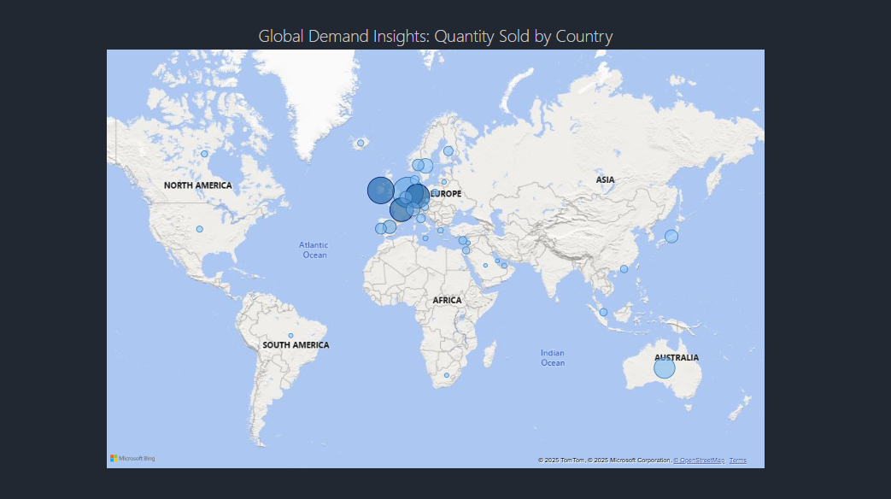
Quantity sold by Country

Slide 15
Solution #4 – Explore & Expand
• Research 2 white-space regions
• Understand local markets
• Build phased entry plan
→ Goal: Expand intelligently

Slide 16
The Transformation Path
If we act:
✅ Align with real sales demand
✅ Maximize our top-performing regions
✅ Protect and grow VIP relationships
✅ Tap into new global markets

Slide 17
Final Call to Action
We’ve seen the story.
Let’s write the next chapter:
Growth, resilience, global leadership.

