Slide 1
Diagnosis Prediction and Classification of Breast Cancer
Team Members:
Sameeh N O Kunbargi 150119693
Yunus Ahmed Stahlschmidt 150119814
Muhammed Fatih Öztel 150119907

Slide 2
Agenda
Project Overview
Tasks and Work division
Dataset
Algorithms
Results
References

Slide 3
Project Overview
Observe which features are most helpful in predicting malignant and benign breast cancer
Observe general trends which help in model and hyperparameter selection
Implement different models and compare them

Slide 4
Tasks & Work Division
Analysis of the dataset - joint task
PLA & Logistic Regression - Muhammed Öztel
SVM with Linear and RBF Kernel - Sameeh Kunbargi
Decision Tree and Random Forest Classifier - Yunus Stahlschmidt
Neural Network - joint task

Slide 5

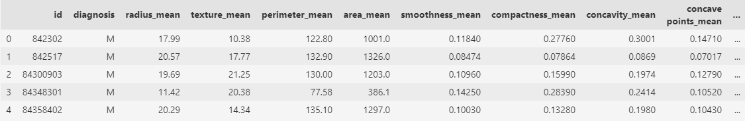
Dataset
Breast Cancer Wisconsin (Diagnostic) Data Set from UCI [1]
Created by Dr. William H. Wolberg
569 Instances and 32 Features/Attributes
80% for training, 20% for testing
Fig.1 Dataset Snapshot
[1]http://archive.ics.uci.edu/ml/datasets/breast+cancer+wisconsin+%28diagnostic%29

Slide 6
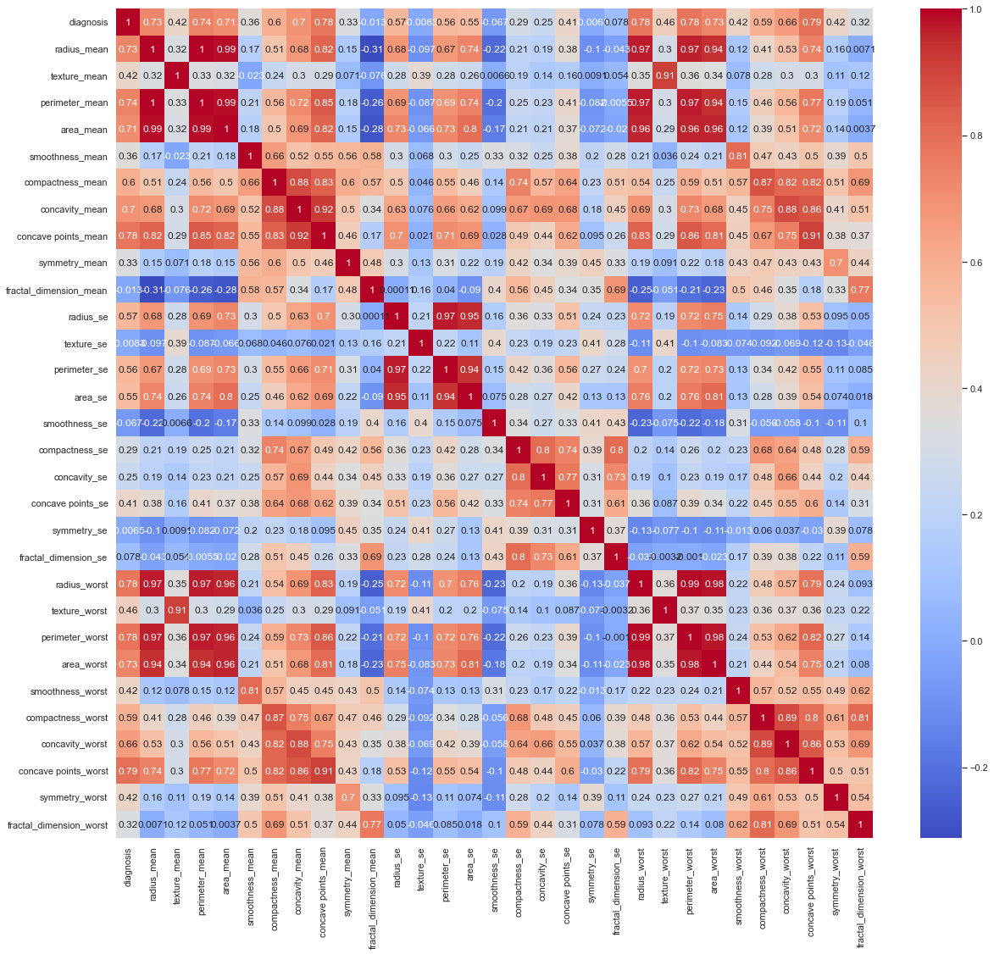
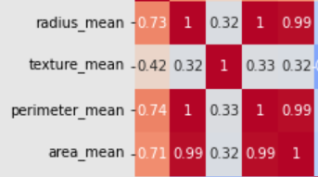
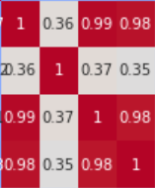
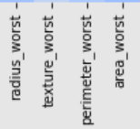
Attributes Correlation In The Dataset
Fig.2 Heat map of the features in the dataset

Slide 7
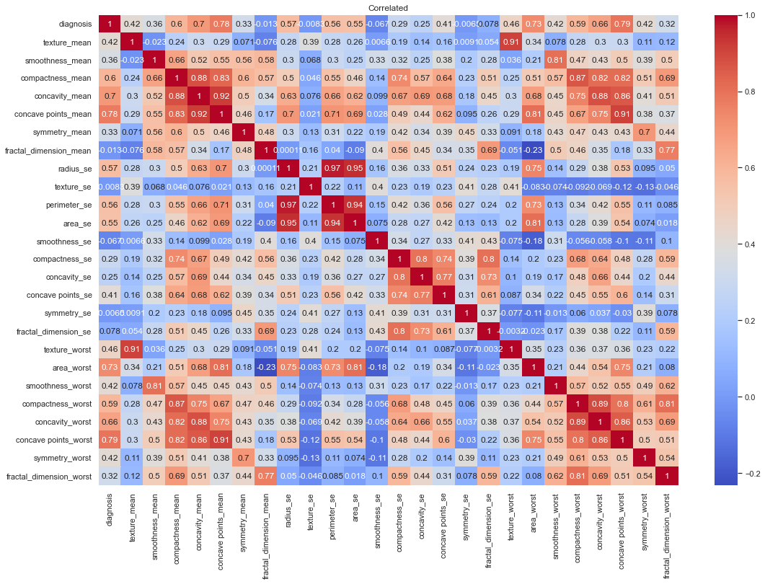
Attributes correlation in the Dataset
radius_mean
perimeter_mean
area_mean
radius_worst
perimeter_worst
Fig.3 Heat map after deletion of highly correlated features

Slide 8
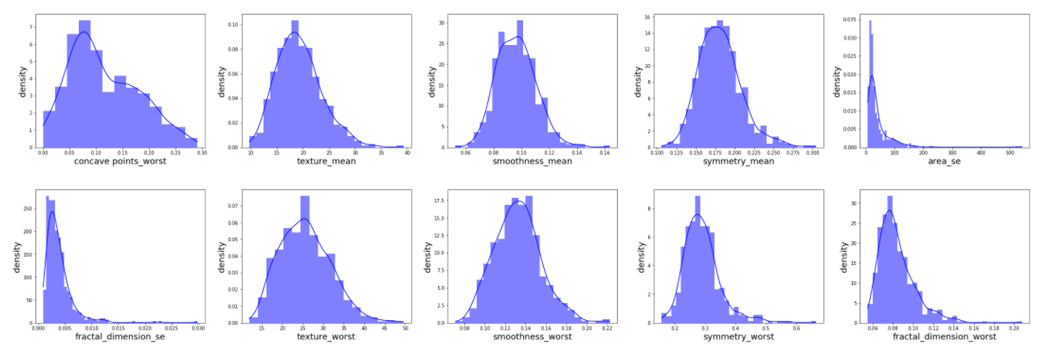
Feature Selection Process

Slide 9
Algorithms
PLA
Logistic regression
SVM - Linear Kernel
RBF Kernel
Decision Tree
Random Forest
NN

Slide 10
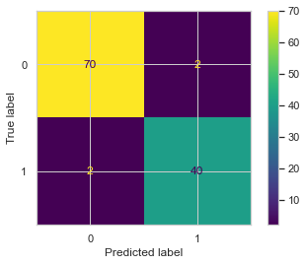
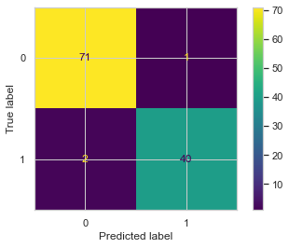
PLA & Logistic Regression
PLA
Logistic Regression
Fig.4 PLA Confusion matrix
Fig.5 Logistic Regression Confusion matrix

Slide 11
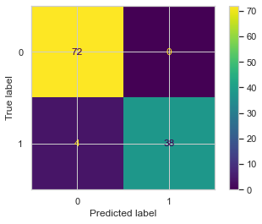

SVM - Linear & RBF Kernel
Linear Kernel
RBF Kernel
Fig.6 Linear SVM Confusion matrix
Fig.7 RBF Kernel SVM Confusion matrix

Slide 12

Decision Tree & Random Forest
Decision Tree
Random Forest
Fig.8 Decision Tree Confusion matrix
Fig.9 Random Forest Confusion matrix

Slide 13
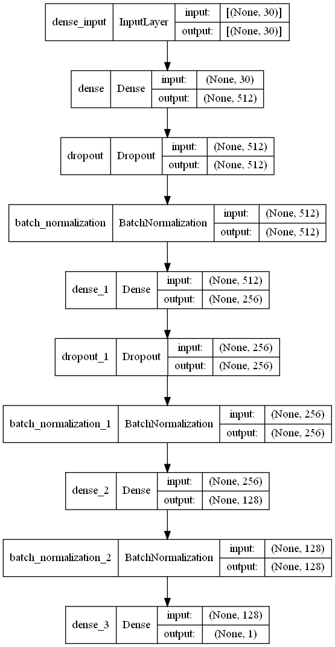
Neural Network
4 hidden layers
182k trainable parameters
16 epochs
First 3 layers - ReLU
Final layer - Sigmoid
Batch Normalization & Dropout
99.12% test
Fig.10 Neural Network Model Representations

Slide 14
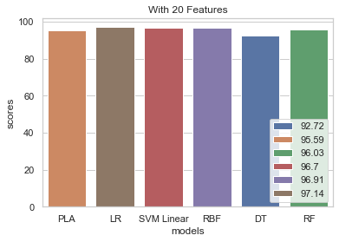
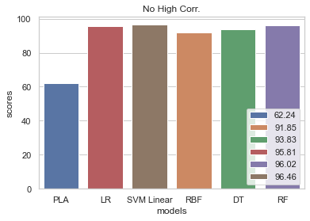
Results
Fig.11 Histogram of the algorithms score with the raw dataset
Fig.12 Histogram of the algorithms score with the no high correlation features

Slide 15
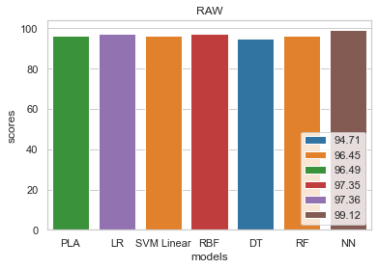
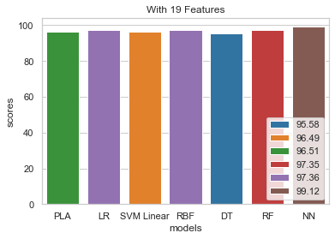
Results
Fig.13 Histogram of the algorithms score with the raw dataset
Fig.14 Histogram of the algorithms score with the only 19 features

Slide 16
Summary
Analysed the dataset
Extracted not important features
Tested with different classifier algorithms
Developed a NN and tested

Slide 17
References
[1] Dataset
http://archive.ics.uci.edu/ml/datasets/breast+cancer+wisconsin+%28diagnostic%29
[2] https://towardsdatascience.com/building-a-simple-machine-learning-model-on-breast-cancer-data-eca4b3b99fa3
[3] https://towardsdatascience.com/deep-learning-in-winonsin-breast-cancer-diagnosis-6bab13838abd
[4] https://www.kaggle.com/subhankar007/breast-cancer-accuracy-98-3#RANDOM-FOREST

