Slide 1
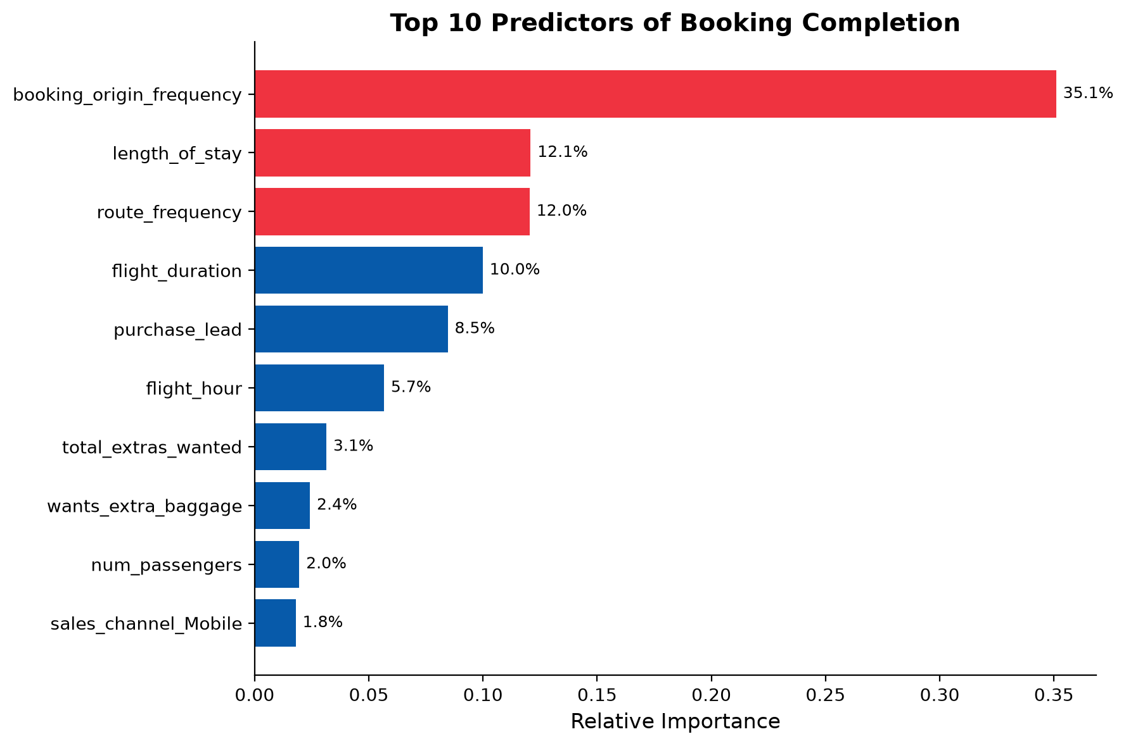
Predicting Customer Booking Completion
Random Forest model — identifying customers likely to complete a booking, before departure
Model Performance
ROC-AUC: 0.77
Model distinguishes bookers from non-bookers well above chance (0.50)
Recall: 72%
Of customers who go on to book, the model correctly flags most of them
Precision: 29%
Of those flagged, about 3 in 10 actually book — expected given bookings are rare (15% of all customers)
Recommendation
Booking origin, route popularity, and trip length are the strongest predictors of booking completion. These signals can power a proactive targeting model — flagging high-likelihood customers for outreach before they reach the airport, rather than reacting after the fact.

