Slide 1
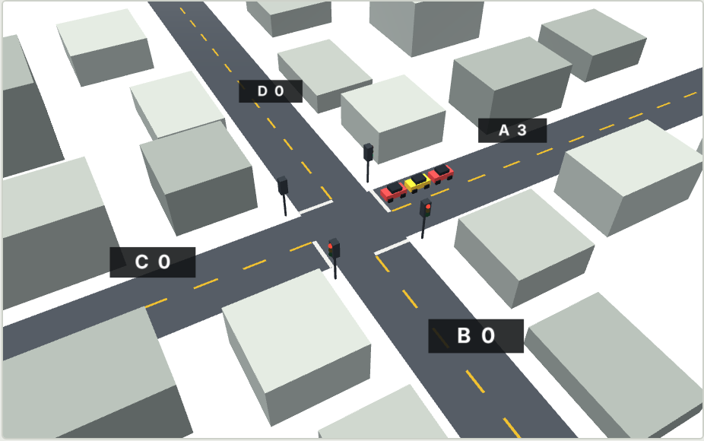
Smart Traffic
ADAPTIVE SIGNAL CONTROL PROTOTYPE
Signals that follow the queue
Live 3D view of the adaptive controller
A browser simulation that compares a fixed timer with an adaptive controller on the same traffic.
Notes:
Smart Traffic is a prototype of an adaptive traffic signal controller. It runs in a web browser and compares two controllers on exactly the same random traffic: a fixed timer, and an adaptive controller that reads the queue on each road. The 3D scene on the right is the live adaptive junction.

Slide 2
Fixed timers waste green time
A fixed timer gives each road the same green, in the same order, all day. It cannot see the queue, so an empty road gets a full turn while a busy road backs up.
63 h
lost to congestion by the average US commuter in 2024, the highest on record
Example: same green, very different queues
Road A
Road B
Road C
Road D
$269B
25 s green
25 s green
25 s green
25 s green
14 cars waiting
1 car waiting
0 cars waiting
6 cars waiting
national cost of congestion in 2024
Source: Texas A&M Transportation Institute, Urban Mobility Report (2025 release, 2024 data).
Notes:
Most signals today run fixed plans. Each road gets the same green in a fixed order, whether or not anyone is waiting. The four boxes show the problem: road A has a long queue and road C is empty, yet both get 25 seconds. The national figures give context for why wasted time matters: the Texas A&M Urban Mobility Report put lost time at 63 hours per commuter in 2024 and the national cost at 269 billion dollars. These are real-world figures, not results from this simulation.

Slide 3


The idea: follow the queue
Fixed timer
Adaptive controller
Same 25 s green on every road
Counts cars waiting on each road
Order never changes
Gives green to the highest score
Ignores the queue
Green length follows the queue
Ambulance waits its turn
Clears the way for ambulances
Same cars, same junction. Only the signal logic differs.
Notes:
The core idea is simple: green time should follow the queue. The fixed timer repeats the same plan. The adaptive controller counts cars waiting on each road after every clearance interval and gives green to the road that needs it most, for as long as its queue justifies. Both controllers see the identical stream of random cars, so any difference in waiting time comes from the signal logic alone.

Slide 4
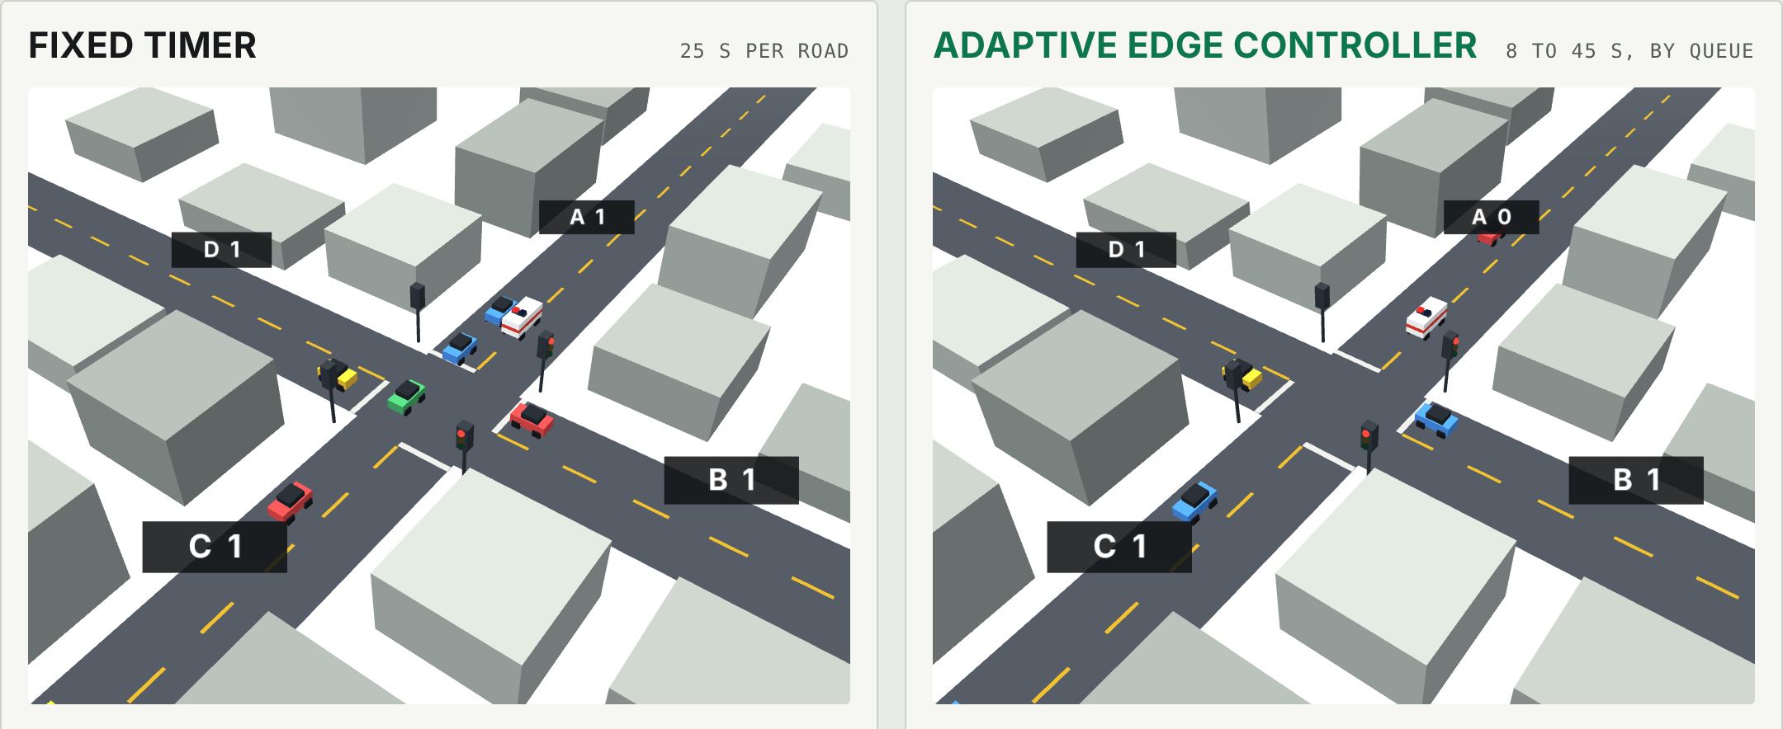
The prototype at a glance
One junction: roads A (north), B (east), C (south), D (west). The number on each road is its queue.
Notes:
This is the simulator. On the left is the fixed timer, on the right the adaptive controller. Roads are A north, B east, C south and D west, and the number on each road is its queue length. Cars arrive at random at rates you set with sliders, and the same cars arrive at both junctions. You can drag the 3D scene to rotate it, or switch to a top-down view.

Slide 5





Five rules decide every green
Clear
Score
Size
End early
Give way
All red for 4 s so cars inside can leave.
Queue plus 0.2 × seconds since last green.
2 s per queued car plus 4 s, held to 8 to 45 s.
If the queue empties after 5 s, move on.
An ambulance gets green after a clearance.
Worked example
Road A: 10 cars, 12 s since green, score 12.4. Road D: 4 cars, 40 s since green, score 12.0. A goes first with 24 s of green, and D is close behind.
Notes:
After each green ends, the controller runs the same loop. First, everything goes red for four seconds. Second, each other road gets a score: its queue length plus 0.2 times the seconds since it last had green. The second term stops small roads from starving. Third, the winner gets two seconds of green per queued car plus four seconds, held between 8 and 45. Fourth, if the queue empties after five seconds the green ends early. Fifth, an ambulance overrides the order. In the example, road A scores 12.4 and road D scores 12.0, so A goes first, but D is not far behind.

Slide 6
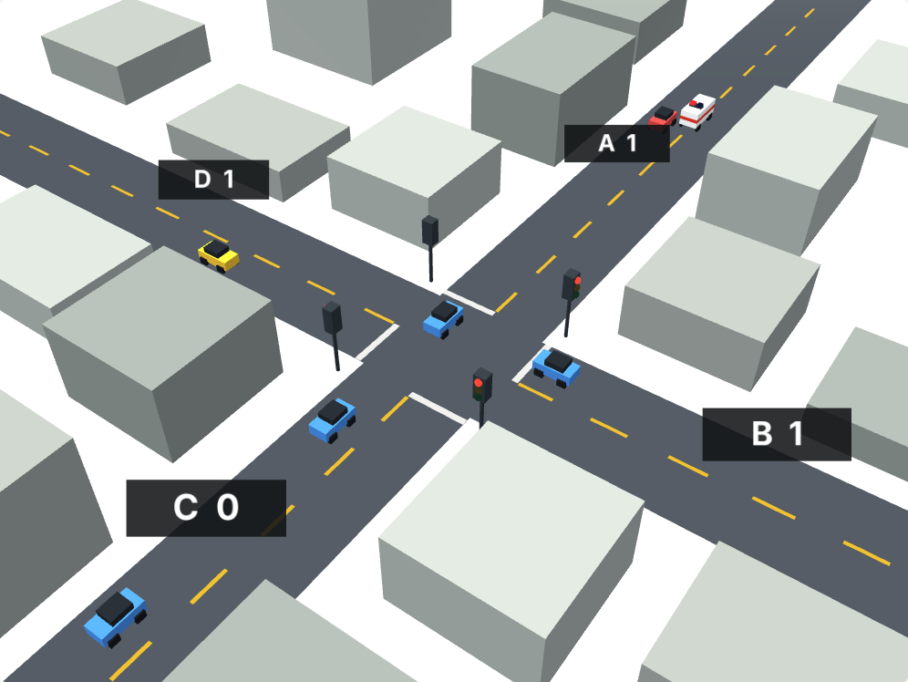
Ambulance priority
1
Detect which road the ambulance is on
2
End conflicting greens, after at least 5 s
3
Hold all red for 4 s to clear the junction
4
Give the ambulance's road 30 s of green and release it once it passes
The ambulance (white, red stripe) joins road A's queue.
Notes:
Emergency vehicles are handled as an override. When an ambulance is detected on a road, conflicting greens end after at least five seconds, the junction clears, and the ambulance's road gets green for up to thirty seconds. The simulator shows the ambulance's delay in each panel. The fixed timer has no override, so the ambulance simply waits for its road's turn.

Slide 7



Edge decides, cloud learns
ON THE ROAD
AT THE JUNCTION
IN THE CLOUD (PLANNED)
Sensing
Edge controller
Learning
Queue length on each approach
Time since each road had green
Emergency vehicle detection
Runs the five rules
Switches the signal heads
Keeps working if the network drops
Learns demand by hour and weekday
Pushes tuned parameters to each edge
Compares junctions along a corridor
Queue counts flow left to right. Tuned parameters flow back to the edge.
Notes:
The design splits the work. Sensors report queue lengths and detect emergency vehicles. The edge controller at the junction makes every signal decision on its own, so it keeps working if the network drops. A cloud layer is planned to learn demand patterns by hour and weekday and push tuned parameters back to each junction. The cloud layer is a design only; it is not part of the current prototype.

Slide 8






What you can test
Traffic sliders
3D and top-down
Rush and ambulance
Set arrival rates per road, or pick a preset.
Drag the 3D scene to rotate it.
Add 15 cars to road A or send an ambulance.
Run a day
Fixed timer control
Repeat trials
Morning and evening peaks with a live clock.
Set its green length, or let it tune itself.
Run 20 fresh simulations and see the spread.
Notes:
The prototype is meant to be explored. You can change traffic per road, rotate the 3D view, trigger a rush or an ambulance, run a full day with peaks, change the fixed timer, and run repeated trials. The trials matter because a single run is random and can flatter either controller.

Slide 9
Results from 100 runs
37%
less waiting than the best tuned fixed plan (24 s against 38 s)
100 of 100
runs where adaptive had the lower average wait
Simulation, not field data. 30-minute runs, 100 per comparison, default traffic (A 0.16, B 0.03, C 0.02, D 0.10 cars per second). Tuned split: greens of 43, 8, 8 and 27 s.
Notes:
These numbers come from running the prototype's own simulation 100 times for each comparison, with 30 simulated minutes per run. A fixed timer with equal 25 second greens averaged 211 seconds of waiting per vehicle. Even the best equal green, 40 seconds, averaged 183. A fairer baseline is a fixed plan with longer greens on the busier roads, which the benchmark found at 43, 8, 8 and 27 seconds. That brought the fixed timer to 38 seconds. The adaptive controller averaged about 24 seconds, roughly 37 percent less than the tuned fixed plan, and had the lower wait in all 100 runs. This is a simulation with one set of traffic rates, so real junctions will differ.

Slide 10
Limits and next steps
What this prototype is not
NOW
Simulator and benchmark
A simulation of one junction, not field data
Assumes sensors give queue counts per road
Cloud learning is a design, not built
NEXT
Pilot at one real junction with sensor counts
LATER
Corridor coordination and cloud learning
Green time should follow the queue.
Notes:
To be clear about limits: this is a simulation of a single junction, it assumes queue counts per road are available from sensors, and the cloud layer is a design. The next step is a pilot at one real junction using sensor counts, then coordination along a corridor and cloud learning. The idea to leave the audience with: green time should follow the queue.

