Slide 1

AI Based Gas and Water Safety Detection System
Using ESP8266 and Machine Learning for Intelligent Hazard Detection
Student Project | Embedded Systems and AI Integration

Slide 2

The Safety Challenge
Why Detection Matters
Intelligent Solution
This project addresses these challenges through machine learning algorithms that adapt to environmental patterns, significantly reducing false positives whilst maintaining high detection sensitivity.
Gas and water leaks pose serious threats to property and human life. Gas leaks can lead to explosions, poisoning, and fire hazards, whilst water leaks cause structural damage, mould growth, and costly repairs.
By combining multiple sensor inputs with predictive analytics, the system provides early warnings before conditions reach dangerous levels.
Traditional detection systems rely on fixed thresholds, generating frequent false alarms that desensitise occupants and reduce trust in the system.

Slide 3

Project Objectives
Real-Time Monitoring
Intelligent Classification
Continuous sensing of gas concentration and water presence using calibrated sensors
Machine learning model to classify conditions into safe, warning, and danger states
Visual and Audible Alerts
Remote Data Access
LED indicators and buzzer to provide immediate feedback on detected hazards
ESP8266 enables wireless transmission to local AI server for processing and logging

Slide 4
System Components
ESP8266 Microcontroller
MQ Series Gas Sensor
Wi-Fi enabled processor that reads sensor data and transmits to server
Detects LPG, methane, smoke, and combustible gases through resistance changes
Water Leak Sensor
LED Indicators
Conductivity-based detection of water presence on surfaces
Green LED for safe conditions, red LED for warnings and danger states
Buzzer Alarm
Local AI Server
Audio alert activated during warning and danger classifications
Flask-based server running machine learning model for classification

Slide 5
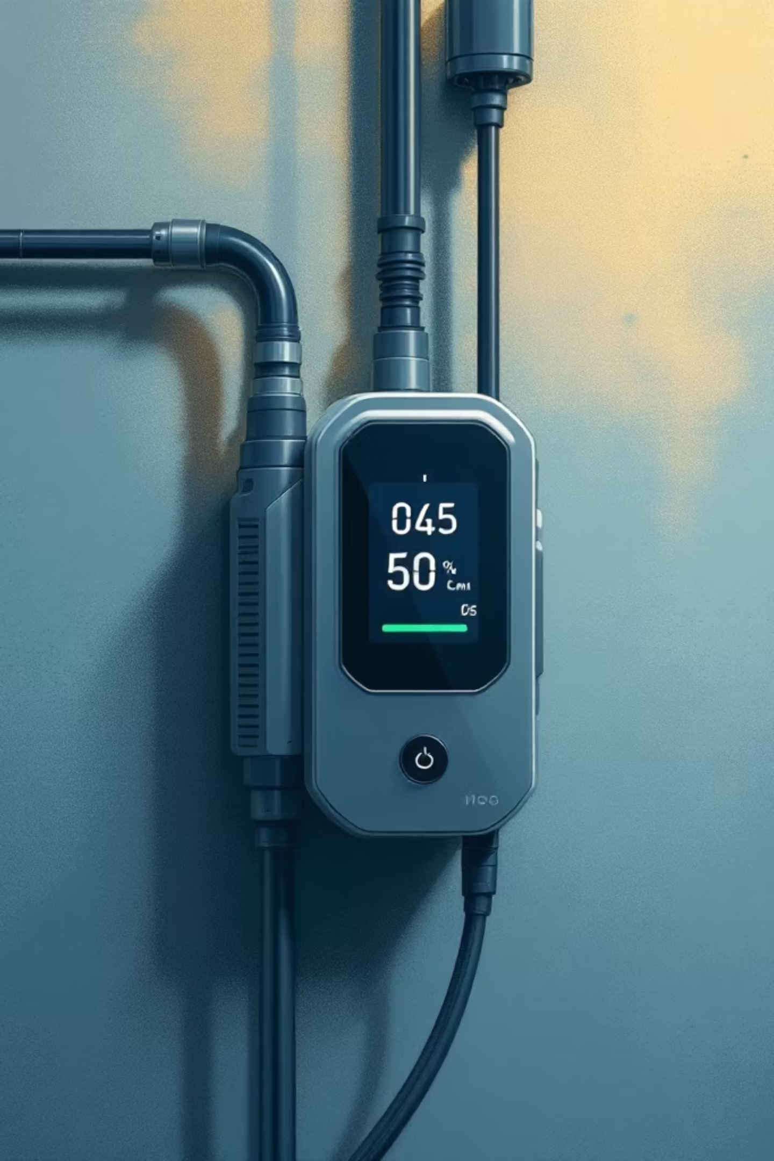
Sensor Operation Principles
MQ Gas Sensor
Water Leak Sensor
MQ series sensors utilise tin dioxide (SnO₂) semiconductor material whose resistance decreases when exposed to reducing gases. The sensor heats to 200-300°C, causing oxygen ions on the surface to react with gas molecules.
Digital sensor detects water presence through conductivity between exposed copper traces. When water bridges the contacts, circuit resistance drops significantly.
Logic high output sent through digital pin D5 triggers immediate processing. Sensor requires regular cleaning to prevent false readings from debris accumulation.
Output voltage proportional to gas concentration is read through analogue pin A0. Calibration accounts for temperature and humidity variations.

Slide 6
Circuit Connections
1
2
Gas Sensor → A0
Water Sensor → D5
Analogue pin reads voltage from MQ sensor, converting gas concentration to 0-1023 digital value
Digital pin receives binary signal indicating water presence or absence
3
4
Green LED → D6
Red LED → D7
GPIO pin drives green LED when system detects safe conditions
GPIO pin activates red LED during warning or danger states
5
6
Buzzer → D8
Common Ground
Digital output triggers audible alarm during elevated hazard levels
All components share ground connection to ESP8266 for consistent reference voltage

Slide 7




Why Machine Learning?
Fixed Threshold Problems
Environmental variations cause false alarms
Pattern Recognition
ML identifies complex relationships between inputs
Adaptive Detection
Reduces false positives whilst maintaining sensitivity
Traditional systems use single-value thresholds that cannot account for correlated sensor behaviour or gradual changes. Machine learning models process multiple input dimensions simultaneously, learning normal versus abnormal patterns through supervised training.

Slide 8

Machine Learning Architecture
Supervised Classification
Random Forest Classifier
Ensemble method combining multiple decision trees provides robust performance with noisy sensor data. Advantages include:
Training dataset labelled with expert classifications enables model to learn decision boundaries between safe, warning, and danger states.
Handles non-linear relationships
Resistant to overfitting
Provides feature importance metrics
Fast prediction suitable for real-time use
Three-Class Output
Safe: All readings within normal range
Warning: Elevated levels requiring attention
Danger: Immediate hazard requiring action

Slide 9

AI System Workflow
Sensor Data Acquisition
ESP8266 continuously reads gas concentration and water presence values at regular intervals
Data Transmission via Wi-Fi
HTTP POST request sends JSON-formatted readings to local Flask server
Feature Engineering
Server calculates derived features: gas increase rate, duration of abnormal readings, trend analysis
ML Model Prediction
Random Forest classifier processes features and outputs safety classification
Alert Activation
GPIO pins update LED states and buzzer based on predicted class

Slide 10

Dataset and Features
Input Features
Training Methodology
Gas sensor value (0-1023)
Water sensor binary state
Gas increase rate (samples/sec)
Duration of abnormal reading
Temperature compensation value
Time since last alarm
Dataset generated through controlled testing with simulated leak scenarios. Labels assigned based on safety thresholds.
Model Validation: K-fold cross-validation ensures generalisation to unseen data. Confusion matrix analysis identifies misclassification patterns.
Performance Metrics: Accuracy, precision, recall, and F1-score calculated for each class.

