Slide 1
Analysis of Electric Production of the Wind Turbine
CSE4062 2020 Spring Project
Group 8
Furkan Can Ercan Industrial En. 150316044
Muhammed Avcı Mechanical En. 150414007
Yasin Gök Computer En. 150115058

Slide 2
Project Scope
In this project we basically aim to generate an appropriate prediction model for our dataset by using regression algorithms.
We followed the steps below:
-Exploratory Data Analysis
-Predictive Analysis
a)Feature Selection
b)Experimenting with different Models
-Cluster Analysis
-Using project management methods
- Conclusion

Slide 3
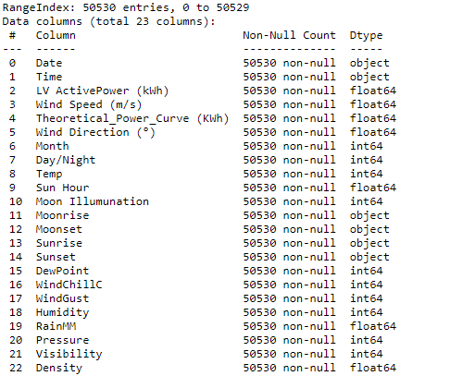
Story of Our Dataset
Dataset about a Wind Turbine Located in Yalova
Represents electric production of the Wind Turbine
Includes measurements per every 10 minutes between 01.01.2018-00:00 to
31.12.2018 -23:50
For better analysis we merged this dataset with weather conditions data to obtain our final dataset

Slide 4
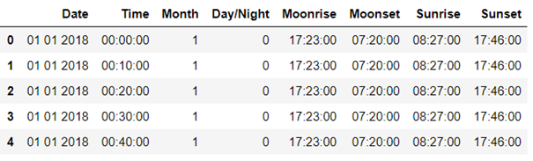
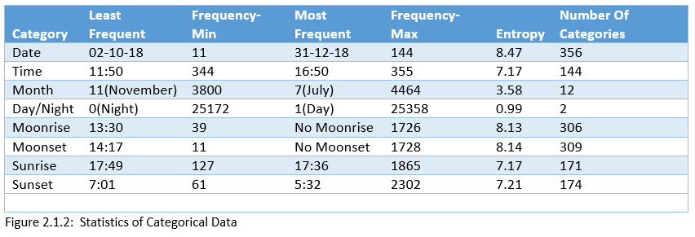
Exploratory Data Analysis
Analysis of Categorical Features
We have 8 non-numeric features.
We consider 4 of them as categories.
Date-Time-Month-Day/Night

Slide 5
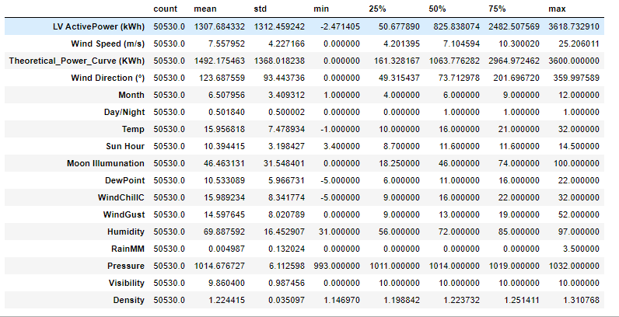
Exploratory Data Analysis
Analysis of Numerical Features
We have 14 numerical features.
LV ActivePower is our target feature.
We will examine its relations with other features

Slide 6
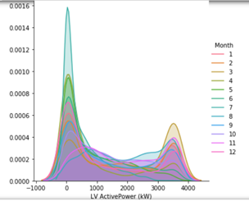
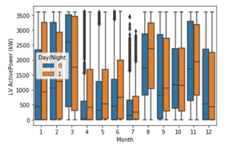
Exploratory Data Analysis
Distribution of our target variable by months
2 peak points
Different scales on different months
Outliers on some months
Because of 0s

Slide 7
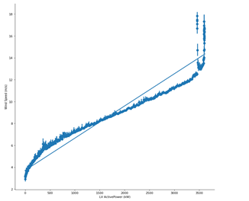
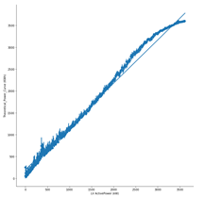
Exploratory Data Analysis
Some important correlations between our target feature and other features.
LV ActivePower-Wind Speed
LV Active Power-Theoretical Power Curve

Slide 8
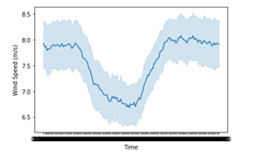
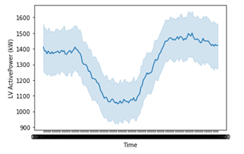
Exploratory Data Analysis
The similarity of the timeline charts below, shows Wind Speed- LV Active power relations
Wind Speed-Time
LV Active Power - Time

Slide 9
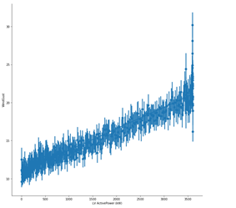
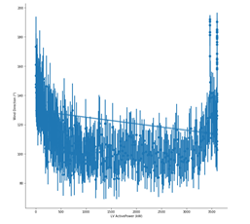
Exploratory Data Analysis
LV ActivePower - Wind Gust
LV Active Power –Wind Direction

Slide 10
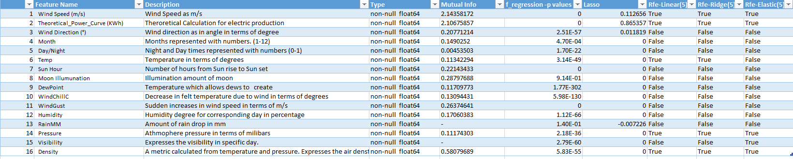
Predictive Analysis
As Feature selection methods we used:
-Mutual Info (MI)
-T-Test
-Recursive Feature Elimination(RFE)
-Lasso Regression

Slide 11
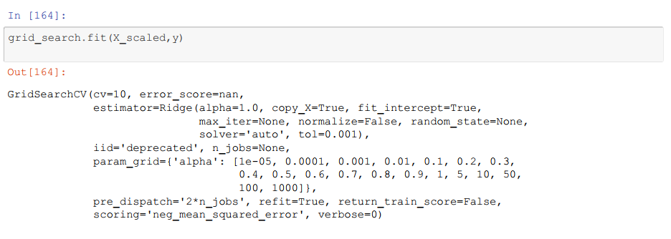
Predictive Analysis
Hyperparameter Tuning
To find best parameters to use on Ridge Regression(alpha), Elastic Regression(alpha,l1-l2ratio).
Without tuning parameters Ridge and Elastic Regression performed poorly.

Slide 12
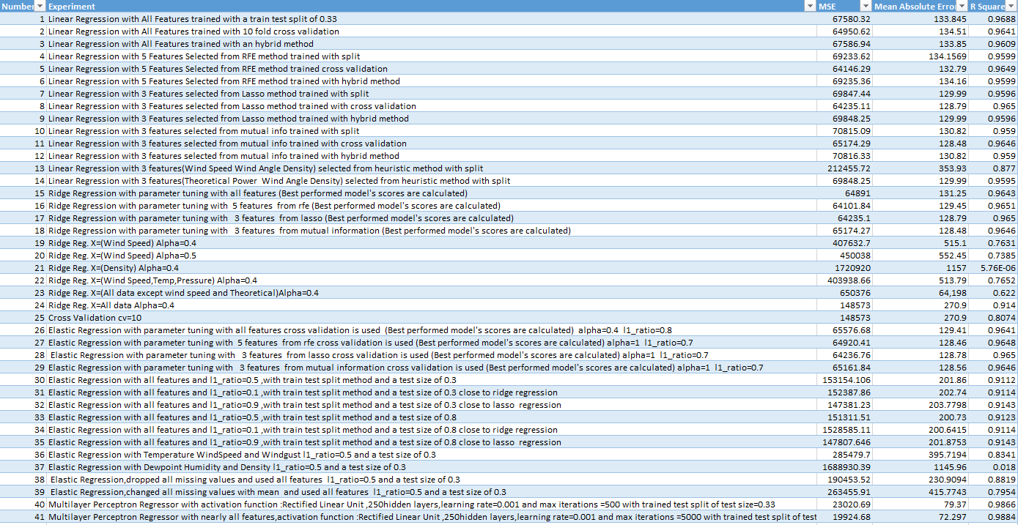
Predictive Analysis
We made experiments with 4 different algorithms:
-Linear Regression
-Ridge Regression
- Elastic Regression
- Multilayer Perceptron (MLP)

Slide 13
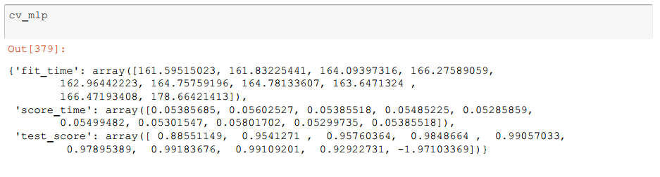
Predictive Analysis
In our experiments our best performing model was Multilayer Perceptron. Here is an example of MLP with 250 hidden layers and 500 iterations. It took about 2-2.5 minutes for a model to finish. Comparing with Regression models, they took only a few seconds.

Slide 14
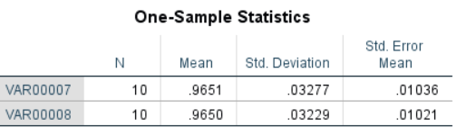
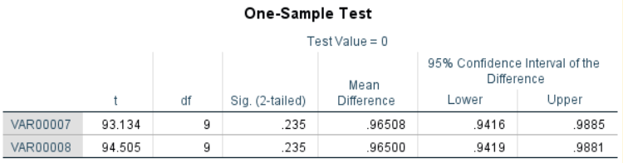
Predictive Analysis
Excluding Multilayer Perceptron 2 of our best perfoming models was:
Linear Regression with 3 Features selected from Lasso method trained with cross validation
Ridge Regression with parameter tuning with 5 features from RFE (Best performed model's scores are calculated)
In the end we obtained a p-value of 0.231 from our t-test. Our confidence interval was 0.95

Slide 15
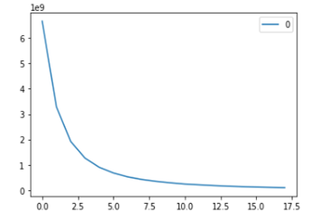
Cluster Analysis
We used K-means algorithm as our clustering method.
We determined our K values according to elbow method

Slide 16
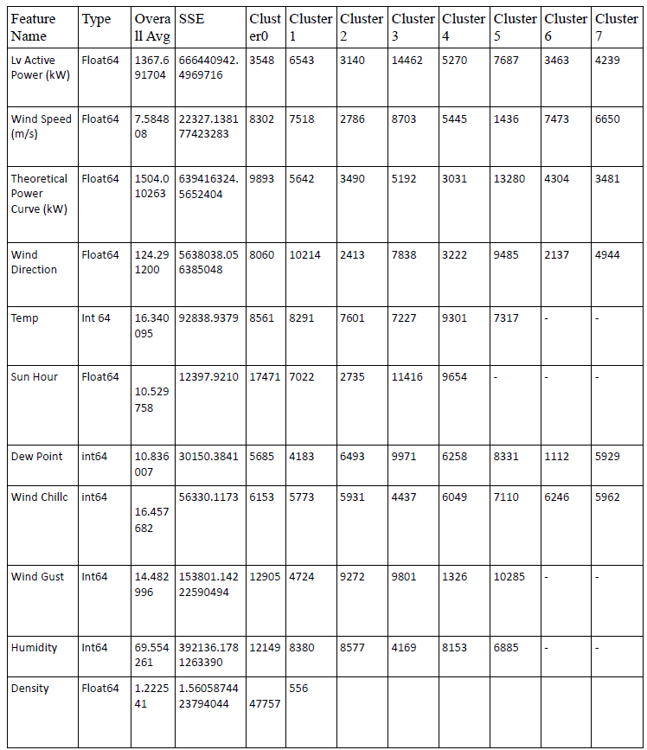
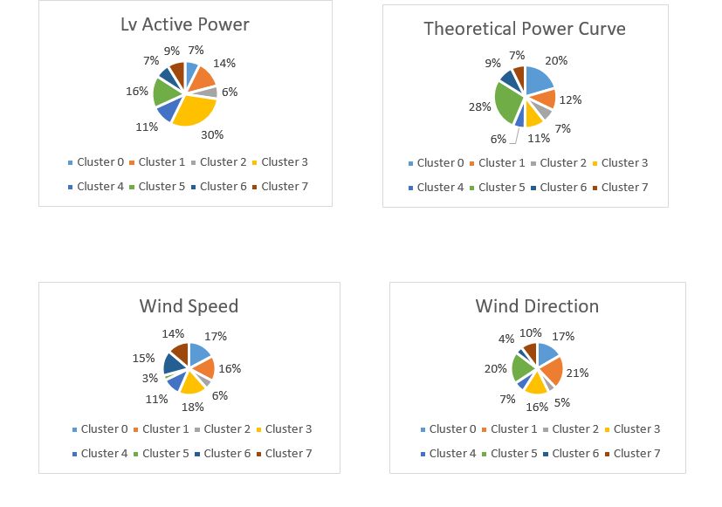
Cluster Analysis
Cluster Analysis of our main features.

Slide 17
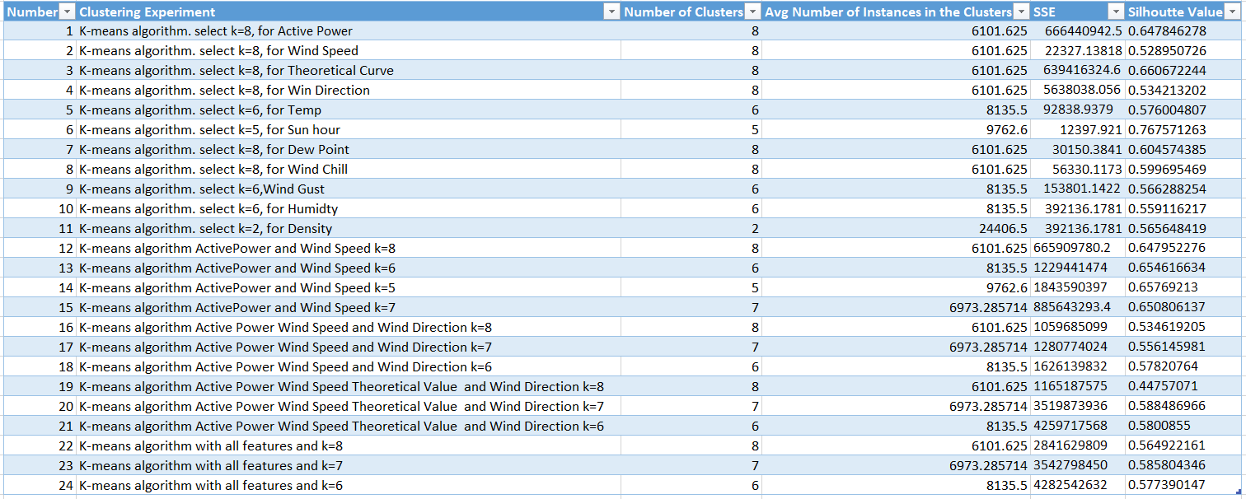
Cluster Analysis
To find the balance between Silhouette Value and Sum of Squared Error metric we experimented with different K values and features

Slide 18
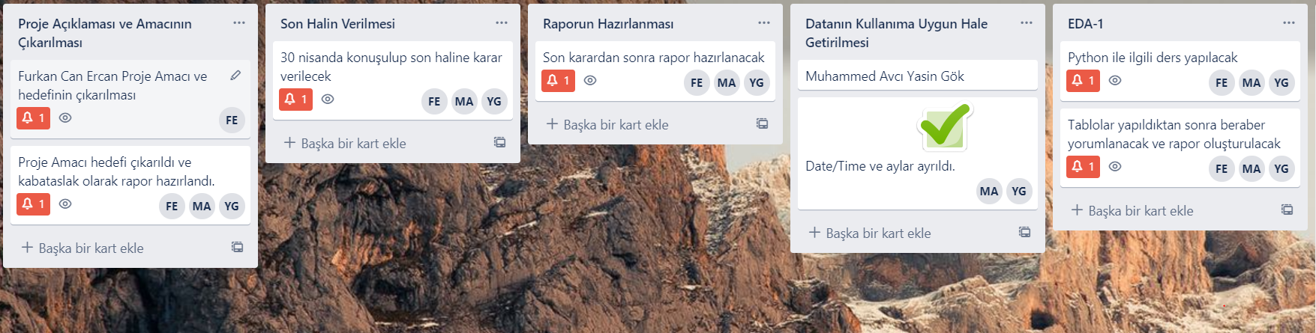
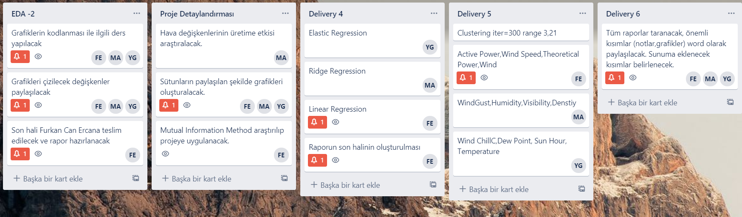
Project Management
We used Trello for planning and delivering tasks to each other.
For some topics we made researches and organized lectures between us to share the knowledge.
We made our meetings and lectures via Zoom.
We wrote our codes on Jupyter Notebook to make our codings portable and independent.

Slide 19
Conclusion
-During this Project:
-We learned that using one metric to evaluate results are not a good way to judge in clustering analysis part.
-We learned that to test the difference between results with statistical methods is important
-We learned that while we are choosing our best model we need to consider both computational time and getting good results. So we chose our regression models over MLP and in the end we chose our Linear Regression model for a real life use.
-We learned the importance of exploratory data analysis to really discover hidden relations between variables.
-We learned the importance of hyperparameter tuning.
-In general we learned that there is not always strict rules to build models we need to experiment with different features and different hyperparameter values to find the best possible model.
-We learned the importance of teamwork and planning in this project.

