Slide 1

CSE 4084 Multimedia Systems
Prof. Dr. Çiğdem Eroğlu Erdem
Department of Computer Engineering
Marmara University
Fall 2021
Final Project Presentation
Comparing Two Deep Neural Networks For Image Segmentation
Team Members
150119900 Emre Okul
150119679 Muhammedcan Pirinççi
Notes:
Hello everyone, my name is Emre and i am together with my teammate Muhammedcan.
Today, we are going to present our project, which is about comparing two deep neural networks for image segmentation.

Slide 2
Overview of our project
Goal: Comparing semantic segmentation architectures with different models
Subtasks
Data collection for our first model to train
Training → Fine Tuning → Increasing performance for First Architecture
Training
Fine Tuning
Increasing performance
Training → Fine Tuning → Increasing performance for Second Architecture
Training
Fine Tuning
Increasing performance
Comparing First and Second Architectures with Different Architectures
Notes:
Emre
We want to compare two deep learning architectures for image segmentation. The first architecture we will use the U-NET architecture to analyze and generate segmentations for the image. The second algorithm we will use the "attention" mechanism to do the image segmentation task. Both architectures give accurate results and are popular and easy to use for developers. That's why we wanted to compare these two architectures.
As can be seen on the slide, the subtasks are given in order. Now, we'll explain each subtask in turn.

Slide 3
1. Data Collection and Processing
We collected our data from Kaggle[1]. We used 843 Mb of data. We used 10% of it in validation process, 10% of it in testing process and 80% of it in training process. Also, we used 30 Mb of data for “train masks”. We transformed our pictures from our data to 224x224 resolution to fit our model. For input, we used 3 channels(RGB). For input-output mask, we used 1 channel because we are testing our model with one class.
Notes:
Emre
We collected our data from Kaggle. We used 843 Mb of data. We used 10% of it in validation process, 10% of it in testing process and 80% of it in training process. Also, we used 30 Mb of data for “train masks”. We transformed our pictures from our data to 224x224 resolution to fit our model. For input, we used 3 channels(RGB). For input-output mask, we used 1 channel because we are testing our model with one class.

Slide 4
2. First Architecture Process
Training: For U-NET Architecture as our first architecture, we used Dice Coefficient for our loss function and we trained our kernels based on this loss function. And based on validation, if our models validation score is decreasing per epoch, we will keep the model that has better validation score.
Architecture Flow: Architecture consists of 2 sections which are encoder and decoder. In encoder stage we are obtaining contextual information about data but we are losing where are those contextual information, in decoder part we are trying to obtain where are those valuable contexts with help of skip connections. That’s why we are using skip connection to transfer spatial information to decoder stage.
Fine-tuning: Before we fine tune, there was 2 channels in the output. We decreased it to the 1.
Increasing performance: We increased the performance with changing learning rate and batch size as hyperparameters.
Notes:
Muhammedcan
Training: For U-NET Architecture as our first architecture, we used dice coefficient for our loss function and we trained our kernels based on this loss function. And based on validation, if our models validation score is decreasing per epoch, we will keep the model that has better validation score.
Architecture Flow: Architecture consists of 2 sections which are encoder and decoder. In encoder stage we are obtaining contextual information about data but we are losing where are those contextual information, in decoder part we are trying to obtain where are those valuable contexts with help of skip connections. That’s why we are using skip connection to transfer spatial information to decoder stage.
Fine-tuning: Before we fine tune, there was 2 channels in the output. We decreased it to the 1.
Increasing performance: We increased the performance with changing learning rate and batch size as hyperparameters.

Slide 5
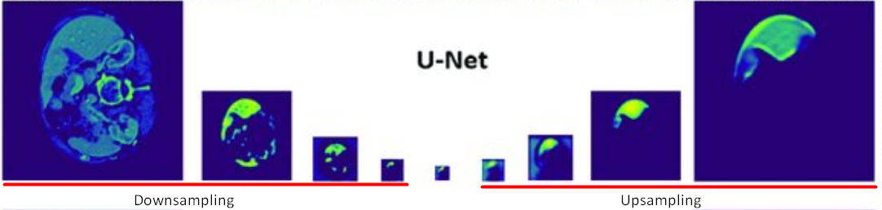
Figure 1. Downsampling and Upsampling processes of the U-NET Architecture
In this figure we can see downsampling and upsampling operations during U-NET to obtain feature maps with better performance. This figure shows how pretrained U-NET semantic segmentation model behaves to predict an image for image segmentation.
Notes:
Muhammedcan
In this figure we can see downsampling and upsampling operations during U-NET to obtain feature maps with better performance. This figure shows how pretrained U-NET semantic segmentation model behaves to predict an image for image segmentation.

Slide 6
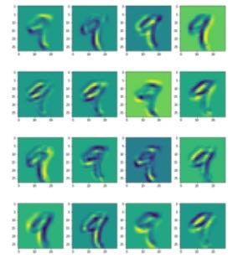
Example of Feature Maps

Slide 7
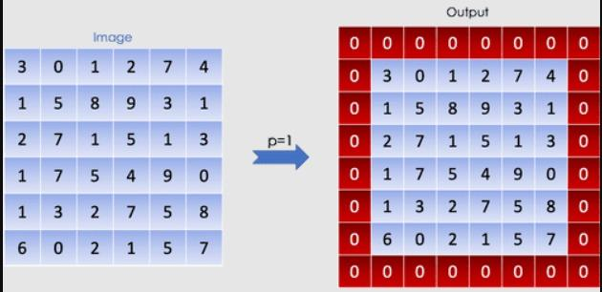
Padding

Slide 8
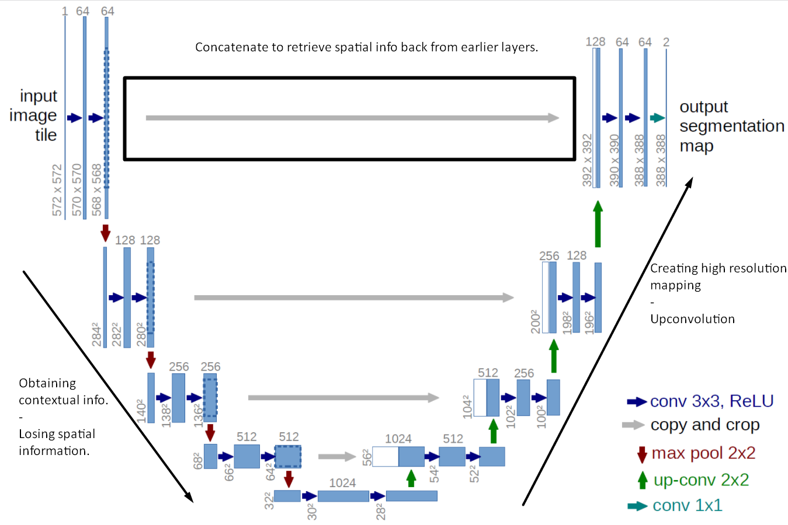
Figure 2. U-NET Architecture
Notes:
Muhammedcan
Here, we can see that each process constitutes two convolutional layers, and the number of channel changes from 1 to 64, as convolution process increases the depth of the image. Each red arrow, pointing down is the max pooling process which halves down size of image. (the size reduced from 572x572 → 568x568 is due to padding issues, but the implementation here uses padding= “same”) This process is repeated 3 more times and now we reaches at the bottommost part. There is still 2 convolutional layers are built, but with no max pooling as before. The image at this moment has been resized to 28x28x1024. In the expansive path as right side of the Figure, the image is going to be upsized to its original size. After the transposed convolution, the image is upsized from 28x28x1024 to 56x56x512, and then, this image is concatenated with the corresponding image from the contracting path and together makes an image of size 56x56x1024. The reason here is to combine the information from the previous layers in order to get a more precise prediction. The uppermost of the architecture, the last step is to reshape the image to satisfy our prediction requirements. The last layer is a convolution layer with 1 filter of size 1x1. (notice that there is no dense layer in the whole network)

Slide 9
3. Second Architecture Process
Training: Our second architecture is Attention U-NET. This architecture takes account of attentions so that it reduces the computational resources wasted on irrelevant activations by providing the network with better generalisation power.
Architecture Flow: During upsampling in the expanding path, the reconstructed spatial information is imprecise. To resolve this issue, U-Net uses hopping links that combine spatial information from the downsampling path with the upsampling path. However, this results in a lot of unnecessary low-level feature extraction, as the feature representation is poor in the early layers. Soft attention applied in jump connections actively suppresses activations in irrelevant regions, reducing the number of redundant features that arise.
Fine-tuning: Before we fine tune, there was 2 channels in the output. We decreased it to the 1.
Increasing performance: We increased the performance with changing learning rate and batch size as hyperparameters.
Notes:
Emre
Training: Our second architecture is Attention U-NET. This architecture takes account of attentions so that it reduces the computational resources wasted on irrelevant activations by providing the network with better generalisation power.
Architecture Flow: During upsampling in the expanding path, the reconstructed spatial information is imprecise. To resolve this issue, U-Net uses hopping links that combine spatial information from the downsampling path with the upsampling path. However, this results in a lot of unnecessary low-level feature extraction, as the feature representation is poor in the early layers. Soft attention applied in jump connections actively suppresses activations in irrelevant regions, reducing the number of redundant features that arise.
During upsampling in the expanding path, spatial information recreated is imprecise. To counteract this problem, the U-Net uses skip connections that combine spatial information from the downsampling path with the upsampling path. However, this brings across many redundant low-level feature extractions, as feature representation is poor in the initial layers. Soft attention implemented at the skip connections will actively suppress activations in irrelevant regions, reducing the number of redundant features brought across.
Fine-tuning: Before we fine tune, there was 2 channels in the output. We decreased it to the 1.
Increasing performance: We increased the performance with changing learning rate and batch size as hyperparameters.

Slide 10
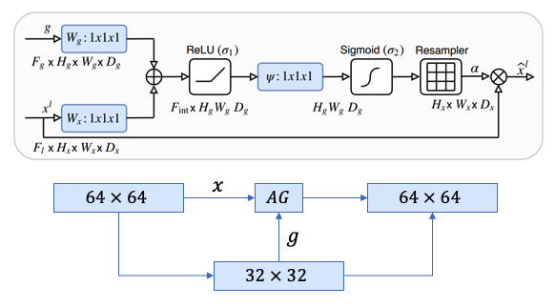
Figure 3. Top: Attention gate (AG) schematic. Bottom: How AGs are implemented at every skip connection.
Notes:
Emre
The attention gate takes in two inputs, vectors x and g.
The vector, g, is taken from the next lowest layer of the network. The vector has smaller dimensions and better feature representation, given that it comes from deeper into the network.
In the example figure above, vector x would have dimensions of 64x64x64 (filters x height x width) and vector g would be 32x32x32.
Vector x goes through a strided convolution such that it’s dimensions become 64x32x32 and vector g goes through a 1x1 convolution such that it’s dimensions become 64x32x32.
The two vectors are summed element-wise. This process results in aligned weights becoming larger while unaligned weights become relatively smaller.
The resultant vector goes through a ReLU activation layer and a 1x1 convolution that collapses the dimensions to 1x32x32.
This vector goes through a sigmoid layer which scales the vector between the range [0,1], producing the attention coefficients (weights), where coefficients closer to 1 indicate more relevant features.
The attention coefficients are upsampled to the original dimensions (64x64) of the x vector using trilinear interpolation. The attention coefficients are multiplied element-wise to the original x vector, scaling the vector according to relevance. This is then passed along in the skip connection as normal.

Slide 11
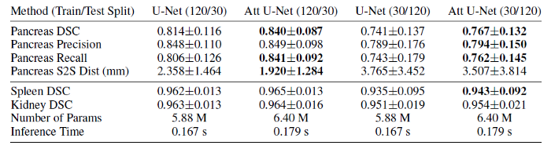
4. Comparison
Figure 4. Results on the CT-150 dataset (Oktay et al. 2018) [2]
Notes:
Emre
Results obtained by Oktay et al. show that the Attention U-Net has outperformed a plain U-Net in the overall Dice Coefficient Score by a sizeable margin. While the Attention U-Net has more parameters, it is not significantly more and the inference time is only marginally longer. In conclusion, attention gates are a simple way to improve the U-Net consistently in a large variety of datasets without a significant overhead in terms of computational cost.

Slide 12
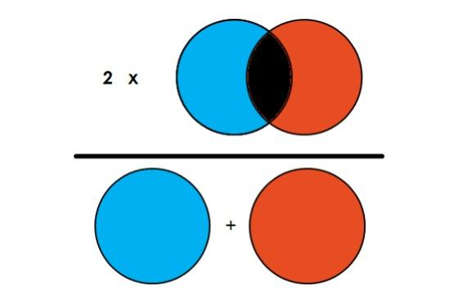
Dice Lose
Notes:
What we have done so far?
Dice Coefficient is 2 * the Area of Overlap divided by the total number of pixels in both images.

Slide 13
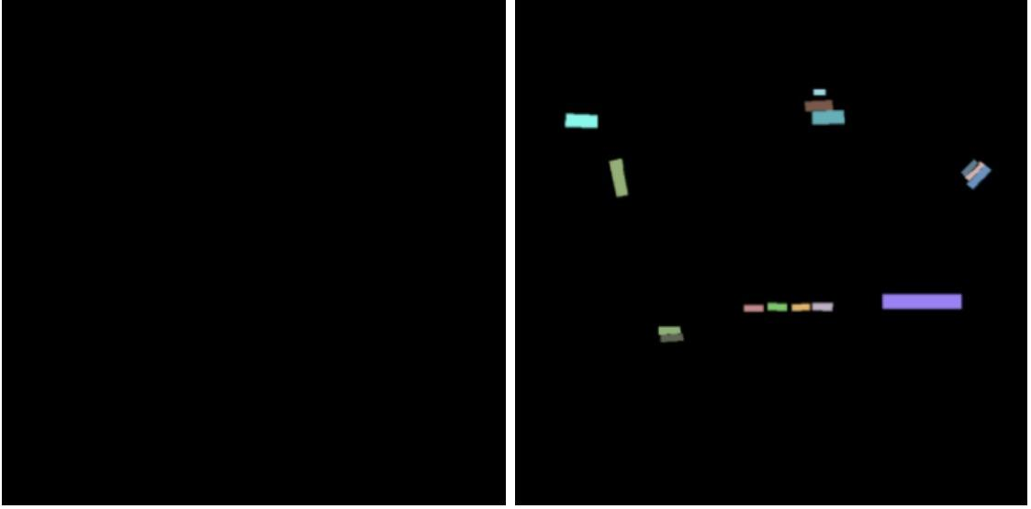
Pixel Lose
Notes:
pixel accuarcy

Slide 14
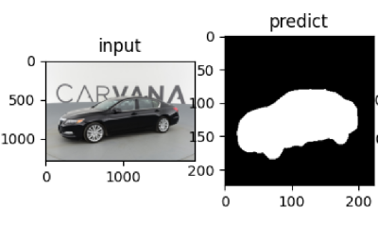
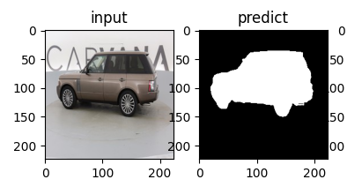
Result
First Model Result
Miou=0.87212,aver_hd=5.19520,aver_dice=0.917211
aver_iou:0.6228722123220560 > best_iou:0
===========>save best model!
epoch 0 loss:19.011
Epoch 10/10
Second Model Result
Miou=0.882872,aver_hd=5.229530,aver_dice=0.937168
aver_iou:0.8828723161505683 > best_iou:0
===========>save best model!
epoch 0 loss:20.021
Epoch 10/10
Notes:
Muhammedcan

Slide 15
Summary
All in all, one of the two architectures we used does not have an obvious advantage over the other. Both can be used in conjunction with deciding whether the performance we want to achieve to a certain extent will waive computational cost or loss. Therefore, Attention U-NET Architecture should be used if it is desired to increase performance with less computational cost. However, if our loss value is desired to be less, U-NET Architecture should be preferred for performance increase.
Notes:
Muhammedcan
All in all, one of the two architectures we used does not have an obvious advantage over the other. Both can be used in conjunction with deciding whether the performance we want to achieve to a certain extent will waive computational cost or loss. Therefore, Attention U-NET Architecture should be used if it is desired to increase performance with less computational cost. However, if our loss value is desired to be less, U-NET Architecture should be preferred for performance increase.

Slide 16
References
[1] Kaggle, (2021, December, 3), https://www.kaggle.com/
[2] O. Oktay, (2018), et al. “Attention UNet : learning where to look for the pancreas”
Notes:
Muhammedcan
Here are our references in this slide.

Slide 17

Thanks for listening
Notes:
Muhammedcan
And thanks for listening our presentation.

