Slide 1
DSA 210 PROJECT PHASE II
Muhammed Emir Acarkan 32619

Slide 2


MOTIVATION
This project is motivated by the need to explore whether there exists a statistically significant relationship between pollution levels and heart disease rates across different regions.
By analyzing indicators such as NO₂, SO₂, CO, and O₃ concentrations, alongside heart failure and coronary heart disease data, this research aims to provide deeper insights into how environmental health influences human health.
Understanding such correlations can contribute to public health policy, urban planning, and preventive healthcare strategies in the long term.
In this slide mostly there is charts you can look for codei in my github The file name is …..

Slide 3
DATA COLLECTION
In this project, I used publicly available datasets obtained from Kaggle, a widely used platform for sharing and accessing real-world datasets.
The dataset contains two primary variables:
Air pollution indicators such as CO, NO₂, SO₂, and O₃
Heart disease statistics such as heart failure and coronary heart disease rates
The data was filtered and merged to focus on regional-level comparisons across different U.S. states. To ensure reliability and relevance, I removed incomplete or irrelevant entries and kept only the values labeled "Overall" for consistent comparisons.
You can access the original dataset from Kaggle and view the cleaned version used in this analysis through the GitHub repository linked in the project.

Slide 4
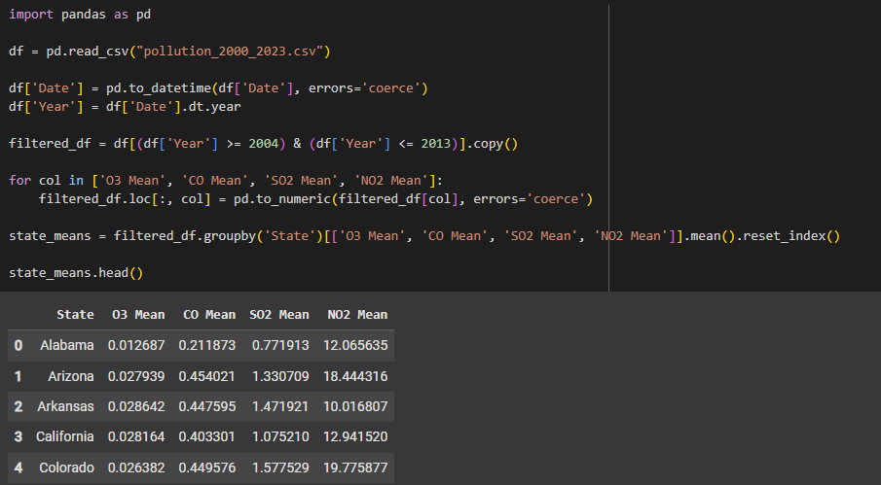
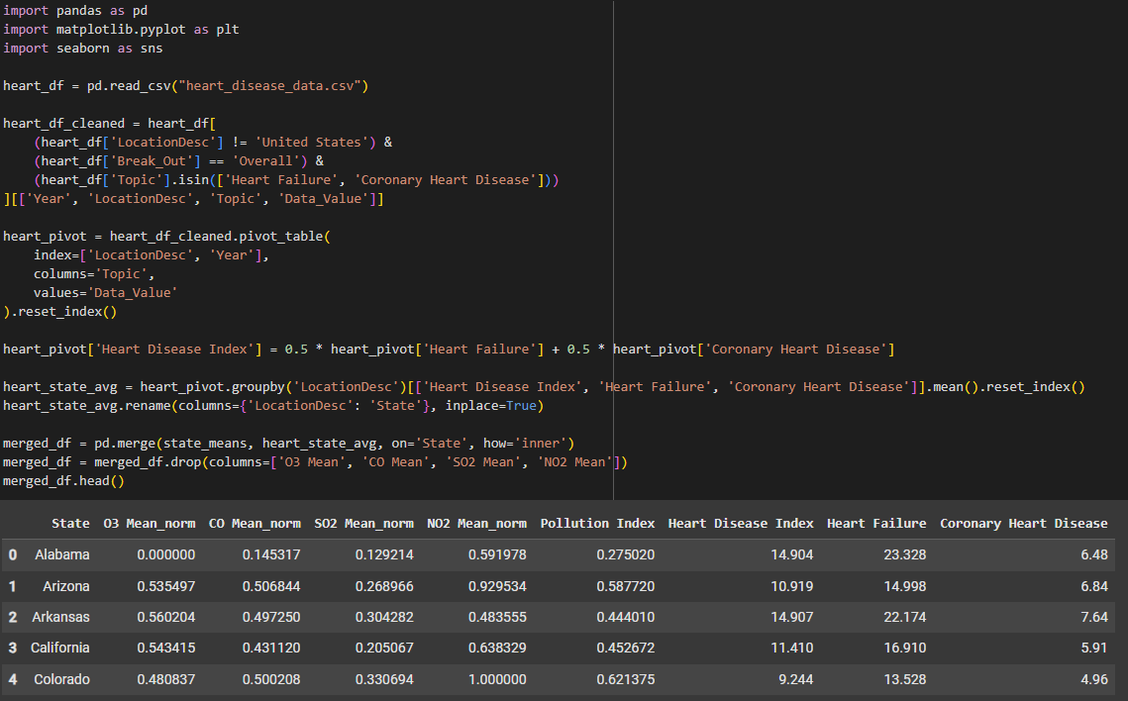
PREPARATION OF DATA
Pollution and heart disease data from 2004–2013 were filtered and aggregated at the state level.
CO, SO₂, NO₂, and O₃ values were normalized using Z-score standardization.
A weighted Pollution Index was calculated using the normalized values (NO₂: 0.35, SO₂: 0.30, CO: 0.20, O₃: 0.15).
Heart Failure and Coronary Heart Disease averages were combined to create a unified Heart Disease Index.
Both datasets were merged on the state column to generate a final enriched dataset (merged_df) for further analysis.

Slide 5
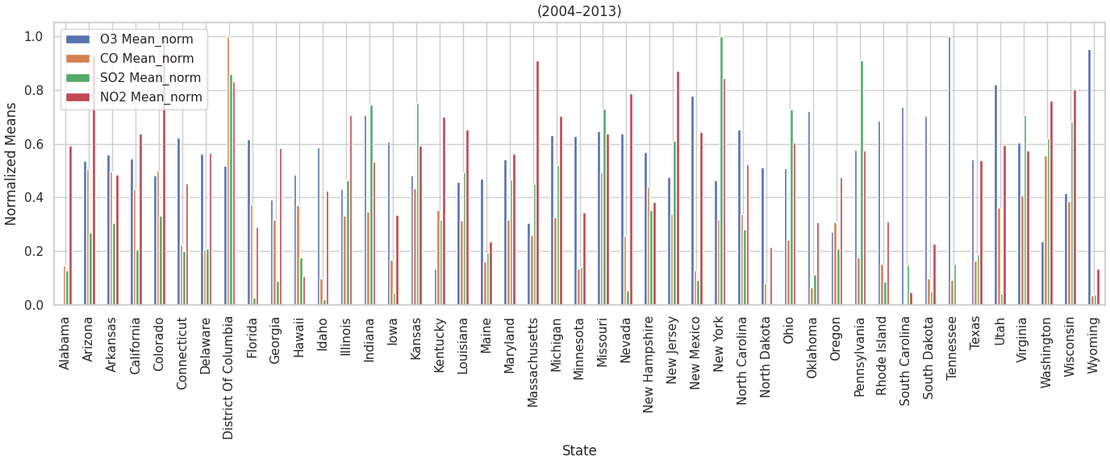
📊 In this bar chart, we observe the normalized averages of four key air pollutants — O₃, CO, SO₂, and NO₂ — across all U.S. states over the 2004–2013 period.
The data was normalized using z-score transformation to ensure comparability.
This visualization helps identify which states had consistently higher levels of specific pollutants.
It sets the foundation for computing an overall Pollution Index, which will be used in later analysis.

Slide 6
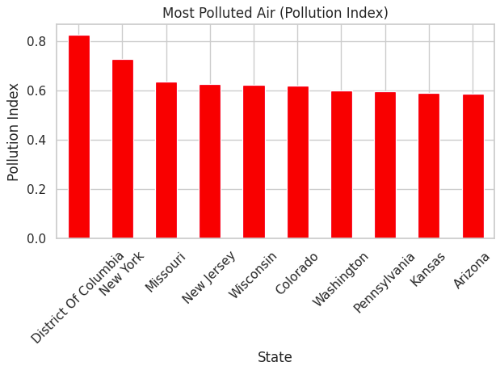
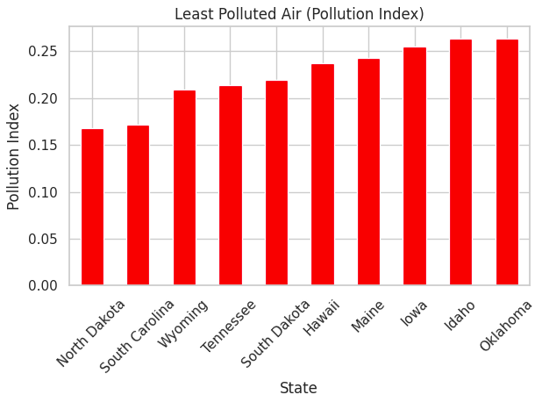
Pollution Extremes Across U.S. States (Based on Pollution Index)
🌍 This slide presents a comparative overview of the most and least polluted states in the U.S. based on the calculated Pollution Index, which aggregates normalized levels of O₃, CO, SO₂, and NO₂ from 2004 to 2013.
🔥 On the left, we observe the top 10 most polluted states, with District of Columbia, New York, and Missouri leading the list. These elevated scores may reflect greater urban density, traffic emissions, and industrial activity in these regions.
🍃 On the right, we highlight the 10 states with the lowest Pollution Index, such as North Dakota, South Carolina, and Wyoming. These states potentially benefit from favorable environmental conditions, geographic advantages, or effective pollution control policies.

Slide 7
🔍 Exploratory Data Analysis (EDA)
Objective: To explore the dataset structure, detect patterns, and determine suitable statistical methods.
1. 📊 Descriptive Statistics
Calculated: Mean, Median, Min, Max, and Standard Deviation
Goal: Understand distributions and data spread.
2. 📈 Distribution Analysis
Applied Shapiro-Wilk test to assess normality.
Determined whether to use:
Parametric tests (e.g., Pearson)
Non-parametric tests (e.g., Spearman)
3. 📉 Visualization
Scatter plots: Pollution vs. Heart Disease
Heatmaps: Correlation matrix of variables
Boxplots: Pollution index across heart disease levels
4. 📎 Correlation Analysis
Used Pearson or Spearman depending on distribution.
Measured strength of association between pollution and heart disease.

Slide 8
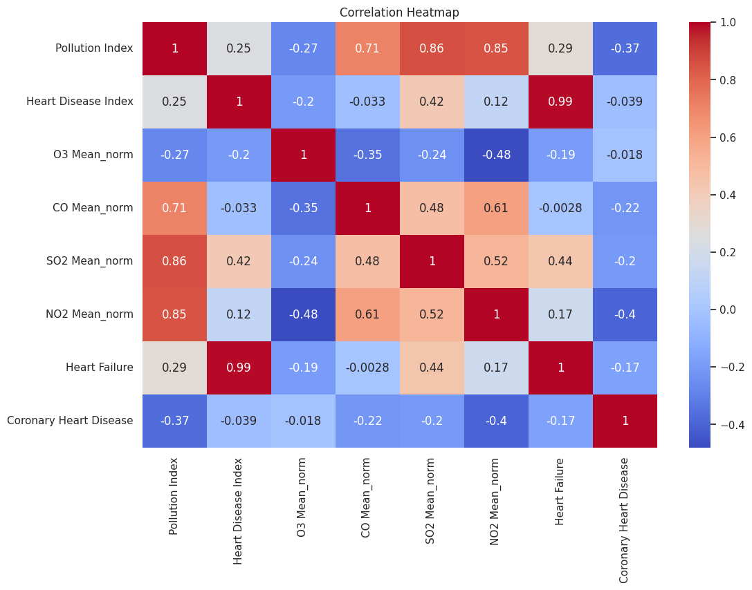
Correlation Heatmap
hdfdf
Purpose: This heatmap illustrates the pairwise correlation coefficients between pollutant levels and heart disease metrics.
Key Insights:
Pollution Index shows:
A moderate correlation with Heart Disease Index (r = 0.25), suggesting a potential environmental influence on cardiovascular health.
CO Mean_norm and NO₂ Mean_norm both show moderate correlations with the Heart Disease Index (r = 0.42 and r = 0.12, respectively).
Heart Failure and Coronary Heart Disease are highly correlated with each other (r = 0.99), justifying their aggregation into a single Heart Disease Index.

Slide 9
📊 Scatter Plot Matrix – Pollution vs. Heart Disease Metrics
Objective: To visually examine the linear relationships between different air pollutants and heart disease indicators.
What’s Shown:
The matrix displays regression plots between four air pollutants (O₃, CO, SO₂, NO₂) and three heart-related outcomes (Heart Disease Index, Heart Failure, Coronary Heart Disease).
Each plot includes a red regression line with a confidence interval to indicate the trend.
Key Observations:
Some pollutants (e.g., CO, NO₂) appear to have slight negative trends with coronary heart disease.
Most relationships show weak or no linear correlation, aligning with the moderate R² observed in the linear regression results.
These visual patterns complement the heatmap findings and guide our attention to more promising predictors for modeling.

Slide 10
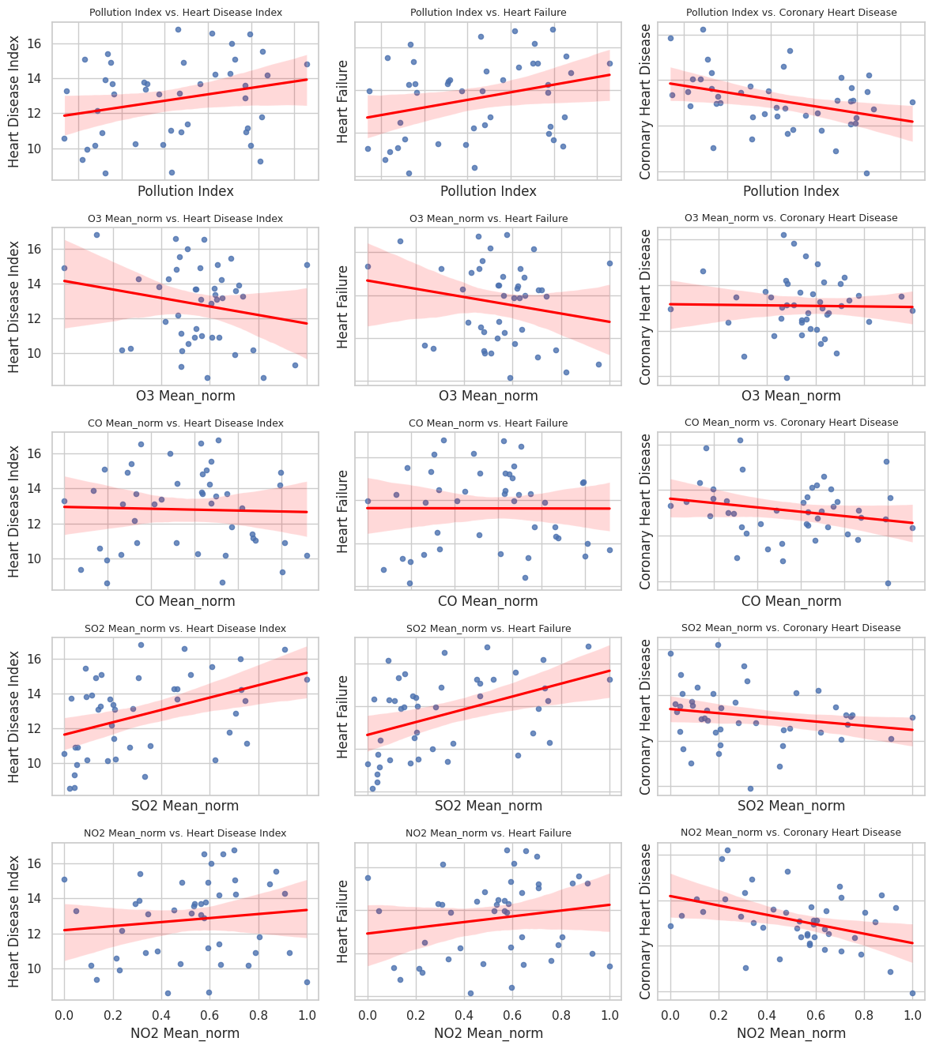
📊 Scatter Plot Matrix – Pollution vs. Heart Disease Metrics
hdfdf

Slide 11
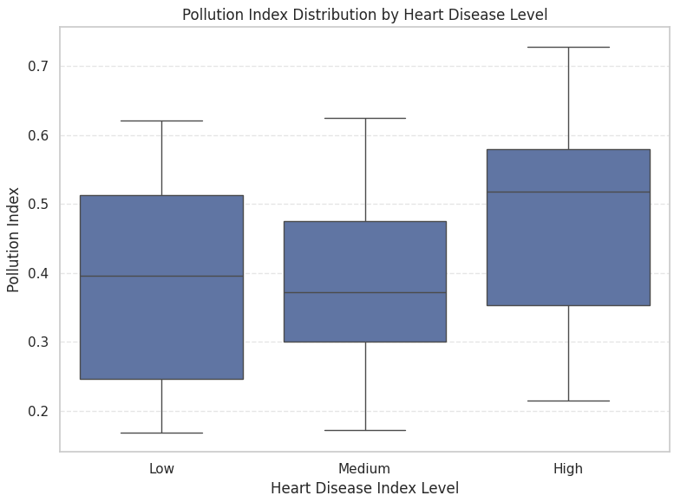
📦 Pollution Index Distribution by Heart Disease Level
hdfdf
Method:
The Heart Disease Index was divided into three equal-sized groups: Low, Medium, and High prevalence.
A boxplot was used to visualize the distribution of Pollution Index within each group.
Key Insights:
Regions with high heart disease prevalence tend to have a higher median pollution index.
The spread of pollution levels is also wider in the "High" group, suggesting more variability.
This visual evidence supports the positive association between pollution exposure and heart disease rates.

Slide 12
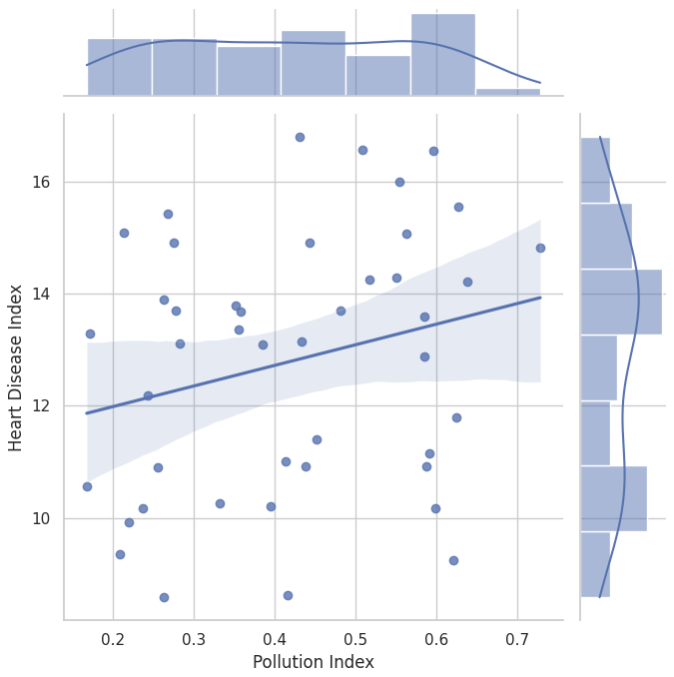
🔗 Relationship Between Pollution Index and Heart Disease Index
hdfdf
Visual elements:
The scatter plot in the center shows individual state data points.
The regression line indicates a positive linear trend between pollution and heart disease.
Histograms on the axes display the distribution of both variables.
Insights:
States with higher Pollution Index values tend to exhibit higher Heart Disease Index scores.
While not perfectly linear, the positive trend supports the hypothesis that environmental pollution may be a contributing factor to heart disease prevalence.
📈 This plot strengthens the evidence of a direct association between air quality and cardiovascular health risks.

Slide 13
Hypothesis Testing Framework
🎯 Objective:
To assess whether there is a statistically significant relationship between Pollution Index and Heart Disease Index.
🧪 Hypotheses:
🔵 Null Hypothesis (H₀): There is no significant relationship between the Pollution Index and Heart Disease Index. Any observed association is due to random chance.
🔴 Alternative Hypothesis (H₁): There is a statistically significant relationship between the Pollution Index and Heart Disease Index. Variations in pollution may be linked to changes in heart disease rates.
🧠 Decision Rule (Based on p-value):
If p < 0.05 → Reject H₀ (significant relationship exists)
If p ≥ 0.05 → Fail to reject H₀ (no significant relationship found)

Slide 14
FINDINGS: Hypothesis Testing Results
🧪 Normality Test Results:
Pollution Index p-value: 0.0373 → Not normally distributed
Heart Disease Index p-value: 0.1249 → Not normally distributed
Since normality assumptions were violated, the Spearman correlation test was used.
📊 Spearman Test Output:
Spearman Correlation Coefficient: 0.2615
Spearman p-value: 0.0865
🧾 Conclusion:
p > 0.05, so we fail to reject the null hypothesis (H₀).
→ No statistically significant association was found between Pollution Index and Heart Disease Index.
This outcome suggests that while a weak positive trend exists, it is not strong enough to be statistically conclusive.

Slide 15
LIMITATIONS
Limited Dataset Scope: The analysis is based on state-level data from a limited time range. Including data across multiple years and more geographic granularity (e.g., city-level) could improve the robustness of the findings.
Missing Confounding Variables: Factors such as age, smoking rates, socioeconomic status, and healthcare access were not included in the analysis, yet they strongly influence heart disease rates.
Correlation vs. Causation: The project explores correlation, not causality. Even if a strong relationship is observed, it does not imply a direct causal link.

Slide 16
FUTURE WORK
So far, we tried linear regression.
We will test models like KNN, Random Forest, and XGBoost. but maybe with some fine-tuning or more data, we could push it even further.
CO and NO₂ seemed to be more related to heart disease. It might be cool to dig deeper into why these pollutants matter more than others.
Finally, we could experiment with different validation techniques or use Grid Search to optimize the models better and avoid overfitting. Just a bit of tweaking might lead to more solid results.

Slide 17
THANKS
Muhammed Emir Acarkan 32619

