Slide 1
DSA 210 PROJECT
PHASE III
Muhammed Emir Acarkan 32619

Slide 2


MOTIVATION
Understanding the impact of environmental factors on public health has become increasingly critical in recent years. This study was motivated by the question:
Can air pollution indicators be used to predict the prevalence or severity of heart disease across U.S. states?
Key points driving this research:
Public Health Relevance: Cardiovascular diseases remain a leading cause of death. Identifying environmental predictors can support preventative strategies.
Environmental Policy Insight: Findings may inform policy makers about the health consequences of air quality regulations.
Data-Driven Exploration: Combining pollution and health datasets enables an interdisciplinary approach that merges environmental science with machine learning.
Model Evaluation: The project allows comparison of various ML models (regression, KNN, tree-based methods) in real-world data contexts.
In this slide mostly there is charts you can look for codes in my github.

Slide 3
📊 Application of Machine Learning Methods
To investigate the relationship between environmental pollution and heart disease, several supervised ML methods were applied. Each model helped analyze different aspects of the dataset using both classification and regression tasks.
Linear Regression Modeled continuous outcomes like the Heart Disease Index to examine the linear influence of pollutant levels.
K-Nearest Neighbors (KNN) Used to classify regions into Low or High heart disease categories based on similarity in pollution profiles.
Decision Tree & Random Forest A decision tree provided initial interpretability, while a random forest improved predictive performance and revealed feature importance.
XGBoost Boosted tree-based method used to model complex, nonlinear associations between air pollution and heart disease severity.
📌 Goal: To assess whether pollution levels can effectively predict heart disease and compare each method’s performance using accuracy, confusion matrix, and ROC-AUC metrics.

Slide 4
🔧 From Phase II: Data Preparation for Machine Learning
This phase focused on cleaning, aggregating, normalizing, and merging pollution and heart disease datasets.
Pollution data (O₃, CO, SO₂, NO₂) was filtered for the 2004–2013 period and averaged per state.
All variables were standardized using Z-score normalization to ensure comparability.
A composite Pollution Index was calculated using weighted contributions (NO₂: 0.35, SO₂: 0.30, CO: 0.20, O₃: 0.15).
Heart disease data was processed at the state level, combining Heart Failure and Coronary Heart Disease into a single Heart Disease Index.
Finally, datasets were merged into a unified merged_df, enabling machine learning model development.

Slide 5
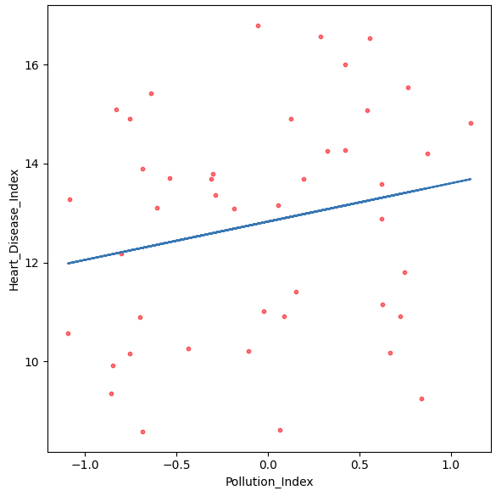
A Simple Linear Regression with Pollution Index
📌 Purpose To examine whether the Pollution Index (based on NO₂, SO₂, CO, O₃ levels) can predict the Heart Disease Index (average of heart failure and coronary heart disease).
⚙️ Model Setup
Applied Linear Regression from sklearn.
X (Independent Variable): Pollution Index
y (Dependent Variable): Heart Disease Index
Dataset used: merged_df
Output includes:
Intercept: 12.828
Coefficient: 0.774

Slide 6
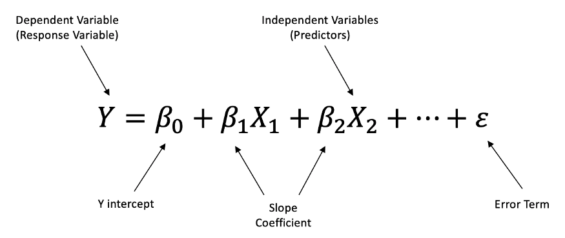
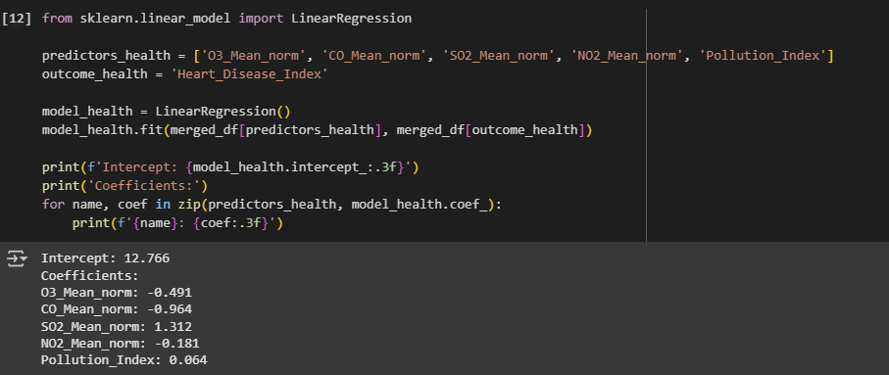
Multiple Linear Regression Analysis
To explore how different air pollutants jointly affect cardiovascular health, we performed Multiple Linear Regression using:
O₃ Mean (normalized)
CO Mean (normalized)
SO₂ Mean (normalized)
NO₂ Mean (normalized)
Pollution Index
as predictors, and Heart Disease Index as the outcome variable.

Slide 7
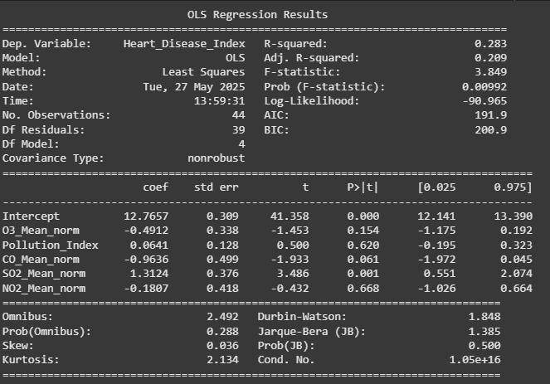
Stats of Models Summary

Slide 8
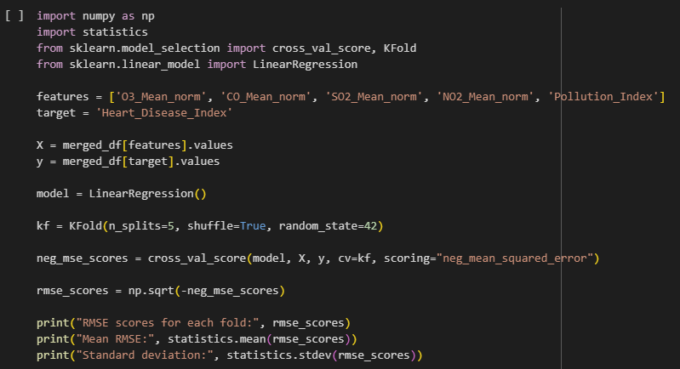
🧪 RMSE Cross-Validation
We implemented 5-Fold Cross-Validation using LinearRegression() from sklearn.
The dataset included 5 predictors: O₃_Mean_norm, CO_Mean_norm, SO₂_Mean_norm, NO₂_Mean_norm, Pollution_Index
Evaluation metric: Root Mean Squared Error (RMSE)
📌 Code Highlights:
cross_val_score() was used with neg_mean_squared_error scoring.
Negative MSEs were converted to RMSEs via square root transformation.
The process was repeated across 5 folds using KFold().
🔢 Results:
Fold RMSEs: 2.27, 1.87, 1.87, 2.26, 2.07
Mean RMSE: 2.07
Standard Deviation: 0.19

Slide 9
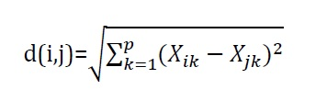
📍 K-Nearest Neighbors (KNN) Classification
🧠 Method:
KNN is a non-parametric, instance-based algorithm.
Predicts class by comparing with the k most similar observations.
Ideal for small datasets (our case: 44 states).
🧪 Validation Strategy:
Used Leave-One-Out Cross-Validation (LOO-CV) → Every observation serves as a test case once. → Ensures maximum use of limited data.
🔧 Model Tuning:
Tested multiple K values to find the best-performing configuration.
Final model was assessed using:
Confusion Matrix
Accuracy
Precision, Recall, F1-Score

Slide 10
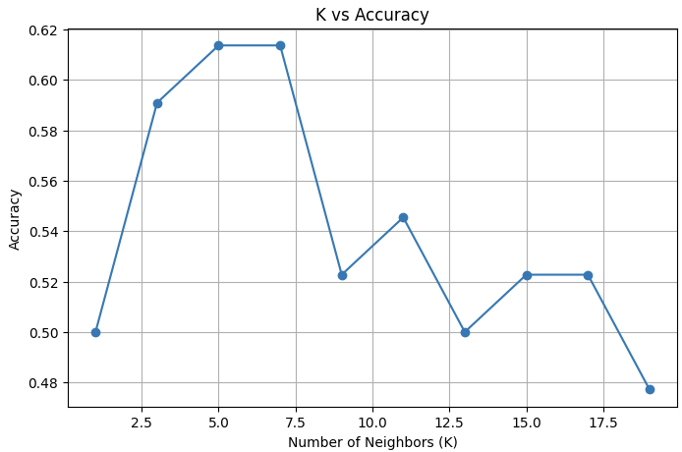
Choosing Best K
To find the most suitable number of neighbors (K) for our K-Nearest Neighbors (KNN) classifier, we applied Leave-One-Out Cross-Validation (LOO-CV), ideal for our small dataset of 44 instances.
We tested odd values of K from 1 to 19 and recorded the mean classification accuracy for each.
The results were visualized using a line plot, allowing us to observe performance trends.
The optimal K was determined as the one with highest average accuracy → K = 5.
This process helps balance bias and variance, improving the reliability and performance of the KNN model.

Slide 11
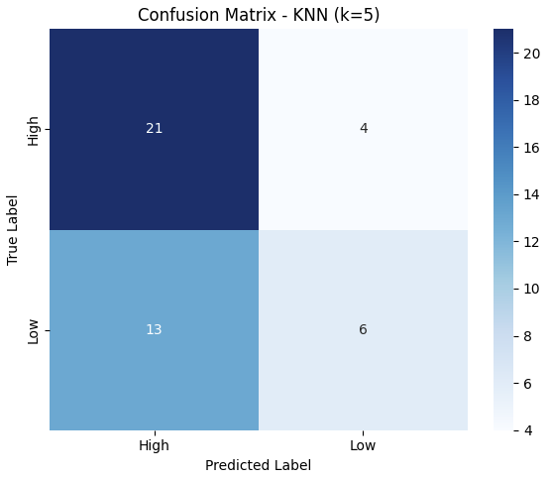
Confusion Matrix for KNN Classification (K=5)
After selecting the optimal K=5, we used Leave-One-Out Cross-Validation (LOO-CV) to classify each observation as "Low" or "High" heart disease risk.
The confusion matrix provides a detailed breakdown of model predictions versus actual labels.
Key Terms:
✅ True Positives (TP): Correctly predicted "High" cases.
✅ True Negatives (TN): Correctly predicted "Low" cases.
❌ False Positives (FP): "Low" cases misclassified as "High".
❌ False Negatives (FN): "High" cases misclassified as "Low".
The matrix offers insights into how well the model distinguishes between risk classes, especially in imbalanced datasets.

Slide 12
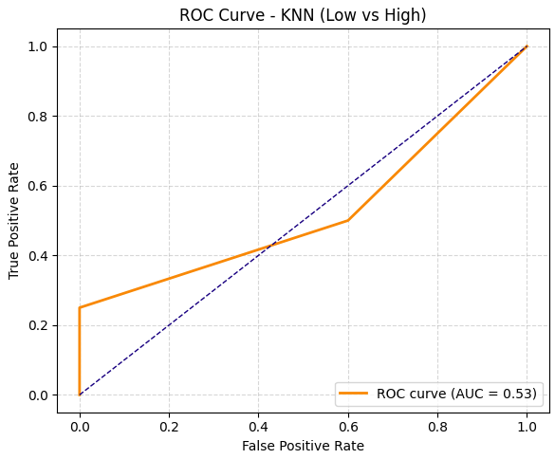
ROC Curve and Accuracy for KNN (k=5)
KNN classifier tested with k = 5 using an 80/20 train-test split.
Accuracy: 0.67 → Shows general classification performance.
ROC Curve (AUC = 0.53):
Indicates poor separability between classes (just above random chance).
Helps diagnose model behavior under varying threshold conditions.
Although accuracy is moderately acceptable, the low AUC suggests the classifier struggles to distinguish between "Low" and "High" heart disease risk levels, particularly under class imbalance.

Slide 13
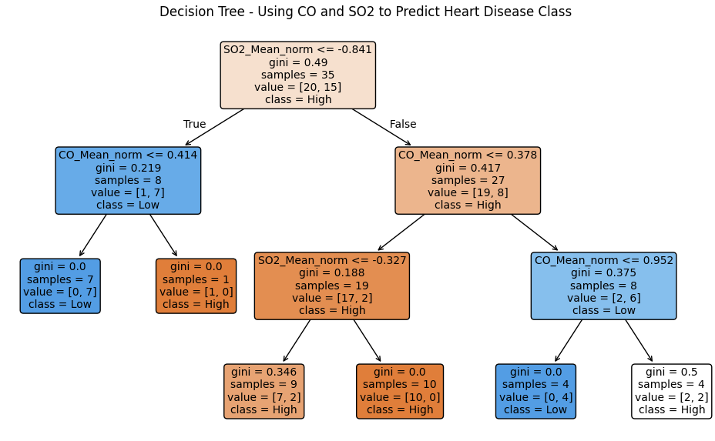
🌲 A Simple Decision Tree for Heart Disease Risk
🧩 Goal: To create an interpretable model to classify heart disease risk (High vs Low) using only two features: CO_Mean_norm and SO2_Mean_norm
⚙️ Model Details:
Used DecisionTreeClassifier from sklearn
Selected a max_depth = 3 to prevent overfitting
Split the dataset using an 80/20 train-test ratio
Model is trained on merged_df

Slide 14
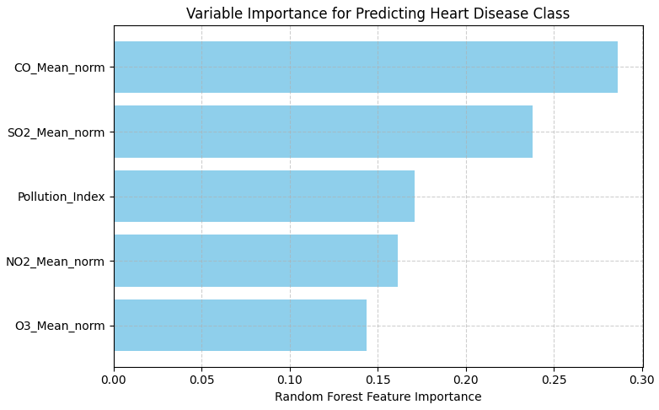
🌲 Feature Importance with Random Forest
🔍 Purpose: To evaluate how much each pollution variable contributes to predicting heart disease risk (Low vs High).
🧠 Why Random Forest?
Provides both high classification accuracy and interpretability.
Calculates feature importances automatically.
📊 Interpretation: The plotted feature importances help identify which pollutants (e.g., CO, SO₂, NO₂, O₃) are the most critical predictors of cardiovascular health outcomes across states.

Slide 15
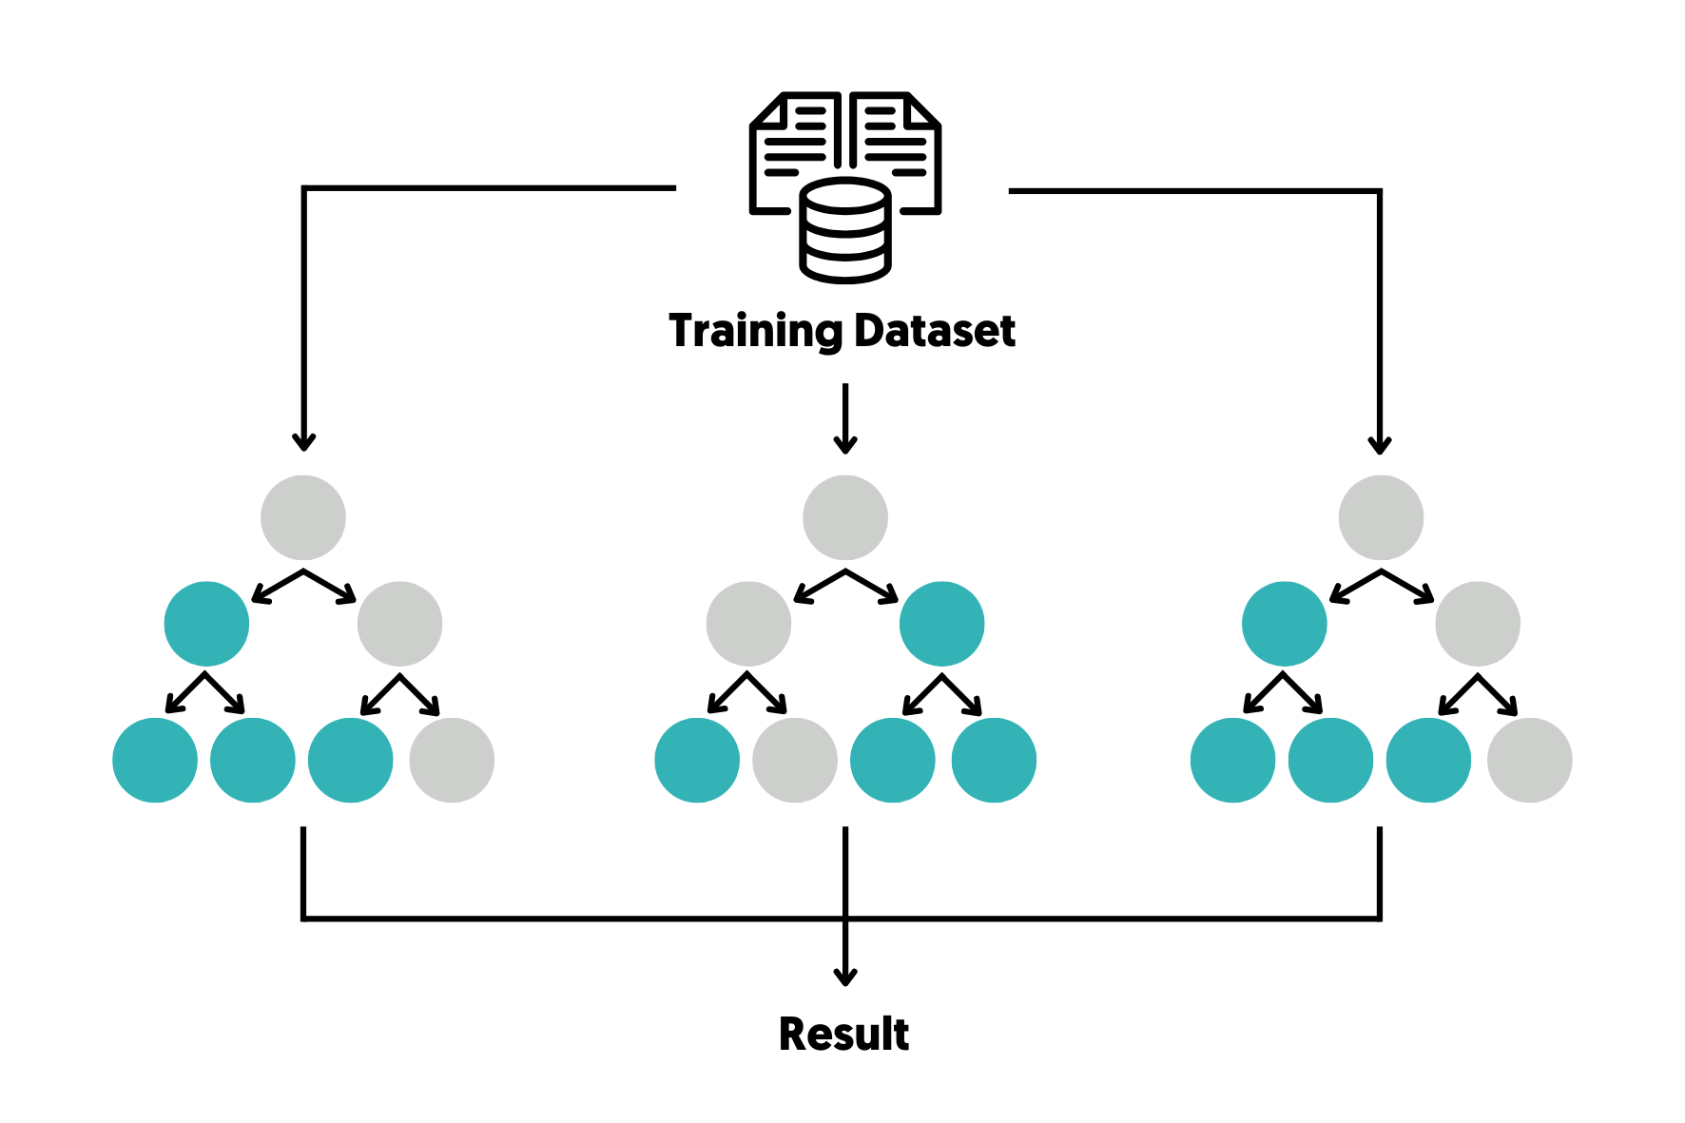
🌲 Random Forest
Goal: To classify U.S. states into Low or High heart disease risk categories based on pollution.
Selected Features:
CO_Mean_norm
SO2_Mean_norm
O3_Mean_norm
NO2_Mean_norm
Pollution_Index
Method:
Used RandomForestClassifier with 500 trees.
Applied Leave-One-Out Cross-Validation (LOOCV) for robust generalization over small sample size.
Encoded class labels using LabelEncoder.
Visualization: A scatter plot was generated to show how predictions align with pollution values, demonstrating RF’s ability to create nonlinear boundaries.

Slide 16
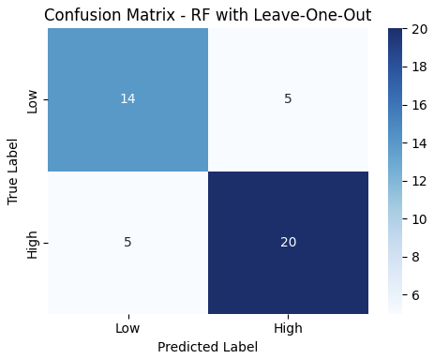
🧪 Random Forest – Confusion Matrix Evaluation (LOOCV)
To assess the predictive accuracy of the Random Forest model, we used Leave-One-Out Cross-Validation (LOOCV), which is well-suited for small datasets. After generating predictions for each state, we built a confusion matrix to compare predicted vs. actual classes.
Accuracy: 0.77 → Shows general classification performance.
🔍 Key Points:
Correct predictions appear on the diagonal, while misclassifications are shown off-diagonal.
The model showed strong performance in identifying 'High' risk states.
It struggled more with 'Low' risk states — possibly due to class imbalance or weaker signal.
📊 This evaluation provides insight into how well the model separates heart disease risk levels, guiding future model refinements.

Slide 17
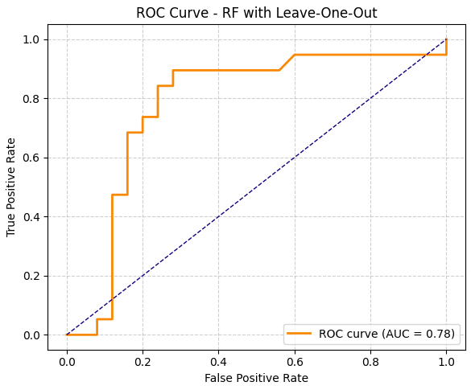
📉 Random Forest ROC Curve & AUC (LOOCV)
To evaluate how well the model distinguishes between high and low heart disease risk, we plotted the ROC Curve using predictions from Leave-One-Out Cross-Validation (LOOCV).
The ROC Curve visualizes the trade-off between True Positive Rate (Sensitivity) and False Positive Rate.
The AUC (Area Under the Curve) score was 0.77, indicating fair to good discriminative power.
This means the model has a 77% chance of correctly ranking a positive instance over a negative one.
✅ These results confirm that Random Forest, combined with LOOCV, is effective at separating heart disease risk classes based on pollution indicators.

Slide 18

XGBoost Classification with Leave-One-Out Cross-Validation
🔍 Overview In this step, we applied the XGBoost Classifier to predict whether a state falls into the Low or High heart disease risk group based on CO Mean and SO₂ Mean pollution levels.
⚙️ Model Setup
Features used: CO Mean (normalized), SO₂ Mean (normalized)
Target: Heart Disease Class (Low vs High)
Validation method: Leave-One-Out Cross-Validation (LOO-CV)
XGBoost configuration:
n_estimators = 25
eval_metric = 'logloss'

Slide 19
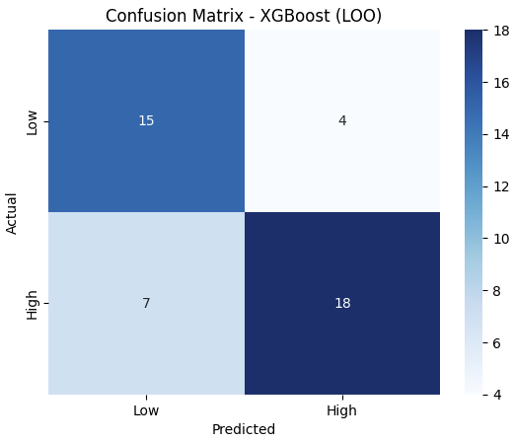
🧩 Confusion Matrix – XGBoost (LOOCV)
📌 Overview
This confusion matrix summarizes the XGBoost classifier's performance in predicting heart disease risk classes (Low vs High) using Leave-One-Out Cross-Validation (LOO-CV).
✅ Key Metrics:
True Positives (High → High): 18
True Negatives (Low → Low): 15
False Positives (Low → High): 4
False Negatives (High → Low): 7
📊 Accuracy Score:
Overall Accuracy: 0.75

Slide 20
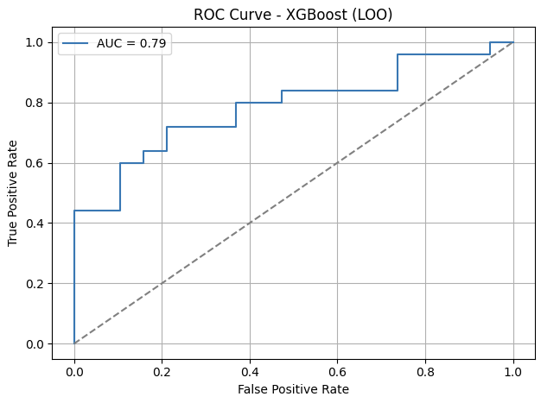
📈 ROC Curve – XGBoost (LOOCV)
🔍 Interpretation:
The ROC Curve visualizes the model’s ability to separate the two heart disease risk classes (Low vs High) across varying thresholds.
True Positive Rate (Recall) is plotted against the False Positive Rate.
The Area Under the Curve (AUC) was calculated as 0.79, indicating strong class separability.
✅ Insights:
AUC ≈ 1.0 → Excellent classification
AUC ≈ 0.5 → Random guessing
Here, AUC = 0.79 → The model performs significantly better than random.
➡️ This confirms that XGBoost is effective in distinguishing between risk levels in a small, imbalanced dataset.

Slide 21
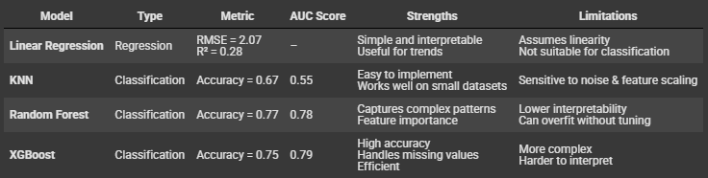
Model Comparison: Summary of Predictive Techniques
This table summarizes the performance of all models applied. It highlights each model’s predictive accuracy, AUC score (for classifiers), and practical trade-offs in terms of complexity and interpretability.

Slide 22
Insights & Final Evaluation
🔺 XGBoost achieved the highest accuracy (0.75) and AUC (0.79) → Best model for classification.
🌲 Random Forest showed strong AUC (0.77) but slightly lower accuracy.
📍 KNN had good accuracy (0.67) but poor AUC (0.55) → Possible class imbalance issue.
📈 Linear Regression helped understand trends but was not suited for classification.
✅ Final Statement:
Overall, XGBoost was the most effective and reliable model for predicting heart disease risk based on pollution data.

Slide 23
THANKS
Muhammed Emir Acarkan 32619

