Slide 1

SIRD – Sports Injury Risk Detection from Video
AI-Powered Sports Movement Analysis
Infosys Springboard Internship Project
Name : Muhammed Faizal F
Project : SIRD – Sports Injury Risk Detection from Video
Program : Infosys Springboard Internship 7.0
Notes:
1

Slide 2
Introduction
What is SIRD?
Why prevention matters
Why video-based analysis
SIRD is an AI-enabled system that analyzes athlete movement from video to detect injury-risk indicators and present role-specific insights.
Early identification of risky movement patterns reduces downtime, improves performance continuity and supports evidence-based training and rehab decisions.
Video is ubiquitous, non-invasive, and captures context-rich movement — enabling retrospective review, longitudinal tracking and scalable monitoring.
Notes:
2

Slide 3
Problem Statement
Manual assessment limits
Hidden abnormalities
Need for structured monitoring
Fragmented information
Manual video review is time-consuming and inconsistent across evaluators.
Subtle deviations in kinematics are easy to miss without quantitative measures.
Coaches and support staff lack a centralized, role-based view of analysis and recommendations.
Athletes require repeatable tracking of movement and recovery progress over time.
Notes:
3

Slide 4
Objectives
Analyze videos
Extract movement features
Ingest and validate athlete video uploads for structured processing.
Derive pose and kinematic features useful for risk assessment.
Detect risk indicators
Maintain profiles
Flag movement patterns correlated with elevated injury risk.
Track athlete history, videos and longitudinal metrics.
Role-based insights
Support decisions
Deliver tailored dashboards for Admin, Athlete, Coach, Physio, Scientist.
Provide actionable guidance for training and recovery planning.
Notes:
4

Slide 5

Existing System — Limitations
Observation-heavy workflows with human variability
Poor historical tracking and fragmented records
No centralized repository for multi-session comparisons
Limited automation for extracting quantifiable movement metrics
Hard to scale across teams and organizations
SIRD addresses these gaps by introducing automated, consistent video processing and unified role-based reporting.
Notes:
5

Slide 6

Proposed System — SIRD Overview
Core user flows and capabilities
01
User authentication (JWT)
Athlete profile & organization management
Video upload and validation
AI-driven video processing and risk prediction
Role-based dashboards and training/recovery guidance
1. Upload
Secure video submission by athlete or staff
02
2. Process
Frame-level pose extraction and feature derivation
03
3. Predict
Compute injury-risk indicators and flag concerns
04
4. Report
Deliver role-specific visualizations and guidance
Notes:
6

Slide 7
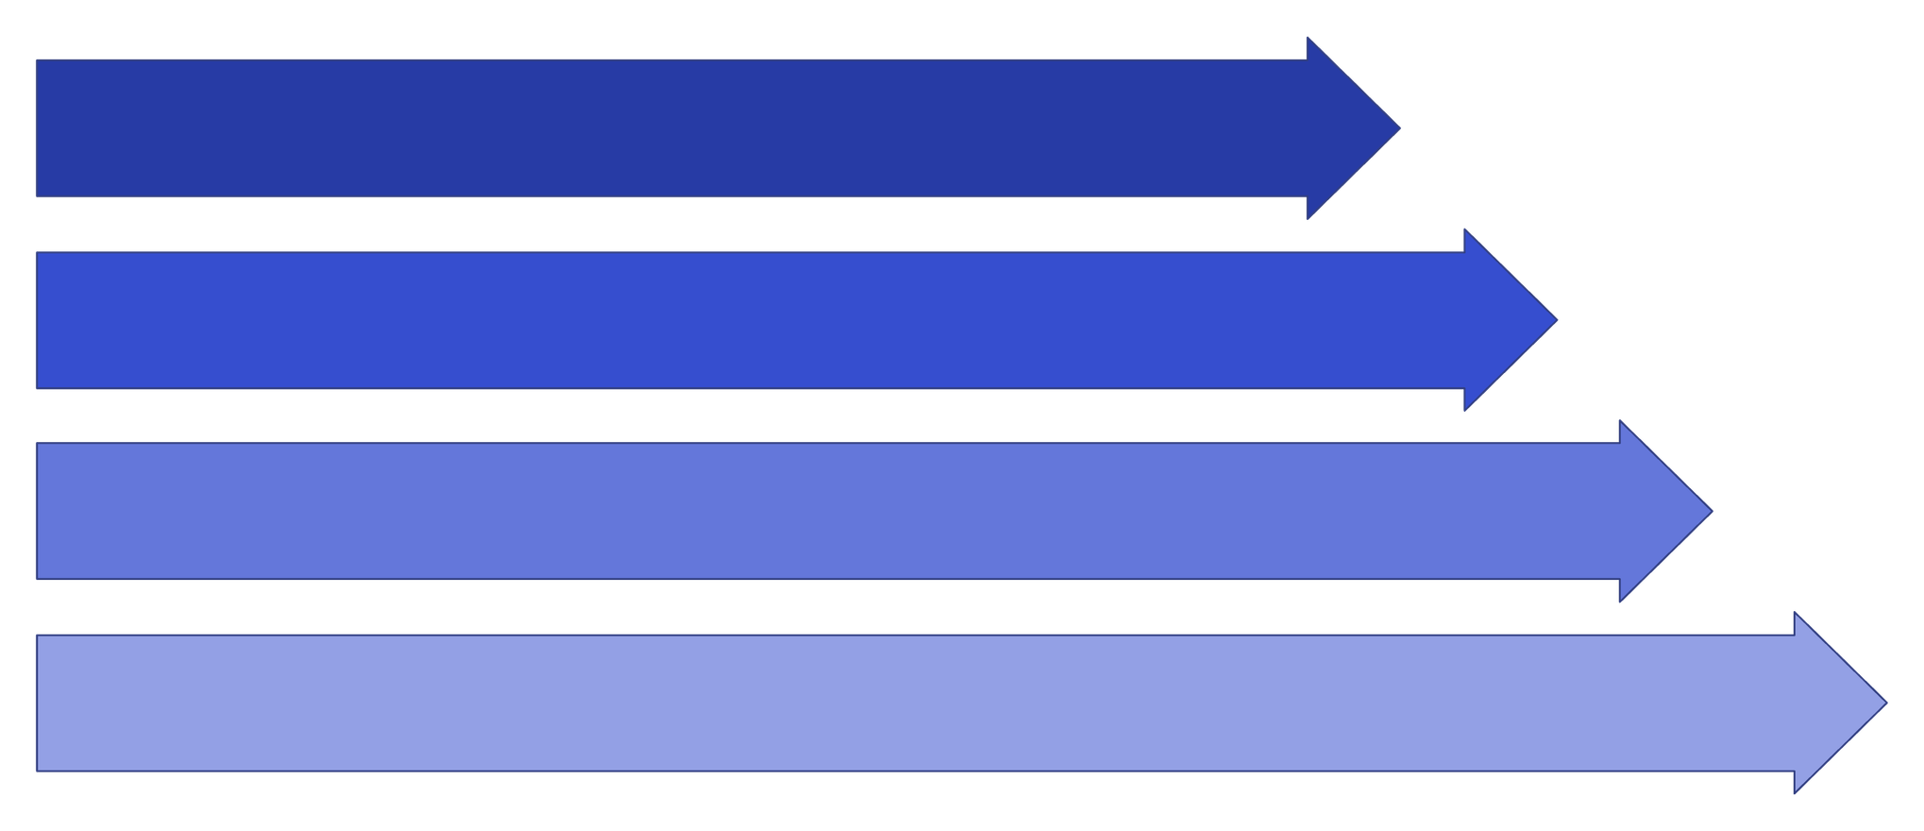
System Architecture
Frontend
Backend API
Storage
AI Pipeline
This architecture separates UI, API, persistent storage and the video/AI pipeline to enable scalability and clear responsibility boundaries.
Notes:
7

Slide 8
Technology Stack
Frontend
Backend & AI
React + Vite — responsive SPA for dashboards and uploads
Python + FastAPI for APIs and the CV/AI pipeline
Storage
Auth & Dev
PostgreSQL managed schema via SQLAlchemy
JWT authentication; Git/GitHub for source control; VS Code for development
Notes:
8

Slide 9
User Roles & Access
Admin
Manage organizations, generate join codes, user and system monitoring
Athlete
Upload videos, view personal progress, follow guidance
Coach
Review athlete performance, quality scores and prescribe training
Physiotherapist
Access injury-relevant metrics, recovery plans and session notes
Sports Scientist
Access research-grade analysis, exportable feature data and cohort comparisons
Notes:
9

Slide 10
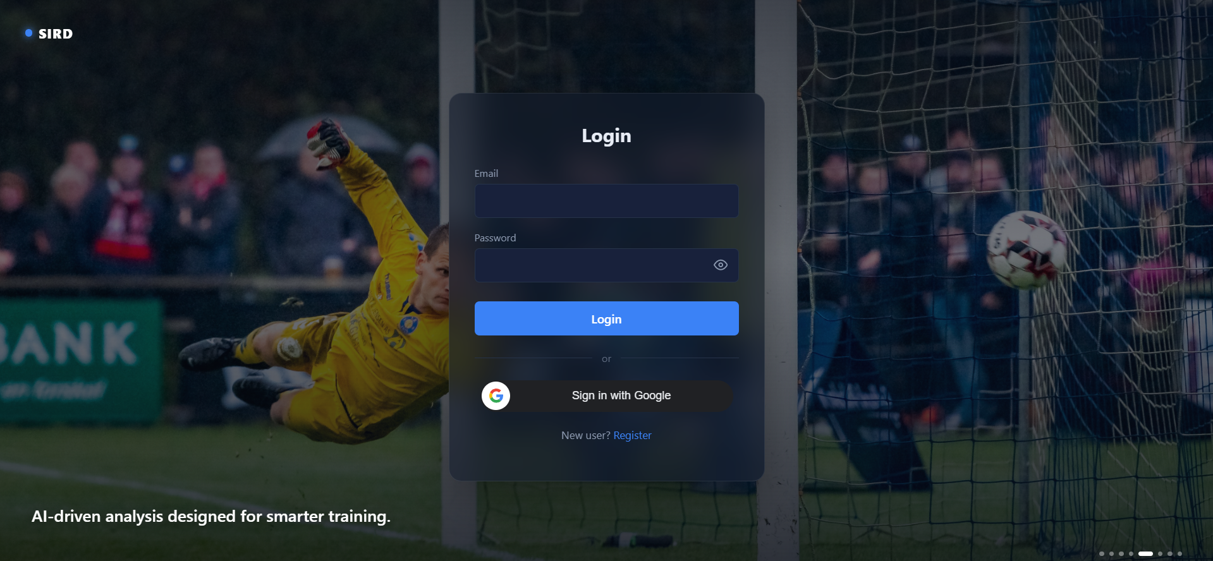
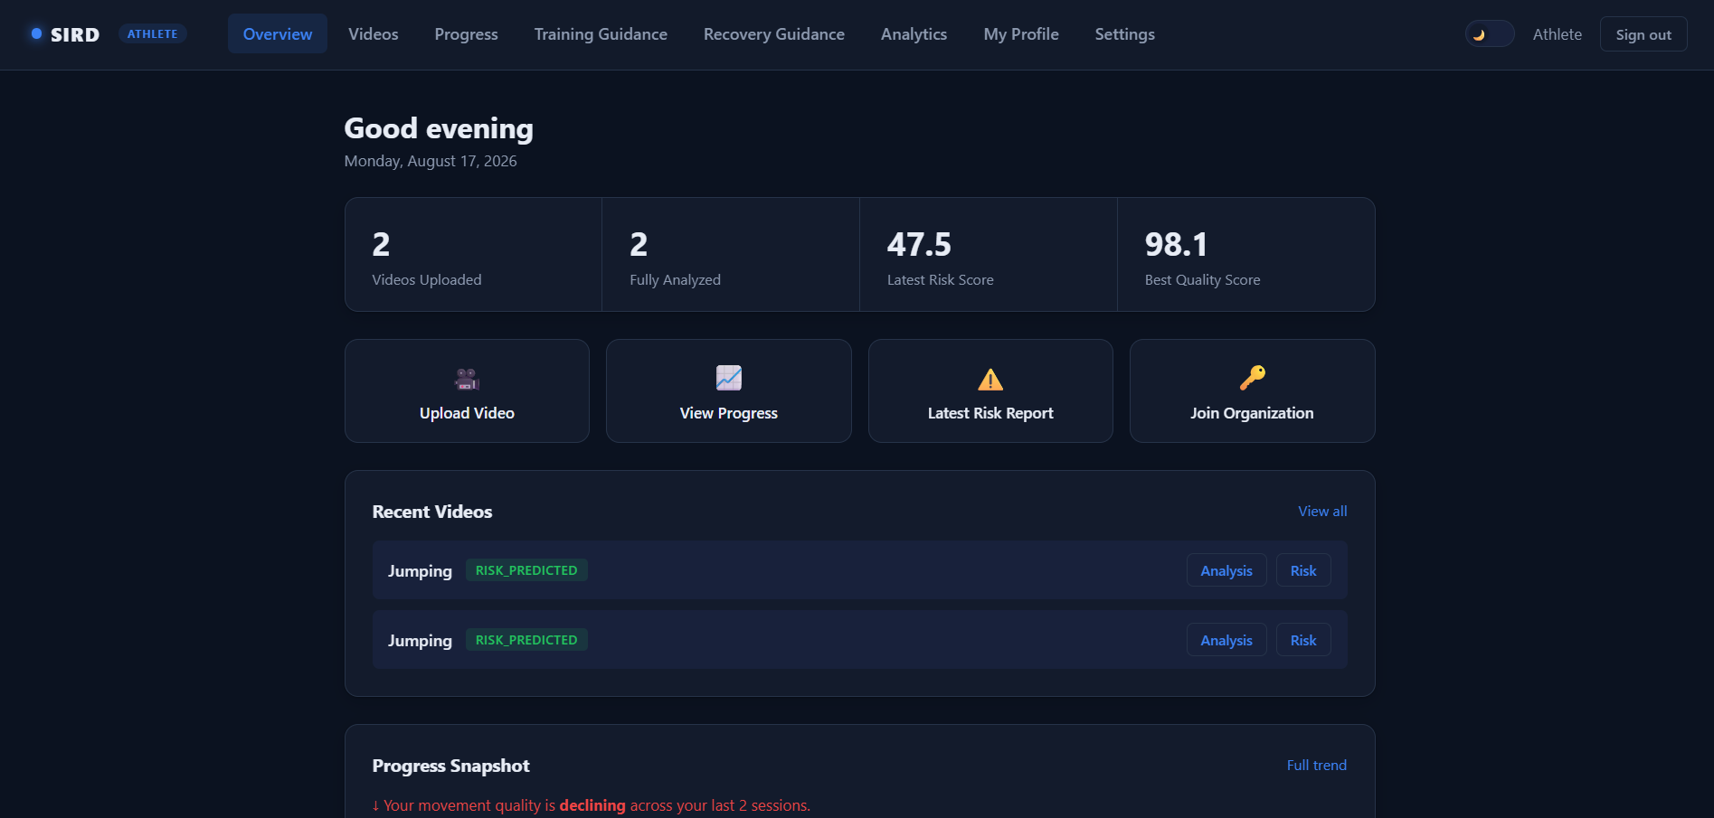
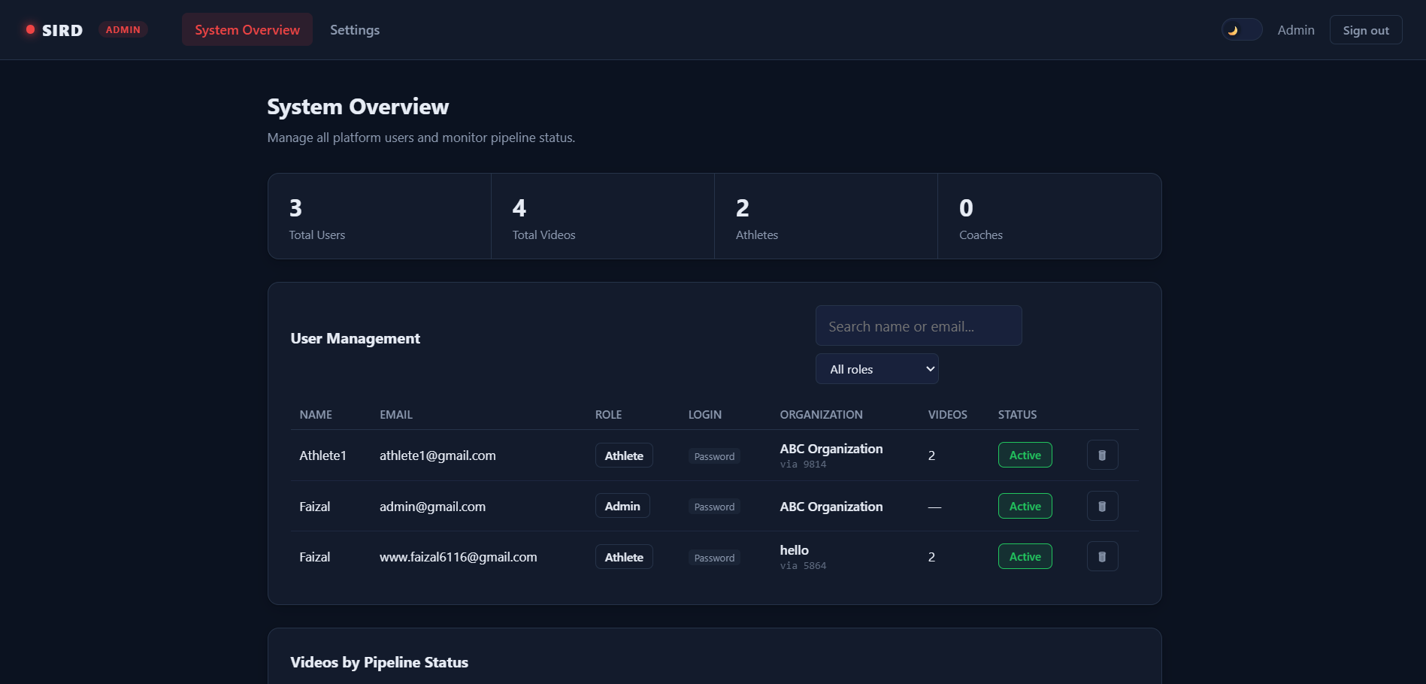
Application Screenshots
Login Page
Athlete Dashboard
Admin Dashboard

Slide 11

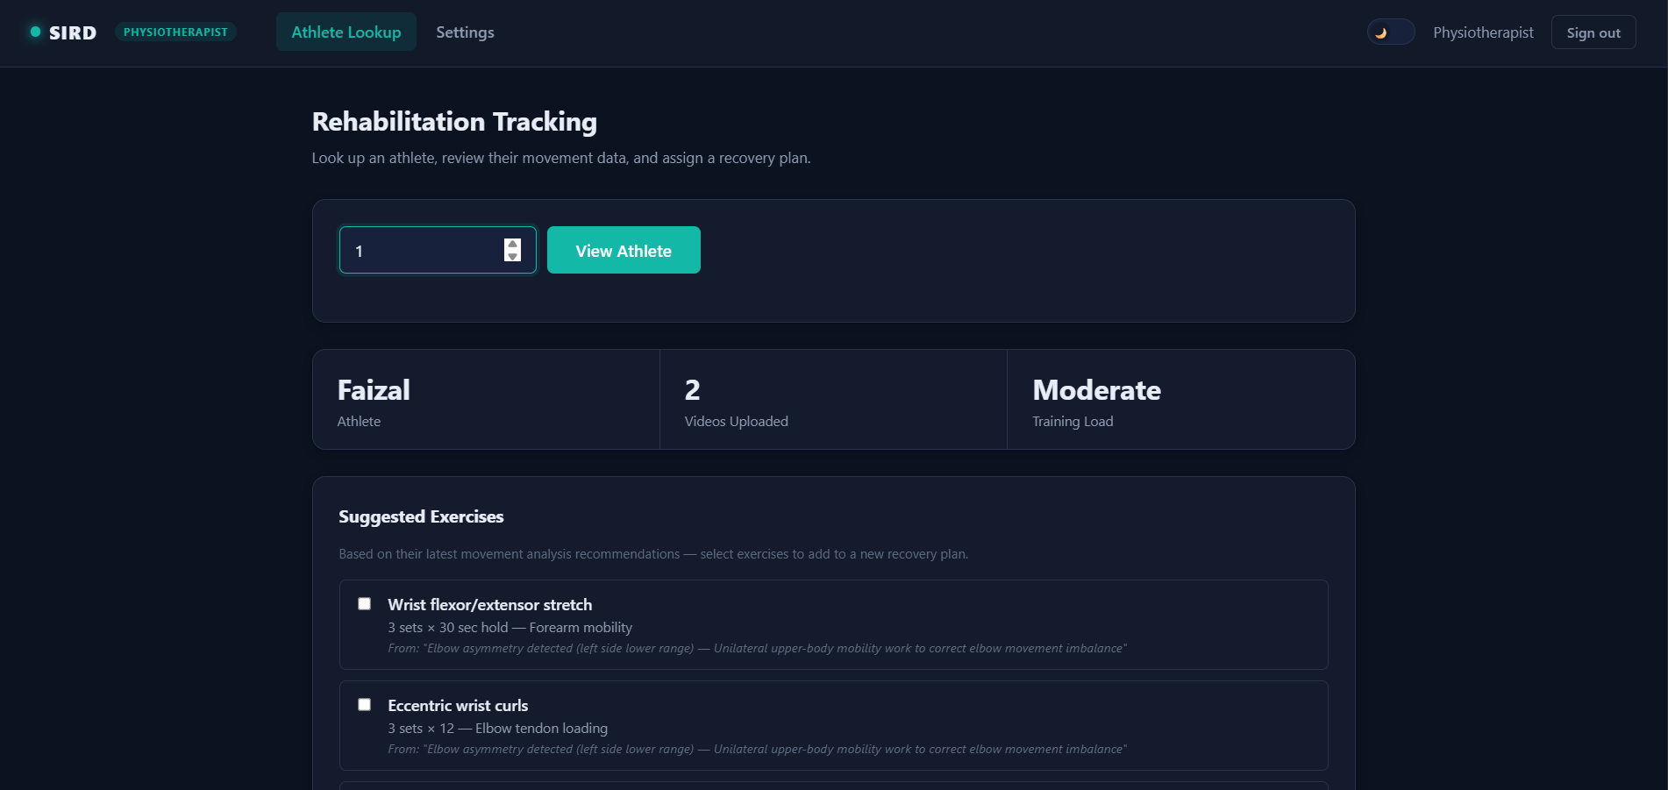
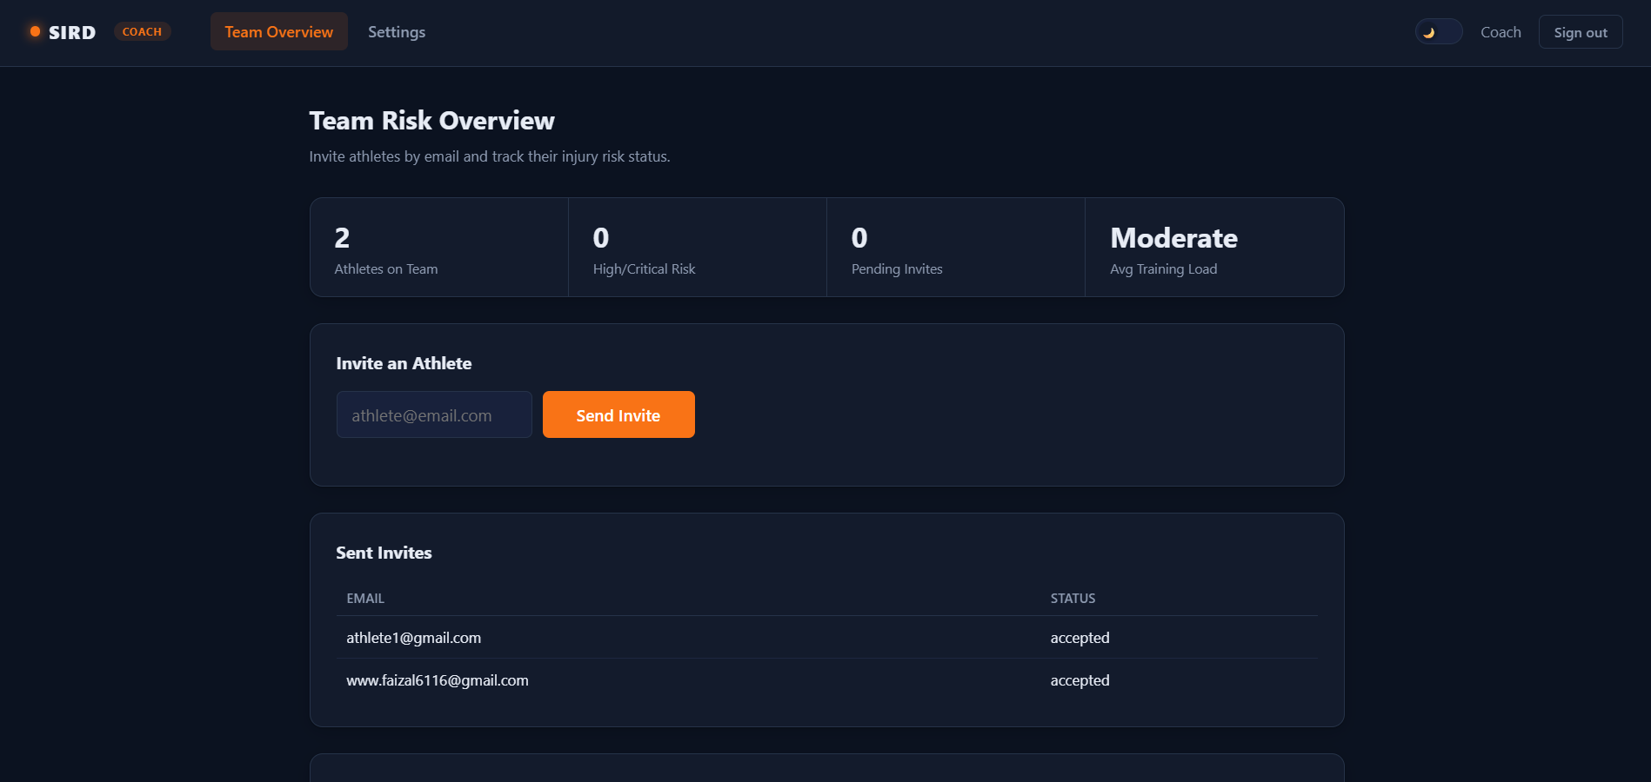
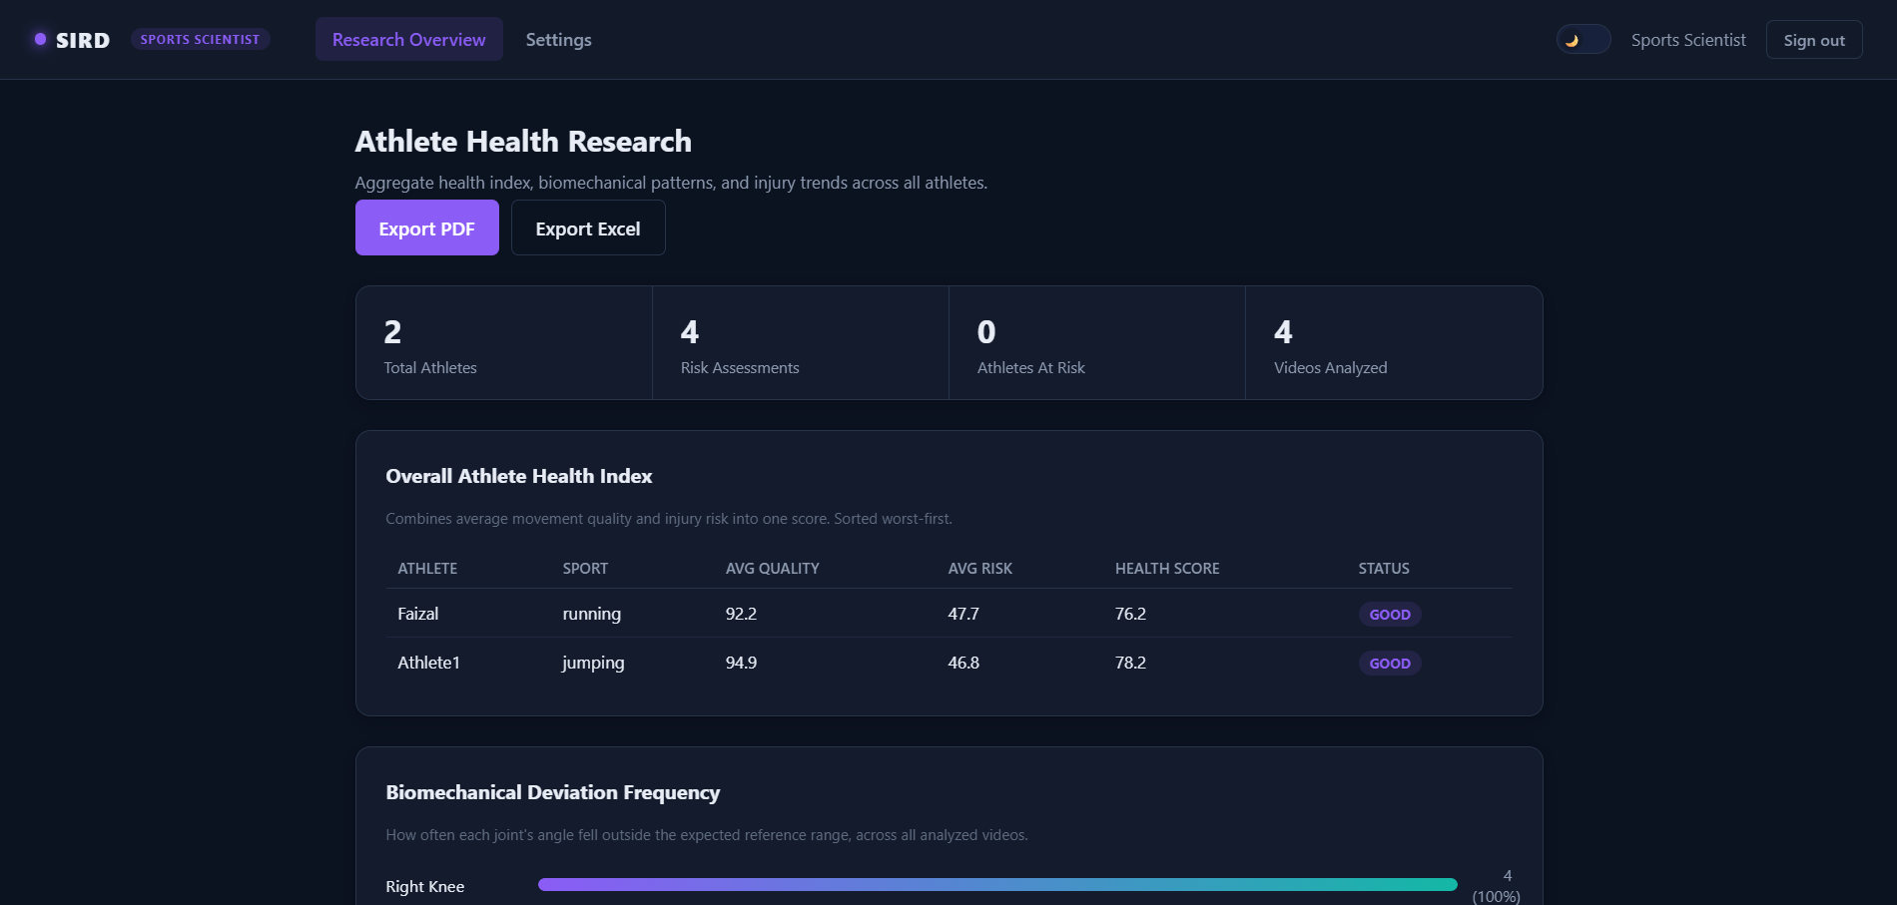
Role-Based Dashboards
Coach Dashboard
Physiotherapist Dashboard
Sports Scientist Dashboard

Slide 12
Future Enhancements
Real-Time Video Analysis Enable live movement and injury-risk analysis during training sessions.
Advanced AI Models Improve movement analysis and risk prediction using more advanced AI techniques and larger datasets.
Mobile Application Provide SIRD features through Android and iOS applications.
Cloud Deployment Deploy the system on cloud infrastructure for scalable access and storage.
Personalized Training Plans Generate customized training and recovery recommendations based on athlete data.
Long-Term Athlete Monitoring Track performance and injury-risk trends over multiple training sessions.

Slide 13
Conclusion
SIRD provides an integrated platform for video-based sports movement analysis and injury-risk assessment.
The system enables athletes to upload and monitor their performance while providing role-based access for coaches, physiotherapists, sports scientists, and administrators.
By combining video processing, AI-based analysis, athlete profiles, risk indicators, and centralized dashboards, SIRD aims to support early risk identification, informed decision-making, and safer sports training

Slide 14
Q&A
THANK YOU

