Slide 1
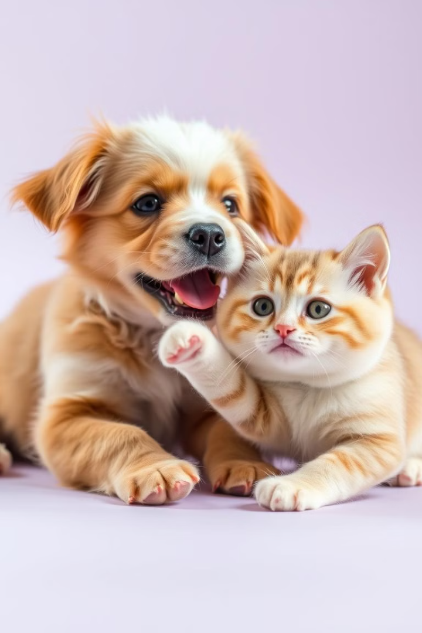
Discovering Dogs and Cats Using Artificial Intelligence and Deep Learning
In this presentation, we will explore artificial intelligence and deep learning techniques to create a system capable of accurately distinguishing dogs from cats. We will cover the basic steps from data collection to model performance evaluation.

Slide 2
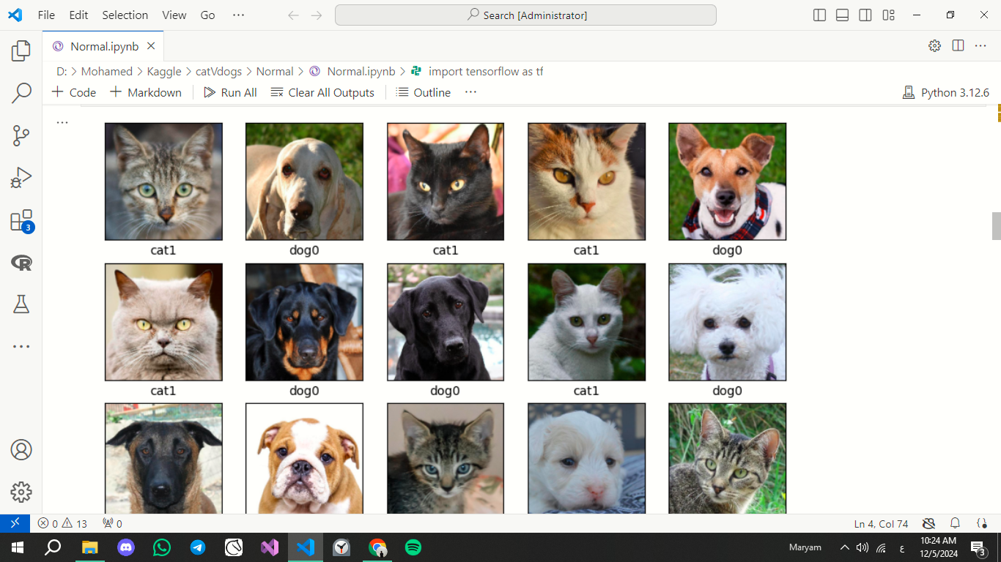
Part of the Data:

Slide 3
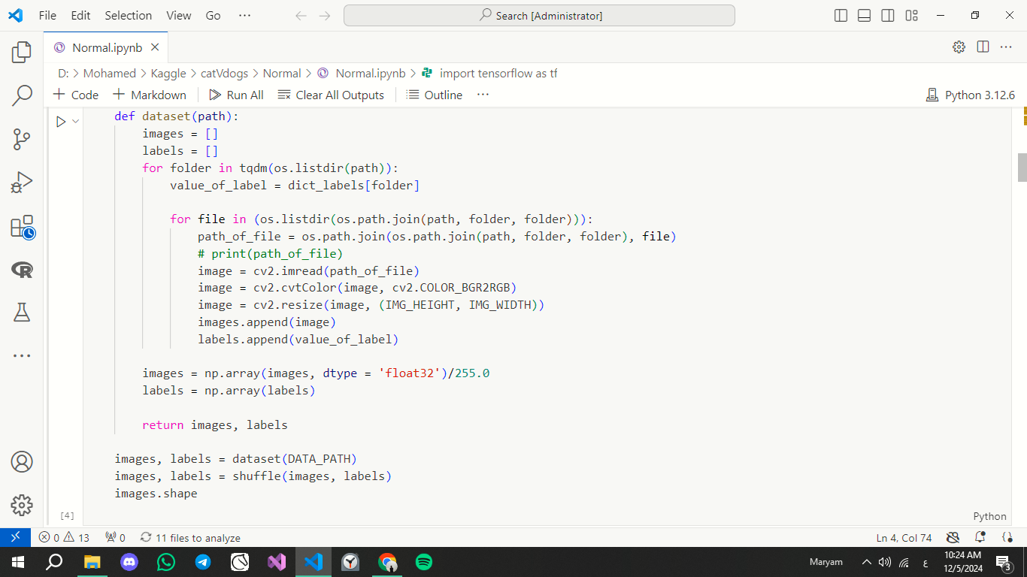
Reading Data: Explaining How to Read Data

Slide 4
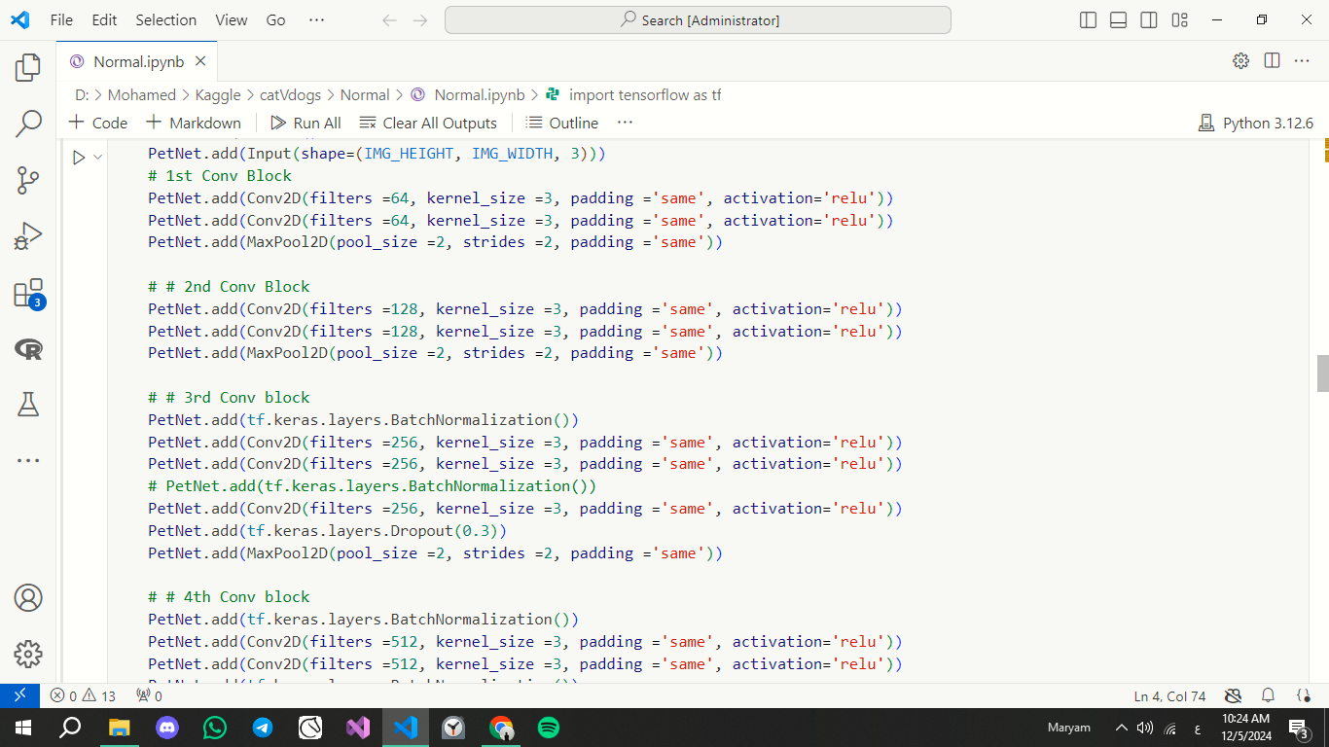
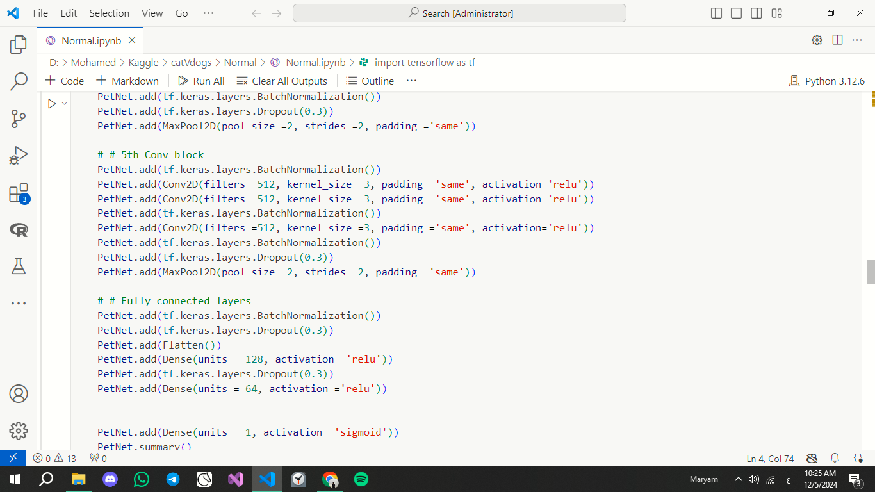
Building the Model: The PetNet Model

Slide 5
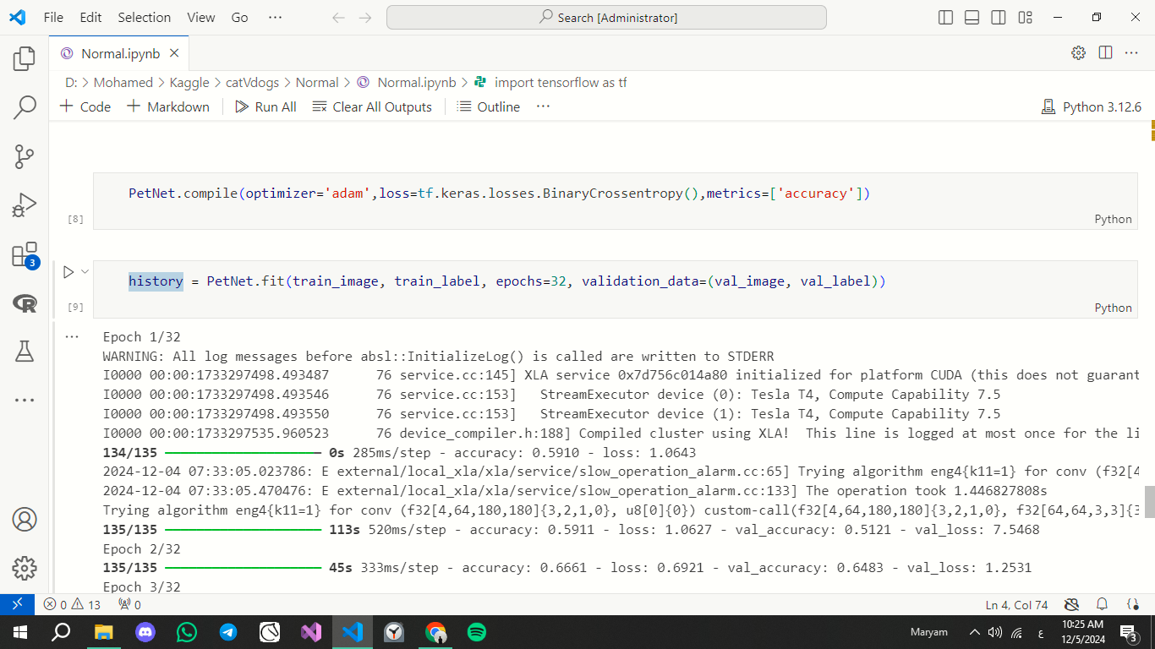
Model Training:

Slide 6
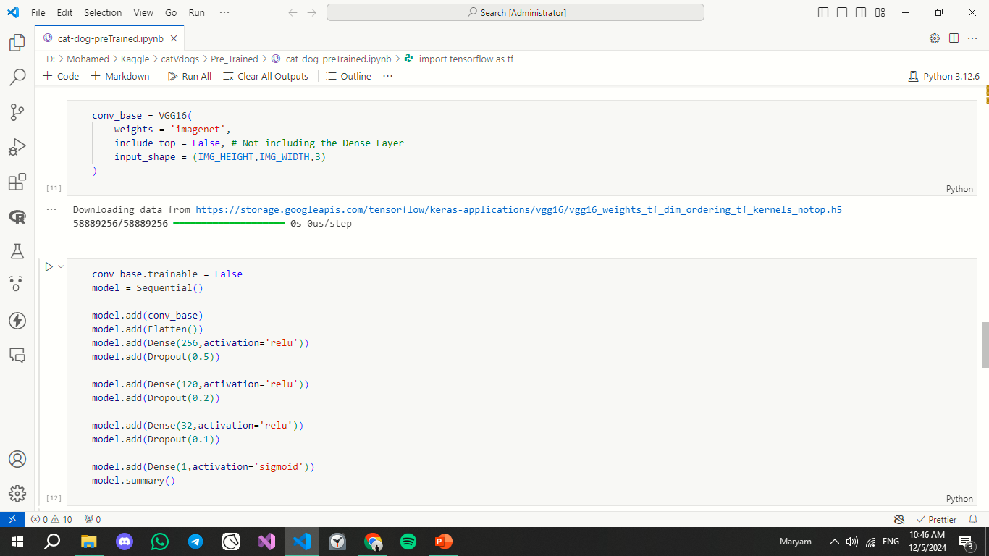
Building the Model: The Pre-Trained Model

Slide 7
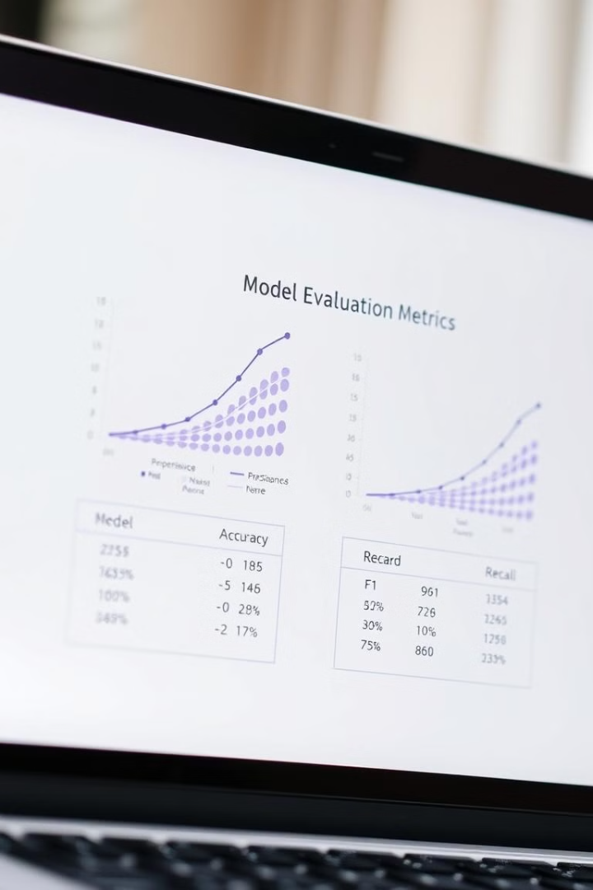
Model Evaluation: Explaining How to Evaluate Model Performance
99%
98%
Pre-Trained
PetNet

