Slide 1
AADHAR BASED FINGERPRINT VOTING MACHINE

Slide 2
INTRODUCTION
The user should show his voter ID card whenever he goes to the booth to poll his vote. This is often a time consuming method because the person needs to check the voter ID card with the list he has, make sure it as an authorized card and then enable the person to poll his vote. Thus, to avoid this type of issues, designed a finger print based voting machine wherever the individuals no ought to carry his ID which contains his entire details.
The person at the booth should show his Finger. This Finger print reader reads the details from the tag. This information is passed to the controlling unit for the verification. The controller reads DATA from the reader and compares this data with the already existing data. If the data matches with the already stored information, the person is allowed to poll his vote. The polling mechanism carries out manually using the switches.

Slide 3
SYSTEM COMPONENTS
1.POWER SUPPLY
2.ARDUINOUNO
3.FINGERPRINT MODULE
4.LCD
5.LED
6.RESISTOR
7.CAPACITOR
8.BUZZER

Slide 4
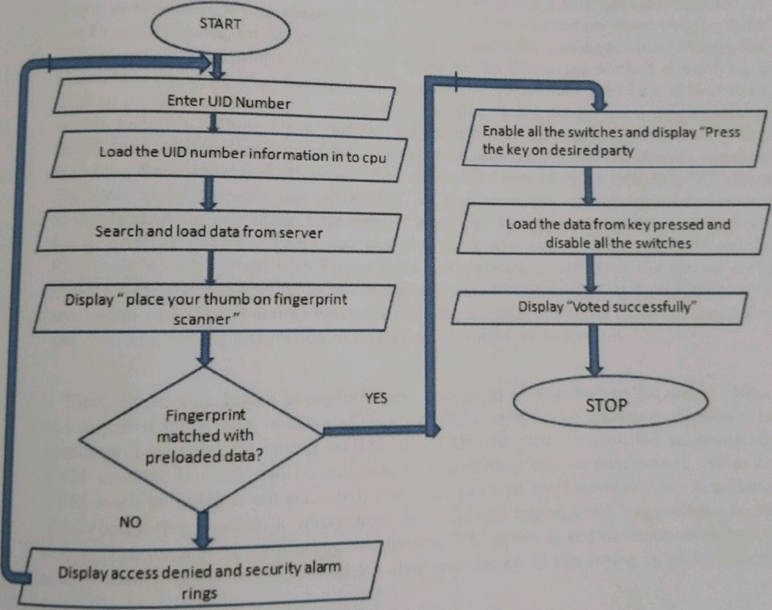
FLOW CHART

Slide 5
1.POWER SUPPLY:
input to the circuit is applied from the regulated power supply. The a.c. input i.e., 230V from the mains supply is step down by the transformer to 12V and is fed to a rectifier.The output obtained from the rectifier is a pulsating d.c voltage.
2.ARDUINO UNO:
Arduino is a prototype platform based on an easy-to-use hardware and software. It consists of circuit board, which can be programed (referred to as a microcontroller) and a ready-made software called Arduino IDE (Integrated Development Environment). which is used to write and upload the computer code to the physical board.

Slide 6
3.LED
A light-emitting diode (LED) is a two-lead semiconductor light source. It is a pn junction diode that emits light when activated. When a suitable current is applied to the leads, [6] [7] electrons are able to recombine with electron holes within the device, releasing energy in the form of photons. This effect is called electroluminescence, and the color of the light is determined by the energy band gap of the semiconductor.
4.RESISTOR
Resistors are elements of electrical networks and electronic circuits and are ubiquitous in most. electronic equipments. resistors can be. made of compounds and films, as well as resistance wire( wire made of high-resistivity alloy, such as nickel/chrome). The primary characteristics of a resistor are the resistance, the tolerance, the maximum working voltage and power rating. Resistors can be integrated into hybrid and printed circuits, as well as integrated circuits. Size and position of leads (or terminals) are relevant to equipment designers;resistors must be physically large enough not to overheat when dissipating their power.

Slide 7
5. CAPACITOR
A capacitor is a passive two-terminal electrical component that stores potential energy in an electric. The effect of a capacitor is known as capacitance. While some capacitance exists between any two electrical conductors in proxirnity in a circuit, a capacitor is a Component designed to add capacitance to a circuit. The capacitor was originally known as condenser
6.BUZZER
A buzzer or beeper is an audio signalling which may be mechanical, electromechanical, or piezoelectric (piezo for short). Typical uses of buzzers and beepers include alarm dcviccs, timers, and confirmation of user input, such as a mouse, click or keystroke.There are different types of buzzers.

Slide 8
7.LCD
A liquid-crystal display (LCD) is a flat-panel display or other electronically modulated optical device that uses the light-modulating properties of liquid crystals. Liquid crystals do not emit light directly, instead using a backlight or reflector to produce images in colour or monochrome. LCDs arc available to display arbit,rary images or fixed images with low information content, which can be displayed or hidden, such as preset words, digits, and 7-segment displays: as in a digital clock.
8.FINGERPRINT MODULE
The module itself does all of the heavy lifting behind reading and identifying the fingerprints with an on-board optical sensor and 32-bit CPU. All you need to do is send it simple cornrnands. To get started, just register each fingerprint that you want to store by sending the corresponding command and pressing your finger against the reader three times. The fingerprint scanner can store different fingerprints and the database of prints can even be downloaded from the unit and distributed to other modules. As well as the fingerprint "template," the analyzed version of the print, you can also retrieve the image of a fingerprint and even pull raw images from the. optical sensor.

Slide 9
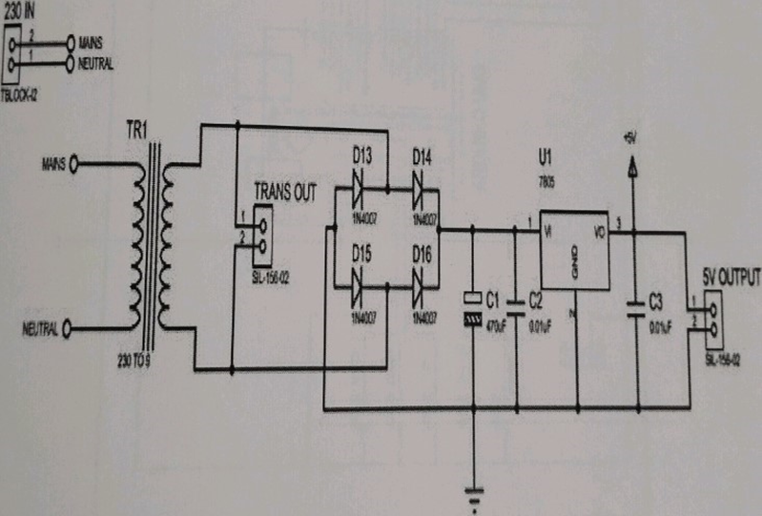
CIRCUIT

Slide 10
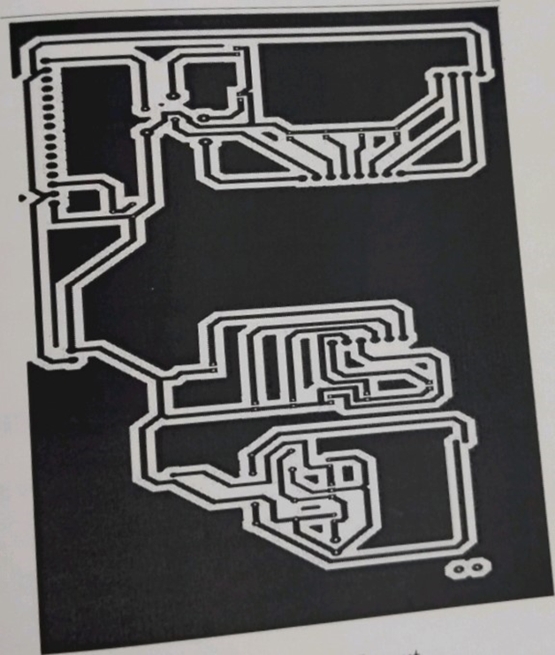
PCB LAYOUT

Slide 11
ADVANTAGE AND DISADVANTAGE
*Accuracy: cast ballot cannot be altered. Therefore, it must not be possible to delete ballots nor to add ballots, once the election has been closed
*Public verifiability: anyone should be able to readily check the validity of the whole voting process
*People must be enrolled with Aadhar card

Slide 12
FUTURSCOPE
could be interfaced with the personal computer and result could be stored in the central server and its backup could be taken on the other backend servers.
Once the result is on the server it could be relayed on the network to various offices of the election conducting authority.

Slide 13
CONCLUSION
The AADHAR based electronic voting machine is based on the current scenario of making Aadhar mandatory in all aspects. It can be used as a real time application instead of using EVM in polling booths because it avoids consecutive verification of voter, provides greater security and avoid false casting of votes.These type of voting machine have advantage of faster tabulation of results,greater accuracy and lower risk of human and mechanical errors.

Slide 14
THANKYOU

