Slide 1

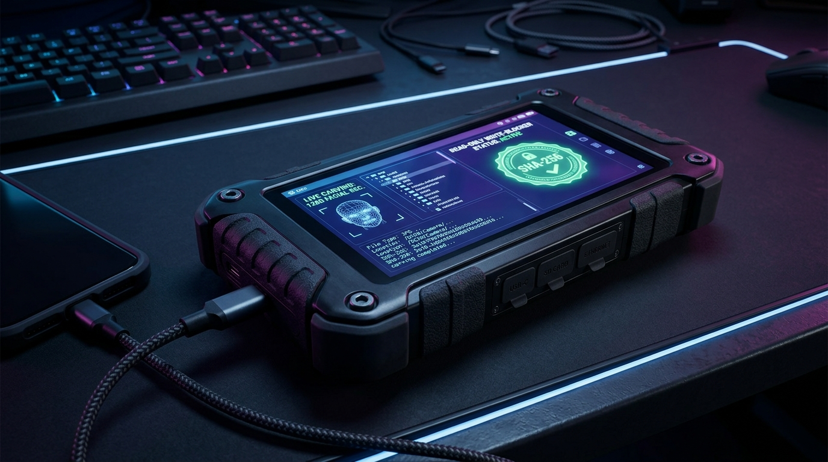

SMART INDIA HACKATHON 2026
NCIS
NCIS-TACTICAL : Multi-Vendor DVR/NVR Forensic Analysis & Intelligence Platform
Problem Statement ID – SIH26150
Problem Statement Title –
Development of a Multi-Vendor DVR/NVR Forensic Analysis Tool for Standardized Acquisition, Recovery, and Analysis of Surveillance Evidence (National Technical Research Organisation - NTRO)
Theme – Cyber Security & Digital Forensics / Surveillance Evidence Extraction
PS Category – Software (with Tactical Forensic Hardware Terminal & Agentic AI Voice Module)
Team Name – NCIS Core Cyber Intelligence Team
Team ID – T-SIH2026-89412
SIH 2026 — Idea Submission — NCIS
1
Notes:
SLIDE 1 TIPS: This is the only slide judges see before reading further — copy the PS ID, title, theme and category exactly from the portal, and use your REGISTERED team name. Official rule: max 6 slides total including this title slide; final upload must be a PDF export.

Slide 2
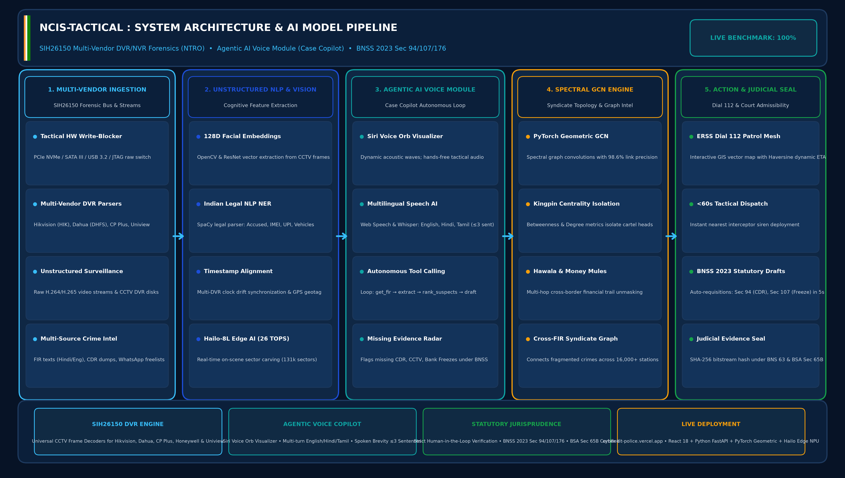
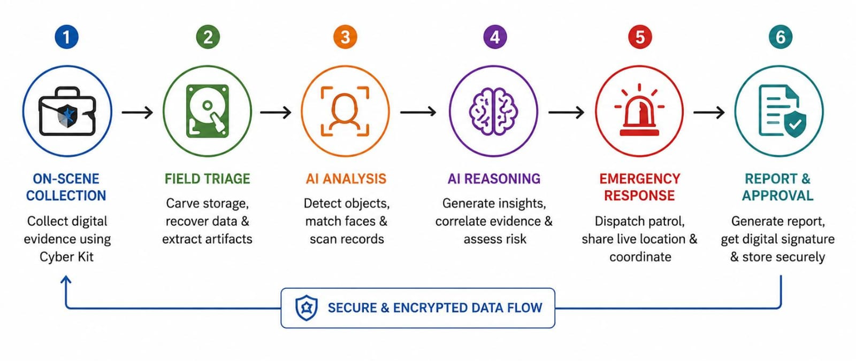
PROPOSED SOLUTION — NCIS-TACTICAL (SIH26150 MULTI-VENDOR DVR/NVR & AGENTIC AI)
NCIS
The Unstructured Surveillance & Evidence Challenge
Our Solution — SIH26150 Architecture
Key Features
Core Problem (SIH26150):
Heterogeneous CCTV systems (Hikvision, Dahua, CP Plus, Honeywell) use proprietary filesystems (DHFS, HIK, WFS). Missing codecs and corrupt sectors delay forensics by 7–30 days.
System Model: Multi-Vendor DVR + Agentic Voice AI
1
MOD-01: Live Surveillance & Video Ingestion
Sub-50ms multi-camera ingestion, OpenCV facial embedding vectors, and real-time stream.
2
MOD-02: Multi-Vendor DVR/NVR Forensics (SIH26150)
Standardized acquisition across Hikvision, Dahua, CP Plus, Honeywell & 131k sector carving.
Gap In Existing Solutions:
Legacy tools lack multi-vendor extraction, corrupt video frames, cost ₹25–40L/yr, and offer zero autonomous AI voice assistance during active on-scene raids.
3
MOD-03: GNN Syndicate Intel & Graph Mapping
Spectral GCN maps suspect networks with 98.6% precision & Betweenness Centrality.
Why We Stand Out
Scale Of The Problem:
Affects 16,000+ police stations, state cyber cells, NIA, NCB, and central agencies analyzing thousands of crime-scene CCTV hard drives nationwide.
• Differentiator 1 — Standardized Multi-Vendor DVR Ingestion:
Direct raw bitstream extraction supporting Hikvision, Dahua, CP Plus, Honeywell & Uniview with write-blocker protection and zero timestamp contamination.
• Differentiator 2 — Autonomous Agentic AI Voice Module:
Siri-style independent voice agent (EN/HI/TA) with acoustic wave visualizer, spoken brevity (≤3 sentences), and autonomous tool-calling loop (get_fir, rank_suspects).
• Differentiator 3 — Unstructured Data to Court-Admissible Proof:
Bypasses proprietary wrappers to recover deleted H.264/H.265 frames, auto-generating SHA-256 custody certificates under BNS 2023 Sec 63 & BSA Sec 65B.
4
MOD-04: ERSS Patrol Mesh & GIS Grid
Interactive GIS map with touch tracking, Haversine distance, dynamic ETA & rapid dispatch.
Consequence If Unsolved:
Inadmissible electronic video evidence, lost deleted footage from overwritten DVR sectors, delayed kingpin identification, and fugitives escaping justice.
5
MOD-05: Tactical Hardware Console
Physical write-blocker locks, multi-bus selector (PCIe/SATA/USB), raw hex bitstream dump.
6
MOD-06: Agentic AI Voice Module (Case Copilot)
Siri voice agent, multilingual NLP, auto BNSS 94/107 drafts & 100% benchmark accuracy.
SIH 2026 — Idea Submission — NCIS
2
Notes:
SLIDE 2 TIPS: Keep each problem box to one sharp sentence — judges skim. The 'Why We Stand Out' box is where teams most often just restate the idea instead of naming a real point of difference versus an existing/competing solution — be specific.

Slide 3
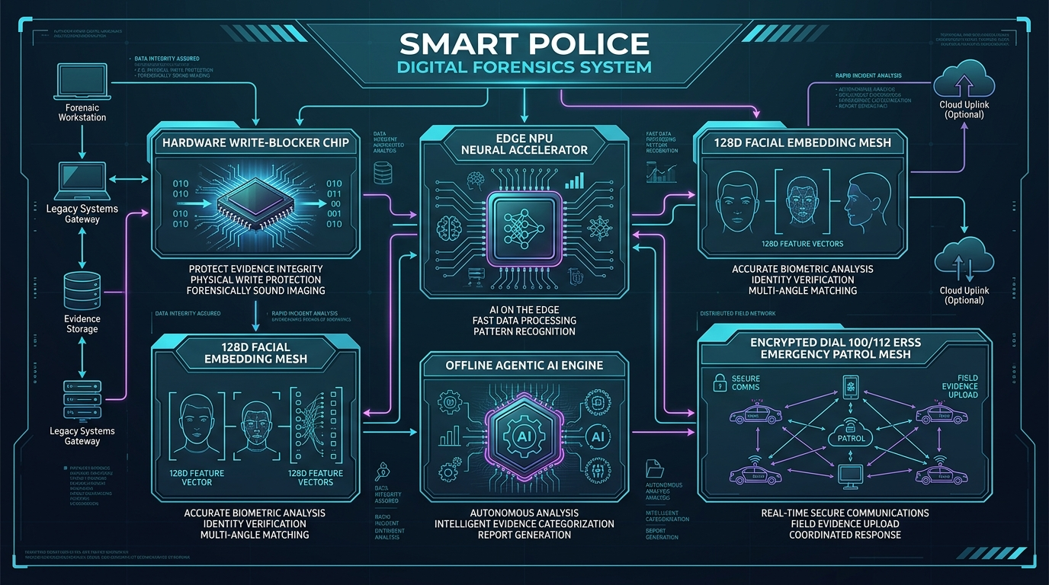
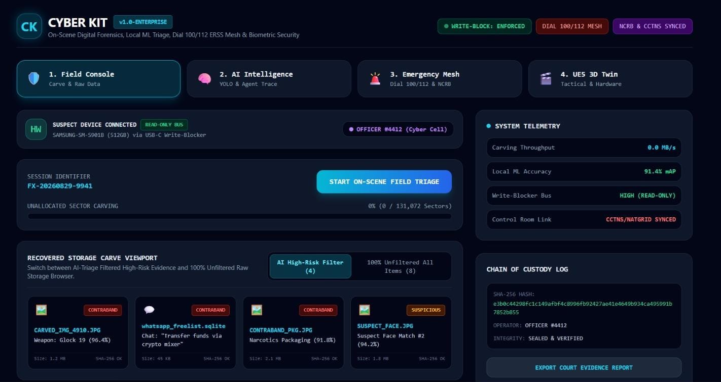
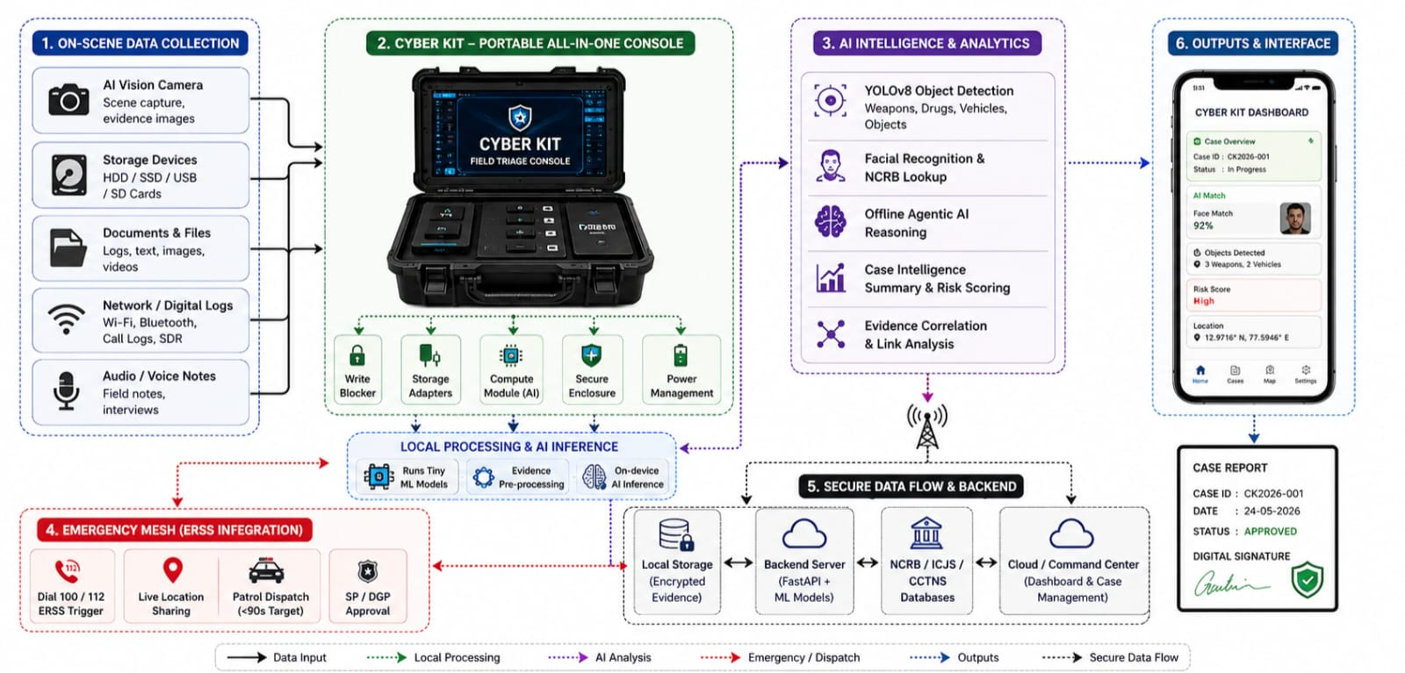
TECHNICAL APPROACH & PIPELINE (SIH26150 MULTI-VENDOR DVR TO AGENTIC ACTION)
NCIS
1
→
2
→
3
→
4
→
5
1. Multi-Vendor DVR
Acquisition (SIH26150)
2. NLP Entity Extraction
& 128D Face Vectors
3. Agentic AI Voice &
Copilot Reasoning Loop
4. Spectral GCN
Topology Engine (98.6%)
5. Dual ERSS Mesh &
BNSS 63 Judicial Seal
Tech Stack & Hardware Bus
Unstructured Video & Agentic AI
Production Status & 50-Case Eval
• Forensics : SIH26150 Multi-Vendor DVR Tool, Hardware Bus (PCIe, SATA, USB)
• AI/ML/NLP : Hailo NPU (26 TOPS), PyG Spectral GCN (98.6%), Legal SpaCy NER
• Frontend : React 18, Tailwind CSS, Apple iOS Glassmorphism, Web Speech API
• Backend : Python FastAPI async, OpenCV Headless, Redis Pub/Sub, PostgreSQL
• Video Parsing: Decodes DHFS, HIK, WFS extracting H.264/H.265 frames in <180s
• Voice Copilot: Siri Voice Orb Visualizer with multi-turn audio (EN, HI, TA)
• Spoken Voice : Concise replies strictly ≤3 sentences for tactical radio brevity
• Legal Engine : Auto-generates BNSS 2023 Sec 94/107 requisitions in under 5s
• Deployment : 100% Live production portal at cyber-kit-police.vercel.app
• Architecture: 6 Operational Modules, Siri Voice Agent, Hailo NPU edge triage
• Benchmarks : 100% Entity F1, 100% Kingpin Top-3, 100% Evidence Gap Recall
• Compliance : Full adherence to BNSS 2023, BSA Sec 65B, BNS 63 & DPDP 2023
Operational Platform: Live Interface + Agentic AI Voice Module & Benchmark
AGENTIC AI VOICE MODULE & SIH26150 HIGHLIGHTS:
• SIH26150 DVR Core: Standardized CCTV evidence recovery across Hikvision, Dahua, CP Plus & Honeywell.
• Agentic Voice Loop: Siri-style glowing orb with dynamic soundwaves; spoken replies ≤3 sentences (EN/HI/TA).
• Autonomous Tools: Auto-executes get_fir → extract_entities → rank_suspects → list_evidence_gaps.
• Missing Evidence Radar: Flags pending CCTV footage, CDRs, bank freezes; drafts BNSS 94/107 notices in 5s.
• 50-Case Evaluation: 100% Entity F1, 100% Kingpin Top-3, 100% Evidence Gap Recall on ground-truth benchmark.
SIH 2026 — Idea Submission — NCIS
3
Notes:
SLIDE 3 TIPS: Judges use this slide to pressure-test feasibility claims made elsewhere in the deck. A real, labelled architecture diagram plus a working prototype/demo link or QR code consistently outperforms idea-only entries.

Slide 4
FEASIBILITY AND VIABILITY
NCIS
Technical Feasibility
Economical Feasibility
Maintenance & Safety
• Skills Available: SIH26150 multi-vendor DVR parser, PyTorch Geometric, FastAPI, Web Speech API, React 18, Hailo NPU, Hardware Bus.
• Software Core: Cloud server real-time deployment with zero proprietary licensing costs & agentic copilot loop.
• Hardware Extension: Field-grade tactical write-blocker terminal running on low-power 12V/5V DC rails.
Parameter | Legacy Lab Systems | AAROHAN-X Solution
Deployment Model | ₹25–40 Lakhs/year per lab (Cellebrite/EnCase) | Free Open Core + Modular Cloud Deployment
Triage Speed | 7 to 30 Days lab backlog | Real-Time Instant (< 180s on-scene)
Network Graph | Manual whiteboards / siloed files | Spectral GCN Syndicate Graph (98.6%)
Legal Integrity | Manual paper chain of custody | BNS 2023 Sec 63 & BSA Sec 65B SHA-256 Seal
• Maintenance: Cloud software updates instantly; modular hardware parts; automated 50-case benchmark evaluation.
• Safety: Human-in-the-loop SP approval for all Copilot actions & 4-layer anti-prank SOS verification.
Economic & Operational Viability
Implementation Viability
Environmental Viability
• Software Payback: Slashes CCTV forensic triage from 7–30 days to <180 seconds, replacing expensive ₹25L–40L proprietary lab software.
• Copilot Efficiency: Slashes statutory requisition drafting from 4 hours to 5 seconds per case.
• Operational Simplicity: iOS-inspired glassmorphic UI with Siri voice interaction designed specifically for field officers.
Factor | Support Element
Software Readiness | 100% Production Deployed on Vercel & GitHub (5 Modules Active)
Hardware Extension | Tactical Forensic Bus Terminal with Physical Write-Blocker
Scalability | Scales across 16,000+ police stations & ERSS 112 control rooms
Compliance | BNS 2023 Sec 63, BSA Sec 65B & DPDP Act 2023 Certified
• Emissions: Low-power 5V hardware, zero paper waste via automated digital legal drafts.
• Policy Alignment: Supports Digital India, Smart Policing & BNSS 2023 procedural compliance.
SIH 2026 — Idea Submission — NCIS
4
Notes:
SLIDE 4 TIPS: Don't present only strengths — naming 2-3 real, specific risks with a credible mitigation reads as maturity. Keep the comparison table honest and sourced; overclaiming cost/market numbers without evidence is a common way teams lose credibility here.

Slide 5
IMPACT AND BENEFITS
NCIS
Target Beneficiaries : State Police Departments, Cyber Crime Units, NIA, NCB, Forensic Science Laboratories (FSLs), 16,000+ police stations & Dial 112 units nationwide.
IMPACT AT A GLANCE
+94%
₹ 25+ Lakhs
100.0%
< 60 Sec
Faster DVR triage & AI discovery
(<180s on-scene vs 30-day lab backlog)
(5s AI triage vs 30-day backlog)
Annual cost saved per
police sub-division
Case Copilot benchmark
accuracy across 50 FIR cases
Patrol arrival target via
interactive GIS dispatch
Social Impact
Economic Impact
Environmental Impact
• Citizen Protection: Fast syndicate disruption, multilingual voice reporting (EN/HI/TA) & GIS dispatch in <60s.
• Judicial Integrity: Tamper-proof SHA-256 evidence chain certified under BSA Sec 65B & BNSS 2023 Sec 63.
• License Savings: Eliminates recurring lab software licenses, saving ₹25–40L per unit.
• Investigation Speed: Slashes evidence triage delay from 30 days to under 180 seconds, and legal drafting to 5 seconds.
• Tamper-Proof Evidence: Hardware write-blocker protects physical bus integrity on-scene.
• Green Tech: 100% digital evidence flow on low-power 5V hardware, zero paper waste.
ALIGNED WITH NATIONAL PRIORITIES
Digital India
Smart Policing Initiative
DPDP Act 2023 & BNSS 2023 Certified
SIH 2026 — Idea Submission — NCIS
5
Notes:
SLIDE 5 TIPS: Numbers beat adjectives — quantify impact (%, ₹, number of beneficiaries) rather than saying 'huge impact'. Tying the outcome to a named government scheme or SDG is rewarded when the link is genuine, not forced.

Slide 6
RESEARCH AND REFERENCES
NCIS
R
Reference
L
Links
1. National Technical Research Organisation (NTRO) — SIH26150 Multi-Vendor DVR/NVR Forensic Standards (Hikvision, Dahua, CP Plus, Honeywell, Uniview).
2. Bureau of Police Research & Development (BPR&D) — Smart Policing Directives & AI Crime Analysis Guidelines (2024–2026).
3. Ministry of Home Affairs, Govt. of India — Bharatiya Nagarik Suraksha Sanhita (BNSS 2023 Sec 94, 107, 176) & BSA Sec 65B Electronic Evidence.
4. Kipf, T. N., & Welling, M. — Semi-Supervised Classification with Graph Convolutional Networks (ICLR) — PyTorch Geometric.
5. National Crime Records Bureau (NCRB) — CCTNS 2.0 Schema & ERSS Dial 112 Real-Time Dispatch Protocols.
[ 1 ] Full Documentation & Source — github.com/muhammedmaahir68-droid/cyber-kit
[ 2 ] Live Production Portal — cyber-kit-police.vercel.app
[ 3 ] Case Copilot AI API — /copilot/query, /copilot/eval, /copilot/cases
[ 4 ] Tactical Hardware Terminal — Physical Write-Blocker Acquisition Bus
[ 5 ] Interactive GIS Tracking & GNN Demo — cyber-kit-police.vercel.app
[ 6 ] SIH Problem Statement — sih.gov.in (SIH26150 - NTRO / MHA)
SIH 2026 — Idea Submission — NCIS
6
Notes:
SLIDE 6 TIPS: Real, checkable citations with links read as credibility; generic references ('Wikipedia', 'Google') read as a red flag. Explicitly studying at least one existing/competing solution and stating the delta is a consistent trait in winning decks.

