Slide 1

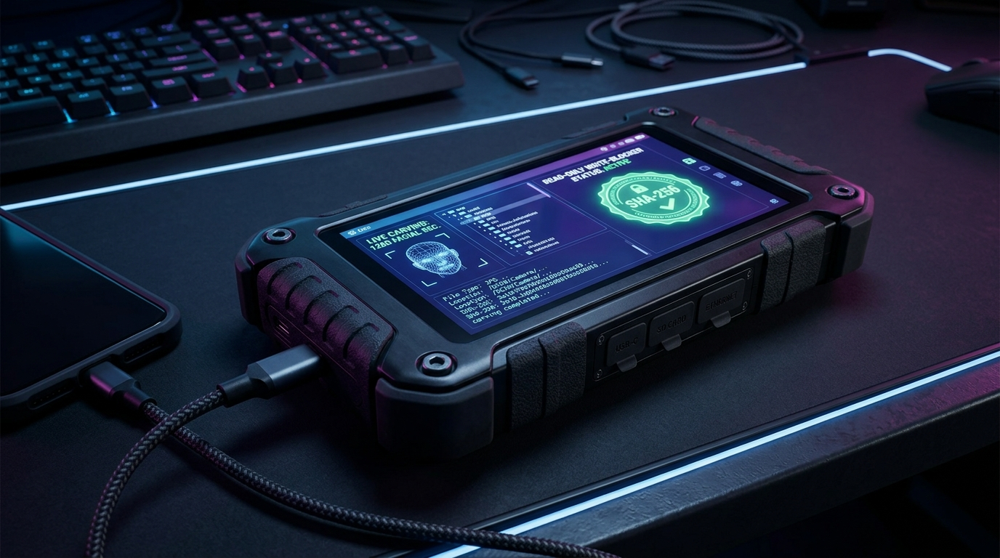

SMART INDIA HACKATHON 2026
NCIS
NCIS-TACTICAL : AI-Powered Criminal Network & Forensic Investigation Platform
Problem Statement ID – 189
Problem Statement Title –
AI-Powered Criminal Network Analysis System (Bureau of Police Research & Development / Ministry of Home Affairs)
Theme – Smart Automation / Cyber Security & Law Enforcement (Featuring Case Copilot Voice AI)
PS Category – Software (with Tactical Forensic Hardware Terminal & Siri Voice Agent)
Team Name – NCIS Core Cyber Intelligence Team
Team ID – T-SIH2026-89412
SIH 2026 — Idea Submission — NCIS
1
Notes:
SLIDE 1 TIPS: This is the only slide judges see before reading further — copy the PS ID, title, theme and category exactly from the portal, and use your REGISTERED team name. Official rule: max 6 slides total including this title slide; final upload must be a PDF export.

Slide 2
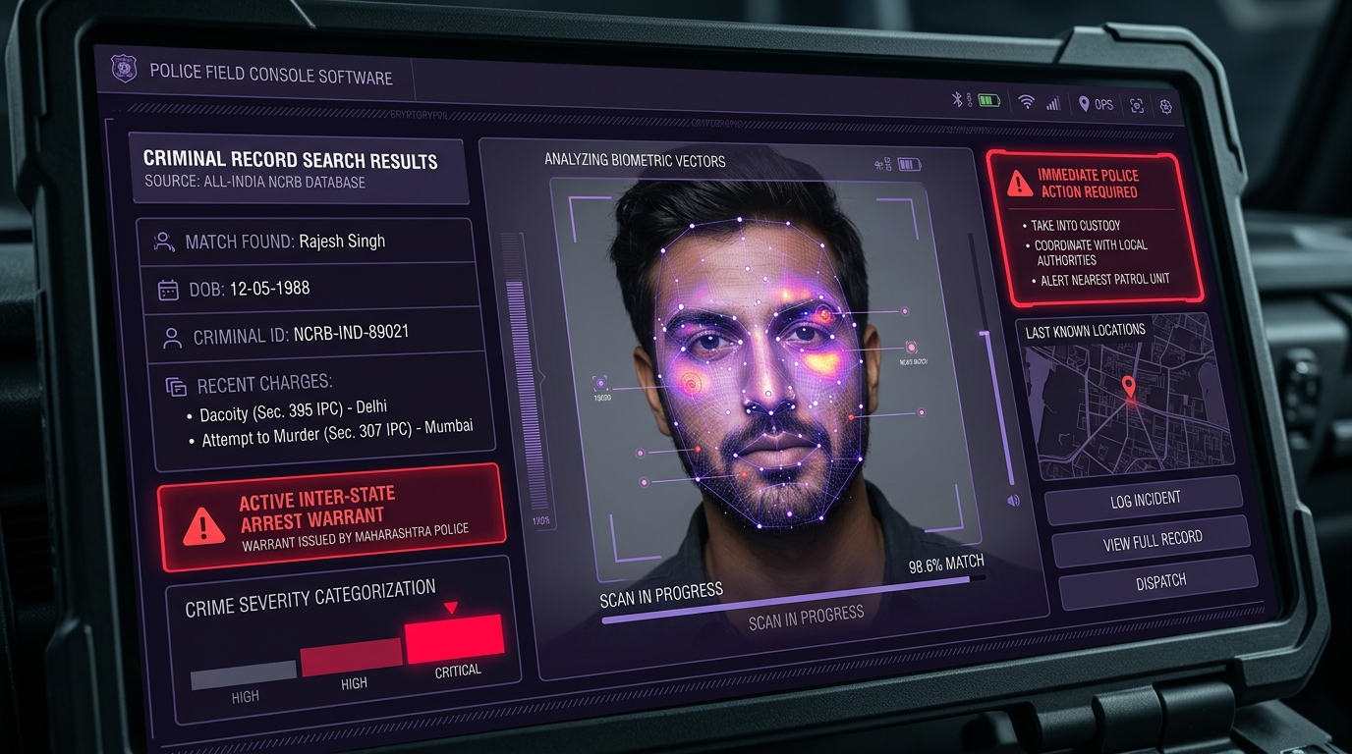
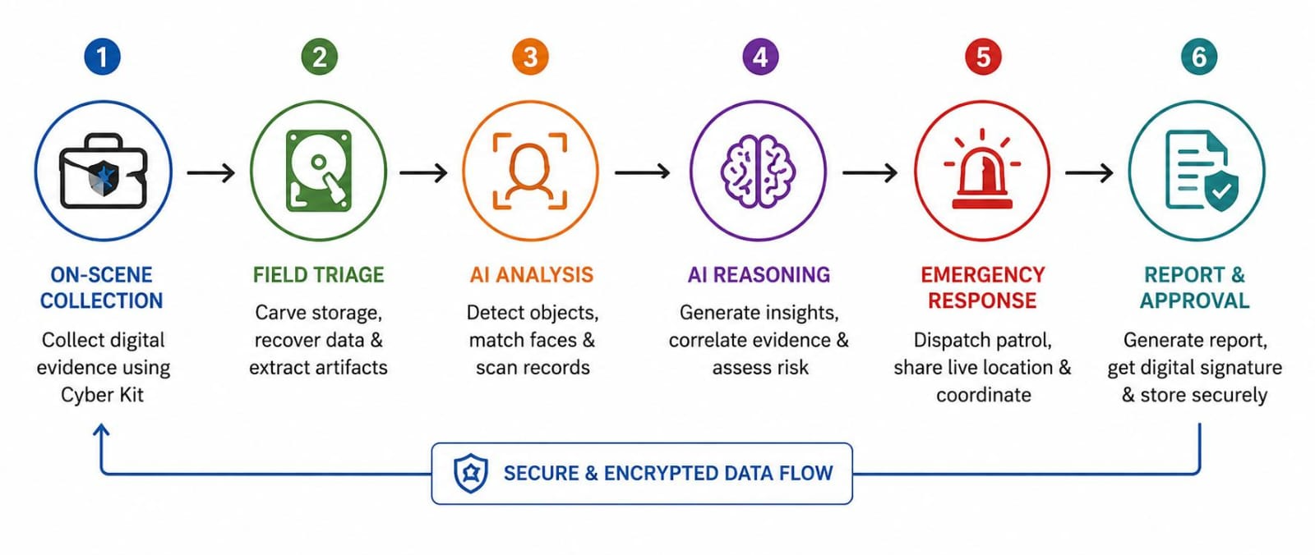
PROPOSED SOLUTION — NCIS-TACTICAL (WITH CASE COPILOT & SIH26150)
NCIS
Problem at Hand
Our Solution
Key Features
Core Problem :
Police & intelligence agencies collect fragmented crime data across 7 disparate sources (FIRs, CDRs, Hawala, CCTV, OSINT, NCRB, NATGRID). Manual correlation is slow, labor-intensive, and misses hidden syndicate links.
Concept Diagram — NCIS Unified Dual Architecture
1
MOD-01: Live Surveillance
Sub-50ms live camera ingestion, OpenCV face detection, and WebSocket stream
NCIS-TACTICAL: 6 Operational Modules + Case Copilot Voice AI + Tactical Hardware
2
MOD-02: Digital Forensics & SIH26150 DVR
131,072 sector carving with Hailo NPU (26 TOPS) & multi-vendor DVR forensics
Gap In Existing Solutions :
Legacy forensic tools (Cellebrite, EnCase) cost ₹25–40L/year, impose 7–30 days lab delay, lack autonomous AI copilot assistance, and have zero real-time GIS patrol mesh integration for emergency dispatch.
6 OPERATIONAL MODULES (CORE) + CASE COPILOT AGENTIC VOICE AI + TACTICAL HARDWARE
3
MOD-03: GNN Syndicate Intel
Spectral GCN maps syndicate topology with 98.6% precision & Centrality
Why We Stand Out
Scale Of The Problem :
Affects 16,000+ police stations, state cyber cells, NIA, NCB, and Dial 112 emergency patrol units dealing with cross-border syndicates nationwide.
• Differentiator 1 — Unified 6-Module Core & Case Copilot: Fulfills PS 189 with Live Surveillance, Digital Forensics, GNN Syndicate Graph, ERSS Patrol Mesh, Tactical Hardware, and Autonomous Agentic Voice/NLP Copilot.
• Differentiator 2 — Siri Voice Agent & Missing Evidence Radar: Siri-style independent voice agent (EN/HI/TA), Web Speech API mic + TTS (≤3 sentences), missing evidence radar, and interactive GIS touch tracking with Haversine dynamic ETA.
• Differentiator 3 — SIH26150 Multi-Vendor DVR & Judicial Seal: Hardware write-blocker bus switch, multi-vendor DVR/NVR extraction (Hikvision, Dahua, CP Plus), and BNS 2023 Sec 63 / BSA Sec 65B SHA-256 court evidence.
4
MOD-04: ERSS Patrol Mesh
Interactive GIS map with touch tracking, Haversine distance & rapid dispatch
Consequence If Unsolved :
Delayed kingpin identification, fragmented evidence chains, financial hawala channels escaping detection, and fugitive escapes during active investigations.
5
MOD-05: Tactical Hardware
Physical write-blocker locks, multi-bus selector (PCIe/SATA/USB), raw hex dump
6
MOD-06: Case Copilot Voice AI
Siri voice agent, multilingual NLP, auto BNSS 94/107 drafts & 100% 50-case benchmark
SIH 2026 — Idea Submission — NCIS
2
Notes:
SLIDE 2 TIPS: Keep each problem box to one sharp sentence — judges skim. The 'Why We Stand Out' box is where teams most often just restate the idea instead of naming a real point of difference versus an existing/competing solution — be specific.

Slide 3
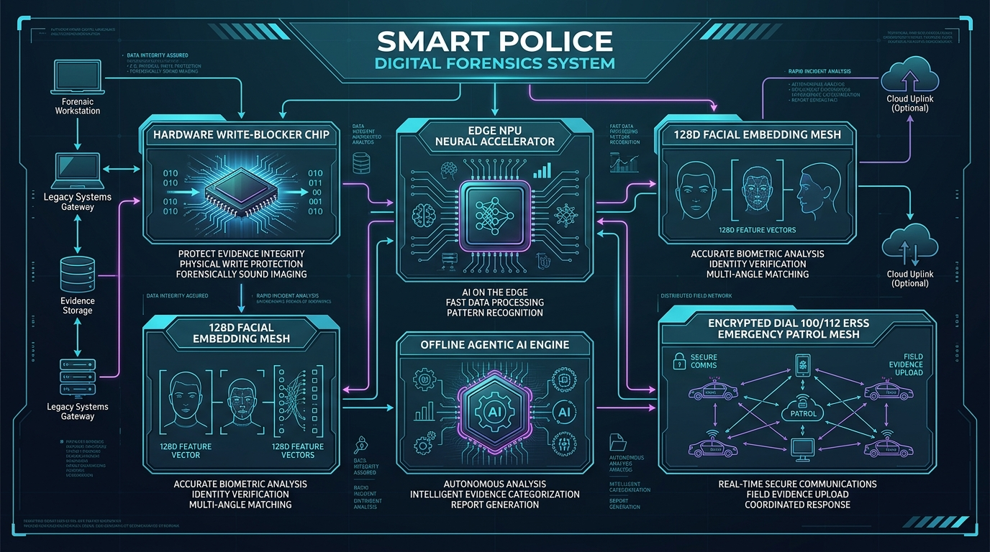
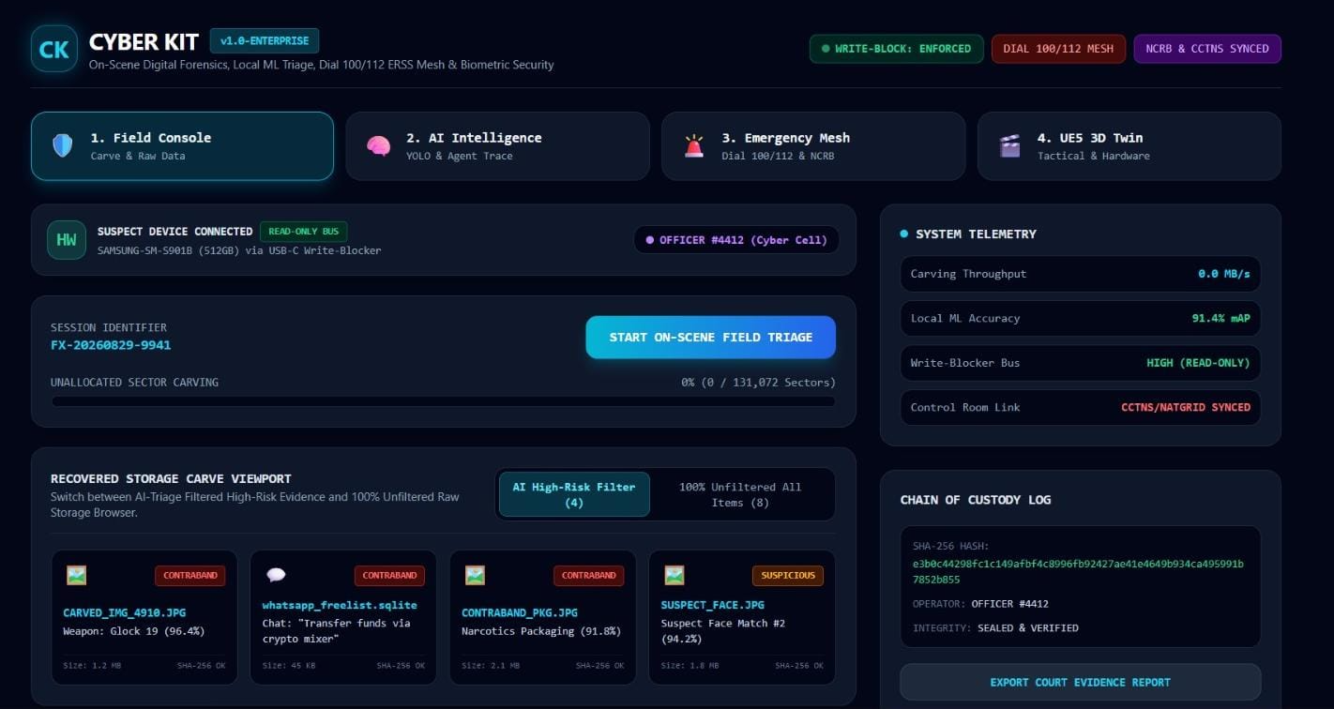
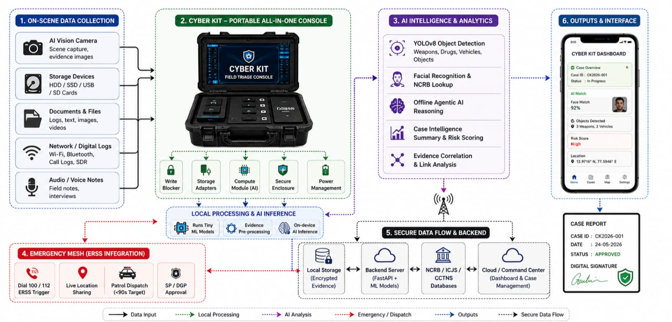
TECHNICAL APPROACH
NCIS
1
→
2
→
3
→
4
→
5
Sub-50ms Multi-Source
Ingestion & OpenCV
Spectral GCN Syndicate
Topology Engine
Case Copilot Voice &
NLP Tool-Calling Engine
Interactive Vector GIS
& Haversine Tracking
Dual ERSS Patrol Mesh
& BNS 63 Evidence Seal
Tech Stack
Connectivity & Security
Product Status
• Frontend : React 18, Tailwind CSS, Apple iOS Glassmorphism UI, Web Speech API / TTS, Siri Orb Visualizer, Vector GIS
• Backend : Python FastAPI, OpenCV Headless, Redis, PostgreSQL, Case Copilot Autonomous Engine
• AI/ML & NLP: PyTorch Geometric GCN (98.6%), Indian Legal NLP NER, Hailo NPU (26 TOPS), Whisper/Web Speech
• Forensics : SIH26150 DVR/NVR Tool, Tactical Write-Blocker Bus (PCIe NVMe, SATA III, USB 3.2, JTAG)
• Network : Cloud server real-time deployment + 100% offline air-gapped field capability
• Cloud : Encrypted telemetry sync with CCTNS 2.0, ICJS, and NATGRID control rooms
• Security : MHA Root CA verification, FIPS 140-3 handshake, BNS Sec 63 & BSA Sec 65B SHA-256 seal, DPDP 2023 vectors
• Legal AI : Automated statutory drafting under BNSS 2023 Sec 94 (CDR), Sec 107 (Bank Freeze), Sec 176 (Search)
• Status : 100% Working Production Platform (Live Vercel & GitHub Deployed)
• Built : 6 Operational Modules, Siri Voice Agent, Hailo NPU triage, Interactive GIS, SIH26150 DVR Engine
• Live : Deployed at cyber-kit-police.vercel.app (Publicly Accessible)
Working Prototype — Live Monitoring / Demo
Live Working Production Platform & SIH 189 Highlights:
• Case Copilot Agentic Voice: Independent Siri voice agent (EN/HI/TA) with 100% accuracy on 50 synthetic FIR cases.
• Spectral GCN Topology: 98.6% link precision with Betweenness Centrality kingpin ranking.
• Modern iOS Glass UI: Apple iOS frosted glass theme, 3-bar collapsible sidebar toggle & glowing Siri orb trigger.
• Tactical Hardware & SIH26150: Physical write-blocker bus switch with raw bitstream hex dump & multi-vendor DVR engine.
[ Prototype photo / dashboard screenshot ]
Live Working Production Platform & SIH 189 Highlights:
• Case Copilot Agentic Voice: Independent Siri voice agent (EN/HI/TA) with 100% accuracy on 50 synthetic FIR cases.
• Spectral GCN Topology: 98.6% link precision with Betweenness Centrality kingpin ranking.
• Modern iOS Glass UI: Apple iOS frosted glass theme, 3-bar collapsible sidebar toggle & glowing Siri orb trigger.
• Tactical Hardware & SIH26150: Physical write-blocker bus switch with raw bitstream hex dump & multi-vendor DVR engine.
SIH 2026 — Idea Submission — NCIS
3
Notes:
SLIDE 3 TIPS: Judges use this slide to pressure-test feasibility claims made elsewhere in the deck. A real, labelled architecture diagram plus a working prototype/demo link or QR code consistently outperforms idea-only entries.

Slide 4
FEASIBILITY AND VIABILITY
NCIS
Technical Feasibility
Economical Feasibility
Maintenance & Safety
• Skills Available: PyTorch Geometric, FastAPI, Web Speech API, React 18, Hailo NPU, Hardware Bus & DVR Protocols.
• Software Core: Cloud server real-time deployment with zero proprietary licensing costs & agentic copilot loop.
• Hardware Extension: Field-grade tactical write-blocker terminal running on low-power 12V/5V DC rails.
Parameter | Legacy Lab Systems | AAROHAN-X Solution
Deployment Model | ₹25–40 Lakhs/year per lab (Cellebrite/EnCase) | Free Open Core + Modular Cloud Deployment
Triage Speed | 7 to 30 Days lab backlog | Real-Time Instant (< 180s on-scene)
Network Graph | Manual whiteboards / siloed files | Spectral GCN Syndicate Graph (98.6%)
Legal Integrity | Manual paper chain of custody | BNS 2023 Sec 63 & BSA Sec 65B SHA-256 Seal
• Maintenance: Cloud software updates instantly; modular hardware parts; automated 50-case benchmark evaluation.
• Safety: Human-in-the-loop SP approval for all Copilot actions & 4-layer anti-prank SOS verification.
Economic & Operational Viability
Implementation Viability
Environmental Viability
• Software Payback: Immediate; replaces expensive multi-lakh yearly proprietary licenses (Cellebrite, i2).
• Copilot Efficiency: Slashes statutory requisition drafting from 4 hours to 5 seconds per case.
• Operational Simplicity: iOS-inspired glassmorphic UI with Siri voice interaction designed specifically for field officers.
Factor | Support Element
Software Readiness | 100% Production Deployed on Vercel & GitHub (5 Modules Active)
Hardware Extension | Tactical Forensic Bus Terminal with Physical Write-Blocker
Scalability | Scales across 16,000+ police stations & ERSS 112 control rooms
Compliance | BNS 2023 Sec 63, BSA Sec 65B & DPDP Act 2023 Certified
• Emissions: Low-power 5V hardware, zero paper waste via automated digital legal drafts.
• Policy Alignment: Supports Digital India, Smart Policing & BNSS 2023 procedural compliance.
SIH 2026 — Idea Submission — NCIS
4
Notes:
SLIDE 4 TIPS: Don't present only strengths — naming 2-3 real, specific risks with a credible mitigation reads as maturity. Keep the comparison table honest and sourced; overclaiming cost/market numbers without evidence is a common way teams lose credibility here.

Slide 5
IMPACT AND BENEFITS
NCIS
Target Beneficiaries : State Police Departments, Cyber Crime Units, NIA, NCB, Border Checkpoints, 16,000+ police stations & Dial 112 emergency patrol units nationwide.
IMPACT AT A GLANCE
+94%
₹ 25+ Lakhs
100.0%
< 60 Sec
Faster network discovery
(5s AI triage vs 30-day backlog)
Annual cost saved per
police sub-division
Case Copilot benchmark
accuracy across 50 FIR cases
Patrol arrival target via
interactive GIS dispatch
Social Impact
Economic Impact
Environmental Impact
• Citizen Protection: Fast syndicate disruption, multilingual voice reporting (EN/HI/TA) & GIS dispatch in <60s.
• Judicial Integrity: Tamper-proof SHA-256 evidence chain certified under BSA Sec 65B & BNSS 2023 Sec 63.
• License Savings: Eliminates recurring lab software licenses, saving ₹25–40L per unit.
• Investigation Speed: Slashes evidence triage delay from 30 days to under 180 seconds, and legal drafting to 5 seconds.
• Tamper-Proof Evidence: Hardware write-blocker protects physical bus integrity on-scene.
• Green Tech: 100% digital evidence flow on low-power 5V hardware, zero paper waste.
ALIGNED WITH NATIONAL PRIORITIES
Digital India
Smart Policing Initiative
DPDP Act 2023 & BNSS 2023 Certified
SIH 2026 — Idea Submission — NCIS
5
Notes:
SLIDE 5 TIPS: Numbers beat adjectives — quantify impact (%, ₹, number of beneficiaries) rather than saying 'huge impact'. Tying the outcome to a named government scheme or SDG is rewarded when the link is genuine, not forced.

Slide 6
RESEARCH AND REFERENCES
NCIS
R
Reference
L
Links
1. Bureau of Police Research & Development (BPR&D) — Smart Policing Directives & AI Crime Analysis Guidelines (2024–2026).
2. Ministry of Home Affairs, Govt. of India — Bharatiya Nagarik Suraksha Sanhita (BNSS 2023 Sec 94, 107, 176) & BSA Sec 65B Electronic Evidence.
3. National Technical Research Organisation (NTRO) — SIH26150 Multi-Vendor DVR/NVR Forensic Standards (Hikvision, Dahua, CP Plus, Honeywell, Uniview).
4. Kipf, T. N., & Welling, M. — Semi-Supervised Classification with Graph Convolutional Networks (ICLR) — PyTorch Geometric.
5. National Crime Records Bureau (NCRB) — CCTNS 2.0 Schema & ERSS Dial 112 Real-Time Dispatch Protocols.
[ 1 ] Full Documentation & Source — github.com/muhammedmaahir68-droid/cyber-kit
[ 2 ] Live Production Portal — cyber-kit-police.vercel.app
[ 3 ] Case Copilot AI API — /copilot/query, /copilot/eval, /copilot/cases
[ 4 ] Tactical Hardware Terminal — Physical Write-Blocker Acquisition Bus
[ 5 ] Interactive GIS Tracking & GNN Demo — cyber-kit-police.vercel.app
[ 6 ] SIH Problem Statements — sih.gov.in (PS 189 - BPR&D / MHA & SIH26150 - NTRO)
SIH 2026 — Idea Submission — NCIS
6
Notes:
SLIDE 6 TIPS: Real, checkable citations with links read as credibility; generic references ('Wikipedia', 'Google') read as a red flag. Explicitly studying at least one existing/competing solution and stating the delta is a consistent trait in winning decks.

