Slide 1
Cryptography & Network Security
Module – V

Slide 2
Network Security
Network security is the practice of preventing and protecting against unauthorized intrusion into corporate networks.
Network security is the process of taking physical and software preventative measures to protect the underlying networking infrastructure from unauthorized access, misuse, malfunction, modification, destruction, or improper disclosure, thereby creating a secure platform for computers, users, and programs to perform their permitted critical functions within a secure environment.

Slide 3
Information, Cyber & Network Security
Information Security
The processes and methodologies which are designed and implemented to protect print, electronic, or any other form of confidential, private and sensitive information or data from unauthorized access, use, misuse, disclosure, destruction, modification, or disruption.
Cyber Security
The practice of protecting systems, networks and programs from digital attacks.
A subset of information security.
Network Security
A subset of cyber security.
Aims to protect the underlying networking infrastructure and network resources.

Slide 4
Goals of Network Security
The primary goal of network security are Confidentiality, Integrity, and Availability.
Confidentiality − The function of confidentiality is to protect precious business data from unauthorized persons. Confidentiality part of network security makes sure that the data is available only to the intended and authorized persons.
Integrity − This goal means maintaining and assuring the accuracy and consistency of data. The function of integrity is to make sure that the data is reliable and is not changed by unauthorized persons.
Availability − The function of availability in Network Security is to make sure that the data, network resources/services are continuously available to the legitimate users, whenever they require it.

Slide 5
Security Attacks
A security attack is an unauthorized attempt to steal, damage, or expose data from an information system such as your website.
Passive Attack
No modification of data occurs and the target does not know about its occurrence unless they have a system that monitors and protects machine identities.
Active Attack
System resources and data are modified or otherwise damaged system, affecting its normal operations.

Slide 6
Attacks Threatening Confidentiality
Eavesdropping
Snooping
Sniffing
Phishing
Wiretapping
Social Engineering
Traffic Analysis

Slide 7
Eavesdropping
It is a form of snooping attack.
It is a type of passive attack.
It is an intrusion where someone tries to steal information that computers, smart phones or other devices.
Eavesdropping attacks are difficult to detect because they do not cause network transmission to appear to be operating abnormally.

Slide 8
Snooping
It is a passive attack.
It is unauthorized access to another person's or company's data.
An unauthorized entity may intercept the transmission and use the contents for his benefit.
It is not necessarily limited to gaining access data during its transmission.
More sophisticated snooping uses software programs to remotely monitor activity on a computer or network devices.

Slide 9
Sniffing
It is an active attack.
Attacker can insert malicious program to infect the other system.
Once the data is captured, the attacker can read the sensitive data like passwords or card numbers.
Using Sniffer applications.

Slide 10
Phishing
Phishing is a method of trying to gather personal information using deceptive e-mails and websites.
Phishing is a type of social engineering attack often used to steal user data, including login credentials and credit card numbers.
It occurs when an attacker, masquerading as a trusted entity, dupes a victim into opening an email, instant message, or text message.

Slide 11
Wiretapping
Wiretapping is the surreptitious electronic monitoring of telephone, telegraph, cellular, fax or Internet-based communication.
It is achieved either through the placement of a monitoring device on the wire in question or through the built-in mechanism in other communication technologies.

Slide 12
Social Engineering
Social engineering is the art of manipulating people so they give up confidential information.
If a criminal manages to hack or socially engineer one person’s email password they have access to that person’s contact list–and because most people use one password everywhere, they probably have access to that person’s social networking contacts as well.
Social engineering is the term used for a broad range of malicious activities accomplished through human interactions.
It uses psychological manipulation to trick users into making security mistakes or giving away sensitive information.

Slide 13
Traffic Analysis
Obtain some other types of information by monitoring online traffic.
Ex:- The attacker can find the electronic address of the sender and receiver or can collect pairs or requests and responses to help the attacker guess the nature of the transaction.

Slide 14
Attack Threatening Integrity
Modification
Masquerading
Replaying
Repudiation
Session Hijacking
Man-in-the –Middle Attack
Data Diddling Attacks

Slide 15
Masquerading
A masquerade attack is an attack that uses a fake identity, such as a network identity, to gain unauthorized access to personal computer information through legitimate access identification.

Slide 16
Replaying
The attacker obtains a copy of a message sent by a user and later tries to replay it.

Slide 17
Session Hijacking
Session Sniffing or Cookie Hijacking

Slide 18
Man-in-the-Middle Attack
It is a form of eavesdropping.
Communication between two users is monitored and modified by an unauthorized party.

Slide 19
Data Diddling Attack
It is act of extracting and changing data in a database without the knowledge of owner.
It is an illegal or unauthorized data alteration.

Slide 20
Attacks Threatening Availability
Denial of Service
Distributed Denial of Service Attack
SYN Attack
Physical Attacks on Server Infrastructure

Slide 21
Cryptography

Slide 22
Cryptography
A word with Greek origins, means secret writing.
The conversion of data into a secret code for transmission over a public network.
Most cryptography is digital, and the original text ("plaintext") is turned into a coded equivalent called "ciphertext" via an encryption algorithm.
The ciphertext is decrypted at the receiving end and turned back into plaintext.
There are two kinds of cryptosystems:
Symmetric
Asymmetric

Slide 23
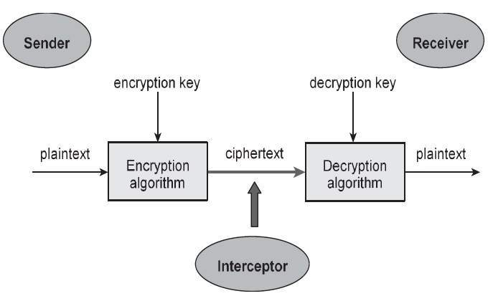

Slide 24
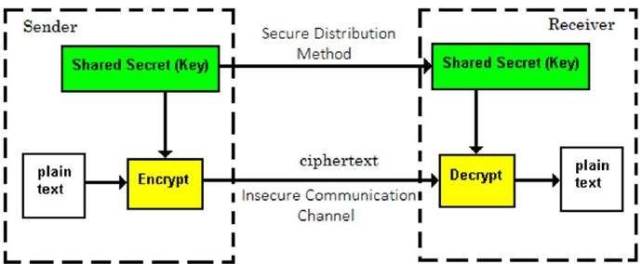
Symmetric-Key Cryptography
The encryption process where same keys are used for encrypting and decrypting the information is known as Symmetric Key Encryption.
sometimes referred to as secret key cryptosystems.

Slide 25
Symmetric-Key Cryptography
The symmetric-key ciphers can be divided into two:
Traditional Ciphers
Modern Ciphers
Traditional Ciphers
Substitution Ciphers
Transposition Ciphers
Substitution Ciphers
Mono-alphabetic Ciphers
Poly-alphabetic Ciphers

Slide 26
Substitution Ciphers
Systematically replace letters or groups of letters with other letters or group of letters.
Ex:- ‘fly at once’ - ‘gmz bu podf’
Mono-alphabetic Cipher
It is a substitution cipher in which for a given key, the cipher alphabet for each plain alphabet is fixed throughout the encryption process. For example, if ‘A’ is encrypted as ‘D’, for any number of occurrence in that plaintext, ‘A’ will always get encrypted to ‘D’.
Poly-alphabetic Ciphers
It is a substitution cipher in which the cipher alphabet for the plain alphabet may be different at different places during the encryption process.

Slide 27
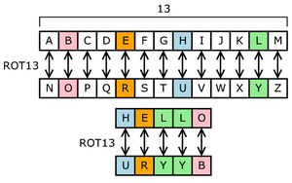

Slide 28
Transposition Ciphers
Transposition Cipher is a cryptographic algorithm where the order of alphabets in the plaintext is rearranged to form a cipher text.

Slide 29
Modern Symmetric-Key Ciphers
Bit oriented ciphers.
It consists numbers, graphics, audio and video data.
It is convenient to convert these types of data into a stream of bits.
Components
Transposition Units
Substitution Units
Exclusive-OR Units
Shifting Units
Swap Unit
Split and Combine Units

Slide 30
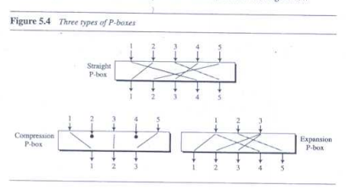
Transposition Units (P-Box)

Slide 31
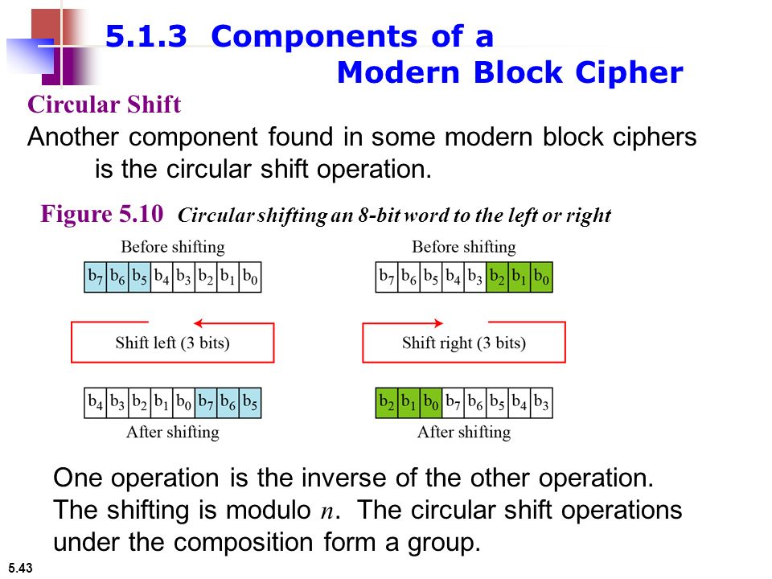
Shifting Unit

Slide 32
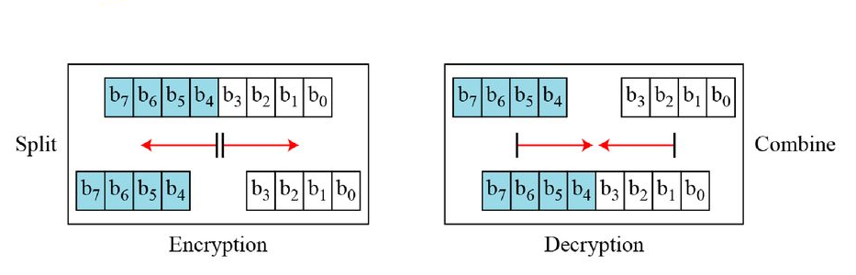
Split and Combine

Slide 33
Data Encryption Standard (DES)
The Data Encryption Standard (DES) is a symmetric-key block cipher.
It uses 16 round Feistel structure.
Round function
Key schedule
Any additional processing − Initial and final permutation.

Slide 34
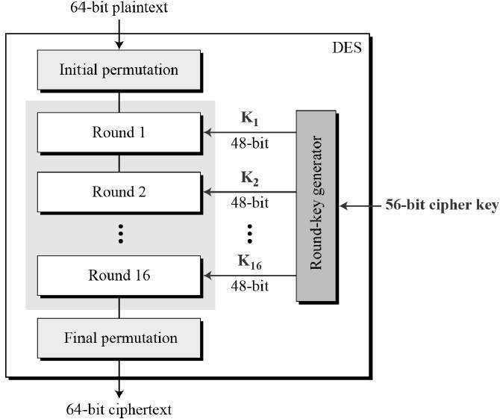

Slide 35
Data Encryption Standard (DES)
Initial and Final Permutation
The initial and final permutations are straight Permutation boxes (P-boxes) that are inverses of each other.
They have no cryptography significance in DES.

Slide 36
Asymmetric-Key Cryptography
Different keys are used for encryption and decryption.
If the public key encrypts a message, only the corresponding private key can decrypt it and vice versa.
The private key is kept secret by its owner and the public key is freely distributed.
To transmit a message securely, the sender uses the receiver’s public key to encrypt message. The receiver then decrypts the message, using his or her unique key.

Slide 37
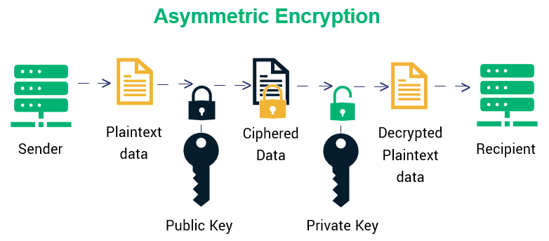

Slide 38
RSA Cryptosystem
RSA algorithm is a public key encryption technique and is considered as the most secure way of encryption.
It was invented by Rivest, Shamir and Adleman in year 1978 and hence name RSA algorithm.

Slide 39
Other Aspects of Security
Message Integrity
Message and Message Digest - Message digests are designed to protect the integrity of a piece of data or media to detect changes and alterations to any part of a message.
A variable-length plaintext is “hashed” into a (typically) fixed-length hash value (often called a “message digest” or simply a “hash”).
Message Authentication
A message authentication code (MAC), sometimes known as a tag, is a short piece of information used to authenticate a message.
To confirm that the message came from the stated sender (its authenticity) and has not been changed.

Slide 40
Digital Signature - Services
Message Authentication
Message Integrity

Slide 41
Digital Signature
A digital signature is a mathematical technique used to validate the authenticity and integrity of a message, software or digital document.
It's the digital equivalent of a handwritten signature or stamped seal, but it offers far more inherent security.
Digital signatures can provide evidence of origin, identity and status of electronic documents, transactions or digital messages.
Signers can also use them to acknowledge informed consent.

