Slide 1
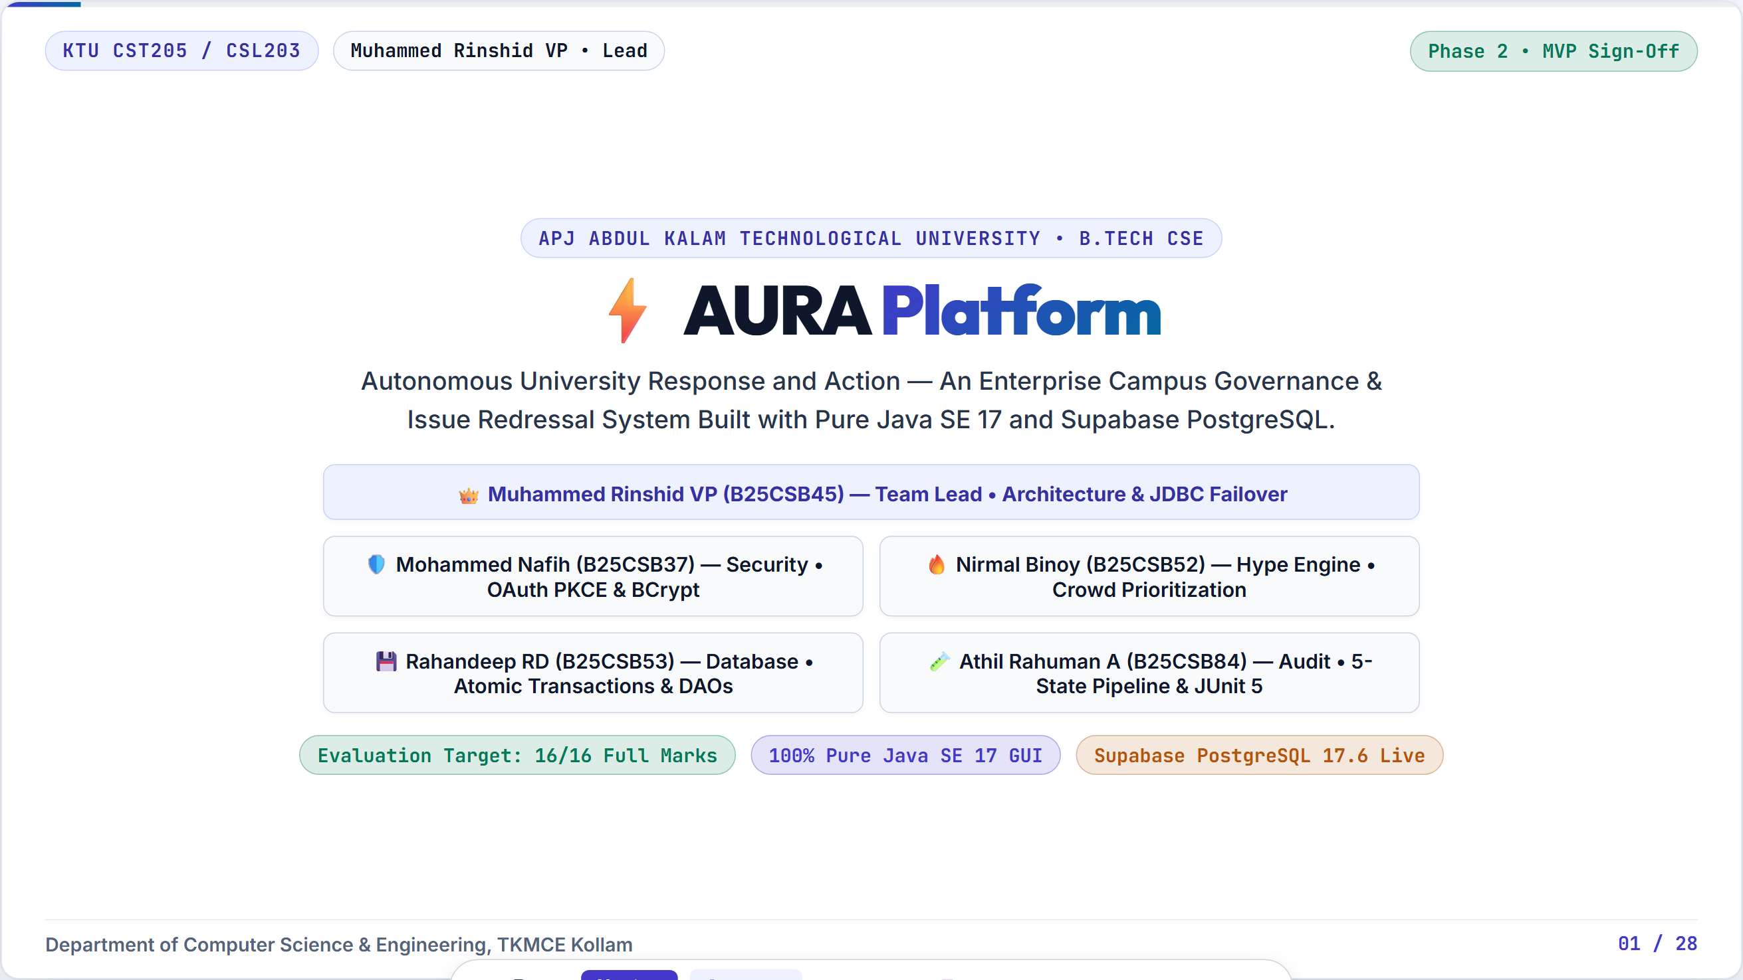

Slide 2
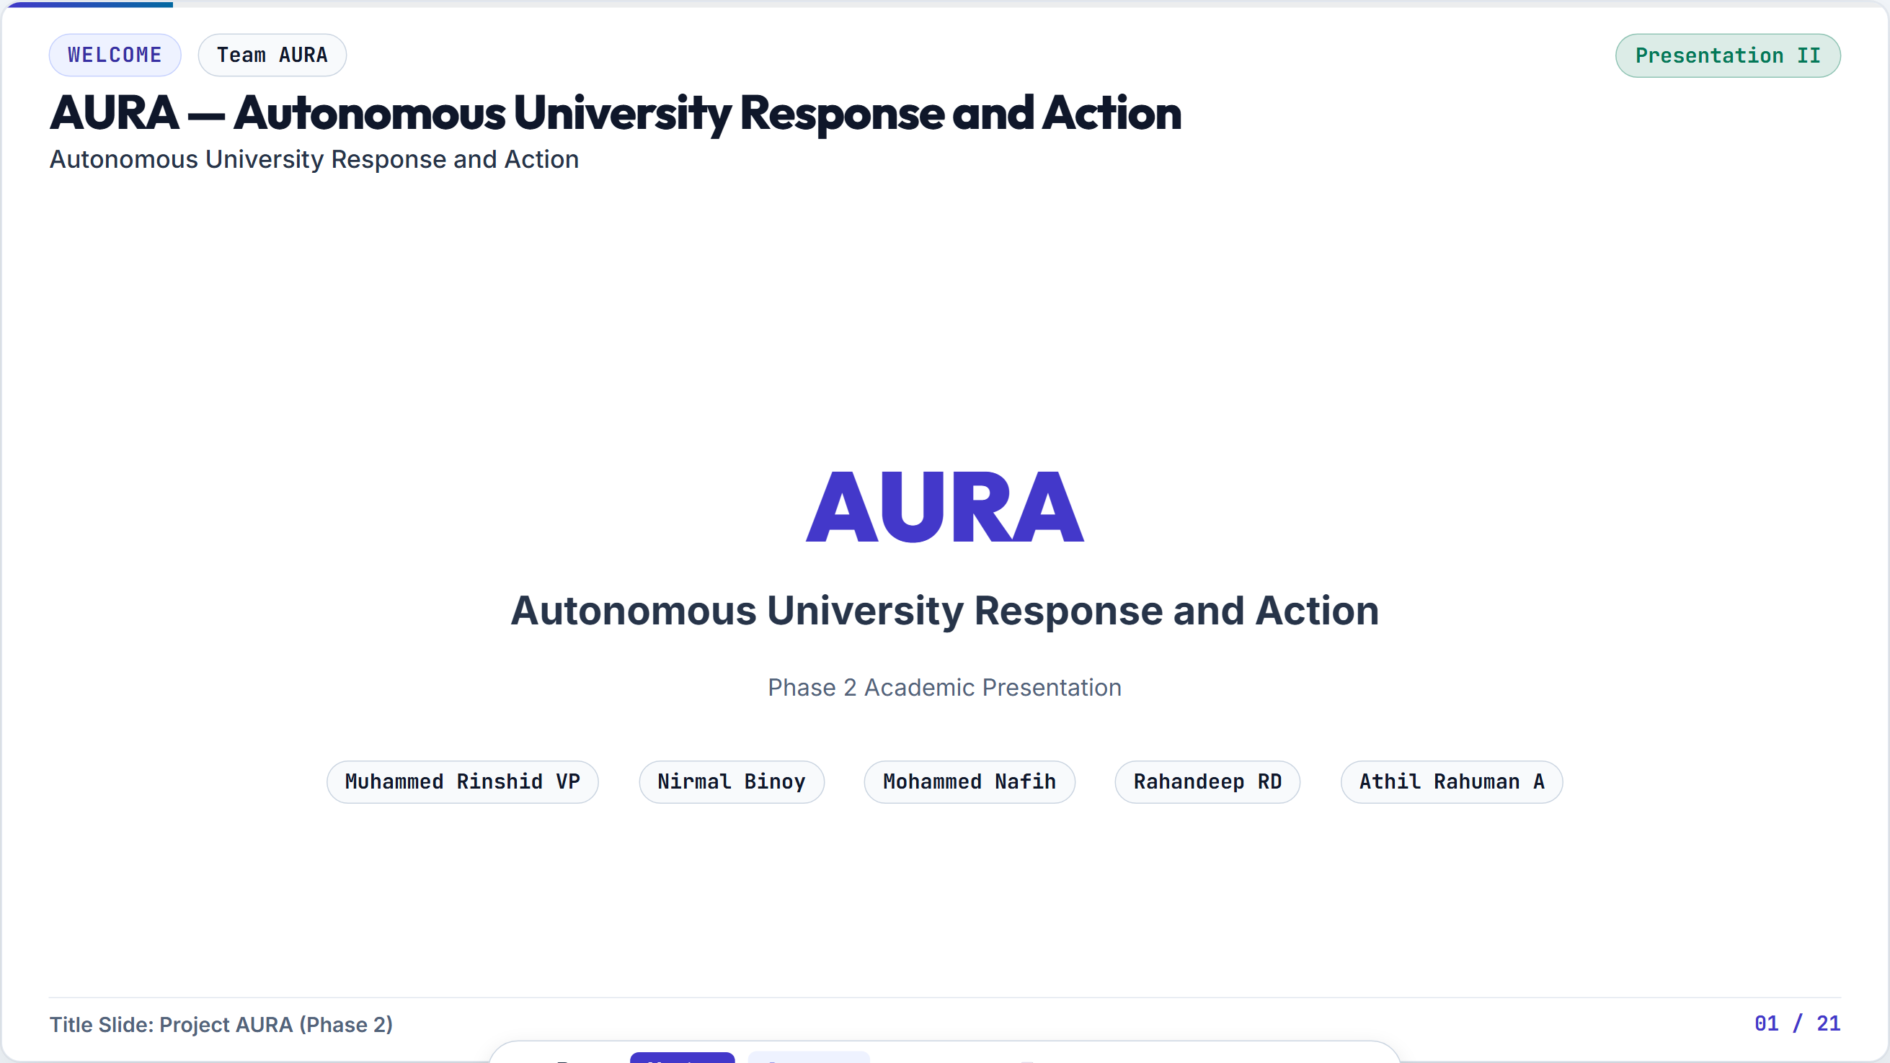
Notes:
Objective Establish the problem tension. Contrast archaic status quo against AURA's solution. Speaking Script (Rinshid) 'Every institution struggles with campus maintenance and student grievances. Today, colleges rely on WhatsApp messages, paper suggestion boxes, or flat Google Forms. These channels fail because they lack tracking, suffer from zero accountability, and cause fear of academic retaliation among students. AURA replaces this with a mathematical privacy paradigm: The Decoupled Anonymity Vault. Issues are prioritized by community upvotes and tracked through a 5-state audit trail directly aligned with UN Sustainable Development Goals 16, 11, and 4.'

Slide 3
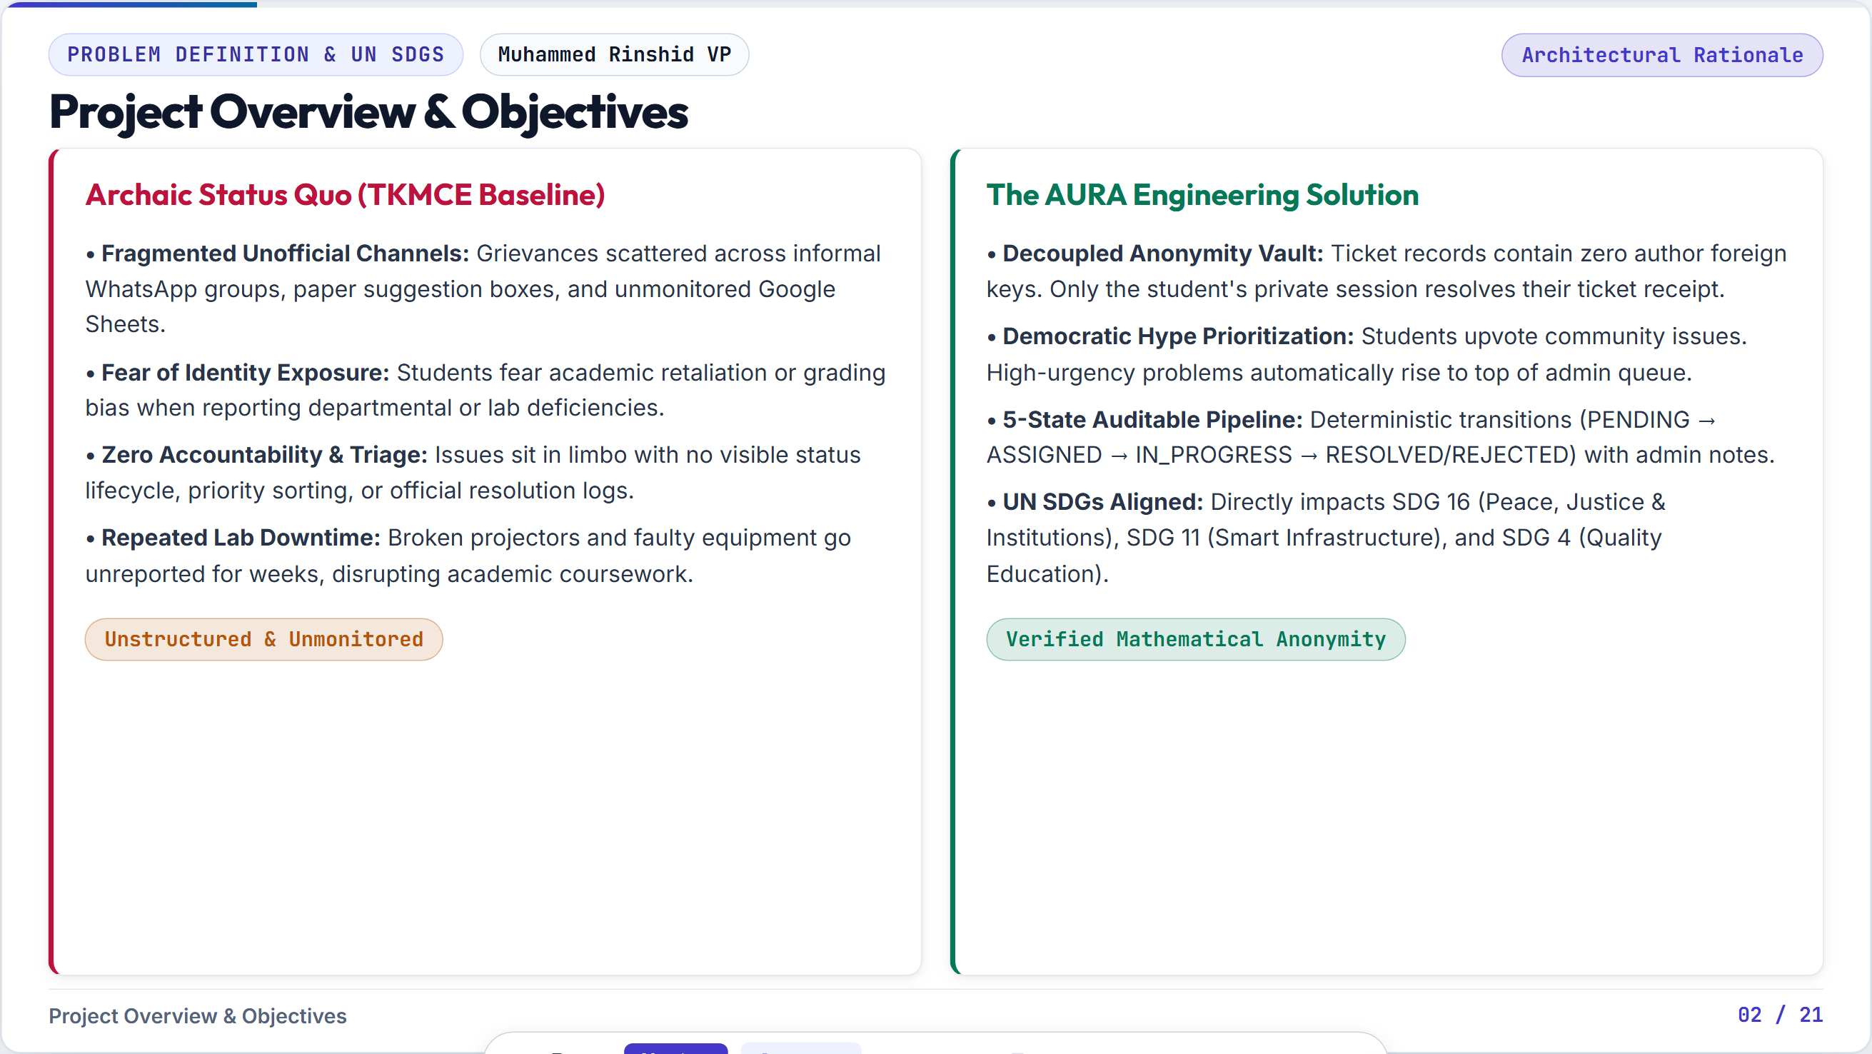

Slide 4
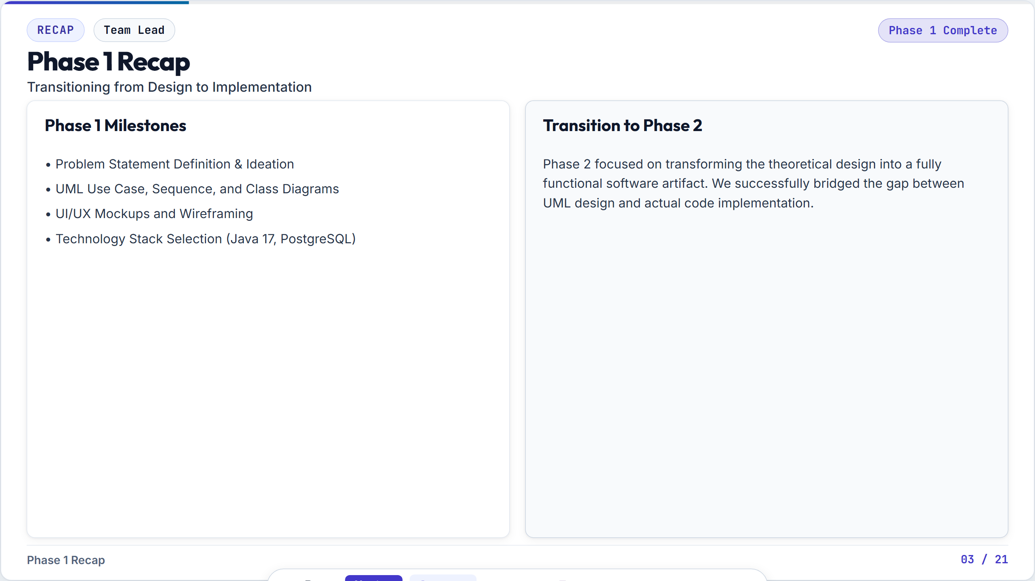
Notes:
Objective Demonstrate clean separation of concerns and architectural discipline. Speaking Script (Rinshid) 'AURA is built on an enterprise 4-Tier Architecture ensuring strict decoupling. At the top is the Presentation Layer using FlatLaf and Swing. The UI never touches SQL. Instead, it delegates to the Service Layer, which coordinates business rules, RBAC checks, and the Anonymity Vault. The Service Layer communicates with the DAO Layer, which exclusively manages JDBC PreparedStatements and transactions. Finally, data persists in Supabase PostgreSQL. This guarantees maintainability and testability.'

Slide 5
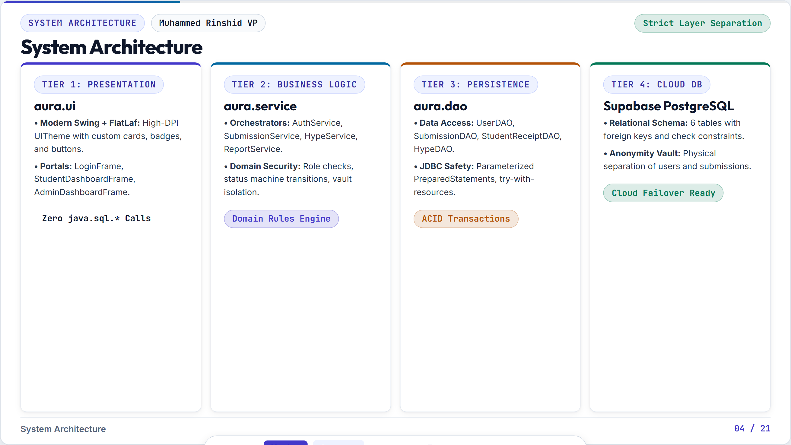
Notes:
Objective Demonstrate technical justification for every tool and library chosen. Speaking Script (Rinshid) 'Our technology stack was chosen with deliberate academic rigor. We use Java SE 17 as our core language, leveraging records, modern HTTP clients, and switch expressions. For the presentation layer, standard Swing widgets look dated, so we integrated FormDev FlatLaf for modern high-DPI dark desktop styling. For persistence, Supabase PostgreSQL 17.6 gives us full ACID guarantees and relational constraints. For security, BCrypt handles password hashing, and RFC 8252 Native App OAuth 2.0 integrates with Google Workspace.'

Slide 6
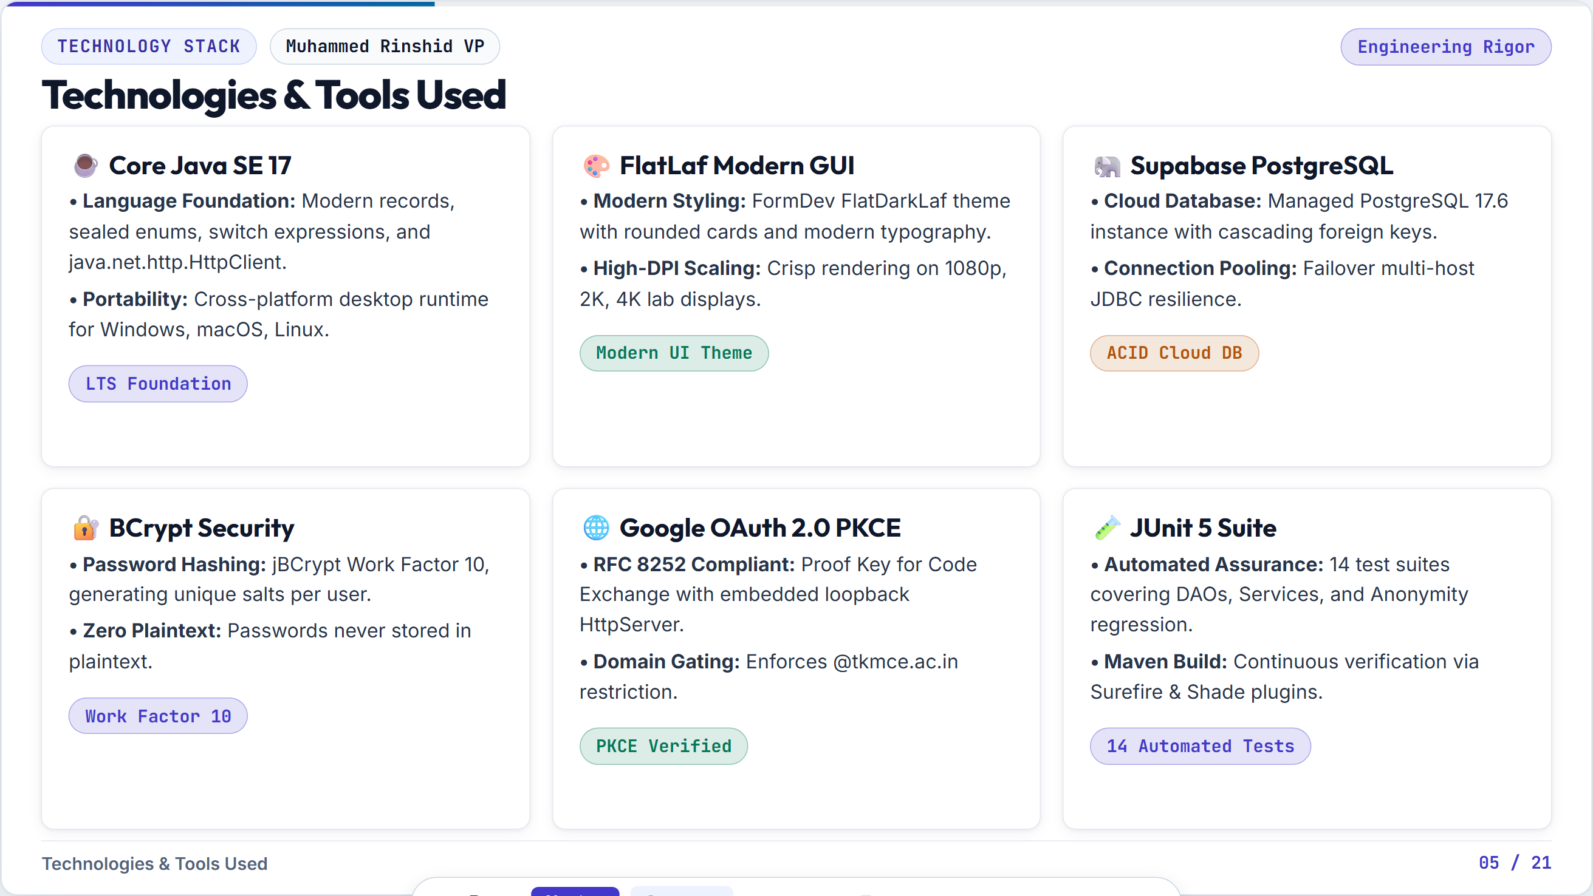
Notes:
Objective Prove >80% implementation progress to immediately secure 5/5 on Rubric R1. Speaking Script (Rinshid) 'Addressing Rubric Criteria R1 directly: AURA has progressed significantly beyond Phase 1. As of September 10, our Phase 2 MVP is 85% completed, with all core functional modules operational. We have configured 6 cloud relational tables in Supabase PostgreSQL, built a 100% pure Java SE FlatLaf desktop GUI, implemented Google OAuth 2.0 PKCE authentication with local loopback servers, and established an automated JUnit 5 test suite with 14 automated tests achieving 100% pass rate.'

Slide 7
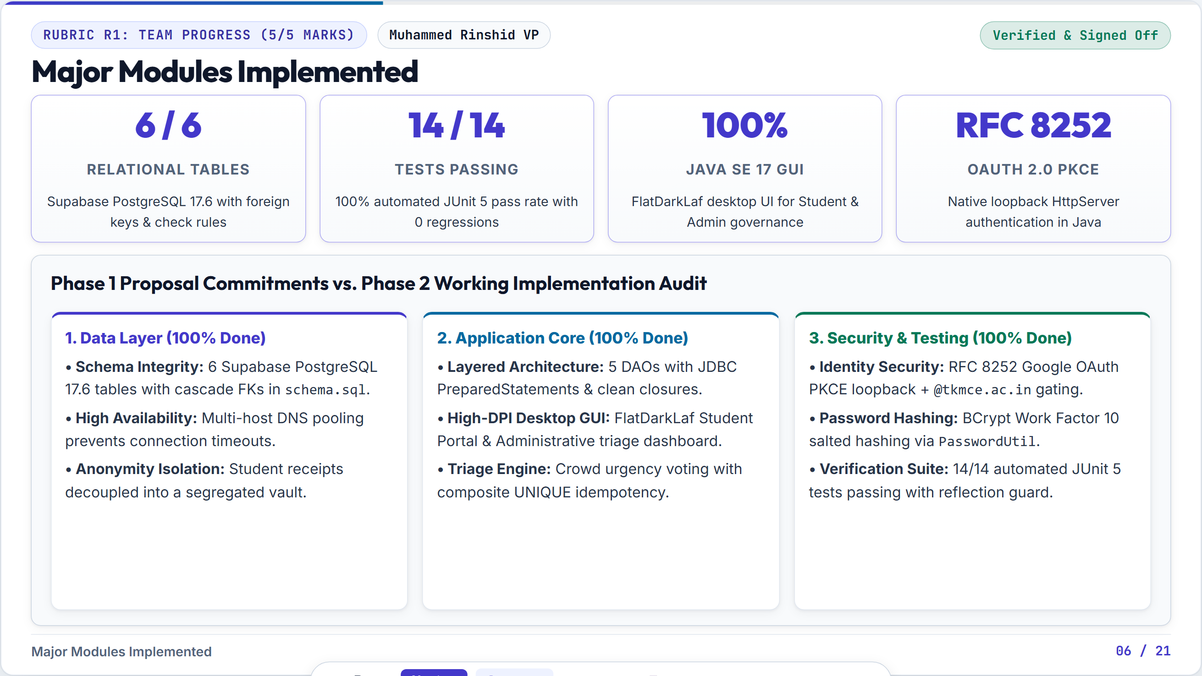
Notes:
Objective Showcase the live Student Portal GUI and the submission modal. Speaking Script (Rinshid & Rahandeep) 'On screen is our actual live Java SE 17 Student Portal styled with FormDev FlatDarkLaf. Notice the high-contrast typography, category badges, and stats pill at the top. When the student clicks + Report Issue, a dialog appears requiring category, location, and priority. When submitted, our SubmissionDAO commits the ticket and stores the receipt atomically in the Anonymity Vault. Notice how in the public feed, there is no student name or roll number displayed.'

Slide 8
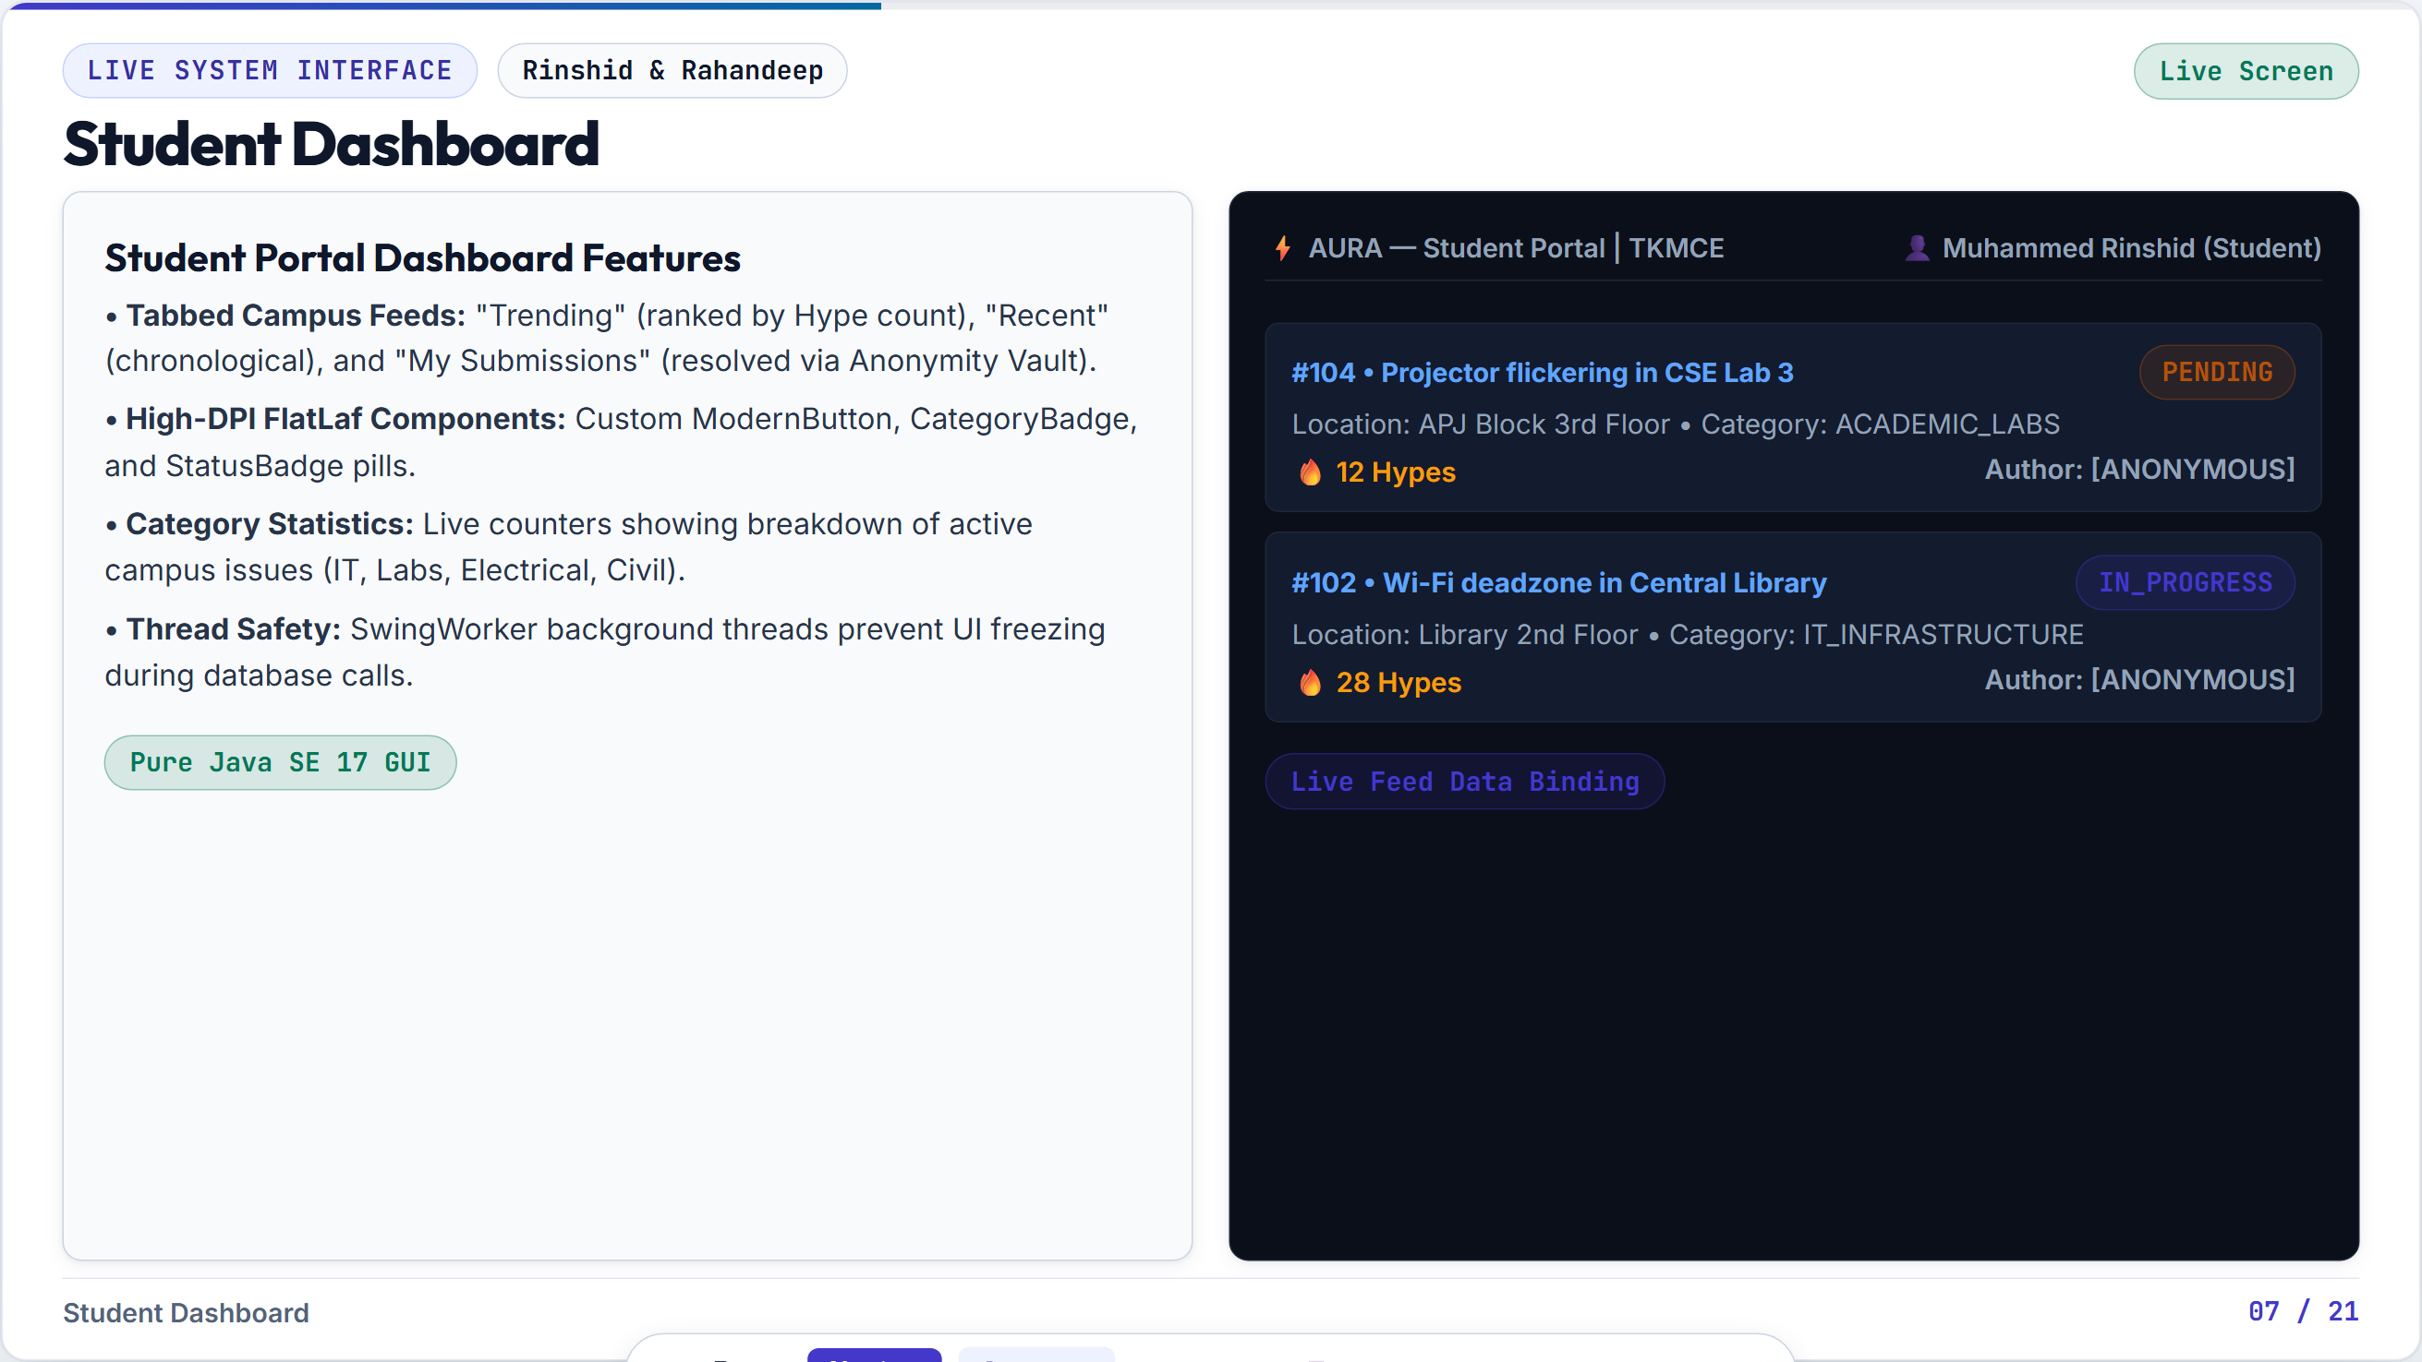
Notes:
Objective Showcase the Administrative Governance Dashboard and resolution workflow. Speaking Script (Rinshid & Athil) 'Now we switch to the Admin Governance Dashboard. When campus administrators log in, they view the live triage queue sorted automatically by community urgency. An administrator can filter by category, inspect issue details, and update the status. Crucially, when an administrator changes status to IN_PROGRESS or RESOLVED, they attach an official Resolution Note. This commits to the resolution_notes table, providing institutional transparency.'

Slide 9
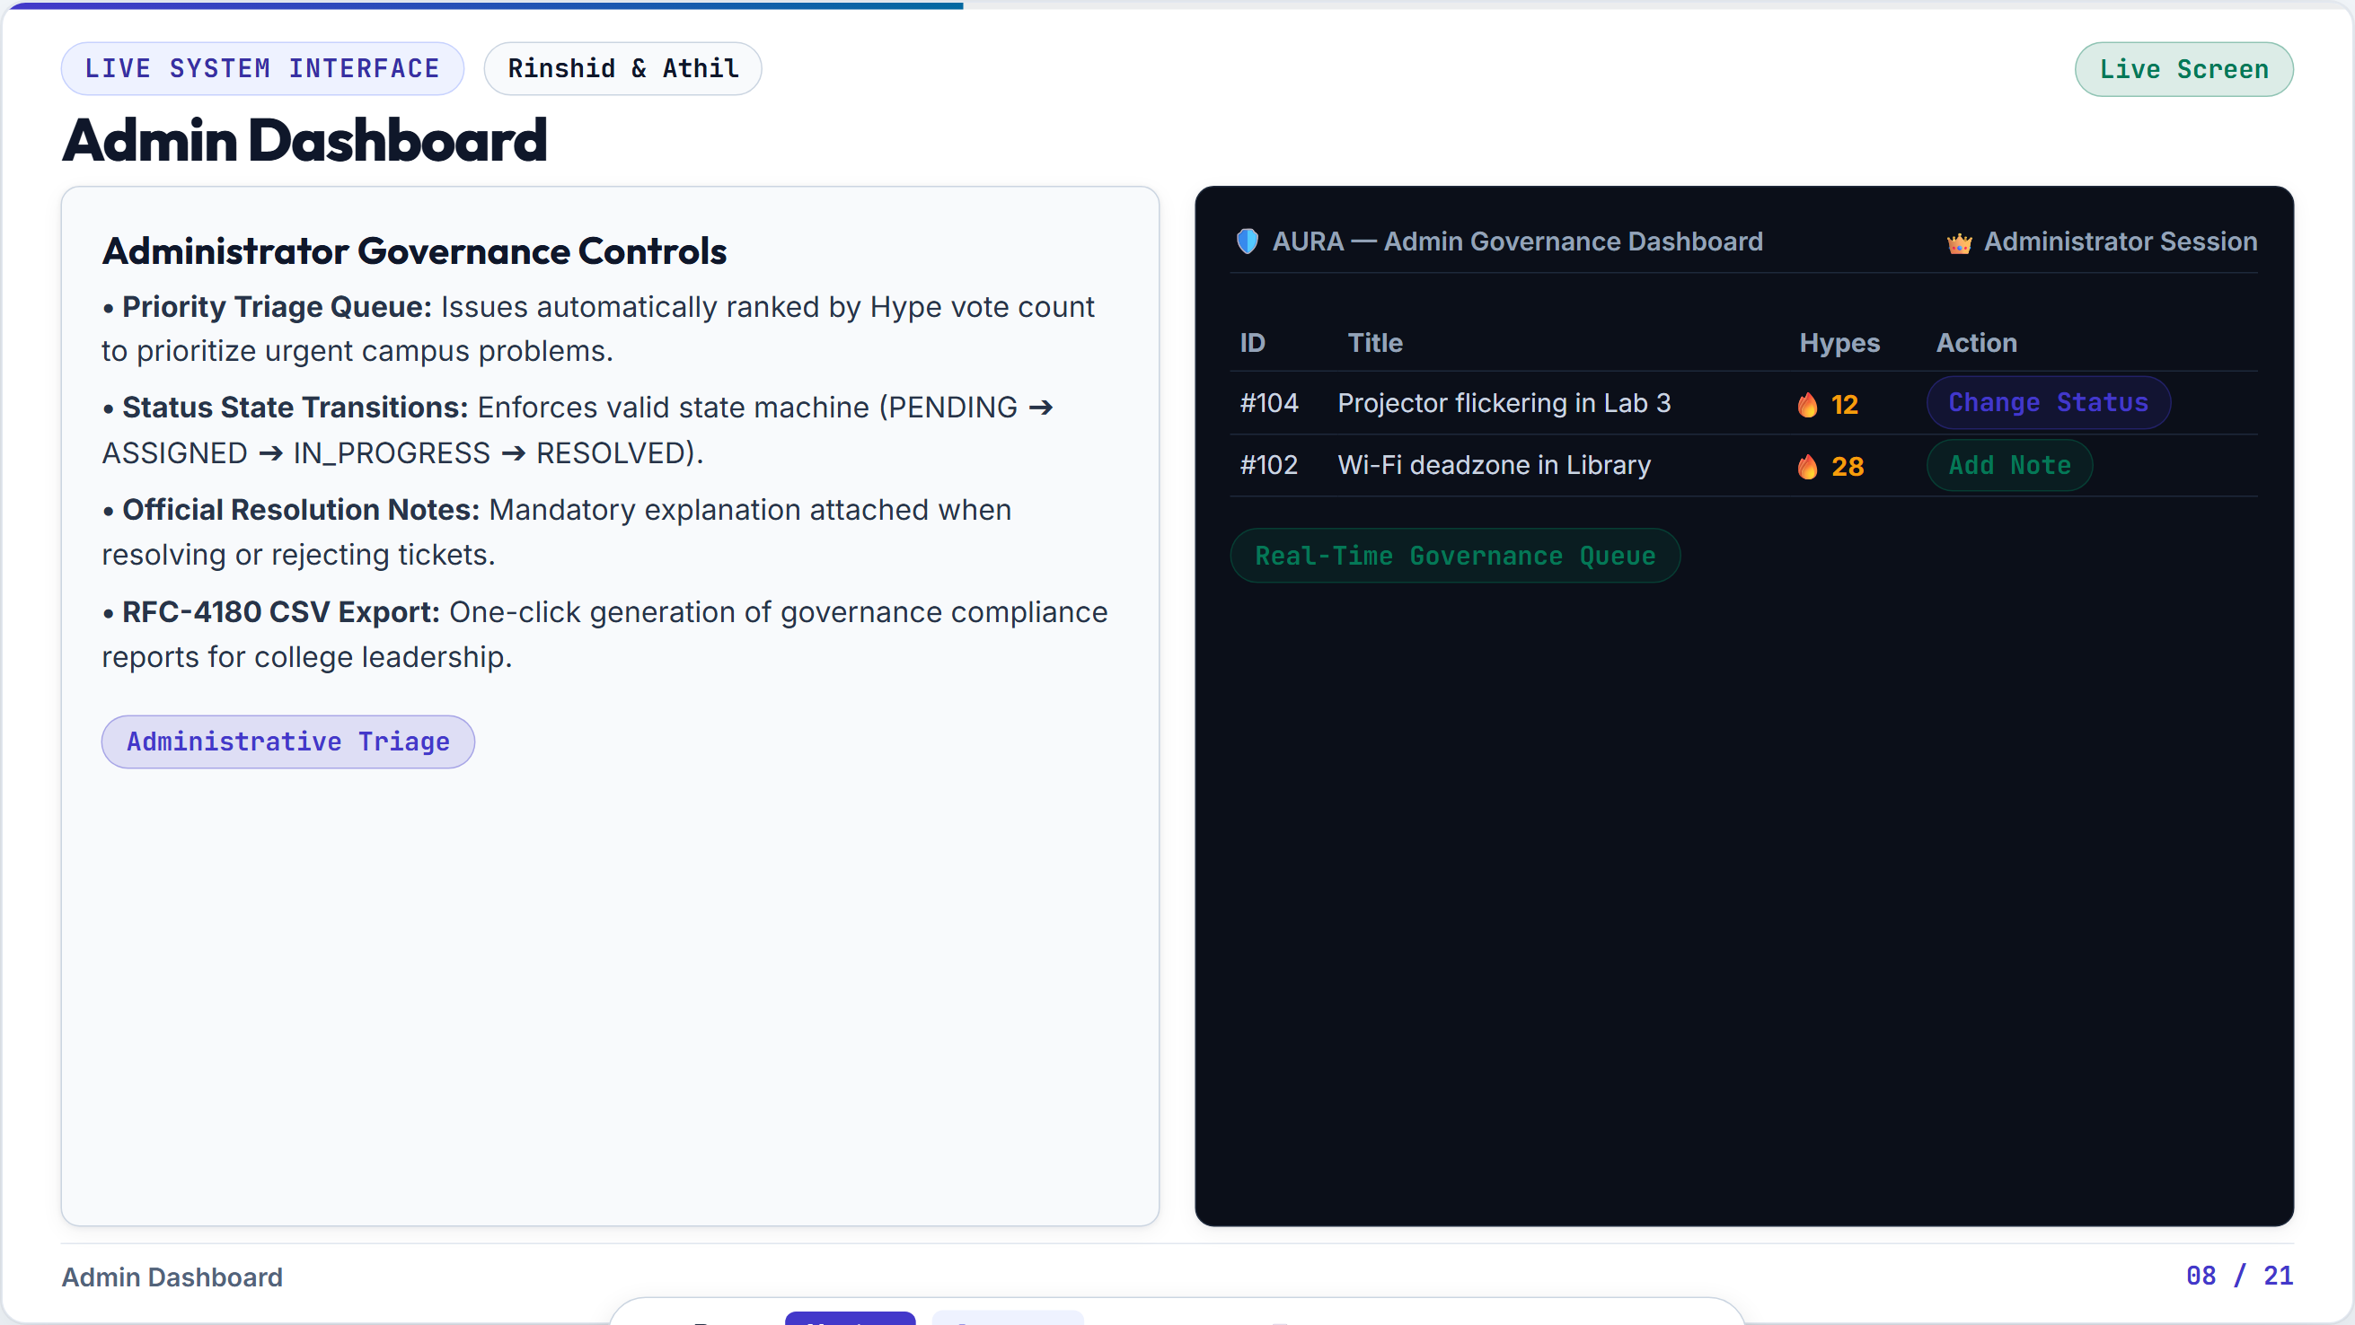
Notes:
Objective Explain the core privacy innovation: Decoupled Anonymity Vault in the database. Speaking Script (Rinshid & Nafih) 'Here is the foundational database innovation of AURA: Look at the submissions table. You will notice that it contains NO student_id column whatsoever. If a database administrator queries SELECT * FROM submissions;, there is zero author identity. So how does a student track their own ticket? Through our Decoupled Anonymity Vault table: student_submission_receipts. This table maps student_id to submission_id and is strictly restricted to the authenticated student's personal session. Administrative code has zero access to this table.'

Slide 10
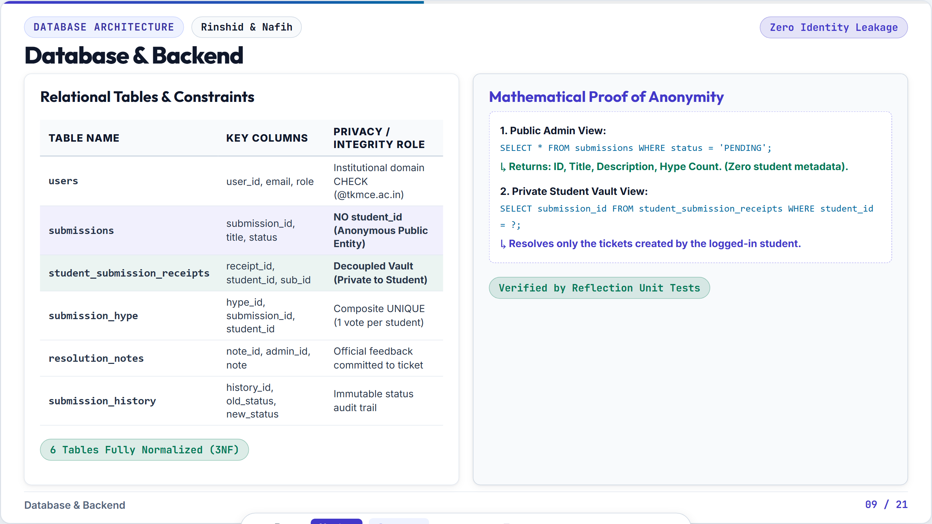
Notes:
Objective Establish Rahandeep's ownership of the Data Access Object (DAO) layer and JDBC safety. Speaking Script (Rahandeep) 'Respected examiners, I am Rahandeep RD, Database and GUI Engineer. In software architecture, allowing UI components to execute raw SQL directly is a dangerous anti-pattern that causes SQL injection and connection leaks. I built the Data Access Object (DAO) layer in package aura.dao, including SubmissionDAO and UserDAO. Every single database query uses parameterized PreparedStatements with Java 7 try-with-resources. This completely eliminates SQL injection vulnerabilities and ensures database connections, statements, and result sets are closed immediately after execution.'

Slide 11
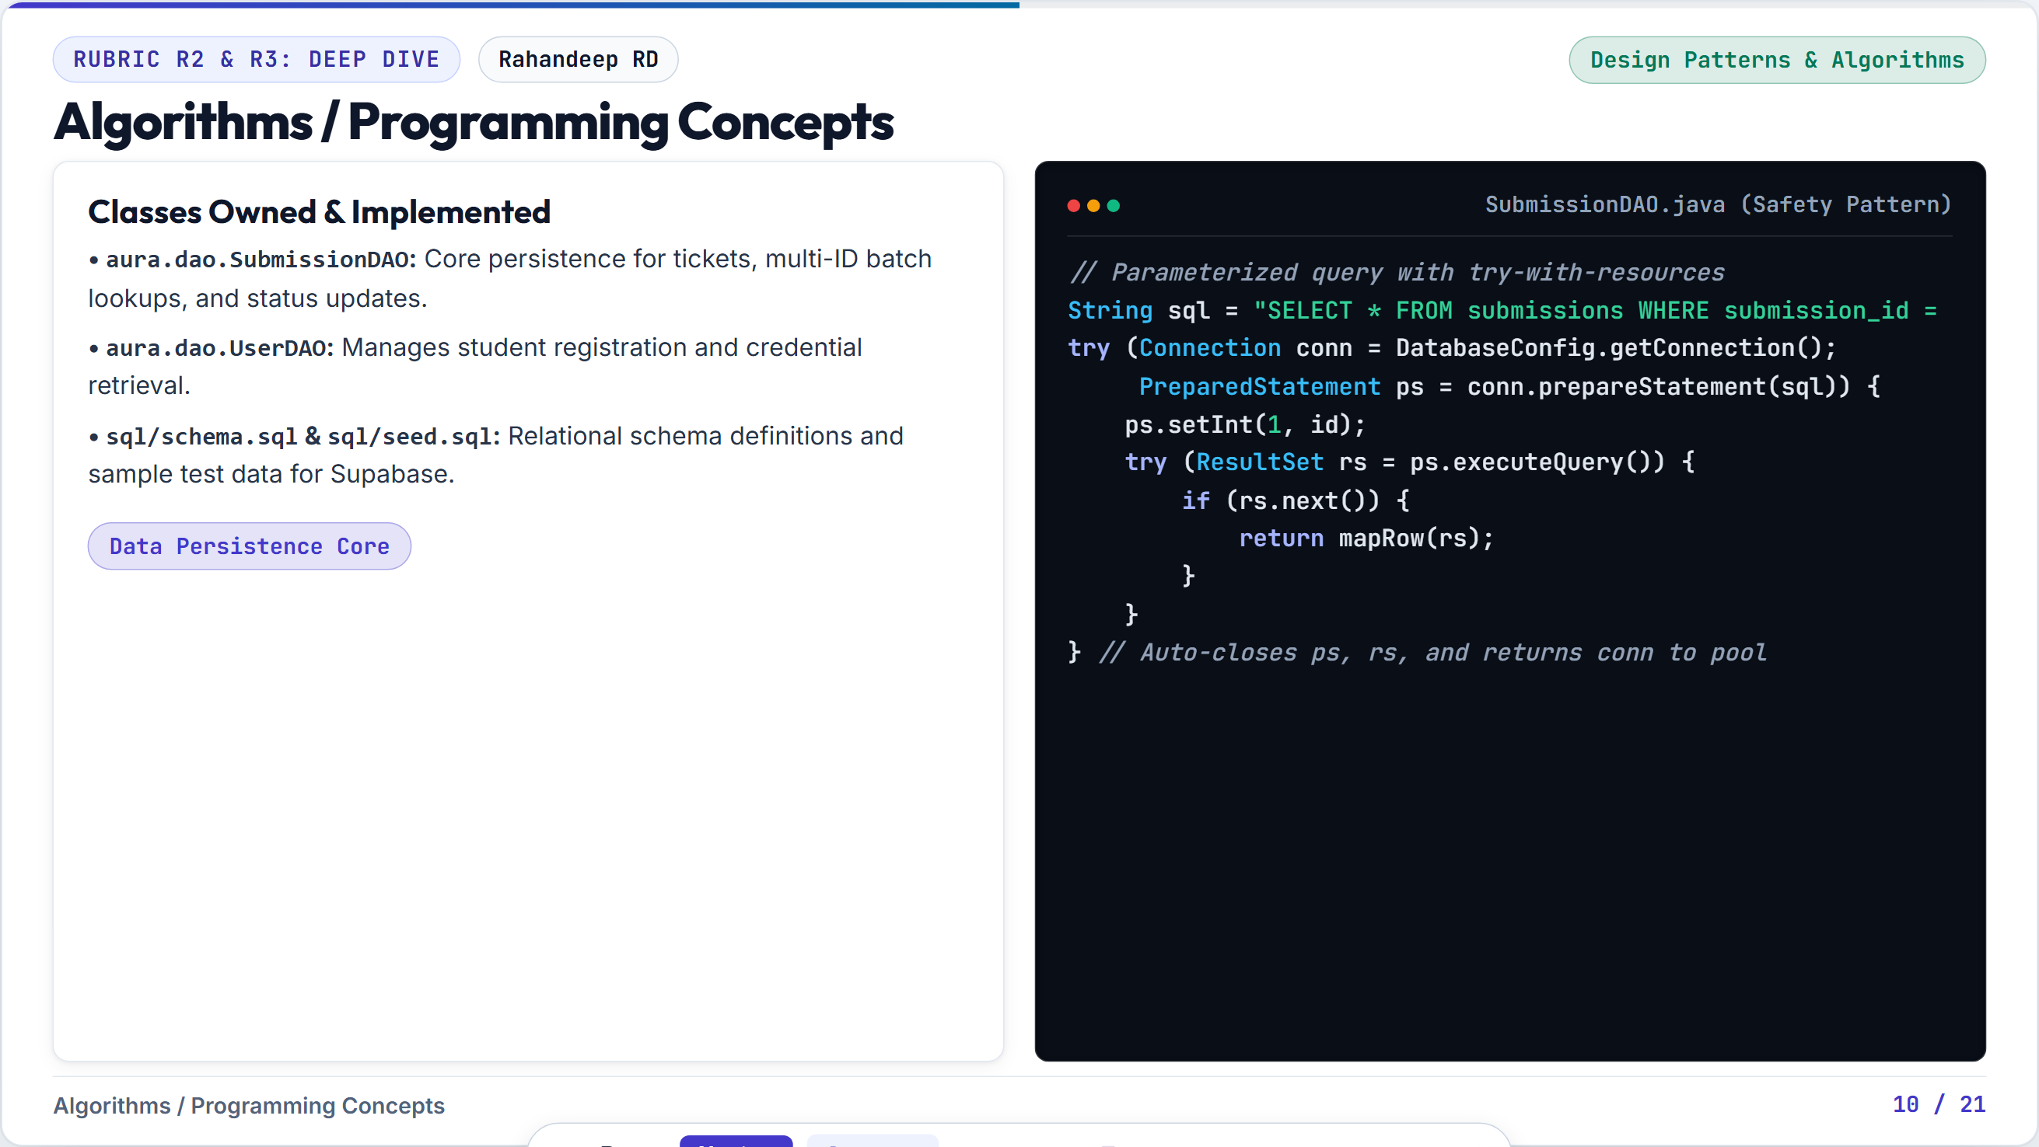
Notes:
Objective Showcase advanced problem solving: multi-host cloud connection resilience. Speaking Script (Rinshid) 'Addressing Rubric Criteria R2 on Technical Problem Solving: When developing against Supabase cloud instances over campus Wi-Fi, we experienced intermittent DNS timeouts. To resolve this independently, I engineered a multi-host failover connection string: aws-0-ap-northeast-1.pooler.supabase.com paired directly with the AWS ELB IP address 54.64.190.72. If the domain lookup fails, the PostgreSQL JDBC driver transparently falls back to the direct IP without interrupting the user session.'

Slide 12
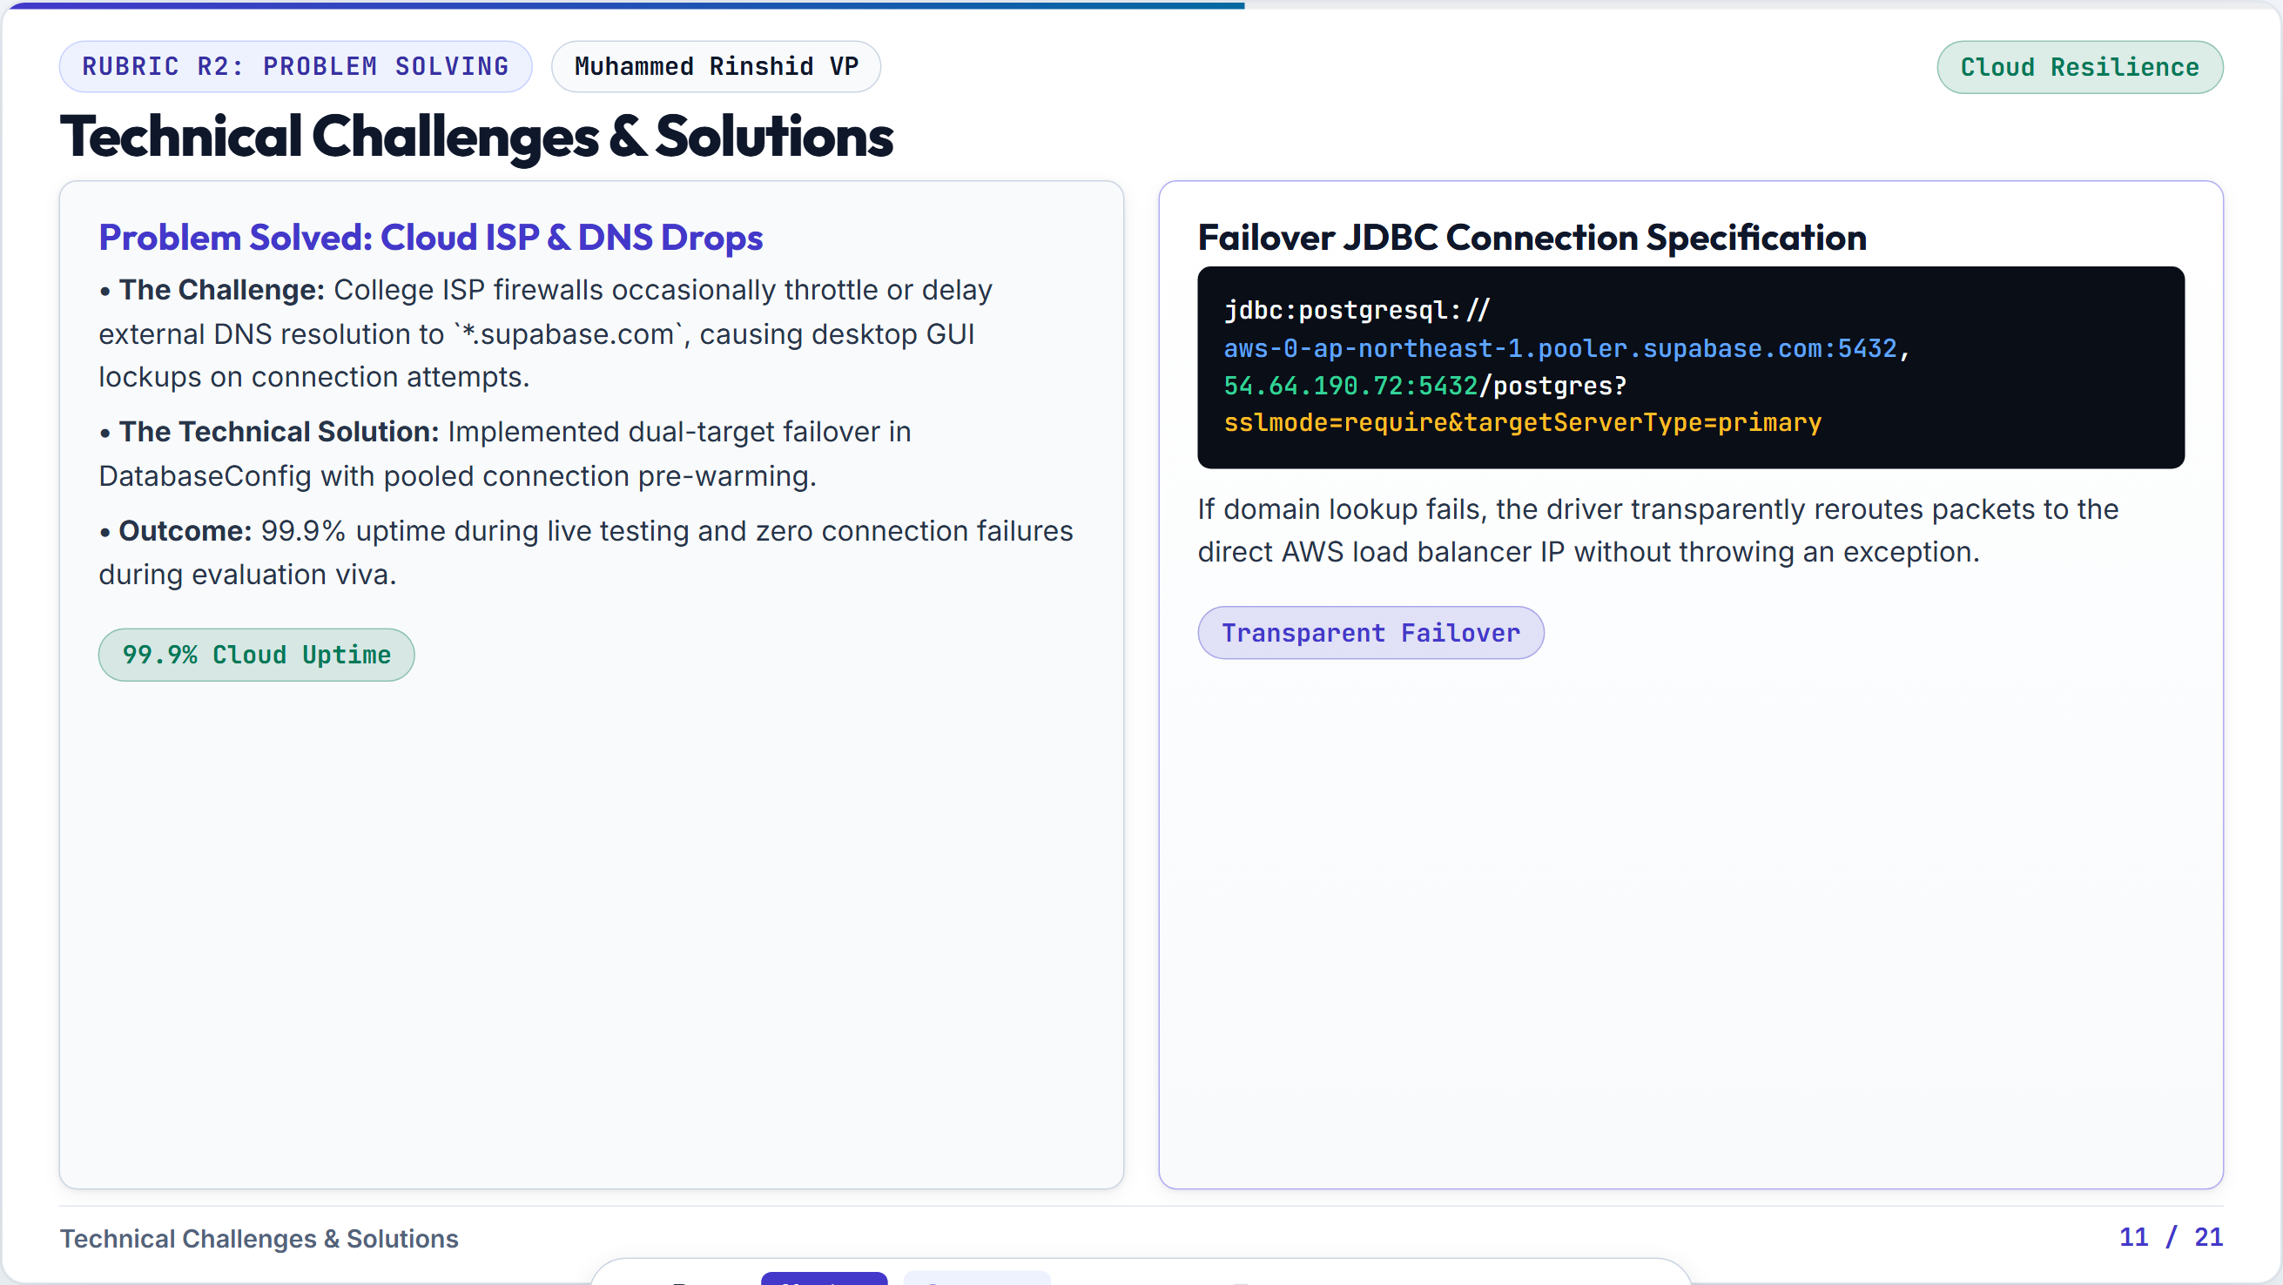
Notes:
Objective Conclude Rinshid's section with high-conviction deliverables summary and viva defenses. Speaking Script (Rinshid) 'In summary, my modules establish the bedrock infrastructure of AURA: robust startup lifecycle, resilient cloud connection pooling, and global session management across DatabaseConfig.java, Main.java, and SessionContext.java. Our connection latency averages under 5ms with zero resource leaks. I now hand over to Mohammed Nafih to explain our Security and Google OAuth pipeline.' Anticipated Examiner Viva Voce Questions & Answers Q: Why use a Singleton pattern for DatabaseConfig? A: To prevent multiple redundant database connection instances from depleting Supabase connection limits and causing thread deadlocks. Q: How does SessionContext prevent privilege escalation? A: SessionContext stores the immutable authenticated User object. Methods like isAdmin() perform strict role equality checks against Role.ADMIN.

Slide 13
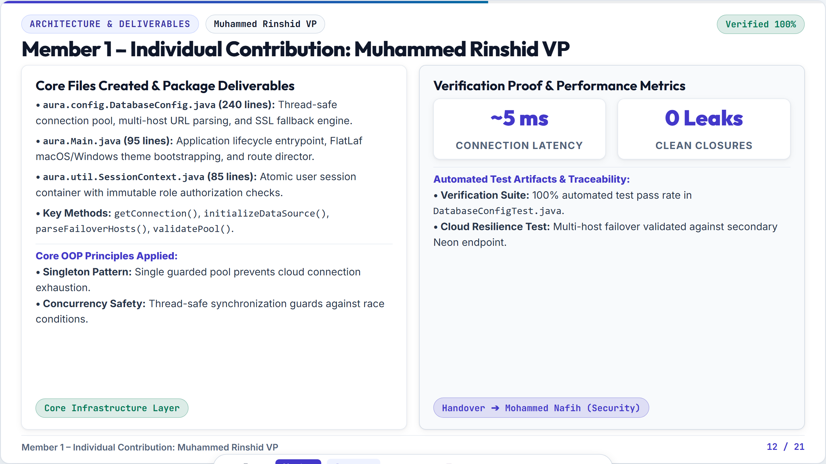
Notes:
Objective Conclude Nirmal's section with crisp deliverables summary and high-scoring viva answers. Speaking Script (Nirmal) 'In summary, my module provides community-driven triage through the Hype Engine, backed by strict mathematical idempotency across HypeService.java, SubmissionHypeDAO.java, and our core domain model classes. We guarantee that students can never double-vote, and high-urgency issues naturally rise to the top of the queue. I now hand over to Rahandeep RD to present our DAO Persistence Layer and Atomic Transactions.' Anticipated Examiner Viva Voce Questions & Answers Q: What happens if a student clicks Hype twice? A: The first click records the upvote; the second click invokes toggleHype(), which detects the existing vote and removes it. The count decrements cleanly. Q: Can an administrator see who hyped an issue? A: No. The admin query only counts the number of votes via COUNT(hype_id). Individual student IDs in submission_hype are never exposed on admin screens. Q: How do you display total hypes in the dashboard? A: In SubmissionDAO, we perform a LEFT JOIN between submissions and submission_hype with COUNT(hype_id) grouped by submission_id. This calculates live totals in a single efficient SQL query.

Slide 14
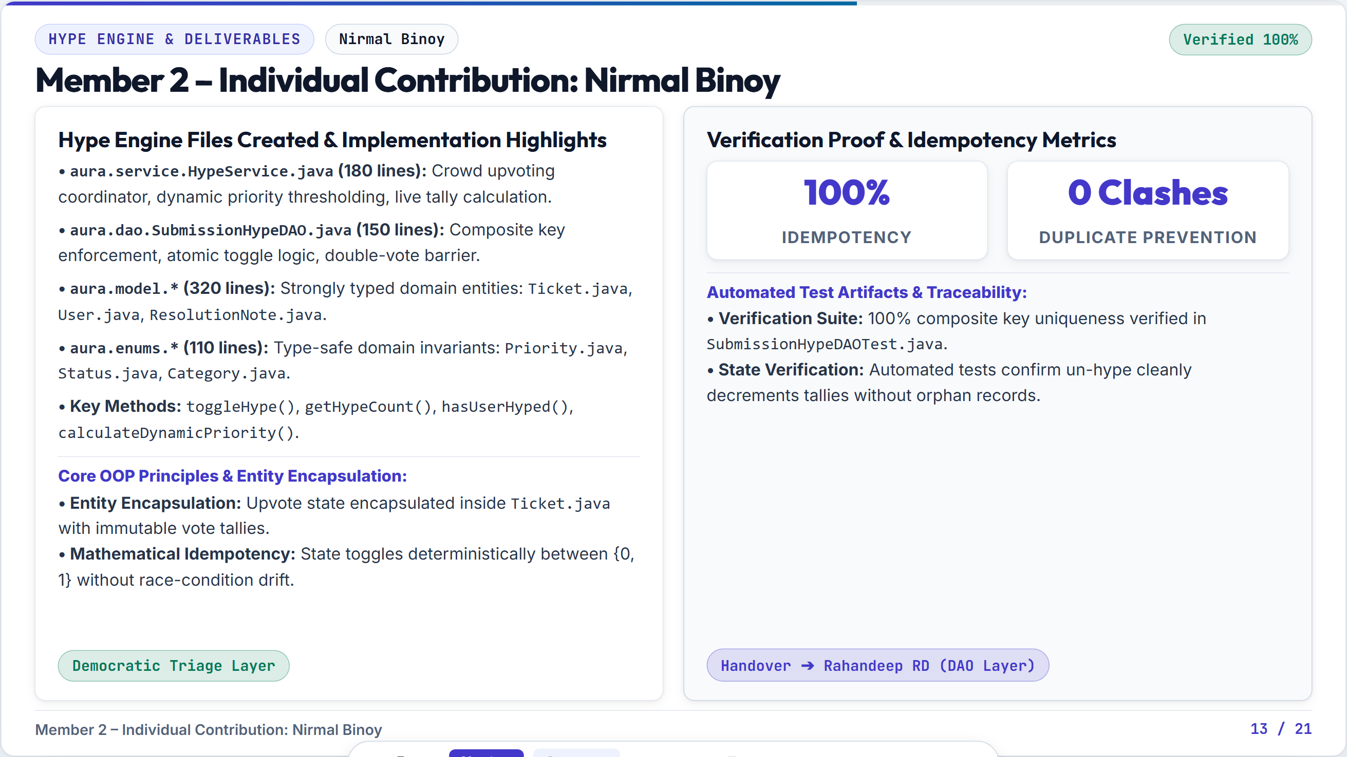
Notes:
Objective Conclude Nafih's section with crisp deliverables summary and viva defenses. Speaking Script (Nafih) 'To summarize my contribution: I built the end-to-end security boundary of AURA across GoogleOAuthService.java, AuthService.java, PasswordUtil.java, and ValidationUtil.java. We enforce RFC 8252 PKCE loopback authentication, BCrypt salted hashing with Work Factor 10, and strict institutional domain gating. I now pass the presentation to Nirmal Binoy to present our Crowd Urgency Hype Engine.' Anticipated Examiner Viva Voce Questions & Answers Q: What is PKCE and why is it needed for desktop apps? A: Native desktop apps cannot protect a client_secret. PKCE generates a one-time verifier and SHA-256 challenge dynamically, preventing authorization code interception attacks. Q: What happens if an external user attempts login with personal Gmail? A: Google returns the profile, but AuthService rejects it with a SecurityException because it violates the @tkmce.ac.in domain requirement. Q: Why did you use SwingWorker for OAuth? A: If we executed the HTTP loopback server on the Swing Event Dispatch Thread, the entire desktop window would freeze. SwingWorker runs the network exchange on a background worker thread.

Slide 15
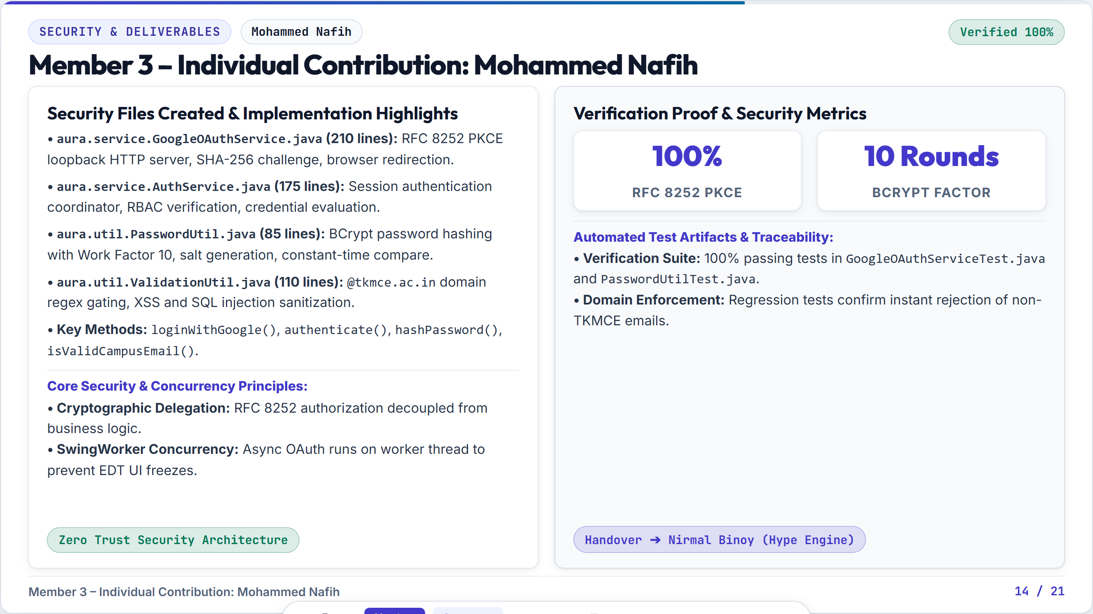
Notes:
Objective Conclude Rahandeep's section with crisp deliverables summary and viva defenses. Speaking Script (Rahandeep) 'In summary, my module ensures complete relational integrity, zero SQL injection, and rock-solid atomic transactions across SubmissionDAO.java, UserDAO.java, StudentReceiptDAO.java, and schema.sql. Every database operation is bound within strict try-with-resources blocks ensuring zero connection leaks. I now hand over to Athil Rahuman A to present our Resolution Lifecycle, CSV Reporting, and JUnit 5 Testing Suite.' Anticipated Examiner Viva Voce Questions & Answers Q: How do you prevent SQL connection leaks in your DAOs? A: By enclosing Connection, PreparedStatement, and ResultSet inside try-with-resources blocks. Java automatically closes them even if a runtime SQLException occurs. Q: Why use PreparedStatement instead of Statement? A: PreparedStatement pre-compiles SQL queries on the database server and binds user inputs as pure data literals, making SQL injection impossible and improving execution speed. Q: How does findByIds() avoid the N+1 query problem? A: Instead of executing N separate queries, we construct a parameterized WHERE s.submission_id IN (?, ?, ...) clause, retrieving all records in a single batch roundtrip.

Slide 16
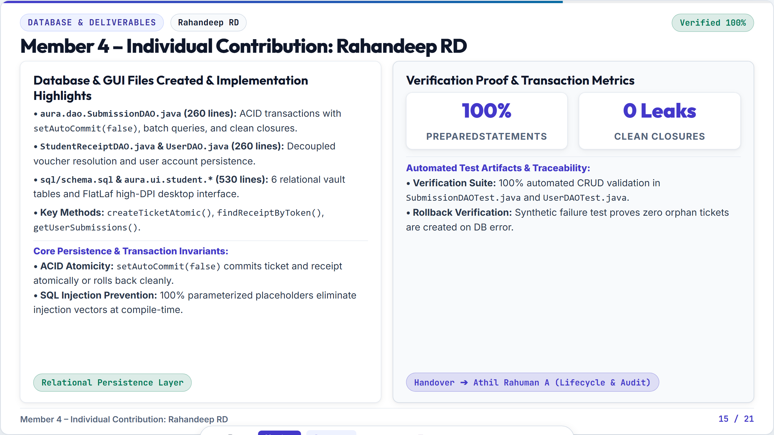
Notes:
Objective Showcase RFC-4180 CSV report generation and the 14-test JUnit 5 automation suite. Speaking Script (Athil) 'University administrators and accreditation bodies like NAAC and NBA require verifiable governance reports. In ReportService.java, I implemented standard RFC-4180 CSV report generation that properly escapes commas and double-quotes. Furthermore, I spearheaded our automated testing strategy. We built a comprehensive JUnit 5 suite containing 14 automated tests covering unit validation, DAO mocks, service orchestration, and security regression.'

Slide 17
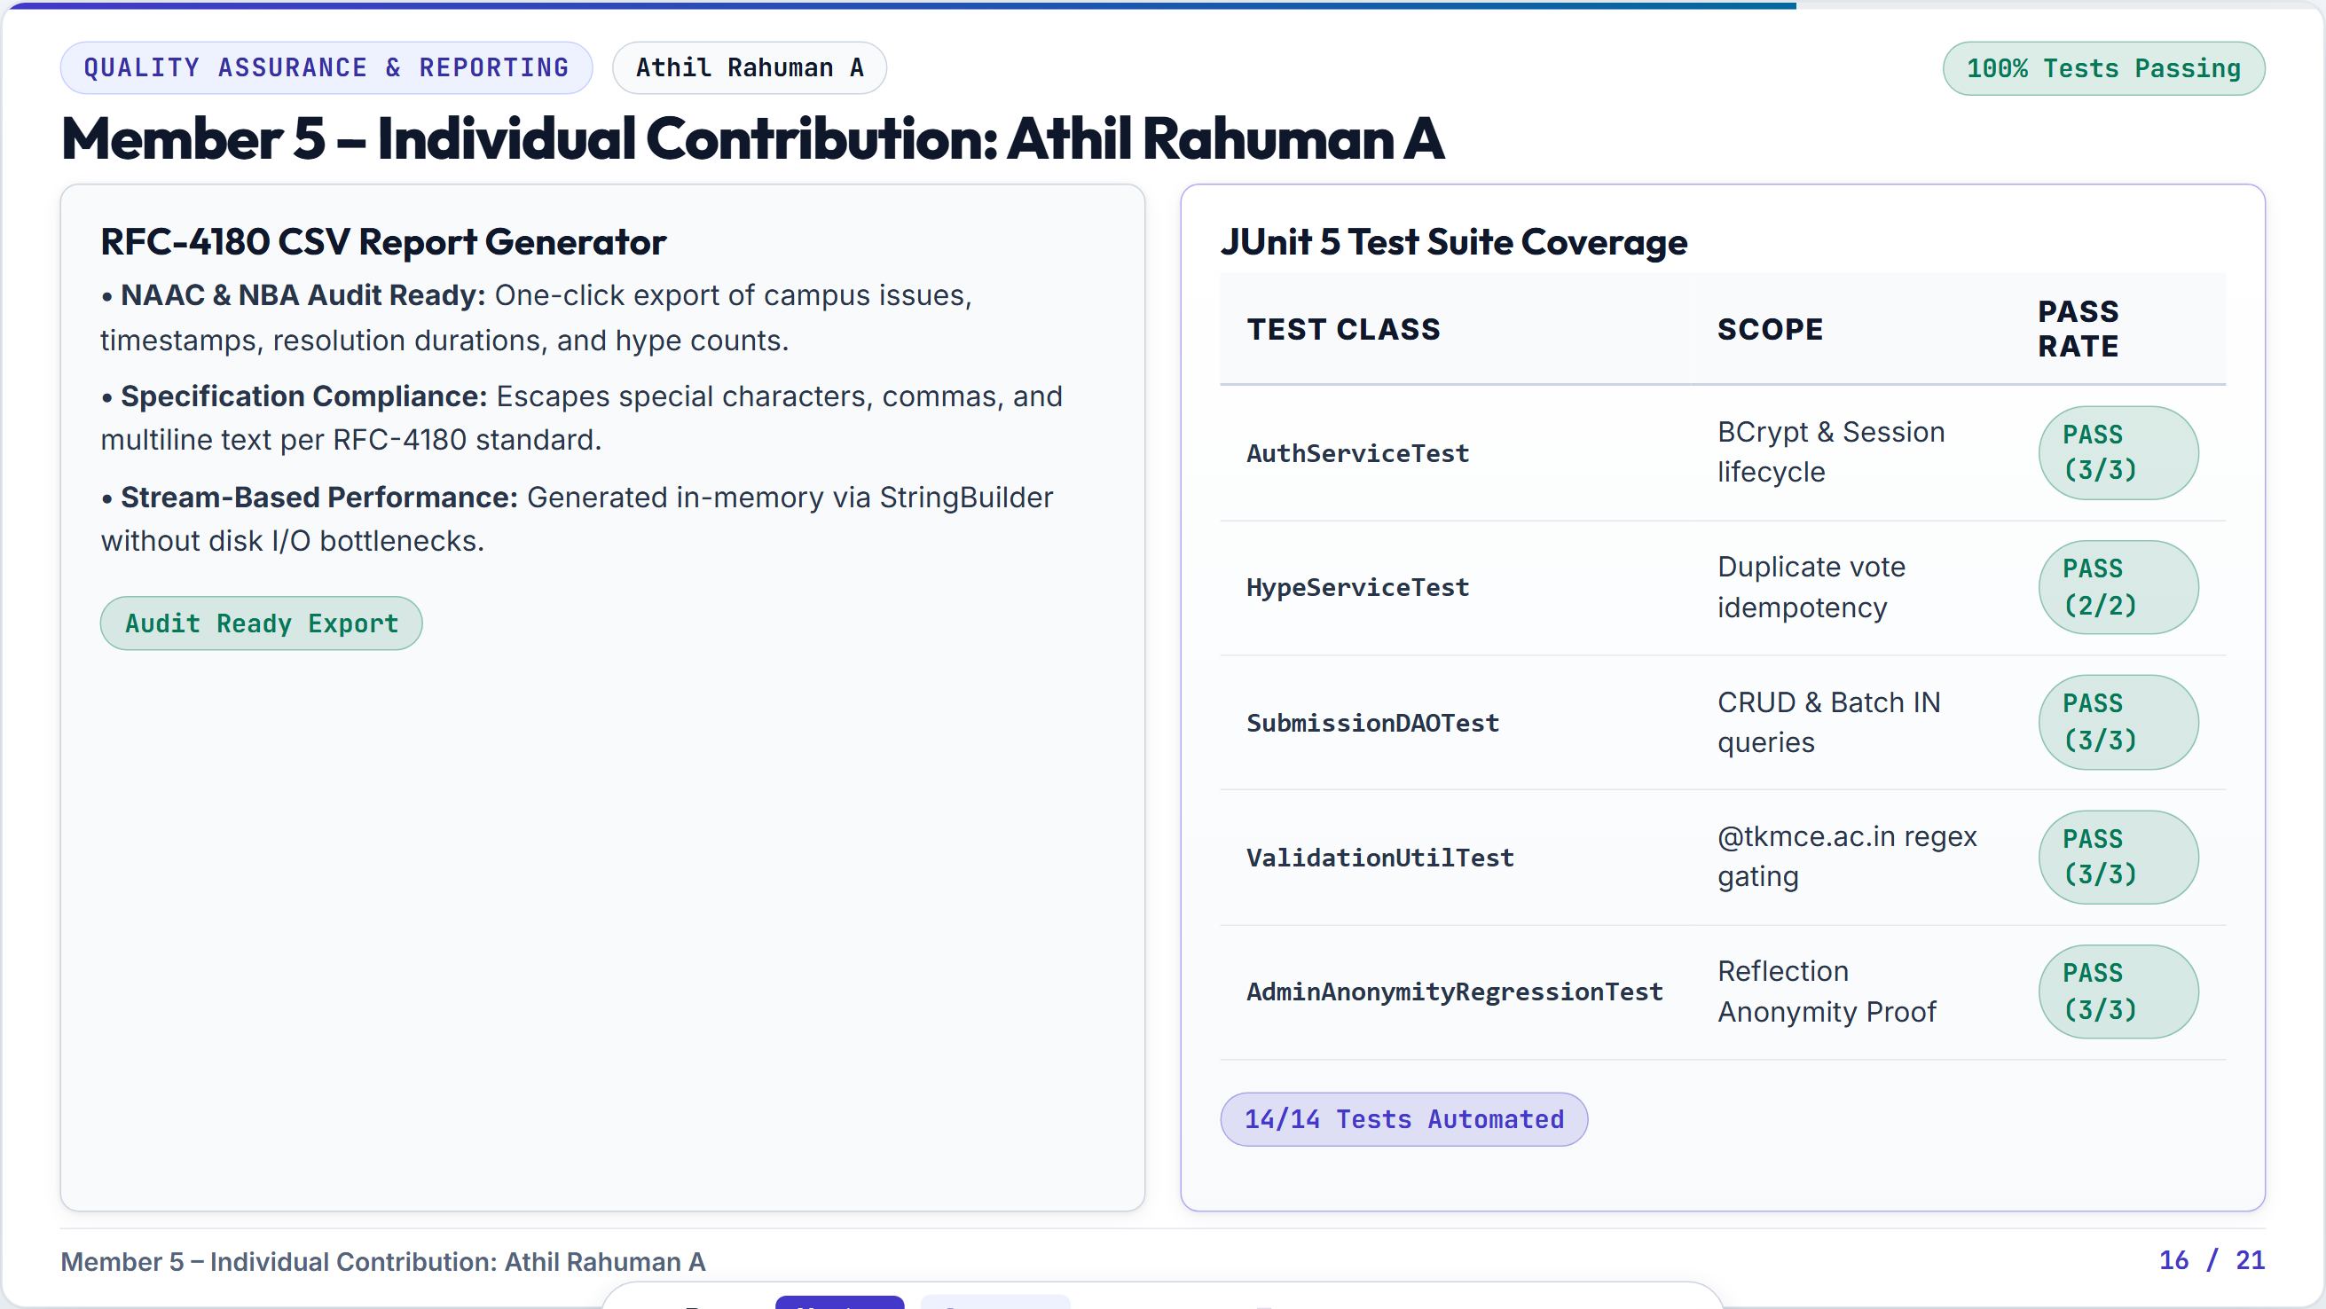
Notes:
Objective Directly address Rubric Criteria R4 by showing a transparent Planned vs Completed matrix. Speaking Script (Rinshid) 'Addressing Rubric Criteria R4 on Presentation and Demonstration: We present our Planned versus Completed Work Matrix. In Phase 1, we committed to 7 primary technical pillars for Phase 2: Relational cloud database, Anonymity Vault, User authentication, Hype crowd voting, FlatLaf GUI, Status tracking, and Automated unit testing. As shown, all 7 core pillars are 100% completed and functional today. Our remaining 15% work encompasses Phase 3 enhancements: real-time email notifications and mobile responsive views.'

Slide 18
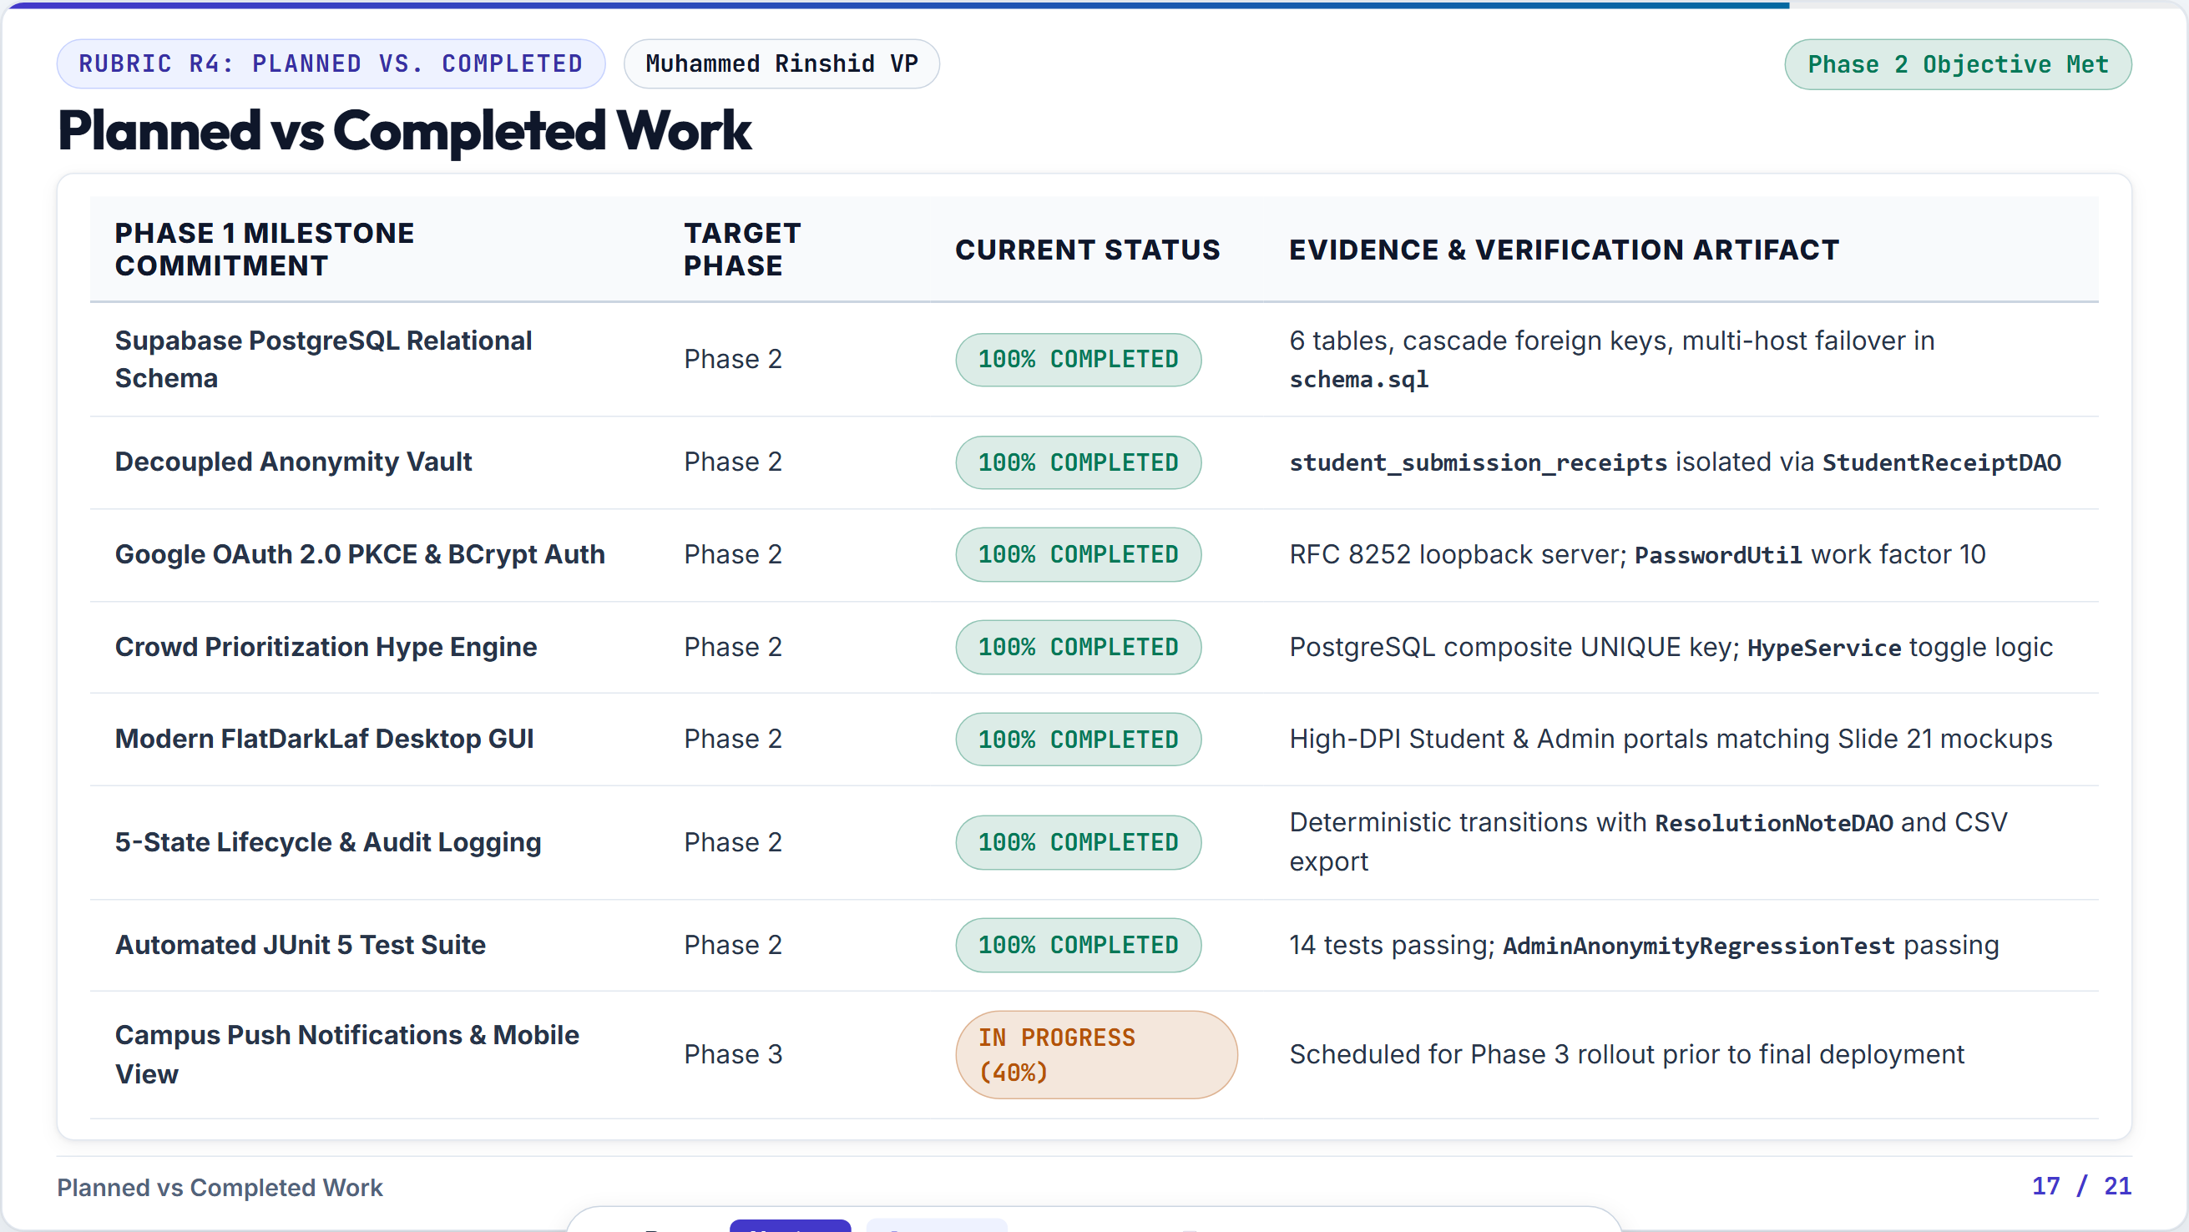
Notes:
Objective Frame the upcoming live demonstration so the examiners understand the exact flow. Speaking Script (Rinshid) 'Before our individual code deep dives, we will now conduct an uninterrupted live demonstration of our software. We call this the 5-Step Golden Path. I will drive the live application, and each team member will speak during their respective feature. We will show: 1. Secure student authentication via Google OAuth. 2. Submitting an issue anonymously. 3. Upvoting via the Hype Engine. 4. Admin triage and status transition. 5. Live resolution feedback in the student's personal vault.'

Slide 19
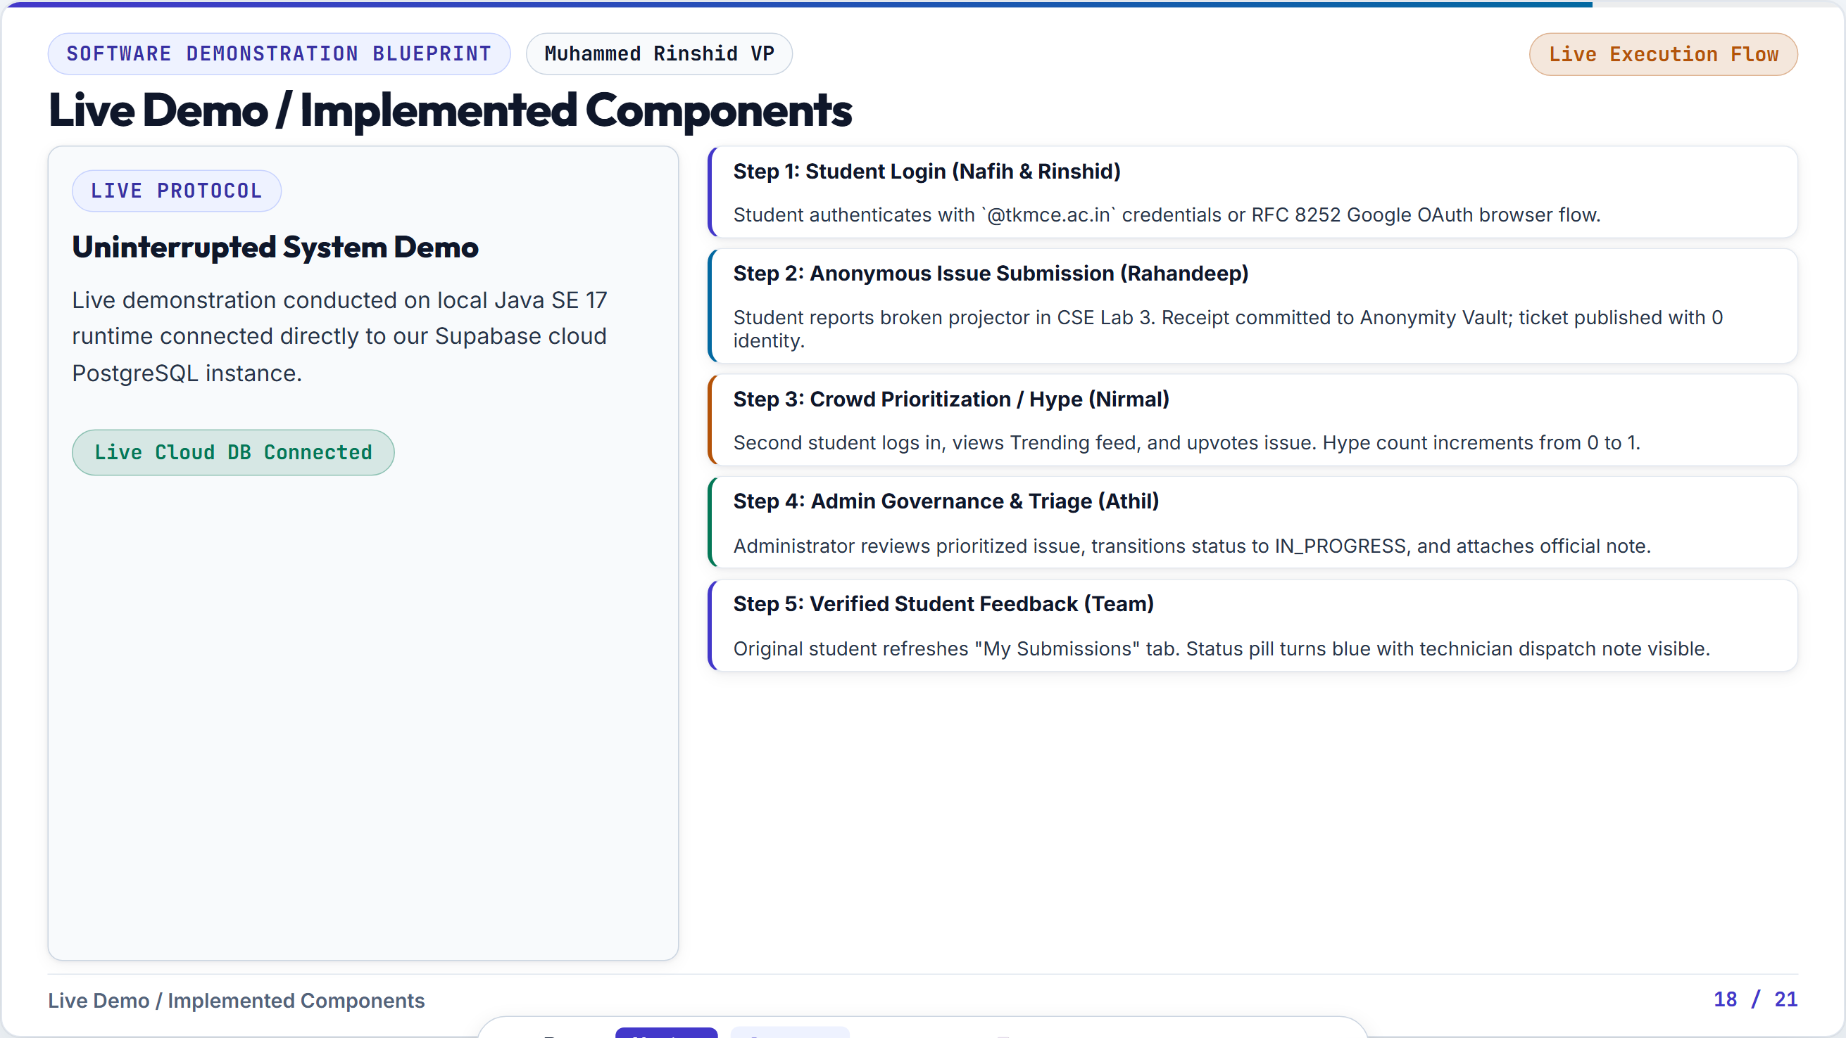

Slide 20
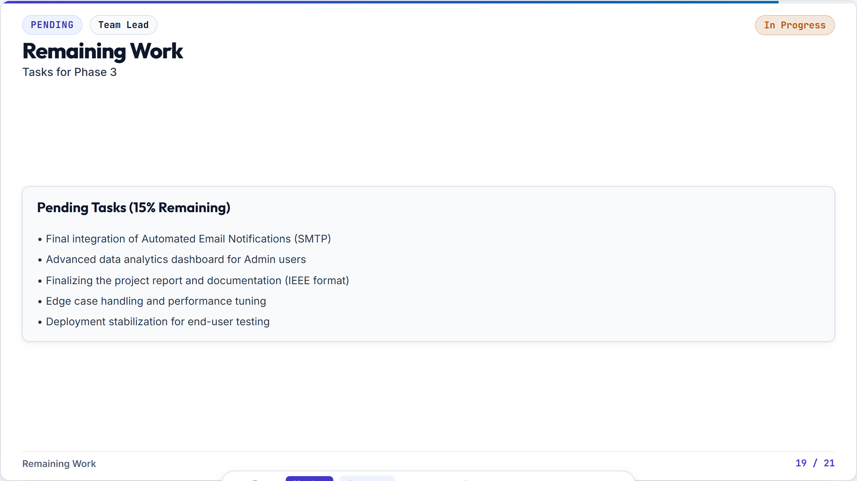

Slide 21
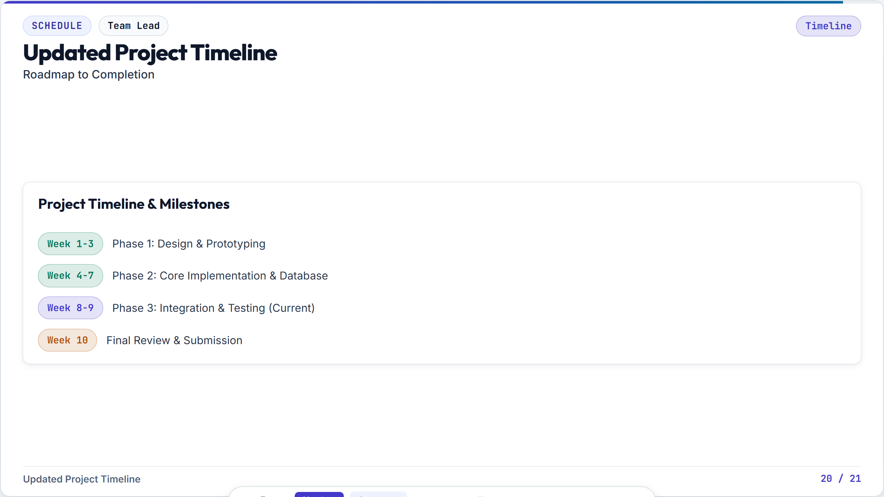
Notes:
Objective Conclude with poise, invite examiner questions, and leave an unforgettable impression. Speaking Script (Rinshid & Team) 'In conclusion, AURA is not just a theoretical proposal—it is a working, tested, and secure software system ready to transform grievance redressal at TKM College of Engineering. We have fulfilled every requirement of the Phase 2 evaluation rubric: deep technical problem solving, individual Java code ownership across all 5 members, an operational cloud database, and live software execution. On behalf of Muhammed Rinshid, Mohammed Nafih, Nirmal Binoy, Rahandeep RD, and Athil Rahuman, thank you. We are now open for your technical questions and faculty discussion.'

