Slide 1
Machine Learning Introduction

Slide 2


Slide 3
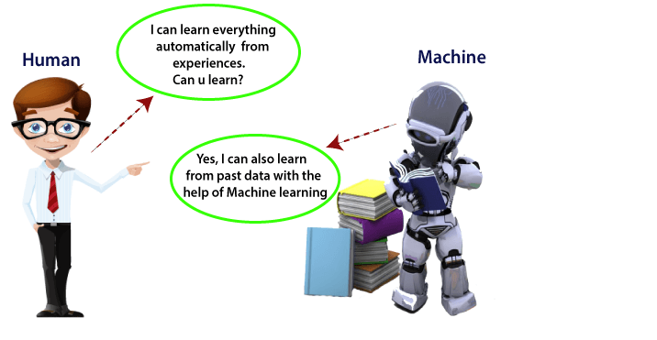

Slide 4


Slide 5


Slide 6
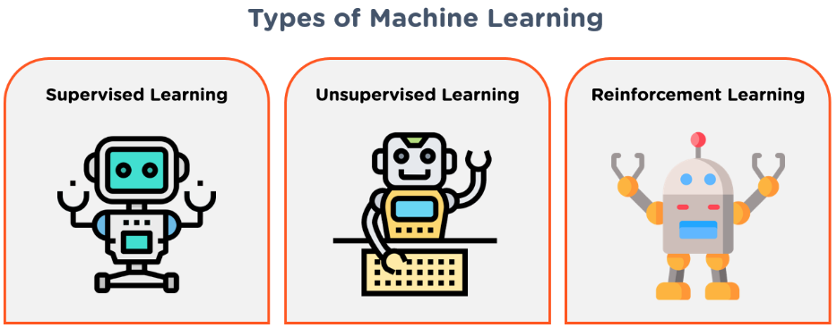

Slide 7
Thank You

