Slide 1
Chapter : SEO Introduction
What is SEO?
Why need SEO for your Website?
Different Techniques of SEO?
Blackhat SEO
Whitehat SEO
Type of SEO:
On page SEO
Off page SEO
On page SEO techniques
Off page SEO techniques
SEO best Practice to follow

Slide 2
What is SEO?
What is SEO?
SEO stands for “search engine optimization.”
Get Traffic (unpaid)
Visibility in Search Engine.
To get 1st page on SERP
Focus quality and quantity
In simple words:
SEO is the way to get relevant traffic for your good quality website content.
SEO is the way to satisfy the user as well as search engine
Don’t target only user or search engine

Slide 3
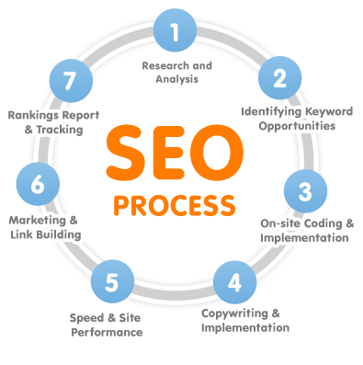
SEO Process
Image Ref: https://www.indiamart.com/proddetail/process-workflow-6303519373.html

Slide 4
Why need SEO for your Website?
Why need SEO for your Website OR Objectives of SEO?
Website Traffic
Promote your content to whole world
Get Students / Reader from the whole world
Sale your products or services to right audience
Free of cost
People trust

Slide 5
Different Techniques of SEO?
Different Techniques of SEO?
BlackHat SEO
WhiteHat SEO
BlackHat SEO
Keyword Stuffing
Hidden Texts
Hidden Links
Blog Comment Spamming
Cloaking Your Content
Publishing Low Quality Content
WhiteHat SEO
Using Relevant keywords
Keyword Analysis
Keyword Research
Quality Backlinks
Relevant Backlinks
Quality content

Slide 6
Type of SEO
Type of SEO
Technical SEO: Make website, easy to crawl and index by search engine
On-site SEO: On the website, like good content, right use of keywords, website layout etc.
Off-site SEO: Promoting website using different techniques as creating quality backlinks etc.

Slide 7
Technical SEO Techniques
Technical SEO Techniques
SSL (Secure Socket Layer)
Mobile Friendly
Speed Up
To Fix Duplicate Content
Robots.Txt
XML Sitemap
AMP
Google Search Console
Bing Webmaster Tools.
Google Analytical Tool

Slide 8
On Page SEO Techniques
On Page SEO Techniques
Relevant Keywords
Title Tag
Meta Description
Create User Friendly Content
SEO Images
SEO URLs
Internal Links
Responsive Website

Slide 9
Off Page SEO Techniques
Off Page SEO Techniques
Quality Backlinks
Blog commenting
Forums
Guest posting
Broken Link Building
Social Bookmarking
Content Marketing
Questions & Answers website like yahoo answer, quora
Newsletters techniques

Slide 10
SEO Best Practice to follow
SEO Best Practice To Follow
Include Main Keyword in different placement of your Content
Write Unique Titles, Descriptions And Content
Optimize Your Title
Improve website Loading Speed
Track Your Results With The Google Search Console
Google Analytical Tool
Images SEO
Use Internal Linking
Publish long and good quality Content
Create Quality Backlinks
Use Social Networking Sites legally

