Slide 1

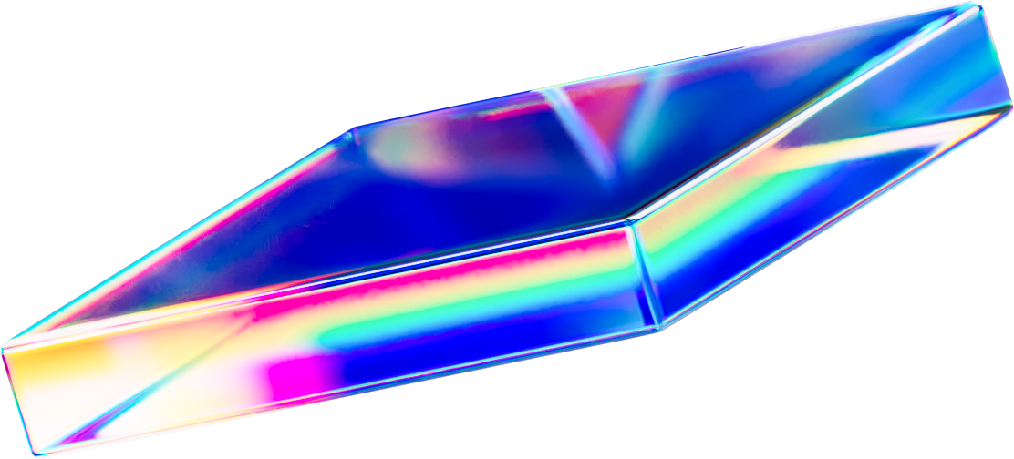
ProofyX
Is this real?
ProofyX answers that in seconds — for any image, video or voice — and shows the evidence behind the answer.
Investor Pitch Deck
Seed Round
Notes:
15s. 'ProofyX answers one question: is this real? For any image, video or voice file, in seconds, with the evidence attached.' Do not explain the architecture yet.

Slide 2
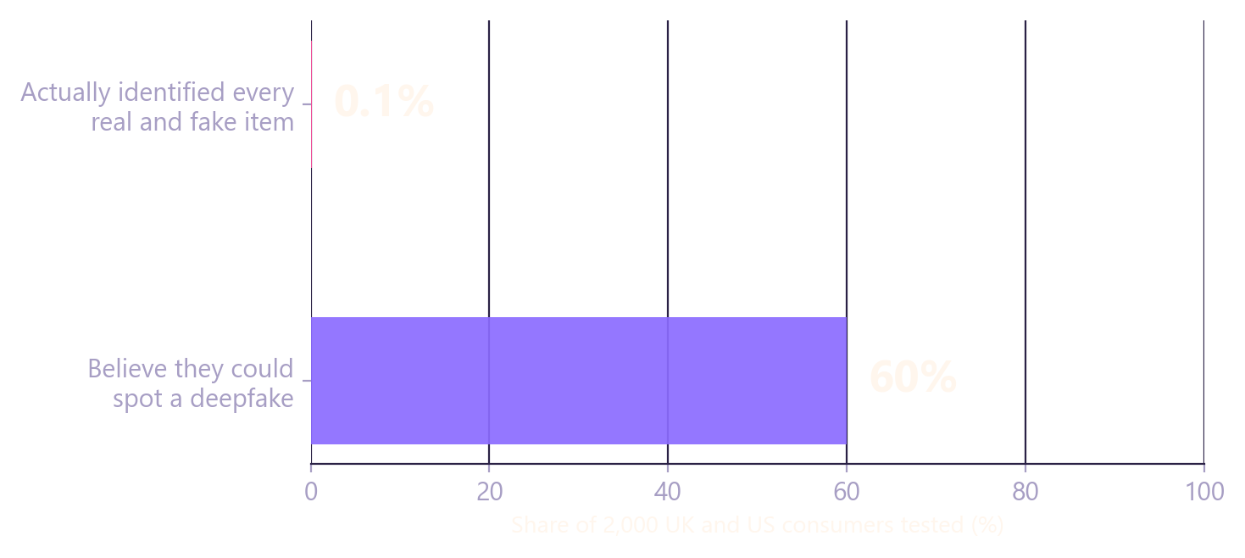
01 / PROBLEM
Nobody can tell what is real any more.
Synthetic media crossed the threshold where human review stops working — and the losses are already being booked.
8M+
Deepfake files in circulation in 2025, up from 500K in 2023
$893M
AI-enabled fraud losses logged by the FBI in 2025, across 22,364 complaints
$280K
Average loss per single deepfake fraud incident
iProov tested 2,000 UK and US consumers on real and fake media. Six in ten backed themselves; one in a thousand got every item right.
Detection is now a compliance problem, not a curiosity. Banks, newsrooms and courts need an answer they can put in a file.
Notes:
35s. Lead with the confidence gap on the right: people are sure they can tell, and they cannot. Then the money. Land on: this is already a booked loss line, not a future risk.

Slide 3
02 / WHY NOW
Detection just became legally mandatory.
Regulation is converting deepfake detection from a nice-to-have into compulsory spend — on a clock we can name.
EU AI ACT
UNITED STATES
INDIA
GLOBAL
Article 50
TAKE IT DOWN Act + 46 states
IT Rules amendment, 2026
China, South Korea, FATF
From 2 August 2026, AI-generated content must be machine-readable and detectable. Article 99 penalties reach EUR 15M or 3% of global turnover.
Signed May 2025. 169 state deepfake laws since 2022, 146 bills in 2025 alone. FinCEN warned financial institutions in Q4 2025.
Synthetic-media labelling and takedown duties for intermediaries — the market where our first design partners sit.
FATF named deepfakes a direct threat to AML and customer due diligence. South Korea legislated after a 1,625% spike in deepfake fraud.
The buyer no longer has to be convinced the problem is real — a regulator already told them. That changes the sales cycle from evangelism to procurement.
Notes:
30s. This is the slide that answers 'why now'. The EU date is fixed and close. Budget already exists on the other side of it.

Slide 4
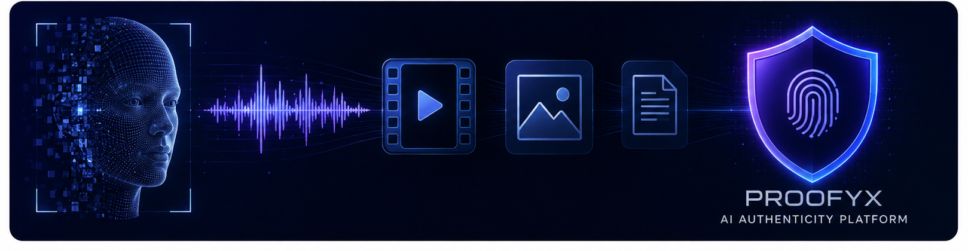
03 / SOLUTION
One number, and the reason behind it.
ProofyX returns a 0-100 Trust Score for any image, video or audio file — plus the heatmap and per-model evidence that produced it.
EVIDENCE, NOT A VERDICT
BREADTH
DURABILITY
Explainable by construction
Image, video, audio and cross-modal
Modular against the arms race
GradCAM heatmaps show which pixels drove the score, and every model in the ensemble reports separately. Competitors return a binary label; a compliance officer cannot file a binary label.
One API covers all three modalities and scores a video on its frames AND its soundtrack, surfacing disagreement between them rather than averaging it away.
Detection is a moving target. Models are swappable behind a stable scoring interface, so a new generator is a model update, not a rewrite.
Notes:
30s. The unique value proposition is the second half of the sentence: everyone can say fake or real. We say why, in a form that survives an audit.

Slide 5
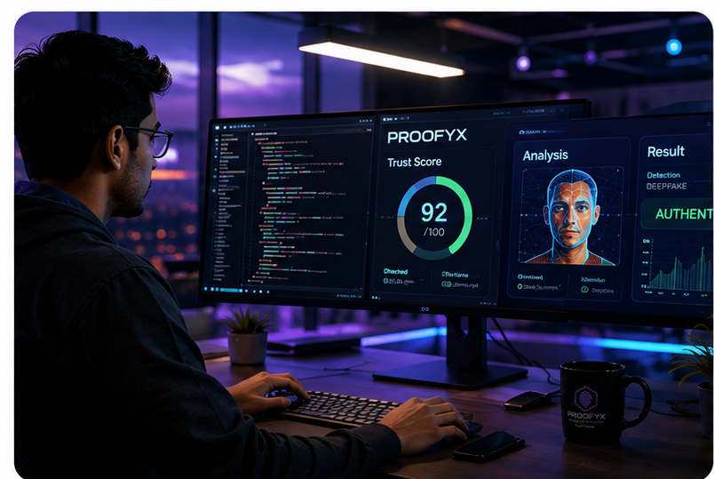
04 / PRODUCT
Upload. Score. Act.
Live product: React dashboard, documented REST API, ten models loaded, running today on image, video and audio.
1
Upload
Drag in a file, or POST to /api/v1. JPG PNG WebP, MP4 MOV MKV, WAV MP3 FLAC.
2
Analyse
Ten models score in parallel; learned fusion reconciles them with calibrated confidence.
3
Explain
Trust Score 0-100, GradCAM heatmap, per-model scores and an EXIF forensics report.
4
Act
Four-tier verdict, exportable report, and a one-click cybercrime complaint filing in India.
Concept render of the analysis view. Replace with a live screenshot before pitching — the product is running.
LIKELY MANIPULATED
POSSIBLY MANIPULATED
UNCERTAIN
LIKELY AUTHENTIC
Four-tier verdict — we say 'uncertain' when we are, rather than forcing a coin-flip.
Notes:
40s. If there is a laptop in the room, demo instead of showing this: upload one fake, land on the heatmap. 60 seconds, one flow.

Slide 6
05 / VALIDATION
What is measured, and what is not.
Every number below is reproducible from this repository. We label targets as targets.
Capability | Status | Measured result | Evidence
CorefakeNet unified image model | Shipped | 82.5% acc · 90.9% ROC-AUC · F1 81.3 | 332 held-out samples
Single-image latency (CPU) | Shipped | 564 ms — 4.9x faster than the ensemble | Benchmark run
Video pipeline, end to end | Shipped | Verified at 1/2/10/20 FPS, all 200 OK | docs section 18
Audio deepfake detection | Shipped | Wav2Vec2 backbone — 97.9% on the model card | Upstream benchmark
REST API + React dashboard | Live | 10 models loaded, OpenAPI documented, rate-limited | Deployed build
7-model ensemble accuracy | In progress | 95%+ target — fusion calibration being corrected | Not yet claimable
Paying customers | Not yet | Zero. Seeking design partners. | Honest baseline
We are pre-revenue. The ask funds the move from a working, measured prototype to a calibrated product with design partners under contract.
Notes:
35s. Do not skip the last two rows. Volunteering the weak number is what makes the strong ones believable in diligence.

Slide 7
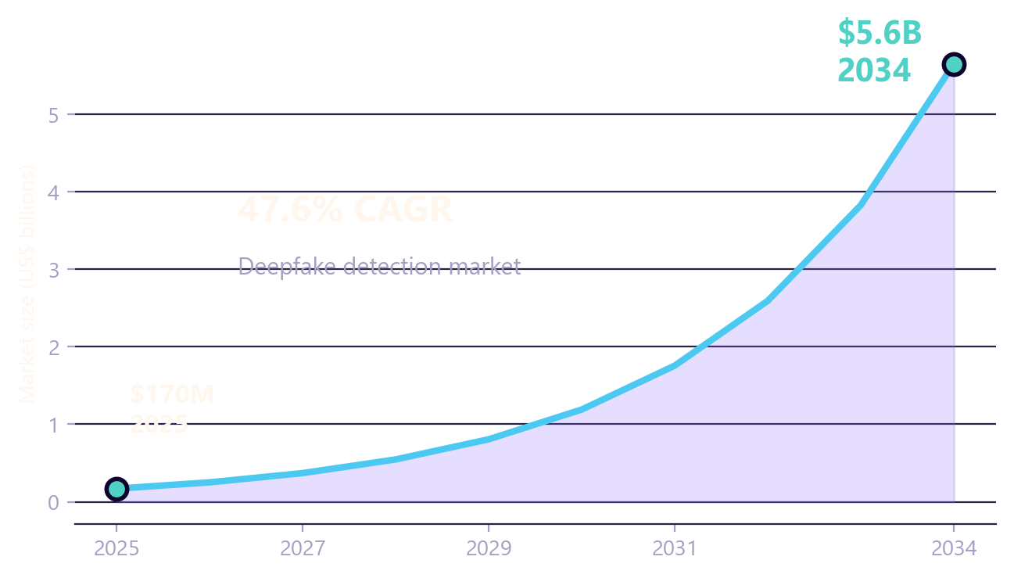
06 / MARKET
A $170M market compounding at 47.6%.
Early, mandated, and accelerating fast.
$5.6B
Deepfake detection market by 2034 (from $170M in 2025)
66.7%
Of the market is video and image detection — our core strength
49.2%
Media and journalism share, with financial services fastest-growing
Adjacent budget lines we can reach from the same API: digital identity verification (~$18B by 2027) and content moderation (~$12B by 2027).
Notes:
25s. The point is the CAGR plus the mandate on the previous slide. A 47.6% CAGR with a legal forcing function is rare.

Slide 8
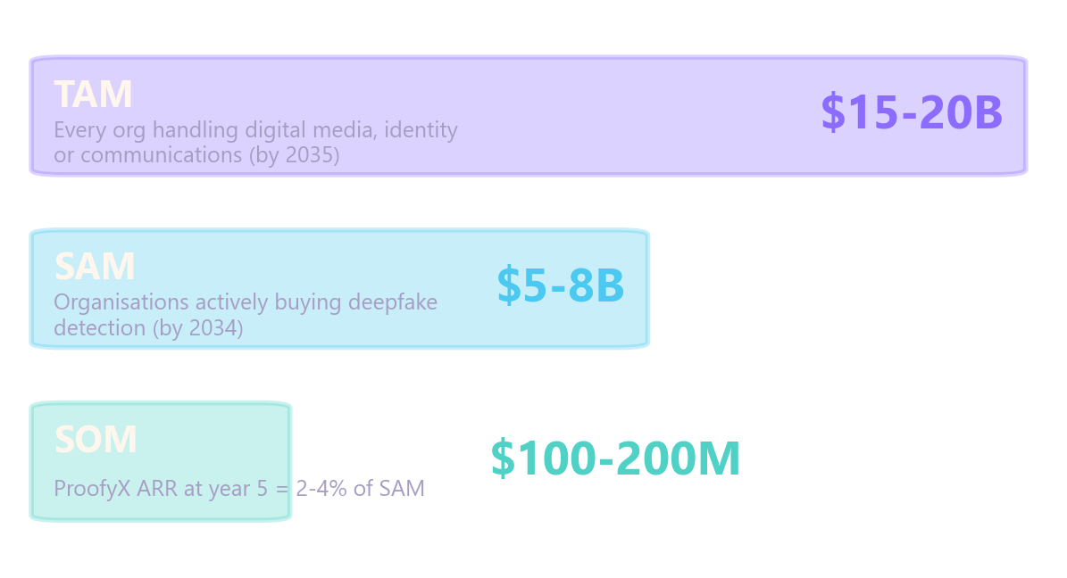
06 / MARKET
TAM, SAM and the share we are underwriting.
Sized bottom-up from the segments a detection API can actually invoice, not from the whole cybersecurity market.
WHERE THE FIRST DOLLARS COME FROM
Financial services
KYC/AML and voice-auth fraud. $0.50-1.50 per verification. Fastest-growing vertical.
Media and newsrooms
Pre-publication verification. Largest current share of the market at ~49%.
Government and legal
Evidence authentication and counter-disinformation. $0.82B defence segment in 2025.
Comparable: Doppel grew enterprise customers 400% in one year.
Notes:
25s. Be ready for 'how did you get to SOM' — it is 2-4% of SAM at year 5, and the assumptions are in the appendix.

Slide 9
07 / COMPETITION
A funded field — and a gap in it.
26 funded companies have raised $259M between them. None of the leaders ship breadth and explainability in the same product.
Player | Raised | Modalities | Explainable | Fast mode
Reality Defender | $52.4M | Multi | Partial | No
Doppel | $124M | Social eng. | No | Real-time
Pindrop | Major VC | Voice only | No | Yes
GetReal Security | $17.5M | Visual | Forensic | No
Sensity AI | Undisclosed | Visual | Forensic | No
Intel FakeCatcher | Internal | Video only | Physiological | Yes
ProofyX | Pre-seed | Image+Video+Audio | GradCAM + per-model | Yes (4.9x)
Our narrow, defensible claim:
ProofyX is the only stack combining all three modalities, per-model explainability and a fast single-pass mode behind one API — the shape a regulated buyer needs to file a decision, not just make one. We are not claiming the best single-model accuracy; we are claiming the most auditable answer.
Notes:
30s. Never say 'no competition'. Name the funded players first, then the one row where we differ. Expect a question on moat — answer with the explainability workflow and the modular retrain loop, not the model weights.

Slide 10
08 / BUSINESS MODEL
Four ways to charge for the same API call.
Land through self-serve and the API, expand into enterprise licences. Benchmarked against what this market already pays.
Stream | Price | Target customer | Why they buy
API-as-a-service | $0.25-0.50 / analysis | Platforms, integrators | Volume moderation, drop-in call
SaaS subscription | $99-499 / month | Newsrooms, SMBs | Desk-level verification workflow
Per-check KYC | $0.50-1.50 / check | Financial services | Regulatory duty, priced per user
Enterprise licence | $50K-500K / year | Banks, government | On-prem, SLA, audit trail
BENCHMARK
GROSS MARGIN
EXPANSION
Sightengine charges $99/mo for 40,000 images; deepidv $19/mo + $0.50/check.
CPU inference today; GPU batch on the roadmap moves unit cost down as volume rises.
Same API serves moderation, KYC and evidence — one integration, three budget lines.
Notes:
20s. Investors want to know the land-and-expand path. Self-serve API is the wedge, enterprise licence is the value.

Slide 11
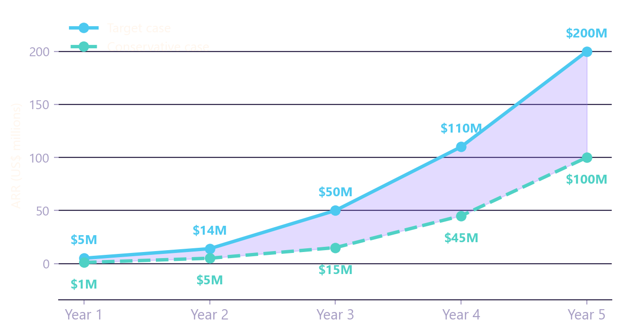
09 / FINANCIALS
Five-year path to $100-200M ARR.
Conservative and target cases. Pre-revenue today — these are projections, and the assumptions are listed opposite.
ASSUMPTIONS BEHIND THE CURVE
Year 1
3-6 design partners at $50-150K. No self-serve revenue assumed.
Year 2-3
Self-serve API opens; enterprise ACV rises as the EU AI Act deadline bites.
Year 4-5
2-4% of a $5-8B SAM. Requires GPU inference and a compliance-certified deployment.
Cost base
Team and compute dominate; inference cost per call falls with batch GPU.
Notes:
25s. Say the word 'projection' out loud. If asked for the model, the spreadsheet is in the data room — do not improvise numbers.

Slide 12
10 / TEAM
Builders who already shipped the hard part.
Ten models, three modalities and a live API — built by this team before raising a rupee.
MS
MA
MS
Muhammed Sayeedur Rahman S
Mohamed Abrar
Mohamed Shahid
Founder / ML & Platform
Co-founder / Product & Frontend
Co-founder / Infrastructure & QA
Owns the detection stack and API: model training, fusion calibration, FastAPI backend and the compliance/traceability layer.
Largest contributor by commit count. Owns the React dashboard, the analysis workflows and the deployment pipeline.
Owns CI/CD, containerisation, security scanning and the test suite across the backend.
What we are missing, and are hiring for
A commercial lead with enterprise security or regtech sales experience, and a senior advisor from media forensics or financial-crime compliance. Both are line items in the ask.
Notes:
25s. Name the gap yourself. An investor who spots a missing hustler before you name it will discount everything else.

Slide 13
11 / THE ASK
Raising $1.5M-$2.5M seed.
18-24 months of runway to reach calibrated accuracy, paying design partners and an EU AI Act-ready deployment.
40%
25%
20%
15%
Engineering
Go-to-market
Compute & data
Compliance
Two ML engineers and one platform engineer. Fix fusion calibration, ship GPU inference.
Commercial lead plus design-partner pilots in financial services and media.
GPU training and inference, licensed evaluation datasets, red-team generation.
Security certification, audit trail and the evidence pack regulated buyers require.
WHAT THE MONEY BUYS — MILESTONES WE WILL BE JUDGED ON
Month 6
Month 12
Month 18
Ensemble calibration fixed; published accuracy on a public benchmark, third-party reproducible.
3-6 design partners live under paid pilots; first enterprise contract signed.
EU AI Act-ready deployment, SOC 2 in progress, GPU inference cutting unit cost.
Instrument: priced seed or SAFE. Valuation open — we would rather find the right partner than the highest cap.
Notes:
30s. Give the range, the runway and the milestones. Do not state a valuation from the stage; keep it a conversation.

Slide 14
Let's make digital
evidence provable again.
We are looking for a lead investor and three design partners in financial services or media. A live demo takes ten minutes.
EMAIL
REPLACE-WITH-REAL@EMAIL
REPOSITORY
github.com/muhammedsayeedurrahman/ai-authenticity-checker
PHONE
REPLACE-WITH-REAL-NUMBER
Investor Pitch Deck
Notes:
10s. Close on the ask, not on 'thank you'. Placeholders on this slide MUST be replaced before the deck leaves the room.

Slide 15
APPENDIX / SOURCES
Every number has a source.
Full research file: docs/PROOFYX_COMPLETE_ANALYSIS.md in the repository.
THREAT STATISTICS
MARKET SIZING
REGULATION
COMPETITION AND FUNDING
· 8M deepfake files by end-2025 — Bright Defense
· $893M AI-fraud losses, 22,364 cases — FBI IC3 2025
· $280K average incident — IRONSCALES, Fall 2025
· 60% confident, 0.1% perfect — iProov, Feb 2025
· $170M to $5.6B, 47.6% CAGR — Market.us
· Deepfake AI market — Mordor Intelligence
· $15.1B by 2035 — OpenPR
· Defence $0.82B — MarketsandMarkets
· EU AI Act Art. 50 / 99 — Blackbird.AI
· TAKE IT DOWN Act — Stack Cyber
· DoD investment — MIT Tech Review
· India IT Rules 2026 — docs/COMPLIANCE.md
· $259M across 26 companies — Tracxn
· Doppel $70M Series C — Fortune
· Reality Defender $33M — SecurityWeek
· GetReal $17.5M — TechCrunch
Every chart is regenerated by scripts/make_pitch_figures.py. ProofyX accuracy and latency figures come from the CorefakeNet evaluation run on 332 held-out samples; the eval harness is in the repository and the run is repeatable on request.
Notes:
Appendix. Do not present unless asked. Hand this slide over when an investor questions a figure.

