Slide 1


ProofyX
Is this real?
Explainable media forensics for fraud teams and investigators. It tells you whether an image, video or voice is AI-generated or tampered — and shows you the evidence.
Built at B.S. Abdur Rahman Crescent Institute of Science & Technology
CIIC incubation application
₹8 lakh · 6 months · 5 outcomes
Notes:
15s. 'Every fraud team, investigating officer and editor now has to answer the same question about a file: is this real? We built the tool that answers it with evidence.' Name yourselves, department, year. Straight to slide 2.

Slide 2
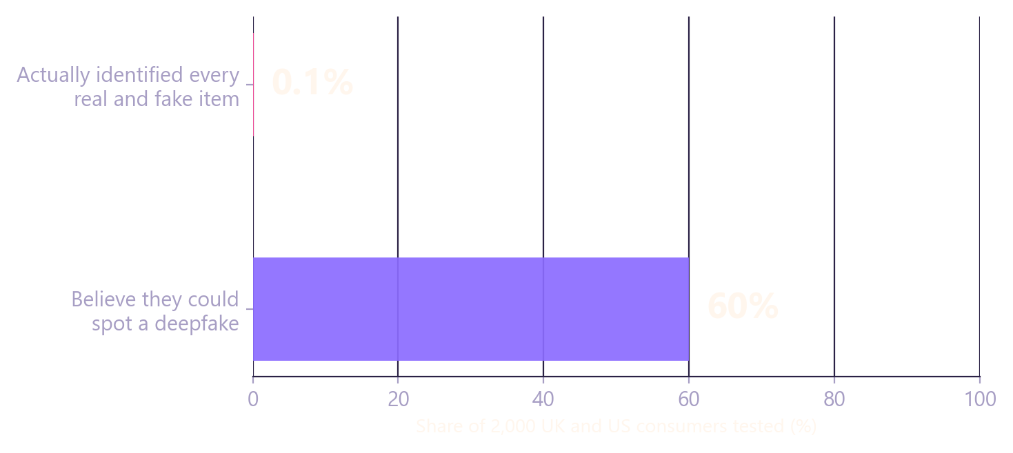
01 / PROBLEM
In India, the deepfake is now a fraud channel.
People cannot tell what is real — and regulators are now asking them to.
₹22,495 cr
Lost to cyber fraud in India in 2025 — 28.15 lakh complaints, up 24% (I4C / MHA)
47%
Of Indians have been a victim of, or know a victim of, an AI voice-cloning scam (McAfee)
1 Sept 2026
TN Cyber Crime Wing registers a CBCID case over a deepfake video of the Chief Minister
iProov tested 2,000 UK and US consumers on real and fake media. Six in ten backed themselves; one in a thousand got every item right.
65% of Indian organisations have already experienced a deepfake-driven attack (Thales, 2026).
Notes:
35s. Numbers first, all Indian. Then the chart: people are confident and wrong. Land on: this is a booked loss line and a policing problem, today.

Slide 3
02 / WHY NOW, WHY INDIA
Detection is now a compliance duty.
The buyer no longer needs convincing that the problem exists. A regulator told them.
MEITY · IT RULES
RBI · KYC
MHA · I4C
EXPORT TAILWIND
IT Amendment Rules 2026
KYC amendment, 14 Aug 2025
27.3 lakh mule accounts flagged
EU AI Act, Article 50
In force 20 Feb 2026. Synthetically generated information must be clearly labelled; platforms carry verification and takedown duties.
Video-KYC (V-CIP) must actively detect AI-generated faces, replays and masks — basic liveness prompts are no longer enough.
Layer-1 mule accounts identified by January 2026. Every one passed a KYC check. RBI's MuleHunter.AI is live across 26 banks.
From 2 Aug 2026 AI-generated content must be machine-detectable — the same capability, sold abroad later.
Banks, NBFCs and investigators now have to answer 'is this real?' as a matter of compliance — and most of them have no tool for it.
Notes:
30s. Two dated Indian mandates, one enforcement number, one export line. This is the slide that answers 'why will anyone pay'.

Slide 4
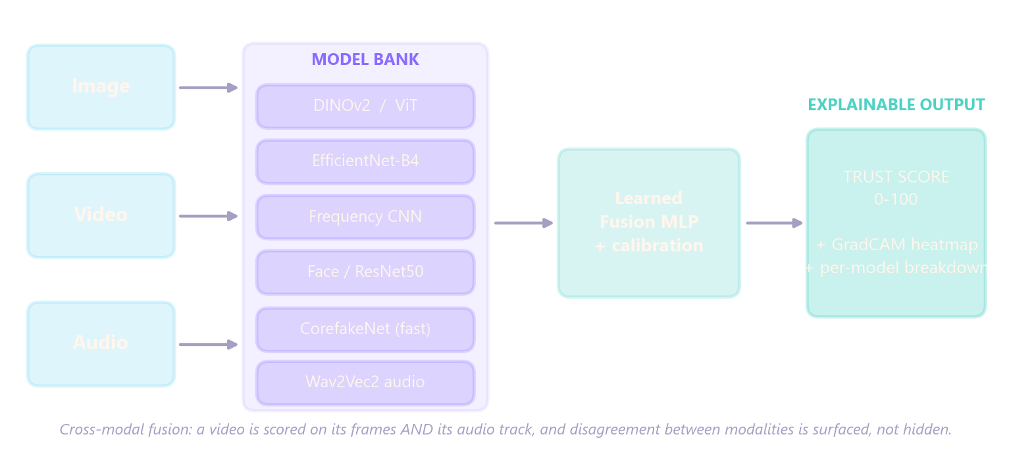
03 / SOLUTION
One score, and the reason behind it.
Image, video or audio in. A calibrated trust score, a heat-map and a per-model breakdown out — the thing a compliance officer can put in a file.
EVIDENCE, NOT A VERDICT
INDIA-FIRST WORKFLOWS
DEPLOYABLE
Grad-CAM shows where; every model reports separately.
Aadhaar / PAN / Voter-ID checks, cybercrime.gov.in-format complaint document, IT-Rules traceability API.
Runs on CPU; on-prem path for banks and police who cannot send evidence to a foreign cloud.
Notes:
30s. Walk the diagram left to right. 'Others return fake/real. We return a score, a heat-map and a breakdown.' Do not name every model.

Slide 5
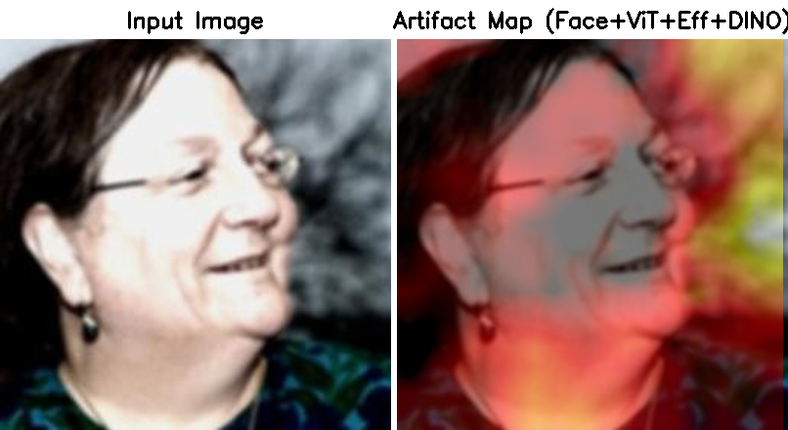
04 / LIVE DEMO
Upload. Score. Explain.
Live build, laptop CPU, no GPU — about 5–6 s per image end to end. One flow: a known fake in, evidence out.
1
Upload
Drag in a file, or POST to /api/v1. JPG PNG WebP · MP4 MOV MKV · WAV MP3 FLAC.
2
Analyse
The model bank scores in parallel; learned fusion reconciles them.
3
Explain
Trust score 0–100, Grad-CAM heat-map, per-model scores, EXIF report.
4
Act
Verdict + confidence band, and a cybercrime.gov.in-format complaint document.
Real output from the current build — a known deepfake portrait, ensemble verdict AI-GENERATED at risk 0.65, 3/7 models detect manipulation, 25.0 s on a laptop CPU.
AI-GENERATED ≥ 0.60
AUTHENTIC < 0.60
CONFIDENCE HIGH / MED / LOW
Verdict plus a separate confidence band, so a 0.55 never reads like a 0.95.
Notes:
90s. DEMO. Upload a known fake. Read the score. Heat-map: say where it lit up and why. Per-model table: 'five of seven agree, frequency strongest'. Complaint document: one click. 'About four seconds on a laptop CPU.'

Slide 6
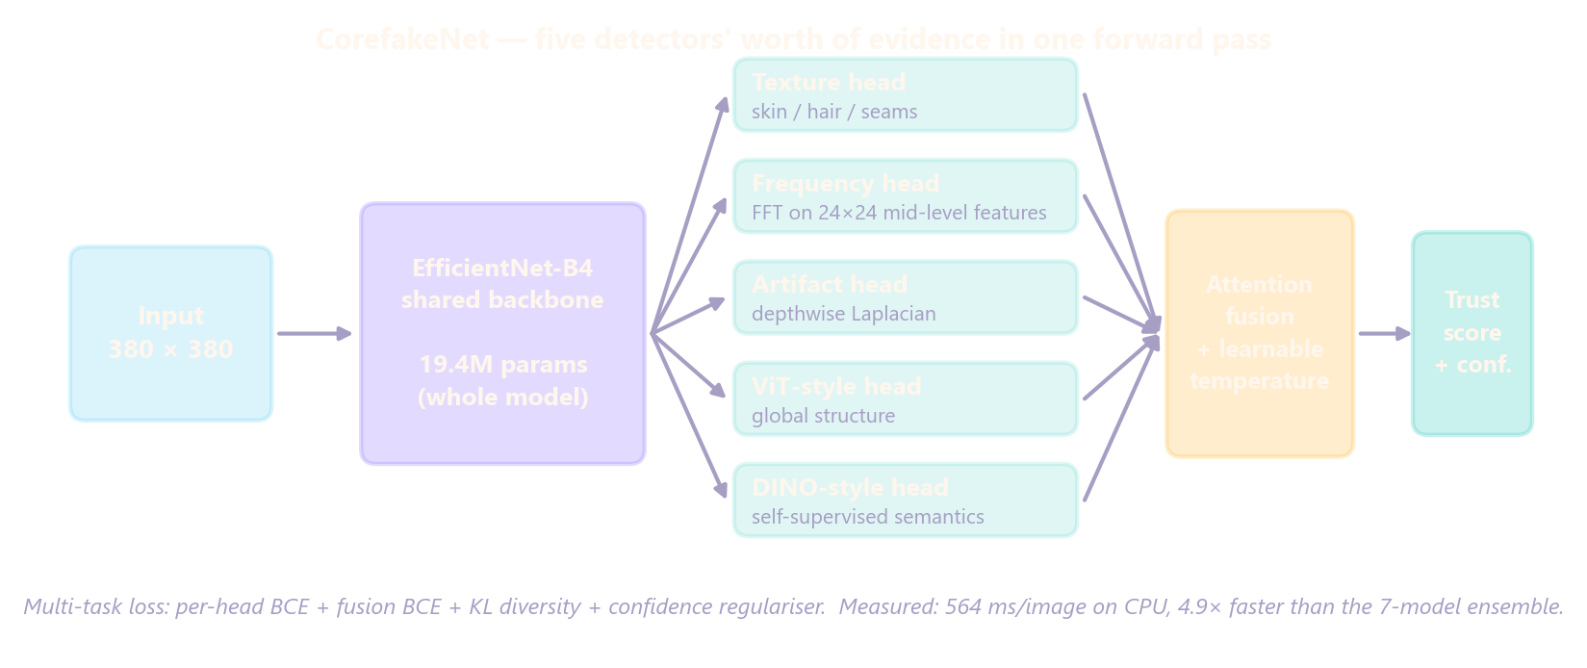
05 / TECHNOLOGY
One backbone, five forensic heads.
A seven-model ensemble is accurate but slow. We trained a single multi-head network to replace it — and we intend to patent the fusion design.
19.4M
564 ms
4.9×
Month 2
parameters, whole model
model forward on CPU; ~5–6 s end to end
vs the 7-model ensemble (2,759 → 564 ms forward)
provisional patent on the fusion design, via CIIC's IP cell
Notes:
40s. 'One EfficientNet-B4 backbone shared across five heads — texture, frequency via FFT on mid-level features, a Laplacian artifact head, and two heads distilled from ViT and DINO — attention fusion, learnable temperature.' Five times faster, on CPU. Patent with CIPR.

Slide 7
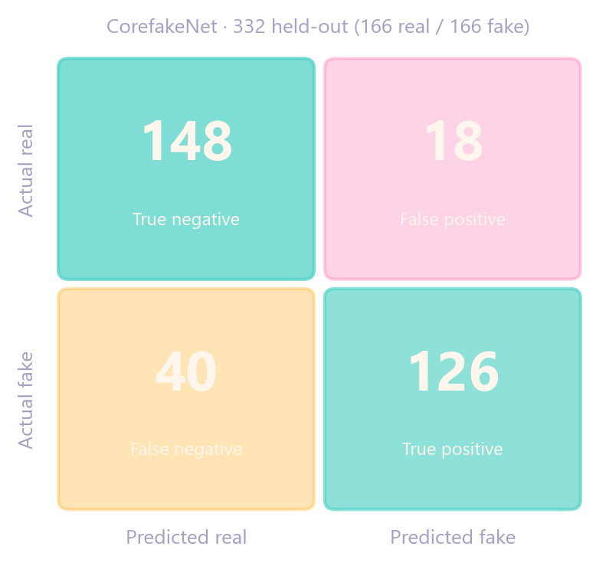
06 / VALIDATION
What is measured, and what is not.
We label targets as targets. The amber and magenta rows are what ₹8 lakh is for.
MEASURED
UPSTREAM
TARGET
GAP
Capability | Status | Result | Scope
CorefakeNet image model | Measured | 82.5% acc · 90.9% ROC-AUC · F1 81.3 | 332 held-out
Latency | Measured | 564 ms model forward on CPU; ~5–6 s end to end | Benchmark run
Video pipeline | Verified | End to end at 1 / 2 / 10 / 20 fps | Live build
Audio (Wav2Vec2) | Upstream | 97.9% is the model card, not ours | Own eval month 3
7-model ensemble | TARGET | 95%+ — calibration bug found; fix month 1 | Not claimable
In-domain spot check | Measured | 62% on 40 portrait samples at the 0.60 threshold (7/20 fakes caught, 2 false alarms) | This week, fast mode
Out-of-domain (OpenFake) | GAP | 46% on 24 illustration/scene samples — generalisation is the gap | Benchmark month 3
Adversarial robustness | TARGET | JPEG / resize / blur sweep | Month 2
Paying customers | GAP | Zero — design partners month 5 | Honest baseline
Reconstructed from the reported precision / recall / accuracy. The committed eval output replaces this in month 1.
Notes:
45s. Read the good rows, then read the bad rows out loud yourself. 'Those last three rows are what the eight lakh is for.' If asked how the numbers were produced: training/eval_corefakenet.py; 251 automated tests; the two spot-check JSONs are in docs/pitch/assets.

Slide 8
07 / FIRST CUSTOMER
Start where the budget already exists.
Not consumers. Three partners in six months — one of them paying.
PAID PILOT
VALIDATION PILOT
DESIGN PARTNER
NBFC / fintech video-KYC fraud teams
A Tamil Nadu cyber-crime / forensics unit
One newsroom
RBI's Aug 2025 amendment made deepfake detection in V-CIP their obligation. They pay per check, and Chennai is dense with them.
Unpaid, through CIIC's government network. This is what gives us credibility with everyone else.
Easiest access, weakest payer — kept for workflow feedback, not revenue.
What a pilot is
8 weeks · one workflow · a success metric agreed up front · hosted or on-prem · pricing hypothesis ₹2–10 per check, tested in the pilot, not assumed.
Notes:
35s. Explain why this wedge and not consumers. Describe the pilot in one breath. Say 'hypothesis' about the price.

Slide 9
08 / MARKET & COMPETITION
A funded field, an India-shaped gap.
We know who is here. We are not claiming the best accuracy — we are claiming the most auditable, deployable answer for regulated mid-market teams.
Player | Base | Focus | Explainability | On-prem / CPU
pi-labs | Pune | LEA, defence, BFSI | Forensic reports | Yes
Kroop AI | India | KYC, enterprise | Not published | Not published
Contrails AI | India | Platforms, govt | Not published | Not published
Reality Defender | US | Multi-modal | Partial | No
Pindrop | US | Voice | No | —
ProofyX | Crescent | Image + video + audio | Grad-CAM + per-model | CPU · on-prem
28.15 lakh
cyber-crime complaints in India, 2025 (the demand side of forensics)
Every V-CIP
RBI-regulated bank, NBFC and fintech doing video-KYC now needs deepfake checks
$170M → $5.6B
global detection market 2025 → 2034, 47.6% CAGR (Market.us)
pi-labs is the incumbent with Indian law enforcement and is in Gartner's 2026 deepfake-detection quadrant. Our claim is narrower: explainable, India-first, on-prem CPU — for the regulated mid-market the big vendors do not serve.
Notes:
35s. Name pi-labs first — the committee will know them. Say the narrow claim. One market line, no TAM theatre.

Slide 10
09 / BUSINESS MODEL
Four ways to charge for one API call.
Land through per-check and team plans; expand into on-prem licences. Every price below is a hypothesis until a pilot tests it.
HYPOTHESIS — tested in pilots
Stream | Price (hypothesis) | Who | Why they buy
Per-check API | ₹2–10 per check | NBFC / fintech KYC vendors | Regulatory duty, priced per user
Team plan | ₹8,000–40,000 / month | Newsrooms, SMB fraud desks | Desk-level verification
On-prem licence | ₹5–50 lakh / year | Banks, government | Data residency, SLA, audit trail
Government project | Project pricing | Cyber-crime units, forensic labs | Evidence workflow, training
UNIT COST
LAND AND EXPAND
DATA RESIDENCY
~5–6 s per image end to end on a laptop CPU today; the model forward is 0.56 s. Compute per check is paise either way — the cost is sales, not inference.
One integration serves KYC, moderation and evidence — three budget lines in the same customer.
On-prem and Indian-cloud deployment is the door-opener for banks and police; foreign APIs cannot follow.
Notes:
20s. Four streams, all in rupees, all labelled hypothesis. Unit cost is the one number to say out loud.

Slide 11
10 / WHY CIIC
What CIIC has is what we need next.
Not flattery — a map of CIIC assets to ProofyX milestones. Every line is from CIIC's own pages.
MISSION
DOMAIN
COMPUTE
CIIC exists to turn Crescent students into startups.
AI/ML and Cyber Security are on CIIC's Industry 4.0 list.
Intel AI Lab and Cloud Computing Lab.
We are Crescent students with a running, measured product.
ProofyX is an AI-security product — not media, not consumer.
The difference between 'target 95%' and a measured number.
IP
FUNDING PATH
NETWORK
CIIC is the university's nodal IP office (CIPR / CTT).
Implementing agency for MeitY GENESIS EiR and SAMRIDH; DST NIDHI-PRAYAS centre.
IHFC (IIT Delhi) CiC; IITMIC co-incubation MoU; government and BFSI ties.
Provisional patent on the fusion design, month 2.
We ask to be hosted for the next open window.
Technical depth we cannot get alone; our first pilots.
Ask: incubation now · hosting for the next scheme window · a named mentor from CSE.
Notes:
30s. Point to each tile. This slide is why it should be CIIC and not any incubator. Do not read the tiles; say the mapping.

Slide 12
11 / THE ASK
₹8 lakh: prototype to validated pilots.
Six months, five outcomes. Not CIIC's balance sheet — a CIIC-hosted scheme window plus in-kind support.
₹ lakh | Activity | Milestone
1.60 | GPU / cloud compute — calibration retraining, robustness sweep, pilot inference | M2 measured ensemble
0.90 | Benchmark & evaluation data, annotation, harness | M3 public benchmark
0.60 | Security hardening + external VAPT of the API | M4 VAPT report
0.90 | Production API, on-prem packaging, pilot environment | M4 pilot live
1.20 | Incorporation, DPIIT, trademark, provisional patent, pilot MoU templates | M1 entity · M2 filing
0.60 | Customer validation & pilots — travel, demos, workshops | M5 three partners
1.40 | Founder sustenance / part-time technical help (≈₹23k per month, team) | Full-time focus
0.80 | Contingency (10%) | —
8.00
WHERE IT COMES FROM
· CIIC-hosted grant: NIDHI-PRAYAS 2.0 (≤₹20 lakh), GENESIS EiR (≤₹10 lakh) or MSME Innovative (≤₹15 lakh) — whichever opens first
· In kind: Intel AI Lab compute, IP filing, DPIIT and legal support
· Crescent Seed Money (₹20,000 per student) as a bridge
FIVE OUTCOMES BY MONTH 6
1 Ensemble calibration fixed and measured
2 A public-benchmark result anyone can reproduce
3 A security-audited, pilot-ready API
4 Three design partners under LOI
5 One paid pilot running
M0
M1
M2
M3
M4
M5
M6
Incorporate · DPIIT · onboard
Calibration fixed
Robustness · patent filed
Public benchmark
VAPT · pilot env live
3 design partners
1 paid pilot · Stage-2 plan
Notes:
45s. Walk the table in rupees. Say the source sentence exactly: 'we are not asking CIIC's balance sheet'. Then the five outcomes. Then the month strip in one breath.

Slide 13
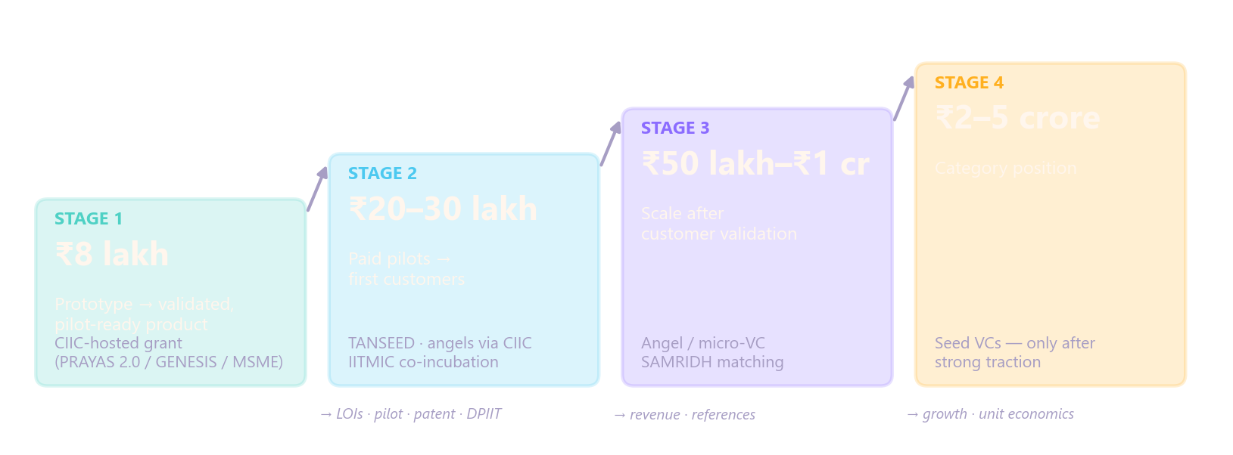
12 / MILESTONES & NEXT STEP
Then ₹20–30 lakh. Then ₹50 lakh to ₹1 crore.
₹8 lakh is the first milestone-based requirement, not the lifetime need. Each stage is unlocked by evidence from the last.
Muhammed Sayeedur Rahman S
Mohamed Abrar
Mohamed Shahid
WE ARE ASKING CIIC FOR
· Incubation-committee slot
· Named CSE faculty mentor
· Scheme-application conversation
ML & platform · detection stack, fusion, API, compliance layer
Product & frontend · dashboard, analysis workflows, deployment
Infrastructure & QA · CI/CD, containers, security scanning, tests
Full-time commitment and department / year for each founder to be stated in the room. Roles above are from repository ownership — confirm before presenting.
Notes:
30s. 'We've built the hard part. We're asking CIIC to help us prove it.' Then the next-step sentence: a committee slot and the scheme conversation.

Slide 14
APPENDIX / WHAT IS BUILT
Shipped, experimental, planned.
For questions. Repository at HEAD, September 2026 — 251 automated tests.
Capability | Status | Note
Image detection — ensemble (DINOv2, EfficientNet, ViT, CLIP, face, texture, frequency) | SHIPPED | Ensemble accuracy not yet measured (calibration bug)
CorefakeNet unified model | SHIPPED · MEASURED | 82.5% / 90.9% AUC / 564 ms
Grad-CAM + per-model evidence | SHIPPED
Video (frame sampling, timeline, temporal LSTM) | SHIPPED | LSTM unvalidated
Audio (Wav2Vec2 wrapper + CNN fallback) | SHIPPED | Upstream model; own eval month 3
Multimodal fusion | SHIPPED | Flagged / clean modalities surfaced
EXIF, GPS, C2PA check, SHA-256 hash | SHIPPED
Compliance & traceability API (orgs, keys, ingest, SLA, audit log, webhooks) | SHIPPED | IT Rules 2026 alignment
Cyber-crime complaint document | SHIPPED | Document only — no custody chain
Document / ID forensics (ELA etc.) | EXPERIMENTAL | Classical CV heuristics
Aadhaar / PAN / Voter-ID validators | SHIPPED | Format & checksum only
Reverse image search | PARTIAL | Needs Bing key
Adversarial robustness eval | SCRIPT ONLY | Run = month 2
Public benchmark · GPU inference | PLANNED | Months 3 · Stage 2
Notes:
Appendix. Show only if asked 'what is actually built'.

Slide 15
APPENDIX / SOURCES
Every number has a source.
Full research and links: docs/pitch/CIIC_STRATEGY.md
INDIA
REGULATION
CIIC
MARKET & COMPETITION
· ₹22,495 cr, 28.15 lakh complaints — I4C / MHA, 2025
· 47% AI voice-scam exposure — McAfee, 2023
· 27.3 lakh mule accounts — I4C, Jan 2026
· CM deepfake case — TN Cyber Crime Wing / CBCID, 1 Sept 2026
· 65% of orgs attacked — Thales, 2026
· IT Amendment Rules 2026 — MeitY, in force 20 Feb 2026
· KYC Master Direction amendment — RBI, 14 Aug 2025
· EU AI Act Art. 50 — 2 Aug 2026
· Vision, mission, domains — ciic.ventures/about, /nidhi-prayas-program
· GENESIS EiR via CIIC — CIIC X, Jan & Mar 2025
· IHFC CiC — ihfc.co.in, 6 Mar 2025
· IITMIC MoU — crescent.education, 31 Mar 2021
· PRAYAS 2.0 guidelines — nidhi-prayas.org, 2026
· $170M → $5.6B, 47.6% CAGR — Market.us
· pi-labs — pi-labs.ai; Gartner 2026
· Kroop AI, Contrails AI — PitchBook, press
· iProov confidence gap — Feb 2025
ProofyX figures: CorefakeNet evaluation on 332 held-out samples; charts regenerated by scripts/make_pitch_figures.py and scripts/make_ciic_figures.py.
Notes:
Appendix. Hand over when a figure is questioned.

