Slide 1
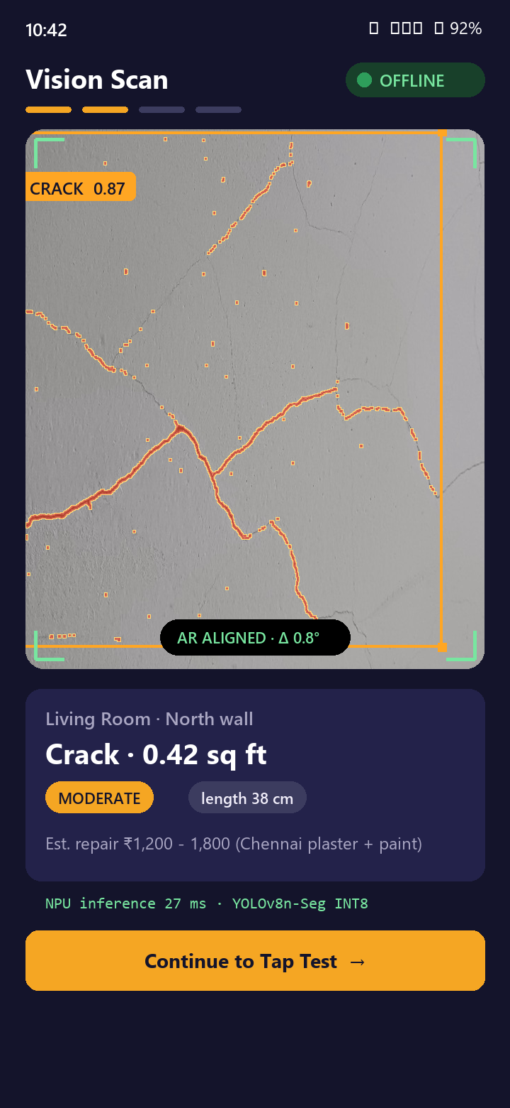
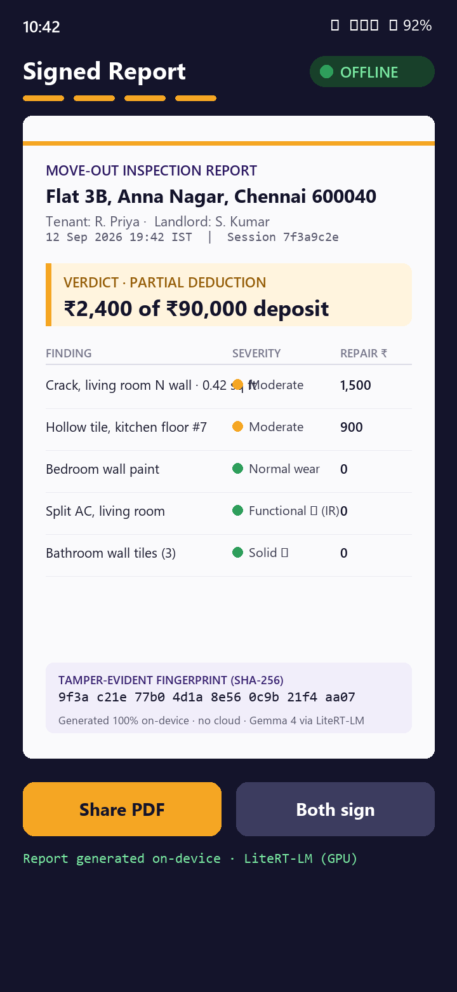
IQOO HACKATHON 2026 · SMART LIVING TRACK · CHENNAI CITY BATTLE · SEP 12–13
SmartLease Edge
Your phone is the property inspector.
Camera, microphone and IR blaster feed three on-device models on the iQOO 15 Hexagon NPU. Sixty seconds later, tenant and landlord hold one signed, tamper-evident move-out report. No internet at any step.
100% OFFLINE
ON-DEVICE GEMMA 4 · LITERT-LM
SNAPDRAGON 8 ELITE GEN 5
SIGNED PDF
TEAM [Team name] · Muhammed Sayeedur Rahman · Mohammed Danish · Prem
[Student / Professional bucket] · github.com/muhammedsayeedurrahman/smartlease-edge-chennai
Screens are illustrative mockups. Live demo runs the real pipeline on-device.
Notes:
TIMING 0:00-0:10. Say: 'SmartLease Edge turns the iQOO 15 into a property inspector. Point the camera, tap the wall, point the IR blaster at the AC, and in sixty seconds both tenant and landlord get a signed report. Nothing leaves the phone.'
PITCH CUT (3-5 min final pitch): use slides 1, 2, 4, 5, 8, 9, 11, 12, 15. Idea-screening submission: all slides 1-15; 16-17 are appendix.
Fill in team names and bucket before submitting. The app itself is real and running (see docs/JUDGE_DEMO_GUIDE.md); these two phone renders are mockup screens, not screenshots.

Slide 2

THE PROBLEM
SCORES NOVELTY & IMPACT 20%
Move-out day in India is a memory contest, with up to ten months' rent at stake.
6–10 mo
>40%
₹1,649–5,999
Priya, Anna Nagar
Moved in with 12 WhatsApp photos. Moves out to hear 'that crack is new'. ₹90,000 deposit, no neutral referee, no timestamp.
rent held as deposit in Bengaluru, versus the 2-month cap the Model Tenancy Act 2021 recommends
of landlord–tenant disputes in India are about the security deposit (industry estimate)
for a human NoBroker inspection, booked days ahead. Most tenants never get one.
PRS India; Mittiyo, Werentt (Karnataka deposit guides)
99acres; RentConnect
NoBroker property-inspection pricing
ROOT CAUSE, EVERY SOURCE AGREES
No timestamped move-in documentation. Photos are subjective, undated and easy to dispute. A surveyor is slow and expensive. And in the empty flat where the inspection happens, there is often no Wi-Fi at all.
SmartLease Edge · iQOO Hackathon 2026 · Chennai City Battle
02 / 17
Notes:
TIMING 0:10-0:45. Hook with a person, not a market: Priya. Then the three numbers. Close on the root cause: no timestamped baseline.
Sources on slide (all verifiable): Model Tenancy Act 2021 cap = 2 months residential (PRS India). Bengaluru 6-10 months is market practice, not law. '>40% of disputes' is an industry estimate from rental portals (99acres/RentConnect), say 'industry estimate' out loud. NoBroker inspection price from its own listing.
Do NOT use the older draft numbers (Rs 2,400 crore, 1.1 crore agreements, 38%) - no source was found for them.

Slide 3



WHY ON-DEVICE, WHY NOW
SCORES NOVELTY & IMPACT 20%
The report has to be made where the internet isn't: an empty flat, a stranger's home, in sixty seconds.
Offline is the use case
Private by physics
Real-time or useless
Move-outs happen in vacated flats with the Wi-Fi cancelled. Tier-2/3 connectivity is patchy. A cloud app fails exactly when it is needed.
Interior photos, tenant IDs and deposit amounts never leave the handset. No account, no upload, no analytics.
AR alignment and defect overlays update per frame. A 400 ms cloud round-trip makes the overlay swim; the NPU answers in under 30 ms.
WHY NOW
Three years ago this pipeline needed a laptop and a cloud key. On the iQOO 15 it fits in a pocket.
37% faster
Loads + narrates
Real, not planned
Hexagon NPU in Snapdragon 8 Elite Gen 5 vs prior gen (Qualcomm)
Gemma 4 E4B (.litertlm) via Google's LiteRT-LM runtime, GPU delegate, on this exact phone (device-tested)
YOLOv8n-Seg INT8 segmenter runs via ExecuTorch today, with an honest heuristic fallback
SmartLease Edge · iQOO Hackathon 2026 · Chennai City Battle
03 / 17
Notes:
TIMING 0:45-1:05. This slide answers the question every on-device-AI judge asks: is local execution essential or decorative? ExecuTorch hackathon organisers said winners were apps 'where local execution was essential to the product experience'. Here it is essential three ways.
Sources: Qualcomm Snapdragon 8 Elite Gen 5 product brief (37% NPU). Gemma 4 load/narrate confirmed by GemmaLoadDeviceTest on the demo iQOO 15 (docs/GEMMA4_SETUP.md) -- tokens/sec not yet benchmarked, so we do not quote one. We switched from the originally planned Llama 3.2 3B/GenieX path to Gemma 4/.litertlm via LiteRT-LM after GenieX's MediaPipe runtime rejected the .litertlm container; say so plainly if asked why the model changed.

Slide 4

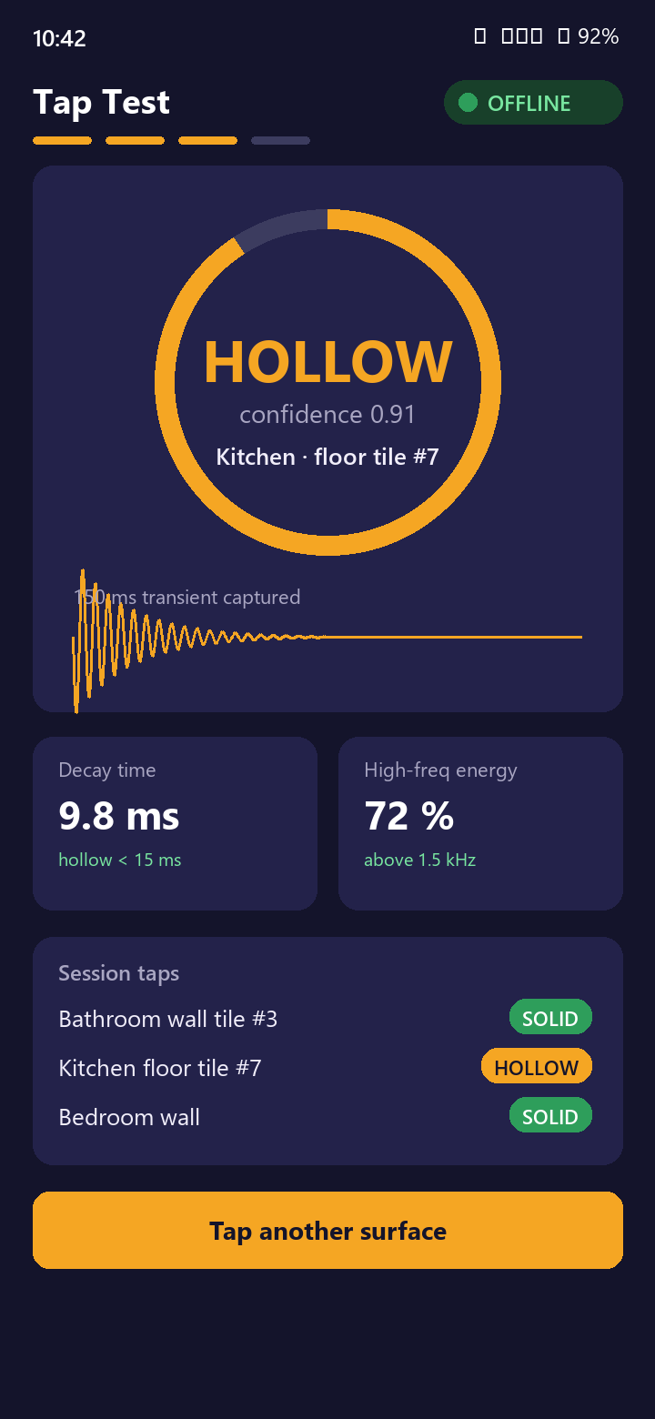



THE SOLUTION
SCORES END PRODUCT QUALITY 30%
Three sensors. One signed report. Zero internet.
VISION SCAN
TAP TEST
SIGNED REPORT
YOLOv8n-Seg finds cracks, stains, peeling paint and reports area in sq ft with a severity band.
Knuckle-tap a tile. A 250 ms transient is classified hollow or solid by a small on-device logistic-regression model.
Gemma 4 writes the findings into a plain-language PDF, each fault captioned under its own move-in/move-out photo pair, with cost bands, timestamp and SHA-256.
Plus a functional check the camera cannot do: the IR blaster fires the captured remote code at the AC, the mic confirms the compressor starts, and the report records 'works', not just 'looks fine'.
Phone renders are illustrative mockups. Live demo runs the real app, live, across three rooms.
SmartLease Edge · iQOO Hackathon 2026 · Chennai City Battle
04 / 17
Notes:
TIMING 1:05-1:30. Walk the three phones left to right. One sentence each. Then the IR line: 'we test whether the AC works, not whether it looks fine'. That functional-test line is the novelty claim no competitor matches; land it every time.

Slide 5

LIVE DEMO
SCORES DEMO & PRESENTATION 10%
The real pipeline, walked across three rooms, in Airplane Mode, mirrored through Office Kit.
0:00
0:10
0:30
0:50
1:10
1
2
3
4
5
Evidence stage
Run the pipeline
Vision + pricing
Narration + report
Live proof
Three rooms -- Living Room, Kitchen, Bedroom. Each move-out photo is its move-in pair with one small defect composited on.
One tap runs vision, deduction, narration and PDF rendering fresh, on this device, off the main thread with live progress text.
The real per-room segmenter findings, priced by the same rate-card deduction engine a live move-out uses.
Gemma 4 (or the template, named honestly if it fell back) writes the summary. PDF lands with its own fresh SHA-256, opened on the spot.
Switch to the real inspection flow: camera capture, knuckle-tap test, IR fire at the venue AC, QR-fingerprint share.
Bundled evidence · on-device
Dispatchers.Default
YOLOv8n-Seg · DeductionEngine
LiteRT-LM · PdfDocument
CameraX · ConsumerIrManager
If the run seems to stall, it's device thermal throttling after heavy builds/installs, not a bug -- let it rest a minute and retry. A screen recording is the fallback.
SmartLease Edge · iQOO Hackathon 2026 · Chennai City Battle
05 / 17
Notes:
TIMING 1:30-3:00 is the LIVE DEMO itself; this slide is the backdrop. One presenter narrates, one drives the phone. This is the actual Demo screen in the app (docs/JUDGE_DEMO_GUIDE.md), not a script for someone to act out -- every number the judge sees is computed fresh on that run.
Telemetry: HackTracker scores creative phone use (camera, mic, on-device AI) and Office Kit usage from device data, so every step deliberately exercises a sensor.

Slide 6
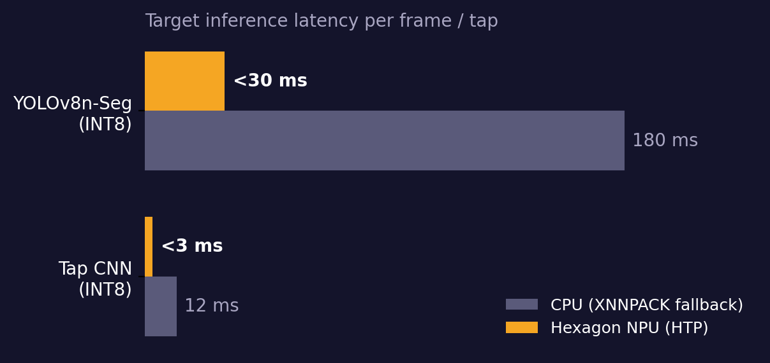
ON-DEVICE MODEL 1: VISION
SCORES TECHNICAL DEPTH 15%
Cracks become square feet, not opinions.
MODEL
YOLOv8n-Seg fine-tuned on 580+ labelled wall-defect images (Roboflow COCO-Seg auto-converted to YOLO-Seg). Classes: crack, stain, mould, peeling, hole.
DEPLOY
torch.export → PT2E quantise (QnnQuantizer 8a8w) → ExecuTorch lower → .pte on the Hexagon HTP. ~6 MB INT8. XNNPACK CPU fallback ships in the same APK.
MEASURE
Area = mask pixels × Z² / (fₓ·fᵧ) using the pinhole model; Z from ARCore depth (±10%) or a typed wall distance (±20%).
Honest status
Real, running today: YOLOv8n-Seg (ExecuTorch .pte) segments every room in the live demo, via DefectSegmenterFactory. It falls back to the labelled heuristic segmenter only if the exported model is missing on a given build -- the UI names which one ran, never silently. Per-frame latency and mAP on the chart are still targets, not yet measured on this build.
DECIDE
Severity bands by area and class. Confidence < 0.30 hidden; 0.30–0.50 shown as 'review'. Users can dismiss a detection.
SmartLease Edge · iQOO Hackathon 2026 · Chennai City Battle
06 / 17
Notes:
Technical-depth slide. If asked 'why nano not a bigger model': nano fits HTP memory at 6 MB INT8 and hits 30 ms; larger models do not improve mAP meaningfully on wall defects. If asked accuracy of area: pinhole model, +/-10% with ARCore depth, +/-20% with typed distance. The segmenter itself is real and wired in (DefectSegmenterFactory prefers YoloSegDefectSegmenter, honest heuristic fallback) -- say 'targets' only for the latency/mAP numbers, not for whether the model exists.

Slide 7
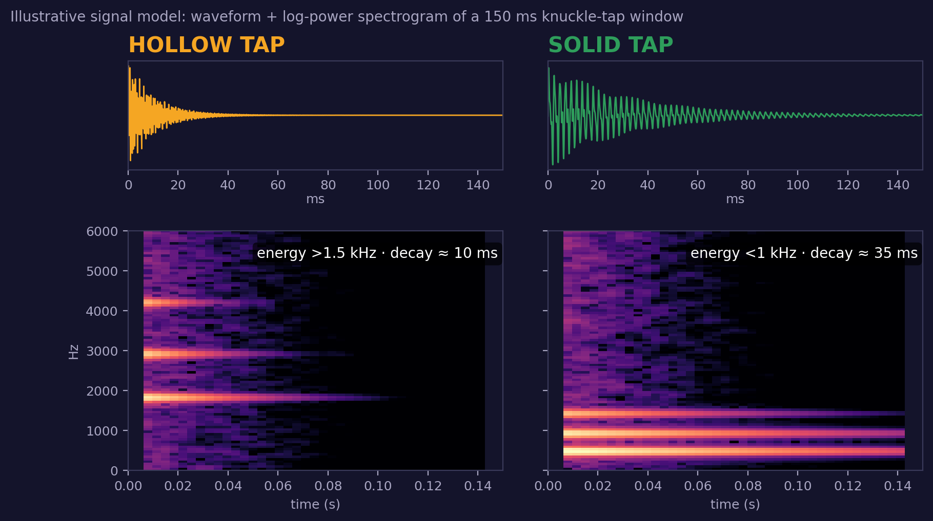
ON-DEVICE MODEL 2: ACOUSTICS
SCORES CREATIVE PHONE USE 15%
Tap a tile. The phone hears what a surveyor's hammer would.
CAPTURE
AudioRecord keeps a listener up at 44.1 kHz. A peak-amplitude gate crops a 250 ms window around the tap transient.
FEATURES
40-band mel filterbank → 13-coefficient MFCC, 36 features total. Hollow taps ring above 1.5 kHz and die fast; solid taps sit lower and ring longer.
MODEL
Logistic regression over those 36 features -- a 73 KB JSON (filterbank + scaler + weights), fit in ml/acoustic. Real, but modest: 36 multiply-adds on the CPU, not an NPU model.
FALLBACK
The deterministic decay-time heuristic already shipping in the app classifies every tap even if the trained bundle fails to load, and its raw measurements are always reported alongside.
Honest training set: 15 own taps on the demo phone, grouped cross-validated accuracy 80% (95% CI 55–93%) -- small and said so out loud. Figure is an illustrative signal model.
Dual stereo speakers play a confirmation tone so a room of judges hears the verdict.
SmartLease Edge · iQOO Hackathon 2026 · Chennai City Battle
07 / 17
Notes:
Creative phone use. Professional tile-sounding needs a trained inspector and dedicated tools; here the phone mic replaces them. Be explicit that the spectrogram figure is an illustrative signal model, not a plotted real recording, and that the trained classifier is a small logistic regression (not a CNN) fit on only 15 labelled taps -- say the 80% (55-93% CI) number and the sample size plainly if asked.

Slide 8
SYSTEM ARCHITECTURE
SCORES TECHNICAL DEPTH 15%
Every byte stays on the phone: sensors, NPU, on-device LLM, signed PDF.
INPUT LAYER
Sony IMX921 50 MP + OIS · ultrawide · periscope
Stereo mics · 16 kHz PCM · Sensing Hub
IR blaster 38 kHz · ConsumerIrManager
Rotation vector · ARCore depth
NPU + GPU (ON-DEVICE AI)
HOST CPU
IR STATE MACHINE
• YOLOv8n-Seg INT8 .pte via ExecuTorch, Hexagon HTP, target <30 ms
• Gemma 4 (.litertlm) via LiteRT-LM on the Adreno GPU delegate
• Both fall back to CPU under memory/thermal pressure
• NMS · mask assembly · area from pinhole model
• Tap logistic regression, 36 MFCC features, 73 KB
• PDF render · SHA-256 · Room DB
• Capture (receiver or library) → store
• Replay at 38 kHz → verify via mic
• Voltas · Blue Star · LG · Daikin fallback codes
DIAGNOSTIC SYNTHESIS · defect areas + tap verdicts + appliance state + OCR of meter/nameplate → one structured JSON record
OUTPUT Signed PDF: timestamp + session ID + SHA-256 fingerprint, both parties sign on-screen, shared by Intent or Office Kit. No cloud call at any stage.
NO NETWORK
PERMISSION
SmartLease Edge · iQOO Hackathon 2026 · Chennai City Battle
08 / 17
Notes:
One diagram, three processor lanes, like the Qualcomm Bengaluru winner GameSense (NPU = models, CPU = glue, plus the IR state machine). Point out the manifest has no INTERNET permission: that is the offline claim made verifiable in 2 seconds.
If asked about the vivo Q3 co-processor: we do not target it (no public SDK); we use the Hexagon NPU directly.

Slide 9
PHONE-FIRST THINKING
SCORES CREATIVE PHONE USE 15%
Built for the iQOO 15, not just running on it.
iQOO 15 hardware
Verified spec
Exact job in SmartLease Edge
Snapdragon 8 Elite Gen 5 · Hexagon NPU
37% faster NPU, INT4/INT8/FP16, Sensing Hub
Runs the segmenter on the NPU and Gemma 4 (LiteRT-LM) on the GPU; tap classifier is a small CPU model
Triple 50 MP: IMX921 OIS + ultrawide + periscope
CIPA 4.5 OIS, 100× digital zoom
OIS steadies the AR baseline overlay; ultrawide captures a full wall; telephoto inspects hairline cracks from 3 m
IR blaster
38 kHz carrier via ConsumerIrManager
Fires the AC, geyser or TV remote code to prove the appliance works, not just looks fine
Stereo mics + Sensing Hub
Always-on, low-power audio path
Detects the tap transient without waking the main NPU; mic confirms the compressor starts
6000-nit 2K LTPO display
Peak brightness
AR overlay stays legible in a sunlit Chennai flat at 2 pm
7000 mAh + 8K vapor chamber
Sustained NPU load without throttling
Twenty-room walkthrough on one charge; inference speed does not degrade mid-demo
Not targeted: the vivo Q3 co-processor has no public SDK, so we say so if asked. Office Kit mirrors the phone to the projector during the pitch.
SmartLease Edge · iQOO Hackathon 2026 · Chennai City Battle
09 / 17
Notes:
This is the 'Device Performance / Phone-first thinking' answer. Name the exact hardware and the exact job; generic 'we used the NPU' scores nothing. Specs verified against iQOO product page, GSMArena and 91mobiles.

Slide 10
ON-DEVICE MODELS AND THE RED LIGHT PLAN
SCORES OFFICE KIT USAGE 10%
Three models, each with a fallback that still demos, and a phone-only build plan.
Model
Architecture
Size
Runtime
Latency
If it fails on stage
Wall-defect segmenter
YOLOv8n-Seg, INT8
~6 MB
ExecuTorch → Hexagon HTP
target <30 ms
XNNPACK CPU .pte (~180 ms); heuristic segmenter
Tap classifier
Logistic regression, 36 MFCC features
73 KB
Plain CPU, 36 multiply-adds
<3 ms
Decay-time heuristic already in app
Report writer
Gemma 4 E4B-it (.litertlm)
~3.7 GB
LiteRT-LM, GPU/CPU delegate
loads + narrates; thermal-dependent
Adaptive token budget under memory/thermal pressure; then rule-based template
RED LIGHT / GREEN LIGHT: WHAT HAPPENS ON THE PHONE ALONE
Red Light (~10.5 h, phone only)
Green Light (~8.5 h, both devices)
Office Kit in the pitch
On-device data capture of venue walls and tiles · threshold tuning · NPU latency runs · IR capture of the venue AC. Driven from the laptop through Office Kit remote control and shared clipboard.
Model export and quantisation · Gradle builds · debugging · overnight polish. APK drag-dropped to the phone with Office Kit file transfer.
Screen mirror to the projector for the live demo · the generated PDF lands on the laptop by file transfer · clipboard sync for the session ID. Practised before Sep 12.
SmartLease Edge · iQOO Hackathon 2026 · Chennai City Battle
10 / 17
Notes:
Office Kit usage is 10% of the score and measured by telemetry (HackTracker), not by the pitch. So Office Kit must be used visibly and often: mirror, file transfer, remote control. Every model has a fallback so the demo never stalls; 'a well-built simple product beats a broken complex one' is the organiser's own motto.

Slide 11
COMPETITIVE LANDSCAPE
SCORES NOVELTY & IMPACT 20%
AI inspection apps exist. None run offline, and none test whether things actually work.
Offline
Functional test
(IR / acoustic)
Defect area
in sq ft
On-device AI
Price for one lease
NoBroker inspection (India)
✕
✕
✕
✕
₹1,649–5,999 + scheduling
human
TurboTenant (US)
✕
✕
✕
✕
Free, manual photos
zInspector + zAssistant
✕
✕
✕
✕
$0–115/mo per portfolio
cloud
RentCheck
✕
✕
✕
✕
$0.60–1.10/unit/mo
cloud
ClaimSnap (insurance)
✕
✕
~
✕
Not published
estimate
cloud
SmartLease Edge
✓
Free + ₹299–499 per signed report
✓
✓
✓
NPU
Precise novelty claim: fully offline, on-device AI with functional diagnostic testing, priced for a single lease event. Cross-checked against five real products; 'AI property inspection' alone is not new and we never claim it is.
SmartLease Edge · iQOO Hackathon 2026 · Chennai City Battle
11 / 17
Notes:
Novelty slide. Say the narrow, defensible claim exactly as written. If a judge names zInspector or RentCheck, agree they have AI, then point to the two empty columns: offline and functional testing. Prices from vendor pages as of Aug 2026.

Slide 12
WORKING MVP, HONESTLY
SCORES END PRODUCT QUALITY 30%
What runs today, what ships by Sep 12, and what happens live at the table.
Real and running now
New today, small and honest
Left to do today
✓ CameraX capture + preview
✓ AR baseline alignment (SensorManager + OIS)
✓ ML Kit OCR of meters and nameplates
✓ IR transmit via ConsumerIrManager
✓ YOLOv8n-Seg segmenter live, honest fallback
✓ Gemma 4 narrator, audited (LiteRT-LM)
✓ SHA-256 fingerprint + dual signature
✓ Live 3-room Judge Demo: real pipeline, not scripted
✓ Fault descriptions under every photo (PDF + screen)
✓ Tap model: logistic regression, 15 taps, 80% CV acc.
✓ Segmenter latency/mAP: still targets, not measured
✓ Grow the tap-classifier training set past 15 taps
✓ Final Office Kit + timing rehearsal
✓ Airplane-mode end-to-end run before the pitch
✓ One flow, one aha, then stop talking
Both hard models run today. The tap classifier is real but trained on only 15 taps, and we say that number out loud rather than hide behind a vague 'trained model' claim.
SmartLease Edge · iQOO Hackathon 2026 · Chennai City Battle
12 / 17
Notes:
Judges punish decks that overclaim; JetBrains judges: 'be very direct about what works, what doesn't'. This slide is the credibility anchor. Everything in column 1 is in the GitHub repo today (app/src/main/java/com/smartlease/edge). Column 2 is honest about the one weak spot: the tap classifier is a real logistic-regression model, not a placeholder, but its training set is tiny (15 taps) and its accuracy CI is wide (55-93%) -- lead with that if a judge inspects the code, don't wait to be caught.

Slide 13



IMPACT AND SCALABILITY
SCORES NOVELTY & IMPACT 20%
One engine, four products, priced for one lease instead of a portfolio.
Who it serves
Priced for one move-out
Scales without new engines
Tenants keep deposits with timestamped evidence. Landlords document damage before it becomes a dispute. PG and co-living operators inspect 50+ rooms a day without a surveyor. Works in Tier-2/3 cities where the cloud apps do not.
Free baseline capture. ₹299–499 for the full diagnostic plus signed report, 5–10× cheaper than a ₹1,649–5,999 human inspection and available on demand. No subscription for a once-a-year event.
New defect class = 200 labelled images, same pipeline. New language = one LLM prompt (Tamil, Hindi). Runs on any Snapdragon 8 Gen 2+ via ExecuTorch; iQOO-exclusive parts are the IR blaster and Sensing Hub.
ROADMAP: SAME VERIFICATION ENGINE, HIGHER FREQUENCY
Phase 0 · Sep 12–13
Phase 1 · 2–4 mo
Phase 2 · 4–8 mo
Phase 3 · 6–12 mo
Move-Out Verify
Maintenance Mode + Insurance Assist
Buyer's Check
B2B2C licensing
The hackathon MVP. Once per lease.
Quarterly appliance health checks; claim-ready docs with functional proof. ₹99–149/mo.
Self-service pre-purchase inspection at ₹499–999 vs ₹10,000+ professional.
Per-unit licences for co-living operators and property managers; rental platforms embed the engine.
SmartLease Edge · iQOO Hackathon 2026 · Chennai City Battle
13 / 17
Notes:
Honest sizing if asked: India's paid inspection-tool market is nascent; NoBroker is the only major domestic player. Distribution and trust are the bottleneck, not the tech. Say that plainly; it reads as market awareness. Business model: free for consumers, B2B2C licensing is the revenue anchor.

Slide 14
TEAM AND SCORING PLAN
Three people, zero overlap, and a plan for each of the six judged criteria.
Muhammed Sayeedur Rahman
Criterion
Weight
How SmartLease Edge scores it
MS
End product quality
30%
One complete flow: baseline → scan → tap → IR → signed PDF. Fallback for every model.
AI / NPU ENGINEER
Trains and exports the vision model, ExecuTorch INT8, LiteRT-LM integration for Gemma 4. Event day: integrate, tune to venue.
Novelty and impact
20%
Offline + functional testing; no competitor has either. Deposit disputes affect every renter.
Mohammed Danish
Creative phone use
15%
Camera, mic, IR blaster, Sensing Hub and NPU all exercised in the demo (telemetry-visible).
MD
ANDROID / HARDWARE LEAD
CameraX, AR overlay, AudioRecord, IR capture and replay, Office Kit Red Light sessions.
Technical depth
15%
INT8 ExecuTorch segmenter, Gemma 4 via LiteRT-LM with a memory/thermal-aware load balancer, pinhole area math.
Office Kit usage
10%
Mirror, file transfer and remote control used through Red Light and in the pitch.
P
Prem
PRODUCT / DEMO PITCHER
Demo and presentation
10%
3-minute script, one presenter + one driver, rehearsed 5×, recorded backup.
Report UI, pricing logic, sourced citations, pitch script, judge Q&A.
SmartLease Edge · iQOO Hackathon 2026 · Chennai City Battle
14 / 17
Notes:
Weights are the published iQOO 2026 rubric (Reskilll/iQOO portal): 30/20/15/15/10/10, with 25% (phone use + Office Kit) measured from HackTracker device telemetry. Fill in names. If the team is mixed student/professional, note that buckets cannot mix.

Slide 15
SMARTLEASE EDGE · IQOO HACKATHON 2026 · CHENNAI
Every Indian renter deserves a fair move-out.
✓
Working Android app in the repo today
✓
Multi-modal: vision + acoustics + IR + on-device LLM
✓
Built for iQOO 15 hardware, feature by feature
✓
100% offline, no network permission
✓
Tamper-evident, signed PDF both parties keep
We are not pitching an idea. We are showing you a working system.
github.com/muhammedsayeedurrahman/smartlease-edge-chennai · [email] · Demo: live on the iQOO 15
Notes:
TIMING 4:30-5:00. Slow down. One line: 'Let us in the room. The models are trained; the 30 hours are for integration and polish.' Then stop talking and invite questions.

Slide 16
APPENDIX
Judge Q&A: the answers we have ready.
Likely question
Answer
What if the model detects a false positive?
Confidence below 0.30 is hidden, 0.30–0.50 is marked 'review', and any detection can be dismissed.
How accurate is the area measurement?
Pinhole model: area = pixels × Z²/(fx·fy). About ±10% with ARCore depth, ±20% with a typed distance -- good enough for severity bands.
Does it work on other phones?
Any Snapdragon 8 Gen 2+ via ExecuTorch. The IR blaster and Sensing Hub paths are iQOO/vivo-specific.
Privacy?
No INTERNET permission in the manifest. No account, no analytics. The PDF is the only artefact and the user chooses where it goes.
Why not ChatGPT plus a photo?
Can't measure area, hear a hollow tile, fire an IR code, or sign a PDF -- and needs internet a vacated flat won't have.
Why YOLOv8 nano?
6 MB INT8 fits HTP memory and runs in ~30 ms; larger models exceed the budget without a meaningful mAP gain on wall defects.
Why Gemma 4 and not Llama 3.2 3B?
GenieX rejected the .litertlm container, so we moved to Gemma 4 via Google's LiteRT-LM, which loads and narrates on this phone.
How good is the tap classifier really?
Logistic regression, 36 MFCC features, 15 training taps: 80% CV accuracy, 95% CI 55-93%. Small sample, said plainly; heuristic is the fallback.
Business model?
Free for consumers; ₹299–499 per signed report; B2B2C licensing to co-living operators and rental platforms is the revenue anchor.
SmartLease Edge · iQOO Hackathon 2026 · Chennai City Battle
16 / 17
Notes:
Backup slide. Do not present; open only when a question comes. Answers mirror the battle plan document.

Slide 17
APPENDIX
Sources behind every number on these slides.
Model Tenancy Act 2021: 2-month residential deposit cap
prsindia.org/billtrack/the-model-tenancy-act-2021
Bengaluru deposits 6–10 months, market practice
blogs.mittiyo.com · werentt.com (Karnataka deposit guides)
Deposit issues >40% of landlord–tenant disputes (industry estimate)
99acres.com/articles/what-are-security-deposits.html · rentconnect.in
NoBroker inspection ₹1,649–5,999; zInspector, RentCheck, TurboTenant pricing
Vendor pages, Aug 2026 (see SmartLease-Edge-Chennai-Battle-Plan.pdf, section 2)
iQOO 15 specs: Snapdragon 8 Elite Gen 5, IMX921 OIS, 7000 mAh, 6000 nits
gsmarena.com · 91mobiles.com · iqoo.com/in
Hexagon NPU 37% faster; INT4/INT8/FP16
Qualcomm Snapdragon 8 Elite Gen 5 product brief (PDF)
Gemma 4 (.litertlm) loads + narrates on the demo iQOO 15 via LiteRT-LM
huggingface.co/litert-community · docs/GEMMA4_SETUP.md, GemmaLoadDeviceTest (own device test)
Tap classifier: 80% grouped CV accuracy (95% CI 55-93%), 15 training taps
app/src/main/assets/acoustic_tap_model.json, produced by ml/acoustic (own training run)
iQOO 15 thermal/CPU/RAM load-test results
tools/load_test_monitor.py, tools/perf_results/ (own captured run, Sep 13 2026)
iQOO Hackathon 2026 rubric, Red/Green Light, Office Kit
iqoo.reskilll.com · reskilll.com/blogs (iQOO City Battles, strategy guide)
ExecuTorch Qualcomm backend, PT2E quantisation
pytorch.org/executorch · Qualcomm AI Hub docs
SmartLease Edge · iQOO Hackathon 2026 · Chennai City Battle
17 / 17
Photos: cracked wall (CC0), peeling paint (CC BY-SA 4.0)
Wikimedia Commons; attribution in ATTRIBUTION.json
Notes:
Every statistic on the deck traces to one of these. If a judge challenges a number, name the source. Never use a number that is not on this list.

