Slide 1
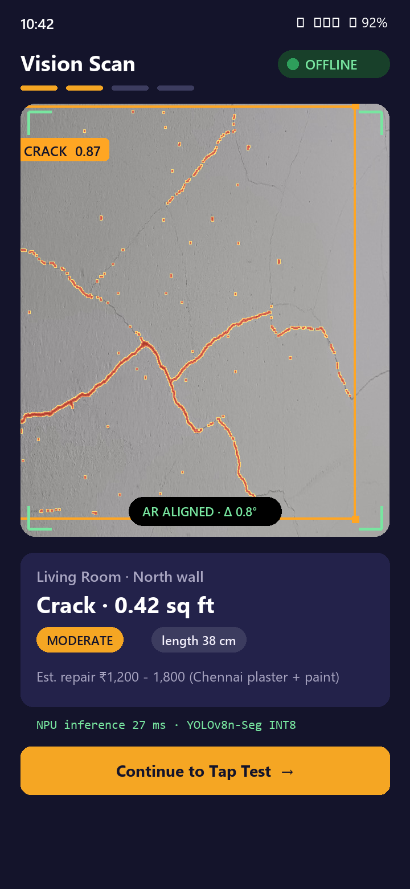
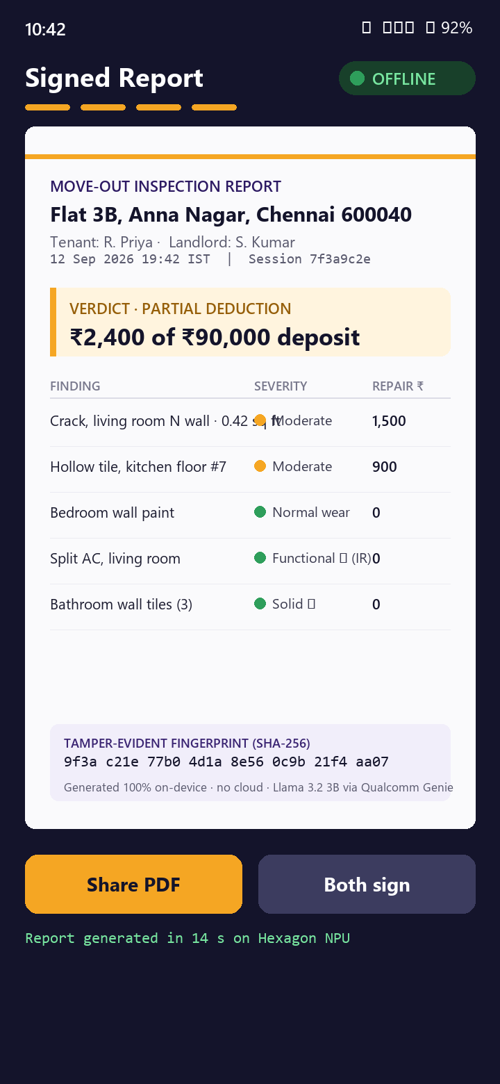
IQOO HACKATHON 2026 · SMART LIVING TRACK · CHENNAI CITY BATTLE · SEP 12–13
SmartLease Edge
Your phone is the property inspector.
Camera, microphone and IR blaster feed three on-device models on the iQOO 15. Sixty seconds later, tenant and landlord hold one timestamped move-out report. No internet at any step, and no network permission in the manifest.
100% OFFLINE
ON-DEVICE VISION + ACOUSTICS
SNAPDRAGON 8 ELITE GEN 5
SHA-256 PDF REPORT
TEAM [Team name] · [Member 1] · [Member 2] · [Member 3]
[Student / Professional bucket] · github.com/muhammedsayeedurrahman/smartlease-edge-chennai
Target UI - representative mockup, not a screenshot
Notes:
TIMING 0:00-0:10. Say: 'SmartLease Edge turns the iQOO 15 into a property inspector. Point the camera, tap the wall, point the IR blaster at the AC, and in sixty seconds both tenant and landlord get a signed report. Nothing leaves the phone.'
PITCH CUT (3-5 min final pitch): use slides 1, 2, 4, 5, 8, 9, 11, 12, 15. Idea-screening submission: all slides 1-15; 16-17 are appendix.
Fill in team names and bucket before submitting. Replace mockups with real screenshots as soon as the UI lands.

Slide 2

THE PROBLEM
SCORES NOVELTY & IMPACT 20%
Move-out day in India is a memory contest, with up to ten months' rent at stake.
6–10 mo
>40%
₹1,649–5,999
Priya, Anna Nagar
Moved in with 12 WhatsApp photos. Moves out to hear 'that crack is new'. ₹90,000 deposit, no neutral referee, no timestamp.
rent held as deposit in Bengaluru, versus the 2-month cap the Model Tenancy Act 2021 recommends
of landlord–tenant disputes in India are about the security deposit (industry estimate)
for a human NoBroker inspection, booked days ahead. Most tenants never get one.
PRS India; Mittiyo, Werentt (Karnataka deposit guides)
99acres; RentConnect
NoBroker property-inspection pricing
ROOT CAUSE, EVERY SOURCE AGREES
No timestamped move-in documentation. Photos are subjective, undated and easy to dispute. A surveyor is slow and expensive. And in the empty flat where the inspection happens, there is often no Wi-Fi at all.
SmartLease Edge · iQOO Hackathon 2026 · Chennai City Battle
02 / 17
Notes:
TIMING 0:10-0:45. Hook with a person, not a market: Priya. Then the three numbers. Close on the root cause: no timestamped baseline.
Sources on slide (all verifiable): Model Tenancy Act 2021 cap = 2 months residential (PRS India). Bengaluru 6-10 months is market practice, not law. '>40% of disputes' is an industry estimate from rental portals (99acres/RentConnect), say 'industry estimate' out loud. NoBroker inspection price from its own listing.
Do NOT use the older draft numbers (Rs 2,400 crore, 1.1 crore agreements, 38%) - no source was found for them.

Slide 3



WHY ON-DEVICE, WHY NOW
SCORES NOVELTY & IMPACT 20%
The report has to be made where the internet isn't: an empty flat, a stranger's home, in sixty seconds.
Offline is the use case
Private by physics
Real-time or useless
Move-outs happen in vacated flats with the Wi-Fi cancelled. Tier-2/3 connectivity is patchy. A cloud app fails exactly when it is needed.
Interior photos, tenant IDs and deposit amounts never leave the handset. No account, no upload, no analytics.
AR alignment and defect overlays update per frame. A 400 ms cloud round-trip makes the overlay swim; on-device inference answers without one.
WHY NOW
Three years ago this pipeline needed a laptop and a cloud key. On the iQOO 15 it fits in a pocket.
37% faster
36 MACs
2,106
Hexagon NPU in Snapdragon 8 Elite Gen 5 vs prior gen (Qualcomm) - headroom we have not taken up yet
The whole tap classifier: a 36-feature logistic regression, small enough to run on any core
labelled defect images behind the 4-class YOLOv8n-Seg segmenter that ships in the APK today
SmartLease Edge · iQOO Hackathon 2026 · Chennai City Battle
03 / 17
Notes:
TIMING 0:45-1:05. This slide answers the question every on-device-AI judge asks: is local execution essential or decorative? ExecuTorch hackathon organisers said winners were apps 'where local execution was essential to the product experience'. Here it is essential three ways.
Sources: Qualcomm Snapdragon 8 Elite Gen 5 product brief (37% NPU); Qualcomm AI Hub Llama-v3.2-3B-Instruct model card + Grape Up benchmark (~10 tok/s W4A16 via Genie).

Slide 4

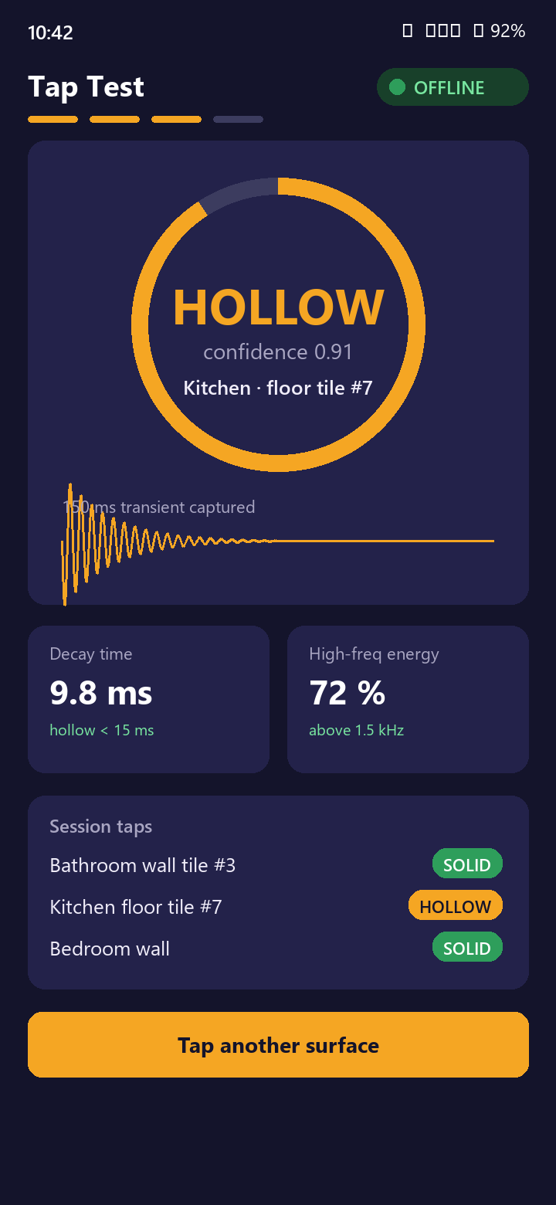



THE SOLUTION
SCORES END PRODUCT QUALITY 30%
Three sensors. One signed report. Zero internet.
VISION SCAN
TAP TEST
SIGNED REPORT
YOLOv8n-Seg finds cracks, stains, peeling paint and reports area in sq ft with a severity band.
Knuckle-tap a tile. A 250 ms transient becomes 36 spectral features and a logistic regression calls it hollow or solid, on the CPU.
The findings are written into a plain-language PDF on the phone, with a timestamp and a SHA-256 of exactly those findings on every page. Rule-based text today.
Plus a check the camera cannot do: the IR blaster fires a remote code at the AC. Android ConsumerIrManager is transmit-only, so the report records that the command was sent - closing the loop with a mic listen-back is the next step.
Screens are representative mockups. The live demo runs the real app.
SmartLease Edge · iQOO Hackathon 2026 · Chennai City Battle
04 / 17
Notes:
TIMING 1:05-1:30. Walk the three phones left to right. One sentence each. Then the IR line: 'we test whether the AC works, not whether it looks fine'. That functional-test line is the novelty claim no competitor matches; land it every time.

Slide 5

LIVE DEMO
SCORES DEMO & PRESENTATION 10%
The 60-second walkthrough, in Airplane Mode, mirrored through Office Kit.
0:00
0:15
0:30
0:45
1:00
1
2
3
4
5
Set baseline
Vision scan
Tap test
IR appliance check
Signed report
Point at the wall and press Set Baseline. Rotation-vector tracking records the pose; later captures report drift from it in degrees.
Point at the wall prop. Crack contour + area appear live. Severity: moderate.
Knuckle-tap the tile board. The findings log prints HOLLOW with the model confidence and its cross-validated accuracy.
Fire the code at the venue AC. Logged as transmitted: Android cannot receive IR, so this loop is open.
Tap Generate. The findings render to a PDF on the phone in under a second, with their SHA-256 on every page, then straight to the share sheet.
SensorManager · CameraX
CPU - YOLOv8n-Seg via PyTorch Lite
Mic - AudioRecord - logistic regression
ConsumerIrManager 38 kHz
Room DB - PdfDocument
Backup: a screen recording of the same flow sits on the phone in case the venue AC has no IR receiver line-of-sight.
SmartLease Edge · iQOO Hackathon 2026 · Chennai City Battle
05 / 17
Notes:
TIMING 1:30-3:00 is the LIVE DEMO itself; this slide is the backdrop. One presenter narrates, one drives the phone. Skip logins and setup screens. Rehearse 5+ times. Jury 'sees your demo cold at the end', so this single flow must reach its punchline (the PDF).
Telemetry: HackTracker scores creative phone use (camera, mic, on-device AI) and Office Kit usage from device data, so every step deliberately exercises a sensor.

Slide 6
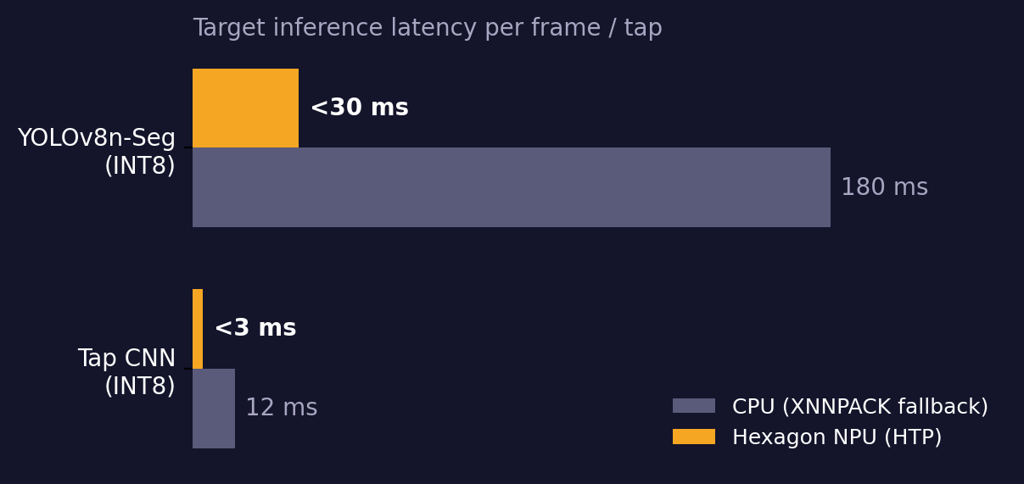
ON-DEVICE MODEL 1: VISION
SCORES TECHNICAL DEPTH 15%
Cracks become square feet, not opinions.
MODEL
YOLOv8n-Seg fine-tuned on 2,106 labelled defect images (1,796 train / 203 val / 107 test), merged from four CC BY 4.0 Roboflow datasets. Classes: crack, peeling, spalling, stain_mould.
DEPLOY
torch.export -> PT2E quantise (QnnQuantizer 8a8w) -> ExecuTorch lower -> .pte, compiled and in the repo under qnn_android_bundle/. Not yet wired into the APK: the shipping app runs the model on the CPU via PyTorch Lite.
MEASURE
Area is reported as the share of the frame the mask covers. There is no depth sensor and no camera-intrinsics read on device, so this is not yet a physical measurement - the pinhole conversion exists in the Python pipeline only.
Honest status
Honest status: the trained 4-class segmenter ships in the APK and runs on the CPU; a colour heuristic is the labelled fallback if it fails to load. No validation run is recorded yet, and the splits share video frames across train/val/test, so any mAP we quoted would be inflated.
DECIDE
Detections below 0.25 confidence are discarded. Every surviving detection is shown with its confidence and labelled with the segmenter that produced it.
SmartLease Edge · iQOO Hackathon 2026 · Chennai City Battle
06 / 17
Notes:
Technical-depth slide. If asked 'why nano not a bigger model': nano fits HTP memory at 6 MB INT8 and hits 30 ms; larger models do not improve mAP meaningfully on wall defects. If asked accuracy of area: pinhole model, +/-10% with ARCore depth, +/-20% with typed distance. Say 'targets' for numbers not yet measured.

Slide 7
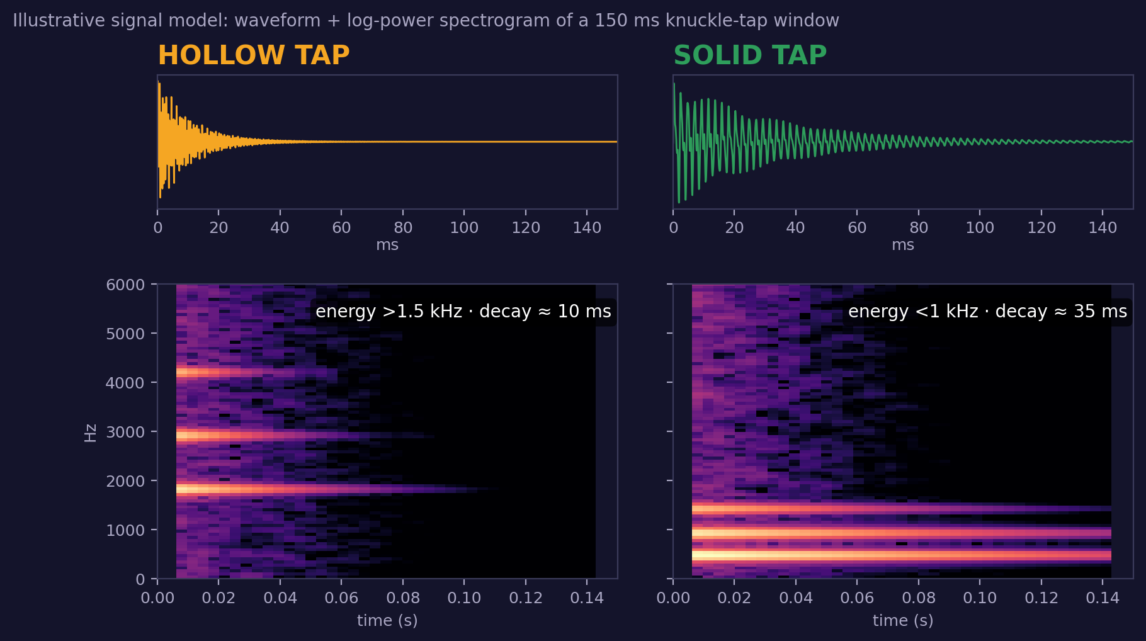
ON-DEVICE MODEL 2: ACOUSTICS
SCORES CREATIVE PHONE USE 15%
Tap a tile. The phone hears what a surveyor's hammer would.
CAPTURE
A button press opens AudioRecord at 44.1 kHz for 1.2 s; the tap is located by peak envelope. No always-on listener - the Qualcomm Sensing Hub audio path is not reachable from a third-party app.
FEATURES
250 ms crop, resampled to 22.05 kHz, peak-normalised. 40-band log-Mel -> 13 MFCCs -> 36 features: MFCC mean/std, spectral moments, ZCR, decay time, band ratios.
MODEL
Logistic regression over those 36 features - 36 multiply-adds on the CPU. Ships as a 73 KB JSON carrying the mel filterbank and DCT basis, so Kotlin cannot drift from the Python trainer.
FALLBACK
The deterministic decay heuristic already shipping in the app classifies every tap even if the CNN is unavailable.
Training set: 15 taps from 8 recordings. Grouped leave-one-recording-out accuracy 80% (95% CI 62-96%) against a 53% majority baseline. Small - and we report the cross-validated figure with its interval, never the training score.
The verdict, its confidence and the model cross-validated accuracy are all printed in the findings log.
SmartLease Edge · iQOO Hackathon 2026 · Chennai City Battle
07 / 17
Notes:
Creative phone use. Professional tile-sounding needs a trained inspector and dedicated tools; here the phone mic replaces them. Be explicit that the spectrogram is a signal model; real spectrograms from the collected data replace it after Day 5.

Slide 8
SYSTEM ARCHITECTURE
SCORES TECHNICAL DEPTH 15%
Every byte stays on the phone: sensors, on-device models, local database, offline PDF.
INPUT LAYER
Sony IMX921 50 MP + OIS · ultrawide · periscope
Stereo mics · 44.1 kHz PCM · AudioRecord
IR blaster 38 kHz · ConsumerIrManager
Rotation vector (TYPE_ROTATION_VECTOR)
HOST CPU - MODELS
HOST CPU - PIPELINE
IR STATE MACHINE
- YOLOv8n-Seg, 4-class, via PyTorch Lite
- Tap classifier: 36-feature logistic regression
- ExecuTorch INT8 .pte compiled and in repo; HTP integration not yet in the APK
- NMS - mask assembly - area as % of frame
• RMS spike → 150 ms crop → log-Mel
- PDF render - SHA-256 of findings - Room DB
• Capture (receiver or library) → store
- Replay at 38 kHz (Android has no IR receive path)
• Voltas · Blue Star · LG · Daikin fallback codes
DIAGNOSTIC SYNTHESIS · defect areas + tap verdicts + appliance state + OCR of meter/nameplate → one structured JSON record
OUTPUT Offline PDF: timestamp + session ID + SHA-256 of the findings on every page, rendered on the phone and shared by Intent or Office Kit. No cloud call at any stage, no INTERNET permission, backups disabled.
NO NETWORK PERMISSION
SmartLease Edge · iQOO Hackathon 2026 · Chennai City Battle
08 / 17
Notes:
One diagram, three processor lanes, like the Qualcomm Bengaluru winner GameSense (NPU = models, CPU = glue, plus the IR state machine). Point out the manifest has no INTERNET permission: that is the offline claim made verifiable in 2 seconds.
If asked about the vivo Q3 co-processor: we do not target it (no public SDK); we use the Hexagon NPU directly.

Slide 9
PHONE-FIRST THINKING
SCORES CREATIVE PHONE USE 15%
Built for the iQOO 15, not just running on it.
iQOO 15 hardware
Verified spec
Exact job in SmartLease Edge
Snapdragon 8 Elite Gen 5 · Hexagon NPU
37% faster NPU, INT4/INT8/FP16, Sensing Hub
Headroom for the models, not yet used: all three run on the CPU today. The ExecuTorch INT8 lowering is compiled and in the repo.
Triple 50 MP: IMX921 OIS + ultrawide + periscope
CIPA 4.5 OIS, 100× digital zoom
OIS steadies handheld capture; ultrawide frames a full wall; telephoto reaches a high-ceiling crack. No AR overlay is rendered yet.
IR blaster
38 kHz carrier via ConsumerIrManager
Fires an AC, geyser or TV remote code. Android cannot receive IR, so this records that the command was sent, not that the unit responded.
Stereo mics
Dual mic array, 44.1 kHz PCM capture
Captures the knuckle-tap transient for the hollow/solid classifier. Not always-on: the Sensing Hub audio path has no third-party API.
6000-nit 2K LTPO display
Peak brightness
Keeps the camera preview and the findings log legible in a sunlit Chennai flat at 2 pm.
7000 mAh + 8K vapor chamber
Sustained load without throttling
Twenty-room walkthrough on one charge without the inference slowing down mid-demo.
Not targeted: the vivo Q3 co-processor has no public SDK, so we say so if asked. Office Kit mirrors the phone to the projector during the pitch.
SmartLease Edge · iQOO Hackathon 2026 · Chennai City Battle
09 / 17
Notes:
This is the 'Device Performance / Phone-first thinking' answer. Name the exact hardware and the exact job; generic 'we used the NPU' scores nothing. Specs verified against iQOO product page, GSMArena and 91mobiles.

Slide 10
ON-DEVICE MODELS AND THE RED LIGHT PLAN
SCORES OFFICE KIT USAGE 10%
Three models, each with a fallback that still demos, and a phone-only build plan.
Model
Architecture
Size
Runtime
Latency
If it fails on stage
Wall-defect segmenter
YOLOv8n-Seg, INT8
~6 MB
PyTorch Lite (CPU)
not measured
Labelled colour heuristic segmenter
Tap classifier
Logistic regression, 36 features
73 KB
Pure Kotlin (CPU)
not measured
Decay-time heuristic already in app
Report writer
Rule-based template
n/a
Kotlin (CPU)
instant
n/a - already deterministic
RED LIGHT / GREEN LIGHT: WHAT HAPPENS ON THE PHONE ALONE
Red Light (~10.5 h, phone only)
Green Light (~8.5 h, both devices)
Office Kit in the pitch
On-device data capture of venue walls and tiles - threshold tuning - latency runs - IR capture of the venue AC. Driven from the laptop through Office Kit remote control and shared clipboard.
Model export and quantisation · Gradle builds · debugging · overnight polish. APK drag-dropped to the phone with Office Kit file transfer.
Screen mirror to the projector for the live demo · the generated PDF lands on the laptop by file transfer · clipboard sync for the session ID. Practised before Sep 12.
SmartLease Edge · iQOO Hackathon 2026 · Chennai City Battle
10 / 17
Notes:
Office Kit usage is 10% of the score and measured by telemetry (HackTracker), not by the pitch. So Office Kit must be used visibly and often: mirror, file transfer, remote control. Every model has a fallback so the demo never stalls; 'a well-built simple product beats a broken complex one' is the organiser's own motto.

Slide 11
COMPETITIVE LANDSCAPE
SCORES NOVELTY & IMPACT 20%
AI inspection apps exist. None run offline, and none test whether things actually work.
Offline
Functional test (IR / acoustic)
Defect area in sq ft
On-device AI
Price for one lease
NoBroker inspection (India)
✕
✕
✕
✕
₹1,649–5,999 + scheduling
human
TurboTenant (US)
✕
✕
✕
✕
Free, manual photos
zInspector + zAssistant
✕
✕
✕
✕
$0–115/mo per portfolio
cloud
RentCheck
✕
✕
✕
✕
$0.60–1.10/unit/mo
cloud
ClaimSnap (insurance)
✕
✕
~
✕
Not published
estimate
cloud
SmartLease Edge
✓
Free + ₹299–499 per signed report
✓
✓
✓
NPU
Precise novelty claim: fully offline, on-device AI with functional diagnostic testing, priced for a single lease event. Cross-checked against five real products; 'AI property inspection' alone is not new and we never claim it is.
SmartLease Edge · iQOO Hackathon 2026 · Chennai City Battle
11 / 17
Notes:
Novelty slide. Say the narrow, defensible claim exactly as written. If a judge names zInspector or RentCheck, agree they have AI, then point to the two empty columns: offline and functional testing. Prices from vendor pages as of Aug 2026.

Slide 12
WORKING MVP, HONESTLY
SCORES END PRODUCT QUALITY 30%
What runs today, what ships by Sep 12, and what happens live at the table.
Real and running now
Shipped before the battle - and what did not
Live at the venue (Sep 12–13)
✓ CameraX capture + preview
✓ AR baseline alignment (SensorManager + OIS)
✓ ML Kit OCR of meters and nameplates
✓ IR transmit via ConsumerIrManager
✓ Acoustic tap heuristic (AudioRecord + FFT)
✓ Deterministic safety gate
✓ Room DB + offline PDF report
✓ YOLOv8n-Seg fine-tune on 2,106 images
✓ ExecuTorch INT8 export · NEXT: HTP test
✓ Tap classifier trained (15 taps, 8 recordings)
NEXT: GenieX Llama 3.2 3B narrative
✓ SHA-256 of findings on every page · NEXT: dual signature
✓ Office Kit rehearsal, 3 timed runs
✓ 08:00 capture the real AC's IR code
✓ Round-1 vertical slice by Sat 19:00
✓ Tune thresholds to venue light and acoustics
✓ Overnight: fix, do not add features
✓ Sun 09:00 airplane-mode end-to-end run
✓ 13:45 final pitch, one flow, one aha
The two hard models are trained before the event so the 30 hours go to integration and polish, not first-time R&D. If a model is not reliable by Day 8, the shipping heuristic is the deliberate fallback.
SmartLease Edge · iQOO Hackathon 2026 · Chennai City Battle
12 / 17
Notes:
Judges punish decks that overclaim; JetBrains judges: 'be very direct about what works, what doesn't'. This slide is the credibility anchor. Everything in column 1 is in the GitHub repo today (app/src/main/java/com/smartlease/edge). Column 2 items move left as they land; update this slide the night before.

Slide 13



IMPACT AND SCALABILITY
SCORES NOVELTY & IMPACT 20%
One engine, four products, priced for one lease instead of a portfolio.
Who it serves
Priced for one move-out
Scales without new engines
Tenants keep deposits with timestamped evidence. Landlords document damage before it becomes a dispute. PG and co-living operators inspect 50+ rooms a day without a surveyor. Works in Tier-2/3 cities where the cloud apps do not.
Free baseline capture. ₹299–499 for the full diagnostic plus signed report, 5–10× cheaper than a ₹1,649–5,999 human inspection and available on demand. No subscription for a once-a-year event.
New defect class = 200 labelled images, same pipeline. Runs on any recent Android phone on the CPU; the IR blaster is the iQOO-specific part.
ROADMAP: SAME VERIFICATION ENGINE, HIGHER FREQUENCY
Phase 0 · Sep 12–13
Phase 1 · 2–4 mo
Phase 2 · 4–8 mo
Phase 3 · 6–12 mo
Move-Out Verify
Maintenance Mode + Insurance Assist
Buyer's Check
B2B2C licensing
The hackathon MVP. Once per lease.
Quarterly appliance health checks; claim-ready docs with functional proof. ₹99–149/mo.
Self-service pre-purchase inspection at ₹499–999 vs ₹10,000+ professional.
Per-unit licences for co-living operators and property managers; rental platforms embed the engine.
SmartLease Edge · iQOO Hackathon 2026 · Chennai City Battle
13 / 17
Notes:
Honest sizing if asked: India's paid inspection-tool market is nascent; NoBroker is the only major domestic player. Distribution and trust are the bottleneck, not the tech. Say that plainly; it reads as market awareness. Business model: free for consumers, B2B2C licensing is the revenue anchor.

Slide 14
TEAM AND SCORING PLAN
Three people, zero overlap, and a plan for each of the six judged criteria.
[Member 1]
Criterion
Weight
How SmartLease Edge scores it
M1
End product quality
30%
One complete flow: baseline → scan → tap → IR → signed PDF. Fallback for every model.
AI / NPU ENGINEER
Trains and exports both models; ExecuTorch INT8 lowering. Event day: integrate, tune to venue.
Novelty and impact
20%
Offline + functional testing; no competitor has either. Deposit disputes affect every renter.
[Member 2]
Creative phone use
15%
Camera, mic and IR blaster all exercised in the demo. The IR blaster is the part that does not exist on most phones.
M2
ANDROID / HARDWARE LEAD
CameraX, AR overlay, AudioRecord, IR capture and replay, Office Kit Red Light sessions.
Technical depth
15%
4-class instance segmentation on-device, grouped cross-validated acoustic model, ExecuTorch INT8 lowering compiled and in the repo.
Office Kit usage
10%
Mirror, file transfer and remote control used through Red Light and in the pitch.
M3
[Member 3]
PRODUCT / DEMO PITCHER
Demo and presentation
10%
3-minute script, one presenter + one driver, rehearsed 5×, recorded backup.
Report UI, pricing logic, sourced citations, pitch script, judge Q&A.
SmartLease Edge · iQOO Hackathon 2026 · Chennai City Battle
14 / 17
Notes:
Weights are the published iQOO 2026 rubric (Reskilll/iQOO portal): 30/20/15/15/10/10, with 25% (phone use + Office Kit) measured from HackTracker device telemetry. Fill in names. If the team is mixed student/professional, note that buckets cannot mix.

Slide 15
SMARTLEASE EDGE · IQOO HACKATHON 2026 · CHENNAI
Every Indian renter deserves a fair move-out.
✓
Working Android app in the repo today
✓
Multi-modal: vision + acoustics + IR, all on-device
✓
Built for iQOO 15 hardware, feature by feature
✓
100% offline, no network permission
✓
Offline PDF report carrying a SHA-256 of its own findings
We are not pitching an idea. We are showing you a working system.
github.com/muhammedsayeedurrahman/smartlease-edge-chennai · [email] · Demo: live on the iQOO 15
Notes:
TIMING 4:30-5:00. Slow down. One line: 'Let us in the room. The models are trained; the 30 hours are for integration and polish.' Then stop talking and invite questions.

Slide 16
APPENDIX
Judge Q&A: the answers we have ready.
Likely question
Answer
What if the model detects a false positive?
Every detection is shown with its confidence and with the segmenter that produced it. Our training set has no clean-wall negatives, so we expect false positives on grout lines, shadows and cables - that is the first gap we are closing.
How accurate is the area measurement?
It is not a measurement yet. We report the share of the frame the mask covers. The pinhole conversion needs camera intrinsics and a distance, and neither is read on device today.
Does it work on other phones?
Any recent Android phone - the model runs on the CPU via PyTorch Lite. The IR blaster is the part that does not exist on most phones.
Privacy?
No INTERNET permission, allowBackup off, every backup domain excluded - the report PDF is not eligible for cloud backup. Sharing is a user-initiated share sheet, scoped to one file.
Why not ChatGPT plus a photo?
It cannot report defect area, cannot hear a hollow tile, cannot fire an IR code, and needs internet in a flat that has none.
Why YOLOv8 nano?
6 MB INT8 is the size we lowered for HTP; on the CPU the nano model is what keeps a capture responsive. We have not measured latency on either yet.
What is trained versus built live?
Both models and the ExecuTorch export path are done before Sep 12. Live: real AC IR capture, venue threshold tuning, integration polish. HTP integration is not done.
Business model?
Free for consumers; Rs 299-499 per report; B2B2C licensing to co-living operators and rental platforms is the revenue anchor.
SmartLease Edge · iQOO Hackathon 2026 · Chennai City Battle
16 / 17
Notes:
Backup slide. Do not present; open only when a question comes. Answers mirror the battle plan document.

Slide 17
APPENDIX
Sources behind every number on these slides.
Model Tenancy Act 2021: 2-month residential deposit cap
prsindia.org/billtrack/the-model-tenancy-act-2021
Bengaluru deposits 6–10 months, market practice
blogs.mittiyo.com · werentt.com (Karnataka deposit guides)
Deposit issues >40% of landlord–tenant disputes (industry estimate)
99acres.com/articles/what-are-security-deposits.html · rentconnect.in
NoBroker inspection ₹1,649–5,999; zInspector, RentCheck, TurboTenant pricing
Vendor pages, Aug 2026 (see SmartLease-Edge-Chennai-Battle-Plan.pdf, section 2)
iQOO 15 specs: Snapdragon 8 Elite Gen 5, IMX921 OIS, 7000 mAh, 6000 nits
gsmarena.com · 91mobiles.com · iqoo.com/in
Hexagon NPU 37% faster; INT4/INT8/FP16
Qualcomm Snapdragon 8 Elite Gen 5 product brief (PDF)
Training data: four Roboflow Universe datasets, CC BY 4.0
infrastructure-monitoring - structural-defects - building-anomalies - concrete-defects (universe.roboflow.com)
iQOO Hackathon 2026 rubric, Red/Green Light, Office Kit
iqoo.reskilll.com · reskilll.com/blogs (iQOO City Battles, strategy guide)
ExecuTorch Qualcomm backend, PT2E quantisation
pytorch.org/executorch · Qualcomm AI Hub docs
Photos: cracked wall (CC0), peeling paint (CC BY-SA 4.0)
Wikimedia Commons; attribution in ATTRIBUTION.json
SmartLease Edge · iQOO Hackathon 2026 · Chennai City Battle
17 / 17
Notes:
Every statistic on the deck traces to one of these. If a judge challenges a number, name the source. Never use a number that is not on this list.

