Slide 1

SIGN LANGUAGE RECOGNITION
Guided By: Presented By:
DR . FOUSIA M SHAMSUDEEN SHAFI S
MCA23-156

Slide 2
Problem Statement:
Communication between hearing-impaired individuals and those who do not understand sign language remains a significant challenge.
Existing communication tools for hearing-impaired and mute people often lack real-time recognition capabilities.
A system capable of translating sign language into words in real time could bridge this gap.

Slide 3
Literature Review:
Sl.No | Title | Authors | Published Year
1. | DeepASLR: A CNN based human computer interface for American Sign Language recognition for hearing-impaired individuals | Ahmed Kasapbasi, Ahmed Eltayeb AHMED ELBUSHRA , Omar AL-HARDANEE,Arif YILMAZ | 2022
2. | American Sign Language Recognition for Alphabets Using MediaPipe and LSTM | Sundar B , Bagyammal T | 2023
3. | Development of a Sign Language Recognition using Machine Learning | Orovwode, Hope & Oduntan, Ibukun & Abubakar, John | 2023

Slide 4
Gap Identified
In previous works,
There is a shortage in size of datasets available for sign language gestures for training the models.
Most previous studies in sign language recognition have relied on custom CNN architectures without exploring the potential of advanced pretrained models like VGG16 and InceptionV3.
Many studies focus on static images for each sign rather than dynamic, real-time gestures, which are closer to real-world applications.

Slide 5
STRATEGY
Dataset Collection:
Using OpenCV and a webcam, a dataset with 2000 samples for each alphabet letter (A-Z) was manually collected, ensuring a more representative range of lighting conditions, backgrounds, and hand shapes
Advanced Model Architectures (VGG16 and InceptionV3): Rather than relying on a single model, this project includes a comparative analysis of CNN, VGG16, and InceptionV3 architectures, allowing for a comprehensive evaluation of each model's performance.
Real-Time Detection and combine predicted letters to form meaningful sentences.

Slide 6
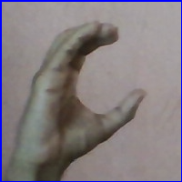
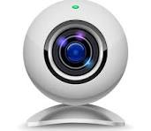

Data Preprocessing
Data Collection
Train the model
MODEL
CNN/VGG16/
InceptionV3
Capture each frame
And send for prediction
Predicted as

Slide 7
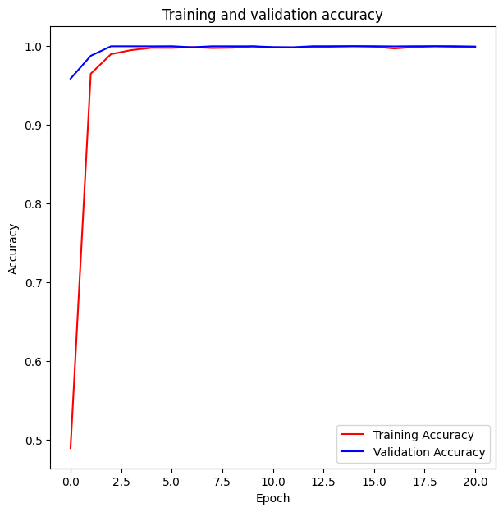
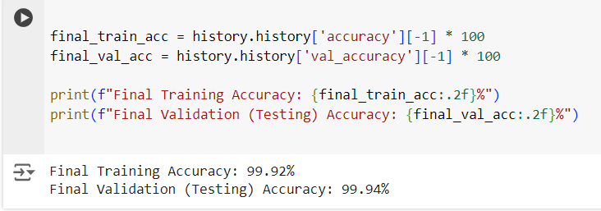
Results
CNN ( Model 1 ) :
Key Takeaways:
The graph shows Training Accuracy and Validation Accuracy over 20 epochs for CNN model.
The model is performing very well with almost perfect accuracy on both training and validation data.
There is no sign of overfitting as the validation accuracy follows closely with the training accuracy.

Slide 8
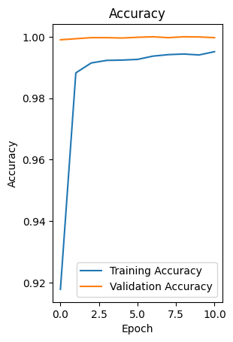
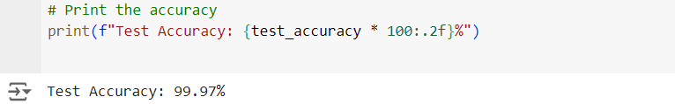
VGG16 ( Model 2 ) :
Key Takeaways:
The graph shows Training Accuracy and Validation Accuracy over 10 epochs for VGG16 model.
The high validation accuracy from the start indicates that the model is performing exceptionally well on unseen data as well.
No sign of overfitting, as the training and validation accuracy are very close to each other.

Slide 9
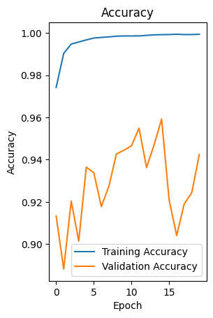

InceptionV3 ( Model 3) :
Key Takeaways:
The training accuracy quickly rises and stabilizes near 100% within the first few epochs
Early stopping appears to be beneficial here, as it prevents the model from continuing to train in a state where it’s likely overfitting.

Slide 10
Model Comparison
MODEL | ACCURACY
CNN | 99.94%
VGG16 | 99.97%
InceptionV3 | 94.24%

Slide 11
THANK YOU

