Slide 1

Sentiment Analysis of
Product Reviews
Using TF-IDF and Machine Learning Classifiers
ANU GOPAL V · RASHA K K · MUHAMMED SHAHID S
Predictive Analytics · Academic Year 2025–26

Slide 2



Project Overview
Objective
Dataset
Approach
Classify customer reviews from Amazon as Positive, Negative, or Neutral using traditional ML — no deep learning.
21,055 Amazon reviews. Ratings mapped: 1–2★ → Negative, 3★ → Neutral, 4–5★ → Positive.
TF-IDF unigrams/bigrams + handcrafted linguistic features + Chi-Square / Mutual Information selection.
Sentiment Analysis of Product Reviews · ANU GOPAL V · RASHA K K · MUHAMMED SHAHID S
2

Slide 3
Exploratory Data Analysis
21,055
68.2%
27.6%
4.2%
Total Reviews
Negative Reviews
Positive Reviews
Neutral Reviews
After cleaning & preprocessing
14,350 samples — dominant class
5,820 samples
885 samples — minority class
Sentiment Analysis of Product Reviews · ANU GOPAL V · RASHA K K · MUHAMMED SHAHID S
3

Slide 4


Data Challenges & Observations
Class Imbalance
Noise in Text
68% of reviews are Negative. This biases models toward the majority class, making accuracy a misleading metric. Macro F1 is used as primary metric.
Reviews contain URLs, HTML tags, special characters, emojis, and inconsistent casing — all requiring systematic preprocessing.
Short & Inconsistent
Strong Negative Signal
Review lengths vary dramatically from single words to long paragraphs, making fixed-length feature extraction challenging.
Negative reviews showed the strongest TF-IDF signals. Words like 'worst', 'terrible', 'broken', and negation patterns were highly discriminative.
Sentiment Analysis of Product Reviews · ANU GOPAL V · RASHA K K · MUHAMMED SHAHID S
4

Slide 5
Feature Engineering Pipeline
01
02
03
04
Text
Preprocessing
TF-IDF
Features
Linguistic
Features
Feature
Fusion
Lowercasing · HTML removal · Special char filtering · Stopword elimination · Tokenisation
Unigrams & bigrams · Sublinear TF scaling · max 15,000 features · min_df=2, max_df=0.95
Sentence length · Punctuation density · Avg word length · Negation word presence
Sparse TF-IDF matrix + 4 dense linguistic features via scipy.hstack into combined matrix
Sentiment Analysis of Product Reviews · ANU GOPAL V · RASHA K K · MUHAMMED SHAHID S
5

Slide 6


Feature Selection Methods
Chi-Square Test (χ²)
Mutual Information
Statistical independence test between each feature and class labels.
Top 500 features selected based on χ² score.
Features with near-uniform distribution across classes are discarded as uninformative, reducing dimensionality and noise.
Information-theoretic measure of dependency between features and sentiment classes.
Top 300 most informative features extracted for comparative analysis.
Captures non-linear dependencies that Chi-Square may miss.
Sentiment Analysis of Product Reviews · ANU GOPAL V · RASHA K K · MUHAMMED SHAHID S
6

Slide 7
Machine Learning Models
01
Logistic Regression
02
Multinomial Naive Bayes
Baseline classifier with L2 regularization and balanced class weights. Fast training with probabilistic outputs and interpretable coefficients.
Probabilistic classifier assuming feature independence. Highly efficient for text classification with Laplace smoothing (α = 0.5).
03
Linear SVM
04
Gradient Boosting
Maximum-margin classifier with calibrated probabilities. Handles high-dimensional sparse feature spaces effectively. C=1.0, max_iter=2000.
Ensemble of 150 trees with sequential error correction. Most computationally expensive (28s) but captures complex non-linear patterns.
Sentiment Analysis of Product Reviews · ANU GOPAL V · RASHA K K · MUHAMMED SHAHID S
7

Slide 8
Model Performance Comparison
Sentiment Analysis of Product Reviews · ANU GOPAL V · RASHA K K · MUHAMMED SHAHID S
8

Slide 9
Model Performance — Key Insights
1
Accuracy
Linear SVM achieved the highest raw accuracy at 88.65%. However, accuracy is misleading on this imbalanced dataset — SVM nearly ignores the Neutral class entirely (F1 ≈ 0.00).
2
Macro F1 (Primary)
Logistic Regression led with Macro F1 = 0.6189, balancing precision and recall across all three classes including the minority Neutral class (recall = 43%).
3
Training Time
Multinomial NB was fastest (~0.01s). Gradient Boosting slowest at 28s but offered the best precision (0.6789). Linear SVM struck the best speed/accuracy trade-off.
Sentiment Analysis of Product Reviews · ANU GOPAL V · RASHA K K · MUHAMMED SHAHID S
9

Slide 10



Best Model — Logistic Regression
BEST MODEL
Class
Precision
Recall
F1-Score
Support
Logistic
Regression
Negative
0.95
0.80
0.87
2,870
78.3%
Accuracy
61.9%
Neutral
0.11
0.43
0.18
177
Macro F1
63.1%
Precision
67.5%
Positive
0.83
0.79
0.81
1,164
Recall
Sentiment Analysis of Product Reviews · ANU GOPAL V · RASHA K K · MUHAMMED SHAHID S
10

Slide 11
Classification Results by Class
87%
81%
18%
F1-Score
F1-Score
F1-Score
Negative Reviews
Positive Reviews
Neutral Reviews
Precision: 95% · Recall: 80%
Precision: 83% · Recall: 79%
Precision: 11% · Recall: 43%
Most samples correctly identified. High precision = low false positives.
Balanced precision and recall. Solid performance on the second-largest class.
Poor performance due to severe underrepresentation (only 4.2% of data).
Sentiment Analysis of Product Reviews · ANU GOPAL V · RASHA K K · MUHAMMED SHAHID S
11

Slide 12


Key Findings & Insights
Dataset Imbalance
Feature Importance
68% Negative class bias forced models to predict majority. Macro F1 was chosen over accuracy as primary metric.
Negation words and intensity terms (worst, best, terrible, excellent) proved most discriminative across all models.
Model Trade-offs
Neutral Class Challenge
Logistic Regression: best Macro F1 + interpretability. SVM: highest accuracy. Gradient Boosting: best precision, slowest.
Recall = 43% for Neutral. Suggests need for SMOTE oversampling, cost-sensitive learning, or a dedicated binary classifier.
Sentiment Analysis of Product Reviews · ANU GOPAL V · RASHA K K · MUHAMMED SHAHID S
12

Slide 13
Future Improvements & Conclusions
01
02
03
04
Class Balancing
Advanced Features
Deep Learning
Cross-Domain
Apply SMOTE or class weighting to boost Neutral class recall from current 43%.
Incorporate sentiment lexicons (VADER, SentiWordNet) and pre-trained word embeddings.
Experiment with LSTM or transformer architectures (BERT) for richer context understanding.
Test model generalisation across different product categories and review platforms.
Conclusion
Traditional ML with TF-IDF and linguistic features achieved reasonable performance (Macro F1 = 0.619), demonstrating viability for sentiment classification without deep learning. Logistic Regression provided the best balance of metrics and interpretability, making it the recommended production model for this task.
Sentiment Analysis of Product Reviews · ANU GOPAL V · RASHA K K · MUHAMMED SHAHID S
13

Slide 14
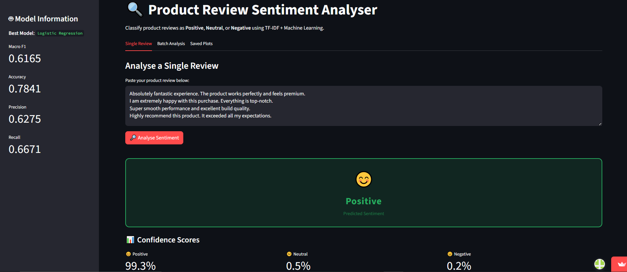
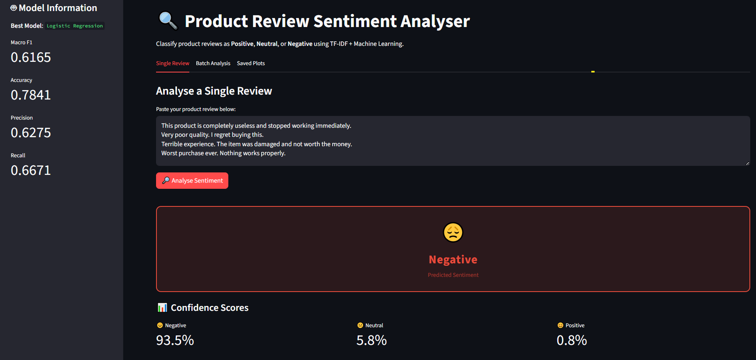
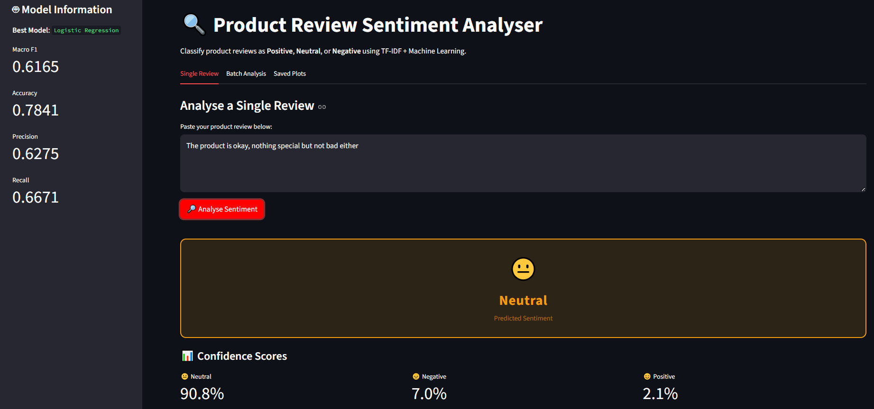
LIVE DEPLOYMENT (STREAMLIT) APP
02
Sentiment Analysis of Product Reviews · ANU GOPAL V · RASHA K K · MUHAMMED SHAHID S
13

Slide 15


Try the Model
Access the Live Sentiment Analysis Classifier
https://sentiment-analysis-appuct-reviews-qpygnmqthyutgevfmux9bf.streamlit.app
Single review analysis with confidence scores
Batch CSV upload & bulk prediction download
Training visualisations and model metrics dashboard

Slide 16
Thank You
Sentiment Analysis of Product Reviews · AY 2025–26
Predictive Analytics Course · Academic Year 2025–26
https://sentiment-analysis-appuct-reviews-qpygnmqthyutgevfmux9bf.streamlit.app
Built with TF-IDF · Logistic Regression · Linear SVM · Multinomial NB · Gradient Boosting

