Slide 1
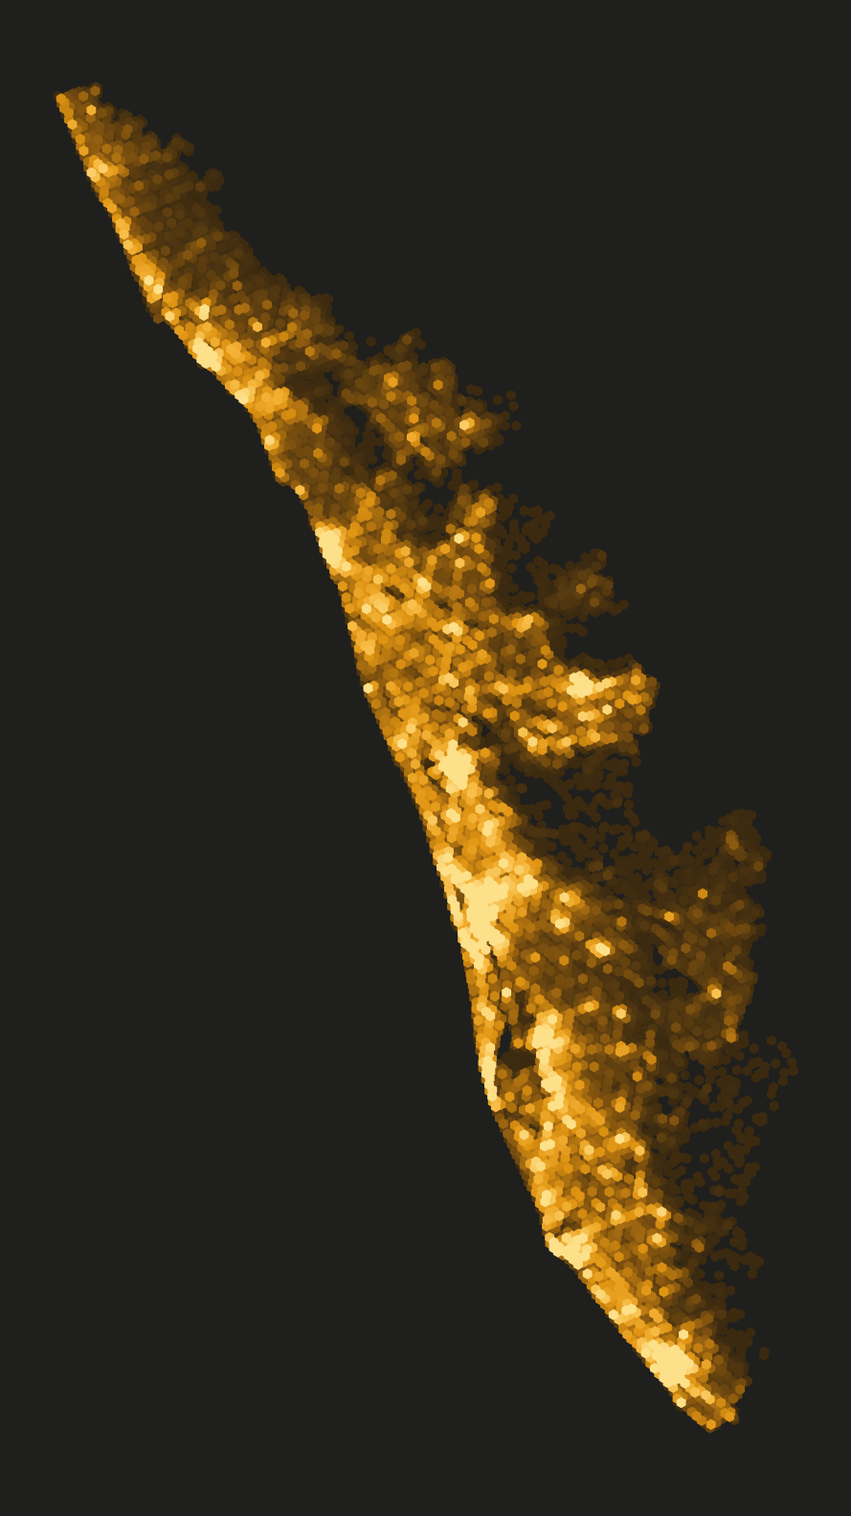
Rooftop Solar Potential of Kerala
Mapping 13 million roofs with spatial big data: Apache Sedona and Spark MLlib
Muhammed Shahid S | Roll No. 253308
M.Sc. Data Science and Geoinformatics, Digital University Kerala
Supervisor: Manoj Kumar T K
Spatial Bigdata Analytics (M5221357) | 12 November 2026
Each glowing cell = solar potential of ~5 km² of roofs
Notes:
TIMING GUIDE (about 12 minutes): Problem 2 min (slides 1-4), Method 6 min (slides 5-14), Results 3 min (15-18), Wrap-up 1 min (19-20). If short of time, skip slide 8 (Describe every roof), because slides 9 and 10 explain the features in more detail.
Good morning. My project asks a simple question: how much electricity could Kerala make from its own rooftops? To answer it I mapped every building in Kerala, about 13 million, using spatial big data tools. The picture on the right is Kerala drawn only from my results; every glowing cell is a piece of land with solar potential.

Slide 2
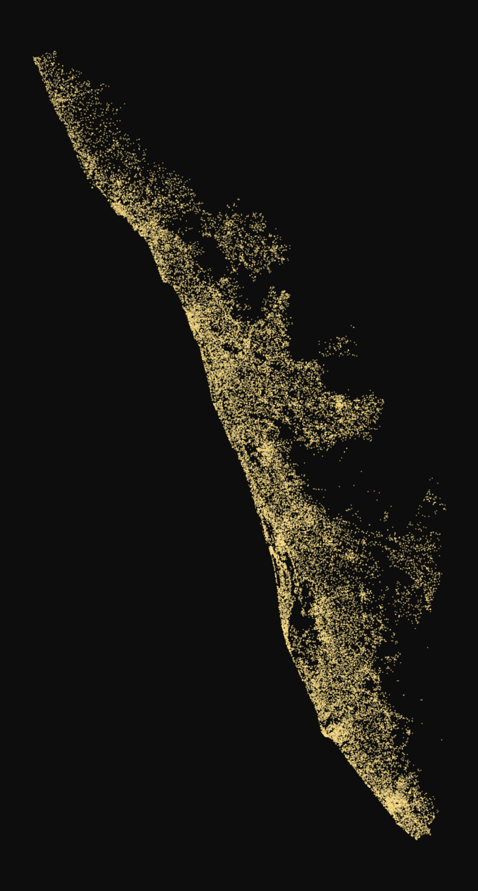
Every roof in Kerala gets strong sun.
How many could power our homes?
~70%
0.95 GW
₹78,000
of Kerala's electricity is bought from outside
of rooftop solar installed today
government subsidy per home (PM Surya Ghar)
Each dot is a real roof (40,000 shown of 13 million)
Notes:
Let me start with a question for you: every roof in Kerala gets strong sun, so how many of them could power our homes? Kerala buys about 70 percent of its electricity from outside. Only 0.95 gigawatt of rooftop solar is installed today, even though the government gives up to 78 thousand rupees per home. Each dot on the right is a real roof from my data.

Slide 3



What this project does
Map every roof
Find good roofs
Measure power
all 13 million buildings in Kerala, from satellite-derived building outlines
machine learning decides which roofs are big and sunny enough
free space on each good roof → kW → electricity per year
13 million roofs · 14 districts · 82 billion map pixels · 12 notebooks in the cloud
Notes:
In one line, my project does three things. First, it maps every roof in Kerala. Second, it uses machine learning to find the roofs that are good for solar: big enough and not shaded by trees. Third, it measures how much free space each good roof has, and turns that into electricity. The scale is large: 13 million roofs, 14 districts and 82 billion map pixels, processed in 12 cloud notebooks.

Slide 4





Why it needs big data tools
19.4 M
building outlines downloaded
Google Colab
cloud computer
Apache Spark
parallel processing
82 billion
pixels in the 1 m tree-height map
Apache Sedona
spatial operations
14 GB
of project data in the cloud
PostGIS
spatial database
12
notebooks run in Google Colab
Spark MLlib
machine learning
40,000 of 13 million roofs, plotted
Notes:
Why big data? I downloaded 19.4 million building outlines. The tree-height map alone has 82 billion pixels. The project data is about 14 gigabytes, which is too large for a normal desktop workflow. So everything ran in the cloud on Google Colab, with Apache Spark for parallel processing, Apache Sedona for spatial operations, PostGIS as a spatial database and Spark MLlib for machine learning.

Slide 5






The method in six steps
1
2
3
4
5
6
Collect
Clean & join
Label
Describe & learn
Measure
Show
buildings, sun, trees
Sedona → 13.0 M roofs
290 example roofs
features + Random Forest
free roof area
results + dashboard
19.4 M buildings → 13.0 M roofs → 6.7 M good roofs → 18.5 GW of solar
Notes:
Here is the whole method in six steps; each next slide shows one step with the real screen. One, collect the data. Two, clean it and join every building to its district. Three, label example roofs so the computer knows what a good roof is. Four, describe every roof with numbers and train a machine learning model on the labelled roofs. Five, measure the free area on each good roof. Six, summarise and show the results. The bottom line is the funnel: from 19.4 million buildings to 13 million roofs, to 6.7 million good roofs, to 18.5 gigawatts of solar.

Slide 6




Collect the data
STEP 1 / 6
Building outlines
Sunshine
Overture Maps (Google, OSM, Microsoft)
19.4 M polygons · 1.7 GB
Global Solar Atlas, World Bank
1,460-1,578 kWh per kW per year
Tree cover
Tree height
ESA WorldCover 2021, 10 m
5 satellite tiles
Meta & WRI canopy map, 1 m
82 billion pixels · ~11 GB
Notes:
Step one: collect. Four free, open datasets. Building outlines from Overture Maps: 19.4 million polygons, mostly made by Google from satellite images. Sunshine from the World Bank's Global Solar Atlas. Tree cover from the European Space Agency at 10 metres. And tree height from Meta's 1-metre canopy map, which has 82 billion pixels over Kerala.

Slide 7
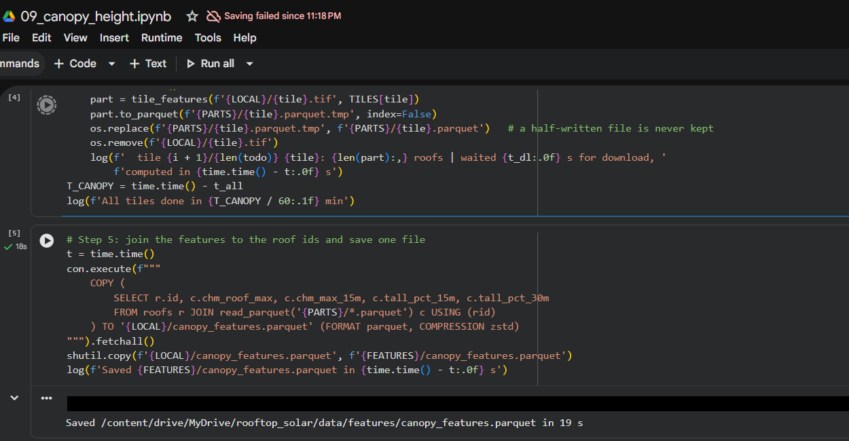
Clean and join with Sedona
STEP 2 / 6
13.0 M
roofs kept inside Kerala
Sedona put each of 19.4 M buildings into its district
Removed 6.35 M outside Kerala and 15,538 tiny ones
Saved as files split by district (GeoParquet)
Real screen: a Google Colab notebook writing results for 13 million roofs
Notes:
Step two: clean and join. This is a real screen from one of my Google Colab notebooks. Apache Sedona checked, for each of the 19.4 million buildings, which district it lies in. That is a spatial join. I removed 6.35 million buildings outside Kerala and about 15 thousand tiny ones under 10 square metres. 13 million roofs remain, saved as files split by district.

Slide 8
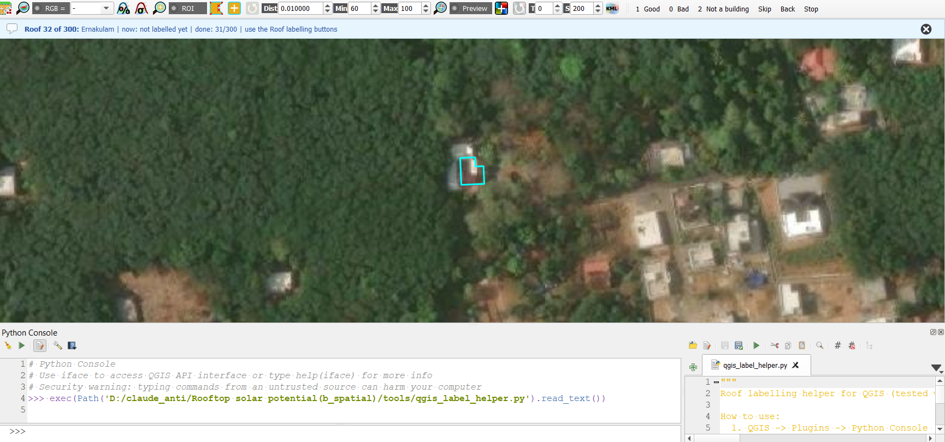
Teach the computer: labelling
STEP 3 / 6
300
random roofs, judged by me and by an AI
click: Good / Bad
218
we agreed on (74%)
72
disagreements re-checked blind
roof to judge
290
final "gold" labels
Real screen: my QGIS labelling tool (Python script)
Notes:
Step three: a computer cannot learn "good roof" without examples. So I built this tool in QGIS. It zooms to a random roof, outlined in cyan, and I click Good, Bad or Not a building. I judged 300 random roofs, 21 per district. An AI vision model, Google Gemini, judged the same roofs separately. We agreed on 218. For the disagreements I looked again blind, without seeing either old answer. That gives 290 reliable gold labels. These labels are the answers; next, I describe every roof with numbers, which the model uses as clues.

Slide 9
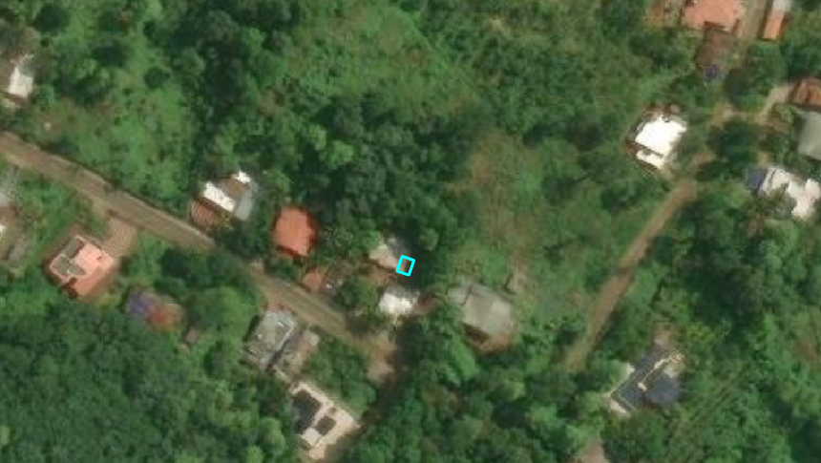
Describe every roof
STEP 4 / 6
6 kinds of roof information
trees shade small roofs
Size and shape of the roof
Sunshine (kWh per kW)
Tree cover within 28-300 m
Tree height within 15 m
Crowding (buildings nearby)
Outline quality
big open roof = good
Real view: Kerala houses among homestead trees (Esri satellite image)
Notes:
Step four: now that we have the answers, I describe every roof with numbers, which are the clues. Look at this real satellite view: many Kerala houses sit under coconut and jack trees, and that shade is bad for solar. So for each of the 13 million roofs I calculated six things: its size and shape, the sunshine, tree cover around it, tree height, how crowded the area is, and how reliable the outline is. One lesson: the first raster method took 6.4 hours; rewritten with NumPy it took 42 seconds.

Slide 10
How the 15 features are made
STEP 4 / 6
Data source
Features for every roof (number of columns)
Model
Building outlines
Overture Maps
Size and shape
roof area · compactness (4πA/P²)
2
Random Forest
15 features
200 trees
learned from 290 labelled roofs
Outline quality
confidence · low-confidence flag · data source
3
Good
Tree map, 10 m
ESA WorldCover
Tree cover
trees within 28, 140, 300 m · seen as built-up
4
Not good
Tree height, 1 m
Meta / WRI canopy map
Tree height
tallest tree ≤5 m, ≤15 m · tall trees ≤15 m, ≤30 m
4
H3 hexagons
count + K-means
Crowding
buildings per hexagon · area type (K-means)
2
for all 13 M roofs
Sunshine (Global Solar Atlas) is not a model input: it only shows location, so it is used later, free area × yield = electricity.
Notes:
This slide shows how the features are made and used. On the left are the data sources. The building outline gives two groups: size and shape, and outline quality. The ESA WorldCover map gives tree cover in three rings and whether the roof looks built-up. The Meta map gives four tree-height numbers. The H3 hexagons give crowding and the area type from K-means. Together that is 2 + 3 + 4 + 4 + 2 = 15 numbers for every roof. The Random Forest, with 200 trees, learned from 290 labelled roofs how these numbers relate to good and not good roofs, and then judged all 13 million roofs. Sunshine is not a model input, because it changes only slowly across Kerala and mostly shows location; it is used later to turn free area into electricity.

Slide 11
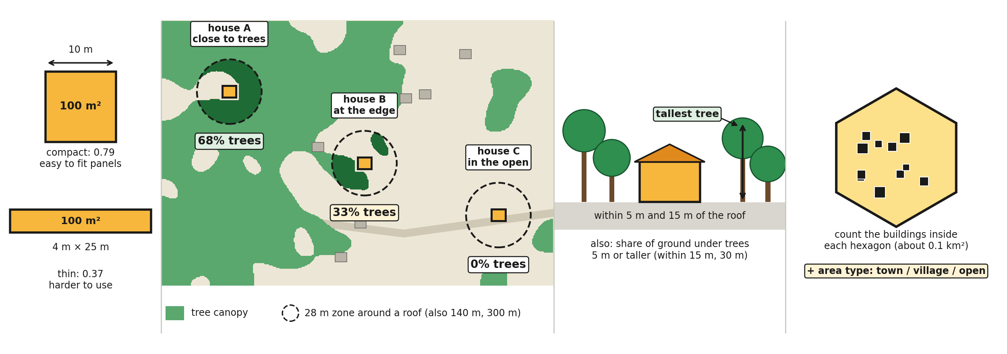
The features, as pictures
STEP 4 / 6
SIZE & SHAPE
same area, 2 shapes
TREE COVER
% of trees in a zone around each roof
TREE HEIGHT
how tall the trees are
CROWDING
buildings nearby
Also: outline quality (how reliable the building outline is). Sunshine is not an input.
Notes:
This slide shows the features as pictures. First, size and shape: these two roofs have the same area, 100 square metres, but the square one is compact and easy to fill with panels, and the thin one is harder to use. Second, tree cover: the green is the tree canopy. Around every roof I draw a zone of 28 metres, and also 140 and 300 metres, and measure how much of it is trees. House A is close to the trees, so 68 percent of its zone is trees and its roof is shaded. House B is at the edge, 33 percent. House C is in the open, 0 percent, so it gets full sun. Third, tree height: the tallest tree near the roof. Fourth, crowding: the number of buildings in each hexagon, which also gives the area type. The last feature, outline quality, is how reliable the building outline is. Sunshine is not an input to the model. The map is a drawing to explain the idea; the percentages are measured on the drawing.

Slide 12
Random Forest judges 13 M roofs
STEP 4 / 6
Tested fairly: trained on 13 districts, tested on the 14th, 14 times. Result: 6.7 M roofs (52%) are suitable.
Notes:
Now the model. With the 290 labels and the 15 features, I trained a Random Forest, which is many decision trees voting together, in Spark MLlib. To test it fairly I trained on 13 districts and tested on the 14th it had never seen, 14 times. It is correct 67 percent of the time; guessing gives 54. The most important clue is roof size, then trees near the roof. Then the model judged all 13 million roofs: 6.7 million, about half, are suitable.

Slide 13
How much of each roof is free
STEP 5 / 6
0.6 m edge
free area for panels
stair room + tank
1. Sedona shrinks each outline 0.6 m (ST_Buffer)
2. Subtract 8 m² for stair room and tank
3. 10 m² free = 1 kW of panels
6.69 M roofs measured in 6.4 minutes
Notes:
Step five: not all of a roof can hold panels. You leave an edge for safety, and the stair room and water tank take space. So for each good roof, Sedona shrank the outline by 0.6 metres from every side, and I subtracted 8 square metres. Small roofs keep only 40 percent, big roofs about 90. Sedona did this for 6.7 million roofs in 6.4 minutes. Then 10 square metres of free roof equals 1 kilowatt of panels.

Slide 14
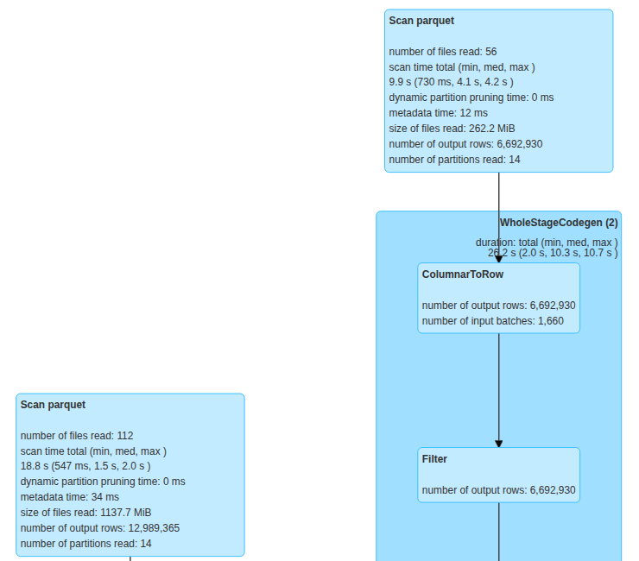
Spark at work: the proof
STEP 6 / 6
1.5 GB
of roof data kept in memory
22 Spark jobs, 8 parallel tasks
1.4 GB moved between tasks
Later summaries reused memory: seconds, not minutes
12,989,365 roofs read
Real screen: Spark UI query plan
Notes:
Step six: summarise and show. This is the proof of big data processing, from the Spark monitor. This query read all 12,989,365 roof records, about 1.1 gigabytes, joined them with the free-area table, and kept 1.5 gigabytes in memory. Because the data stayed in memory, the later summaries for districts and hexagons took seconds instead of minutes.

Slide 15
Result: 88% of Kerala's need
6.7 M
18.5 GW
28.2 TWh
20.5 Mt
good roofs (52%)
solar capacity
electricity a year
CO₂ avoided a year
Scenario | Capacity | Electricity / year
Realistic: every good roof installs up to 3 kW | 18.5 GW | 28.2 TWh = 88% of need
Maximum: every good roof fully covered | 64 GW | 98 TWh
Installed today (Oct 2024) | 0.95 GW | 20× less than realistic
Notes:
Here is the answer. 6.7 million roofs, about half, are good for solar. If each of them installs a normal 3 kilowatt home system, Kerala gets 18.5 gigawatts and 28 terawatt hours a year. That is 88 percent of all the electricity Kerala needs, and it avoids 20 million tonnes of CO2 every year. Today only 0.95 gigawatt is installed, so the realistic potential is 20 times more.

Slide 16
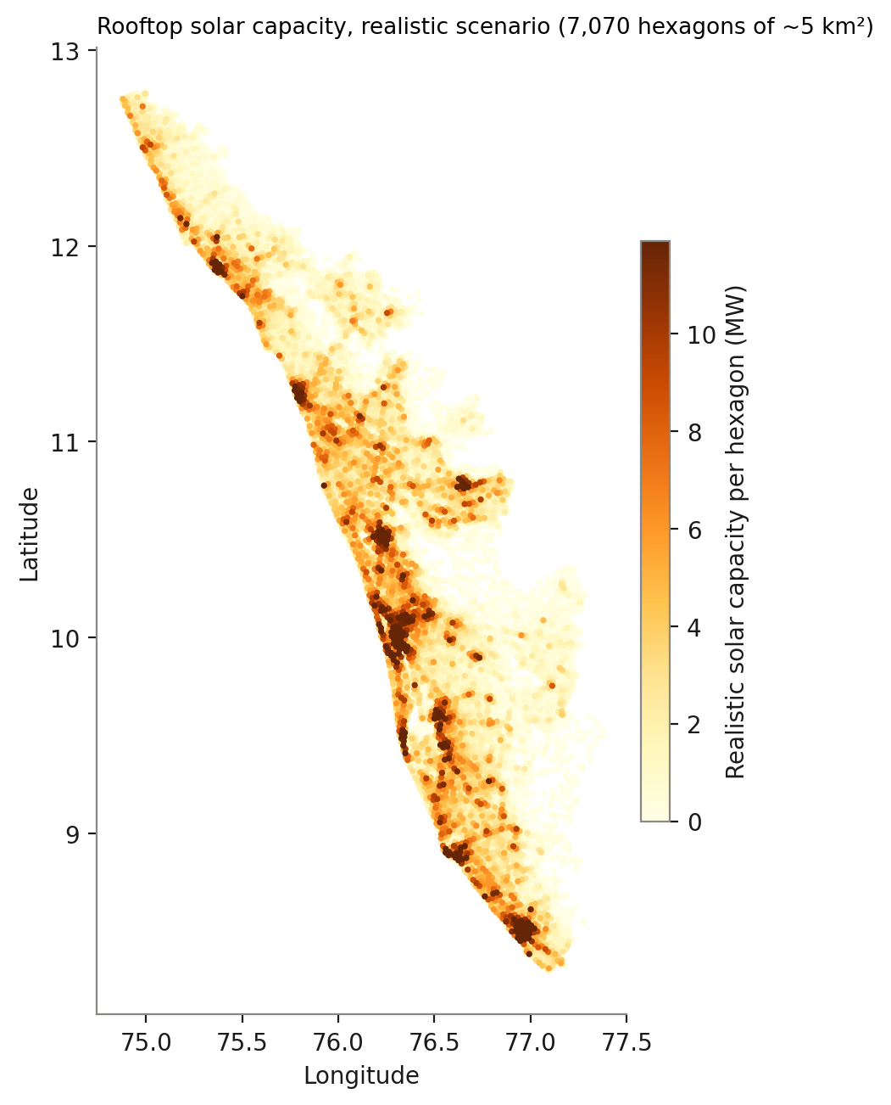
Result: where the potential is
Top: Ernakulam, Thrissur, Malappuram | Towns 78% of roofs good, villages 42%
Notes:
Where is the potential? Ernakulam leads with 3.7 terawatt hours a year, then Thrissur and Malappuram; Wayanad is lowest. On the map, the dark spots are the cities: Kochi, Thiruvananthapuram, Thrissur, Kozhikode and Kannur. In towns 78 percent of roofs are good, but in villages only 42 percent, because of tree shade and small roofs.

Slide 17
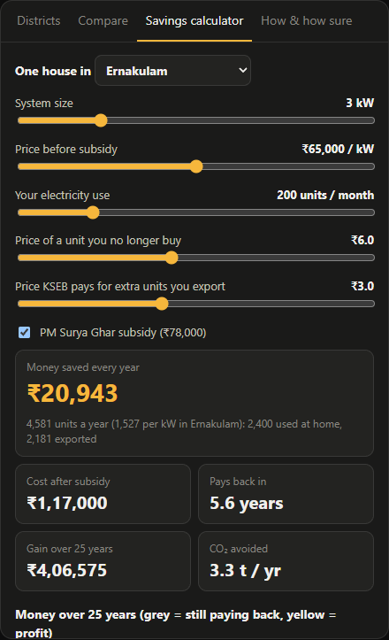
Result: what it means for one family
3 kW
₹1.17 lakh
home system in Ernakulam
cost after the ₹78,000 subsidy
₹21,000
5.6 years
saved on bills every year
to pay back, then 20 years of profit
From my dashboard's savings calculator (prices adjustable)
Notes:
What does this mean for one family? I built a savings calculator into my dashboard. A 3 kilowatt system in Ernakulam costs about 1.17 lakh rupees after the government subsidy. It saves about 21 thousand rupees a year on electricity bills, so it pays for itself in about 5.6 years, and then gives free power for 20 more years.

Slide 18
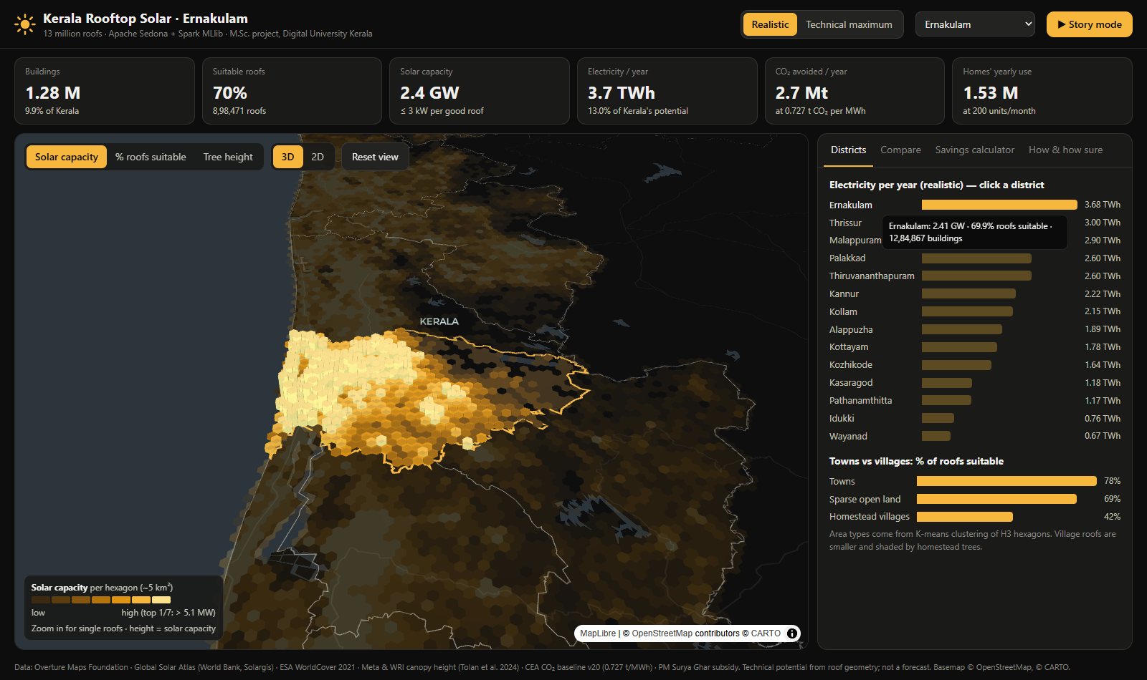
Live demo: the dashboard
1
Open the link (anyone can)
2
Press Story mode: 6-step tour
3
Click Ernakulam: 3D towers
4
Compare two districts
5
Savings calculator
muhammedshahidsds25-collab.github.io/kerala-rooftop-solar/dashboard/web/
Notes:
Now the live demo: the dashboard is public, anyone can open this link. Story mode gives a 6-step guided tour. Clicking Ernakulam shows 3D towers; the height is solar capacity. You can compare any two districts and try the savings calculator. If the internet fails, this screenshot shows the dashboard.

Slide 19


Honest limits and next steps
Limits
Next steps
Only 290 labels; accuracy 67%
The blind re-check was done by me
Roof slope, partial shade and strength not modelled
Photos and data are from different years
Spark ran on one cloud machine
An independent labeller and more labels
Roof slope and shade from 3D data
Check free area on real roofs
Run the pipeline on a cluster
Add grid and income data for adoption
Notes:
To be honest about the limits: I had only 290 labelled roofs, and the model is right 67 percent of the time, which is good for district totals but not for single roofs. The blind check was done by me. Roof slope, partial shade and roof strength are not modelled. Next steps: an independent labeller and more labels, 3D data for slope and shade, field checks, a cluster run, and grid and income data.

Slide 20
Conclusion
CO1
Spark vs Sedona, MapReduce
Half of Kerala's 13 M roofs suit solar
Realistic 18.5 GW = 88% of Kerala's need
Saves about 20 Mt of CO₂ a year
Towns and Ernakulam, Thrissur, Malappuram lead
CO2
Cleaning, partitioning, PostGIS
CO3
K-means, FP-Growth, Random Forest
CO4
CO₂, subsidy, payback
Thank you. Questions?
github.com/muhammedshahidsds25-collab/kerala-rooftop-solar
Notes:
To conclude: half of Kerala's 13 million roofs suit solar. Realistically they could give 18.5 gigawatts, 88 percent of the state's electricity need, saving about 20 million tonnes of CO2 a year. Towns and the districts of Ernakulam, Thrissur and Malappuram lead. The project covers all four course outcomes. All code is public on GitHub. Thank you, I am happy to take questions.

