Slide 1


Eliminating Manual Handoffs with AI Orchestration
Automated Incident Assignment for First-time Accuracy
Leveraging Watsonx Orchestrate and RAG to Ensure Precise First-time Routing and Replace Broken Processes.
TEAM: TKE

Slide 2
Challenge: The Silent Productivity Killer > Miss-Routed Incidents

Slide 3



Eliminate Functional Escalation with Intelligent Triage
1
2
3

Slide 4





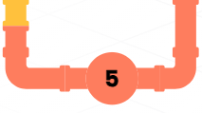
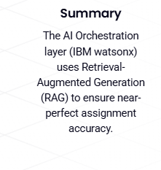
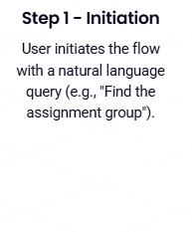
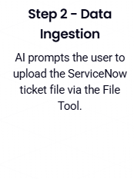
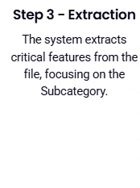
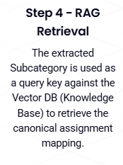
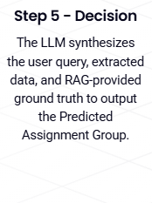
RAG-Enhanced AI Assignment via Orchestration
1
5
3
2
4

Slide 5
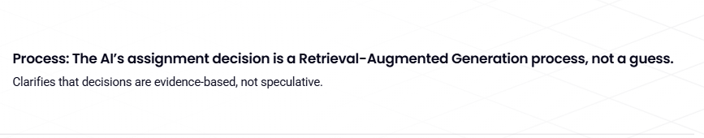


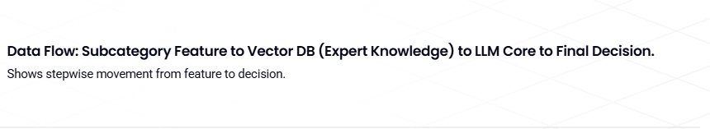
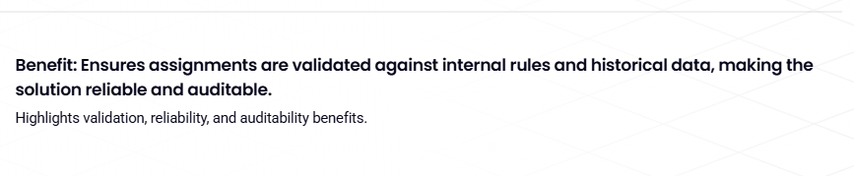

The RAG Engine: Grounding Decisions in Expert Knowledge

Slide 6
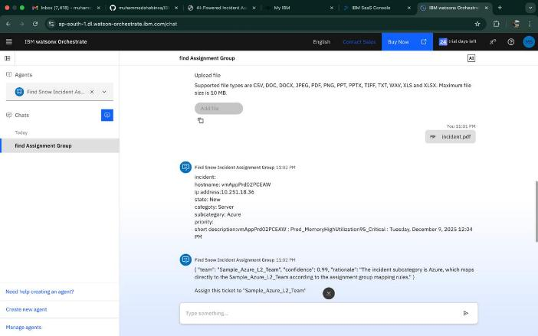
Demo: Assignment group decision

Slide 7
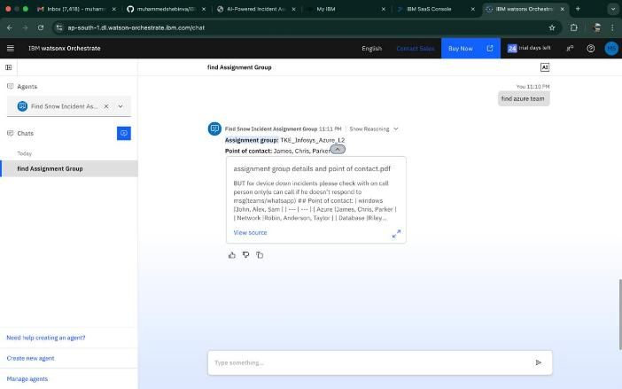
Demo: respective team details

Slide 8
Stop Rerouting, Start Resolving…

Slide 9
Thank You!

