Slide 1
THE WALT DISNEY COMPANY·ACQUISITION OF 21ST CENTURY FOX
PRELIMINARY · CONFIDENTIAL
01
EXECUTIVE TRANSACTION OVERVIEW
Disney acquires the 21st Century Fox entertainment assets in a $69.5 billion cash-and-stock transaction.
STRATEGIC RATIONALE
Combines Disney's franchises and direct-to-consumer platform with Fox's film, television and content library.
Consolidates a controlling interest in Hulu, accelerating the streaming strategy.
RECOMMENDATION
Approve — cash-accretive within three years and deleveraging to a net-cash position.
Scale-defining: pro forma revenue of ~$97.5bn and EBITDA of ~$28.3bn by FY2023E.
ACQUIRER · NYSE: DIS
TOTAL CONSIDERATION · $69,456MM
TARGET · 21ST CENTURY FOX
The Walt Disney Company
Entertainment Assets (RemainCo)
≈ 51% CASH / ≈ 49% STOCK
PURCHASE CONSIDERATION
$ in millions
Cash · $35,703
New Disney equity · $33,753
51.4% of consideration
48.6% of consideration · 307mm new shares
TOTAL CONSIDERATION
PRO FORMA OWNERSHIP
PRELIMINARY GOODWILL
HULU REMEASUREMENT GAIN
$69.5bn
83% DIS / 17% 21CF
$47.7bn
$4.7bn one-time
Source: DIS / 21CF merger model — figures linked live to model engine. $ in millions except per share. Transaction closed March 20, 2019.
01
Notes:
Headline transaction: Disney acquires the 21st Century Fox entertainment assets for $69.5bn, ~51% cash / ~49% new equity, closed March 2019. Recommendation is to approve — optically GAAP-dilutive but cash-accretive within three years and deleveraging to net cash.

Slide 2
THE WALT DISNEY COMPANY·ACQUISITION OF 21ST CENTURY FOX
PRELIMINARY · CONFIDENTIAL
02
TRANSACTION STRUCTURE & FINANCING
Double-dummy structure under TWDC Holdco · sources balance uses at $69,456mm
TRANSACTION TIMELINE & VALUE EVOLUTION
JUN 2018
JUN 2018
MAR 20, 2019
Initial agreed value
Revised agreed value
Close · recorded
$52.4bn equity value
$71.3bn equity value
$69.5bn consideration
SOURCES & USES OF FUNDS
OWNERSHIP — BEFORE & AFTER
Sources
$69,456mm
Existing Disney holders 83.0%
17.0%
New Disney equity
New debt incurred
$33,753
$35,703
1,499mm existing shares
+ 307mm new → 1,806mm total
Uses
$69,456mm
Cash to 21CF holders
Stock to 21CF holders
EXCHANGE RATIO
PER-SHARE VALUE
DIS CLOSE 3/19/19
$35,703
$33,753
0.3328x
$51.57
$110.00
TOTAL DEBT AT CLOSE
NEW ACQUISITION DEBT
ASSUMED 21CF DEBT
RSN PROCEEDS → DEBT PAYDOWN
$38,811mm
$19,603
$19,208· FV 22,800
$13,070
Source: DIS / 21CF merger model — Sources & Uses, Debt and Assumptions schedules. $ in millions.
02
Notes:
Structure: double-dummy under TWDC Holdco. Sources equal uses at $69.5bn. Consideration ~51% cash / ~49% stock; pro forma ownership 83/17 on 1,806mm shares. Total debt at close $38.8bn — new acquisition debt $19.6bn plus assumed 21CF debt $19.2bn; RSN divestiture proceeds of $13.1bn applied to debt paydown.

Slide 3
THE WALT DISNEY COMPANY·ACQUISITION OF 21ST CENTURY FOX
PRELIMINARY · CONFIDENTIAL
03
VALUATION PERSPECTIVE
The agreed $69.5bn consideration within the negotiated value range
NEGOTIATED VALUE RANGE & IMPLIED VALUATION · $ IN BILLIONS
PREMIUM
AGREED · $69.5BN
+36.1%
Initial agreed equity value
$52.4
Uplift from initial ($52.4bn) to revised ($71.3bn) agreed equity value.
Recorded consideration
$69.5
Revised agreed equity value
$71.3
IMPLIED MULTIPLES
Equity / FY19E EBITDA
15.6x
Implied enterprise value
$92.3
EV / FY19E EBITDA
20.7x
incl. assumed debt at FV
0
25
50
75
100
Goodwill / consideration
68.6%
+36% value uplift
Consideration of $69.5bn was struck a touch below the $71.3bn revised value, evidencing disciplined final terms.
$47.7bn of preliminary goodwill (69% of consideration) reflects the intangible-heavy asset base and step-ups.
Multiples reflect the narrow RemainCo perimeter — Hulu equity-method and Sky excluded from EBITDA.
Source: DIS / 21CF merger model — Value Reconciliation, PPA and Fox projection schedules. EBITDA on FY2019E RemainCo basis of $4,452mm.
03
Notes:
Valuation: the $69.5bn consideration sits within the negotiated range that rose from $52.4bn initial to $71.3bn revised — a 36% uplift. Implied enterprise value of ~$92.3bn including assumed debt at fair value. Multiples reflect the narrowly-defined RemainCo entertainment perimeter (Hulu equity-method, Sky excluded).

Slide 4
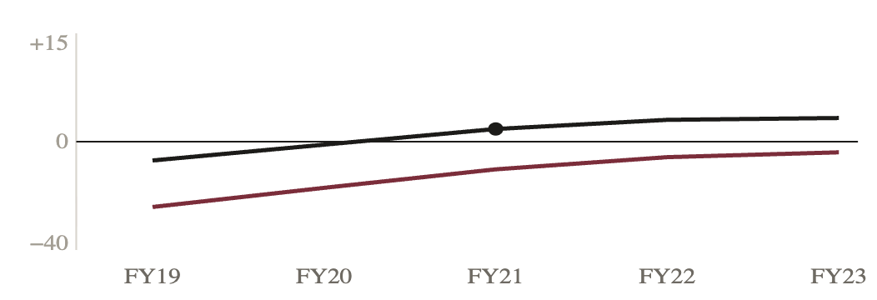
THE WALT DISNEY COMPANY·ACQUISITION OF 21ST CENTURY FOX
PRELIMINARY · CONFIDENTIAL
04
PRO FORMA FINANCIAL IMPACT
GAAP-dilutive on structural drivers — cash-accretive within three years
FY2023E EPS ACCRETION / (DILUTION) BRIDGE
+0.85
0.00
$ per share
FY2023E PRO FORMA
Revenue
8.24
$97.5bn
+1.07
+0.49
7.74
EBITDA
$28.3bn
−1.49
GAAP EPS
$7.74 −6.1%
−1.41
Cash EPS
$9.32 +13.1%
Disney standalone
(−) Share issuance
(+) Fox earnings
(+) Synergies
(−) Integration
(−) PPA amort.
(+) Financing
Pro forma
ACCRETION / (DILUTION) %
COST SYNERGIES REALIZED · $MM
TOTAL DEBT OUTSTANDING · $MM
2,000
2,000
1,800
$2,000 run-rate
19,396
1,000
12,164
200
4,112
0
0
Cash A/(D) — crosses + in FY21E
GAAP A/(D)
FY19
FY20
FY21
FY22
FY23
FY19
FY20
FY21
FY22
FY23
Net cash by FY2022E · 0.67x → net cash
Source: DIS / 21CF merger model — Accretion/(Dilution), Synergies and Debt schedules. GAAP basis; cash EPS excludes non-cash PPA amortization.
04
Notes:
Financial impact: the FY2023E EPS bridge shows standalone $8.24 falling to pro forma $7.74 — GAAP-dilutive, driven almost entirely by share issuance (-$1.41) and non-cash PPA amortization (-$1.49). Offsetting positives: Fox earnings +$1.07, synergies +$0.85, deleveraging +$0.49. Cash EPS turns accretive in FY2021E, reaching +13% by FY2023E. Synergies ramp to a $2.0bn run-rate; all acquisition and assumed debt retired by FY2022E.

Slide 5
THE WALT DISNEY COMPANY·ACQUISITION OF 21ST CENTURY FOX
PRELIMINARY · CONFIDENTIAL
05
RISKS & INVESTMENT CONCLUSION
STRATEGIC BENEFITS
INTEGRATION & EXECUTION RISKS
KEY SENSITIVITIES
Scale-defining content engine across film, television and direct-to-consumer.
GAAP-dilutive through the forecast (−36% → −6%) on share issuance and PPA amortization.
FY2023E cash accretion holds at +7.9% even at 50% of synergies.
Control of Hulu accelerates the streaming roadmap.
$560mm of front-loaded costs to achieve synergies in FY2019–20E.
FY2023E invariant to financing rate (2–6%) — debt fully retired.
$2.0bn run-rate cost synergies by FY2022E.
Rapid deleveraging to a net-cash position by FY2022E.
Synergy realization risk against the FY2022E ramp.
PPA amortization (−$1.49) and shares (−$1.41) dominate the bridge — both structural.
$47.7bn goodwill carries future impairment exposure.
Financing-rate risk concentrated in FY2019E only.
RECOMMENDATION
Strategically compelling and scale-defining. The headline GAAP dilution masks favorable cash economics and a strong deleveraging profile; sensitivity testing confirms FY2023E cash accretion holds even at zero incremental synergies and across a 2–6% financing-rate range.
Approve the transaction.
Accretive on the metric that matters within three years.
Source: DIS / 21CF merger model — Sensitivity & Scenario analysis and Executive Conclusion. $ per share unless noted.
05
Notes:
Conclusion: strategically compelling and scale-defining. Headline GAAP dilution masks favorable cash economics and a strong deleveraging profile. Sensitivity testing confirms FY2023E cash accretion holds even at zero incremental synergies and across a 2–6% financing-rate range. Recommendation: approve.

