Slide 1
PHARMACEUTICAL SALES ANALYSIS
Presented by:
Muhammed Sinan T A

Slide 2
INTRODUCTION
This analysis explores pharmaceutical sales data using Tableau.
Insights include sales trends, revenue by category, regional patterns,
payment method distribution, top medicines, and profit relationships.

Slide 3
OBJECTIVES
Analyze sales trends over time
Identify best-selling medicines
Evaluate revenue by category
Study regional sales distribution
Understand customer payment behavior
Explore sales vs profit correlation

Slide 4
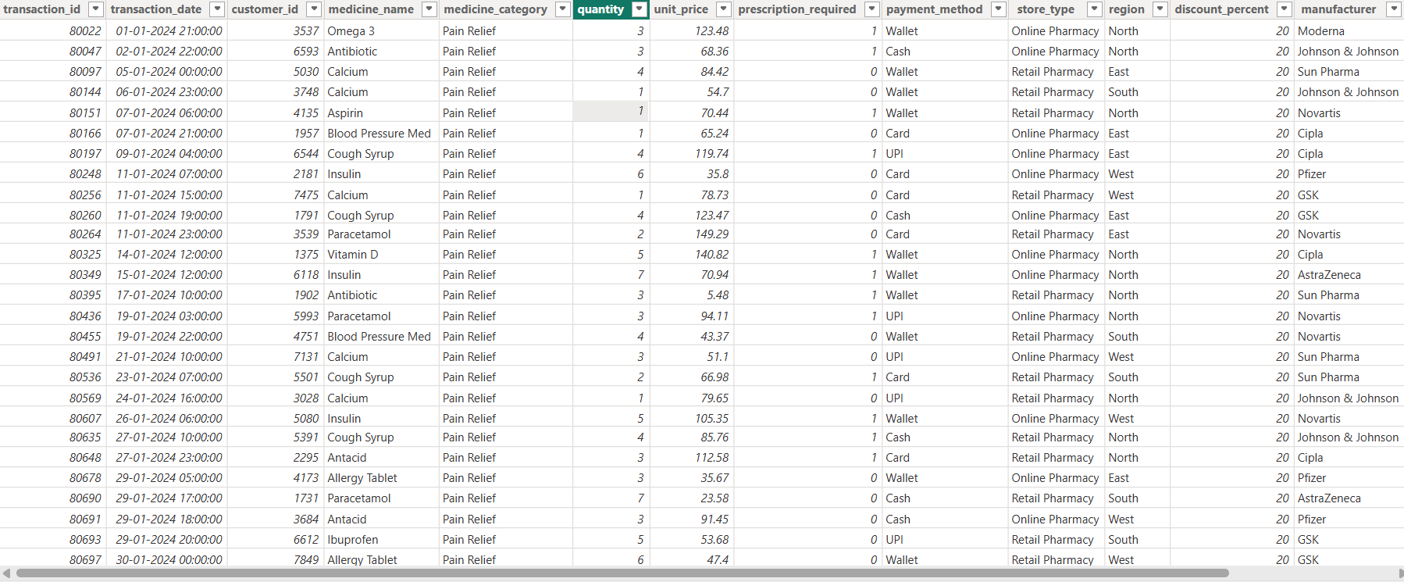
DATASET USED

Slide 5
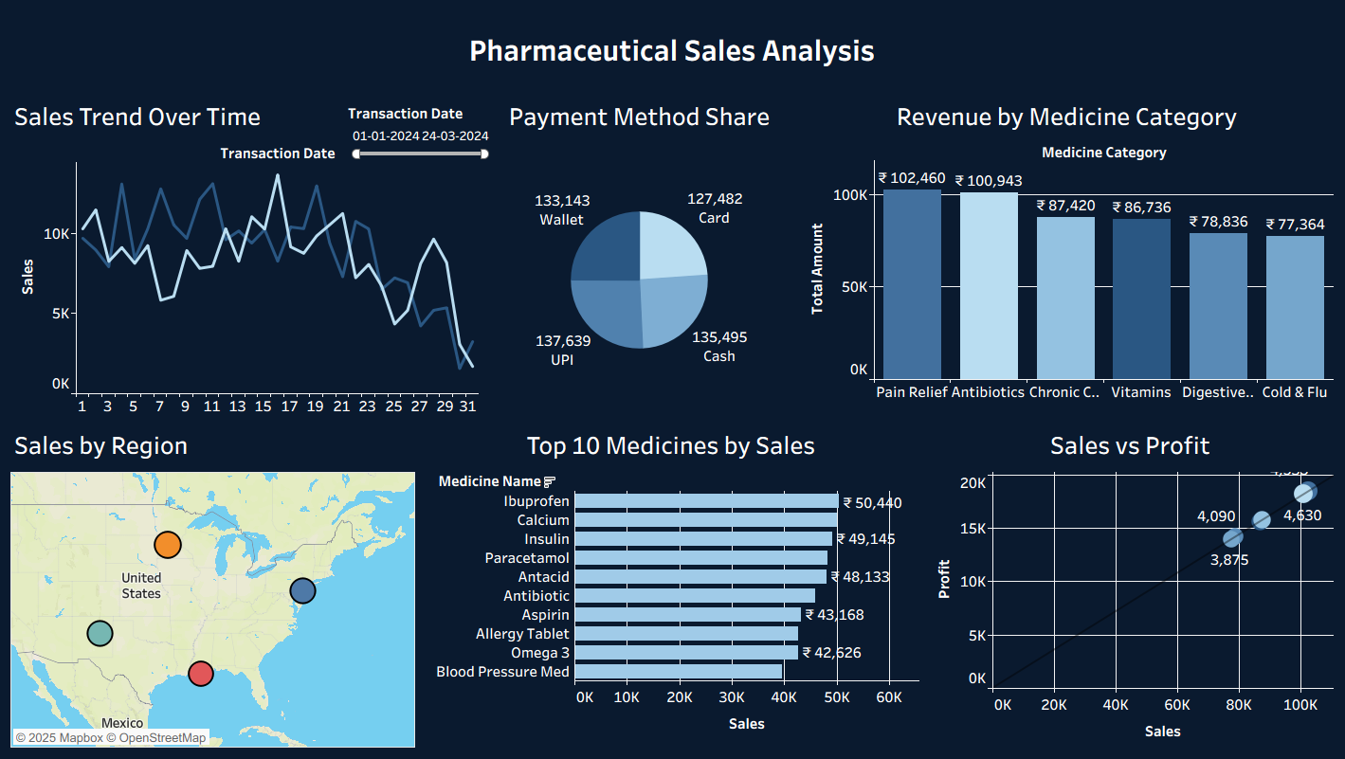
DASHBOARD

Slide 6
CRITERIA USED
Time-series sales evaluation
Category-wise revenue segmentation
Payment share analysis
Regional sales mapping
Ranking top medicines by sales
Sales-profit relationship study

Slide 7
CONCLUSION
Sales fluctuate but remain strong in peak periods
Pain Relief & Antibiotics categories lead revenue
UPI and Wallet are widely used payment modes
Regional variations show growth opportunities
Ibuprofen, Calcium, and Insulin dominate medicine sales
Profit increases proportionally with total sales

Slide 8
SUGGESTIONS
Increase stock for high-demand medicines
Strengthen supply network in strong regions
Encourage digital payments for smoother transactions
Optimize pricing for better margins
Expand top-performing medicine lines
Continuously monitor KPIs via dashboards

Slide 9
REFERENCE
Dataset: Provided pharmaceutical sales data
Tools Used: Tableau
Design Theme: Dashboard visuals created from analysis
Map Attribution: © OpenStreetMap & Mapbox

Slide 10
THANK YOU

