Slide 1
SMART CITY PARKING & TRAFFIC ANALYTICS
Presented by:
Muhammed Sinan T A

Slide 2
INTRODUCTION
This project analyzes smart city parking and traffic data using Power BI
Focuses on vehicle flow, parking utilization, and congestion patterns
Helps city planners optimize traffic and parking management

Slide 3
OBJECTIVES
Analyze total revenue generated from parking
Study vehicle distribution by type and peak hours
Understand occupancy status and congestion levels
Evaluate zone-wise revenue performance
Support smart traffic decision-making

Slide 4
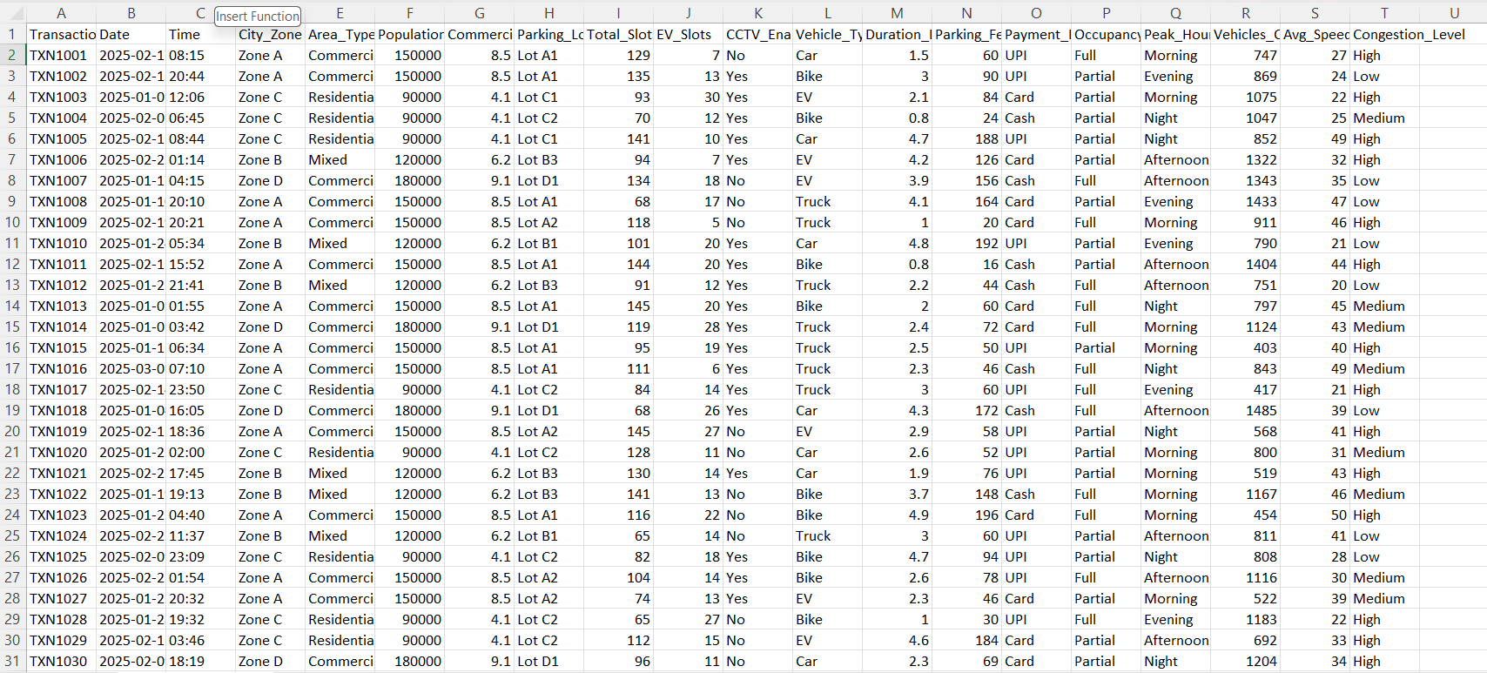
DATASET USED

Slide 5
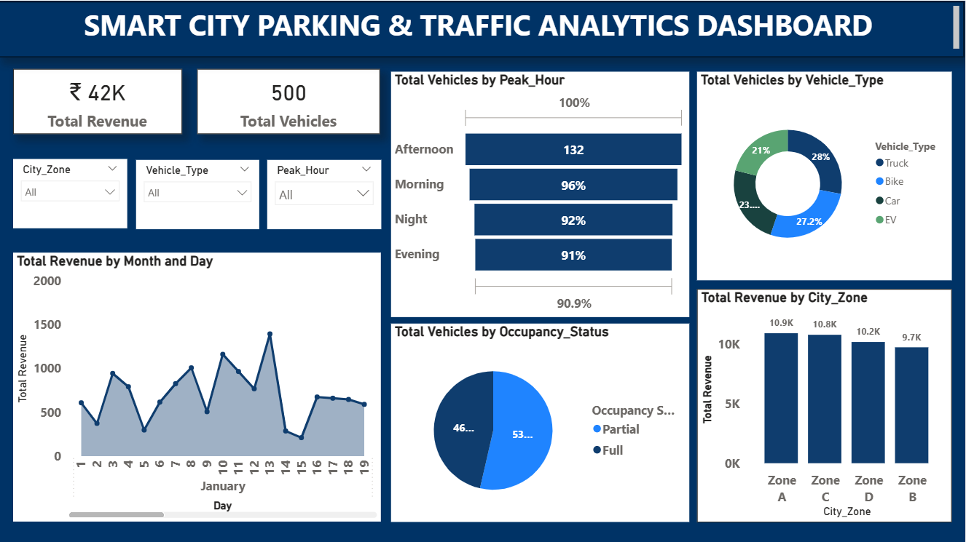
DASHBOARD

Slide 6
CRITERIA USED
City Zone filtering
Vehicle Type filtering
Peak Hour filtering
Revenue aggregation
Vehicle count analysis
Occupancy and congestion evaluation

Slide 7
CONCLUSION
Peak hours significantly impact vehicle volume
Certain zones generate higher parking revenue
Cars and Bikes dominate vehicle distribution
High congestion corresponds with lower average speed
Dashboard enables real-time traffic insights

Slide 8
SUGGESTIONS
Increase parking capacity in high-demand zones
Promote EV parking infrastructure
Use dynamic pricing during peak hours
Improve traffic flow in high congestion zones
Monitor KPIs regularly for smart planning

Slide 9
REFERENCE
Dataset: Smart City Parking & Traffic Dataset :Kaggle
Tool Used: Power BI

Slide 10
THANK YOU

