Slide 1
Cloud Training Management Platform
Azure Cloud Infrastructure & Deployment with AKS

Slide 2
Objective
Centralized training management portal
01
Automated AWS instance lifecycle management
02
Role-based access using Microsoft Entra ID
03
AI-assisted training and lab generation
04

Slide 3
Zero-Trust Network Arcitecture
Edge Protection: A public-facing Azure Application Gateway WAF v2 blocks threats using OWASP 3.2 rulesets in strict Prevention Mode.
Network Segmentation: The architecture isolates traffic across 5 distinct subnets (App Gateway, AKS, AKS API, Private Endpoints, and Functions) to contain breaches.
Private Connectivity: A hub-and-spoke model uses Private Endpoints to map internal IPs to critical services like Storage, Key Vault, ACR, and Azure OpenAI.
Traffic Control: Minimalist Network Security Groups (NSGs) enforce a strict "deny-by-default" policy for all non-essential ingress and egress traffic.
Secure Administration: All cluster management and administrative tasks are isolated through a dedicated bastion jumpbox VM.

Slide 4
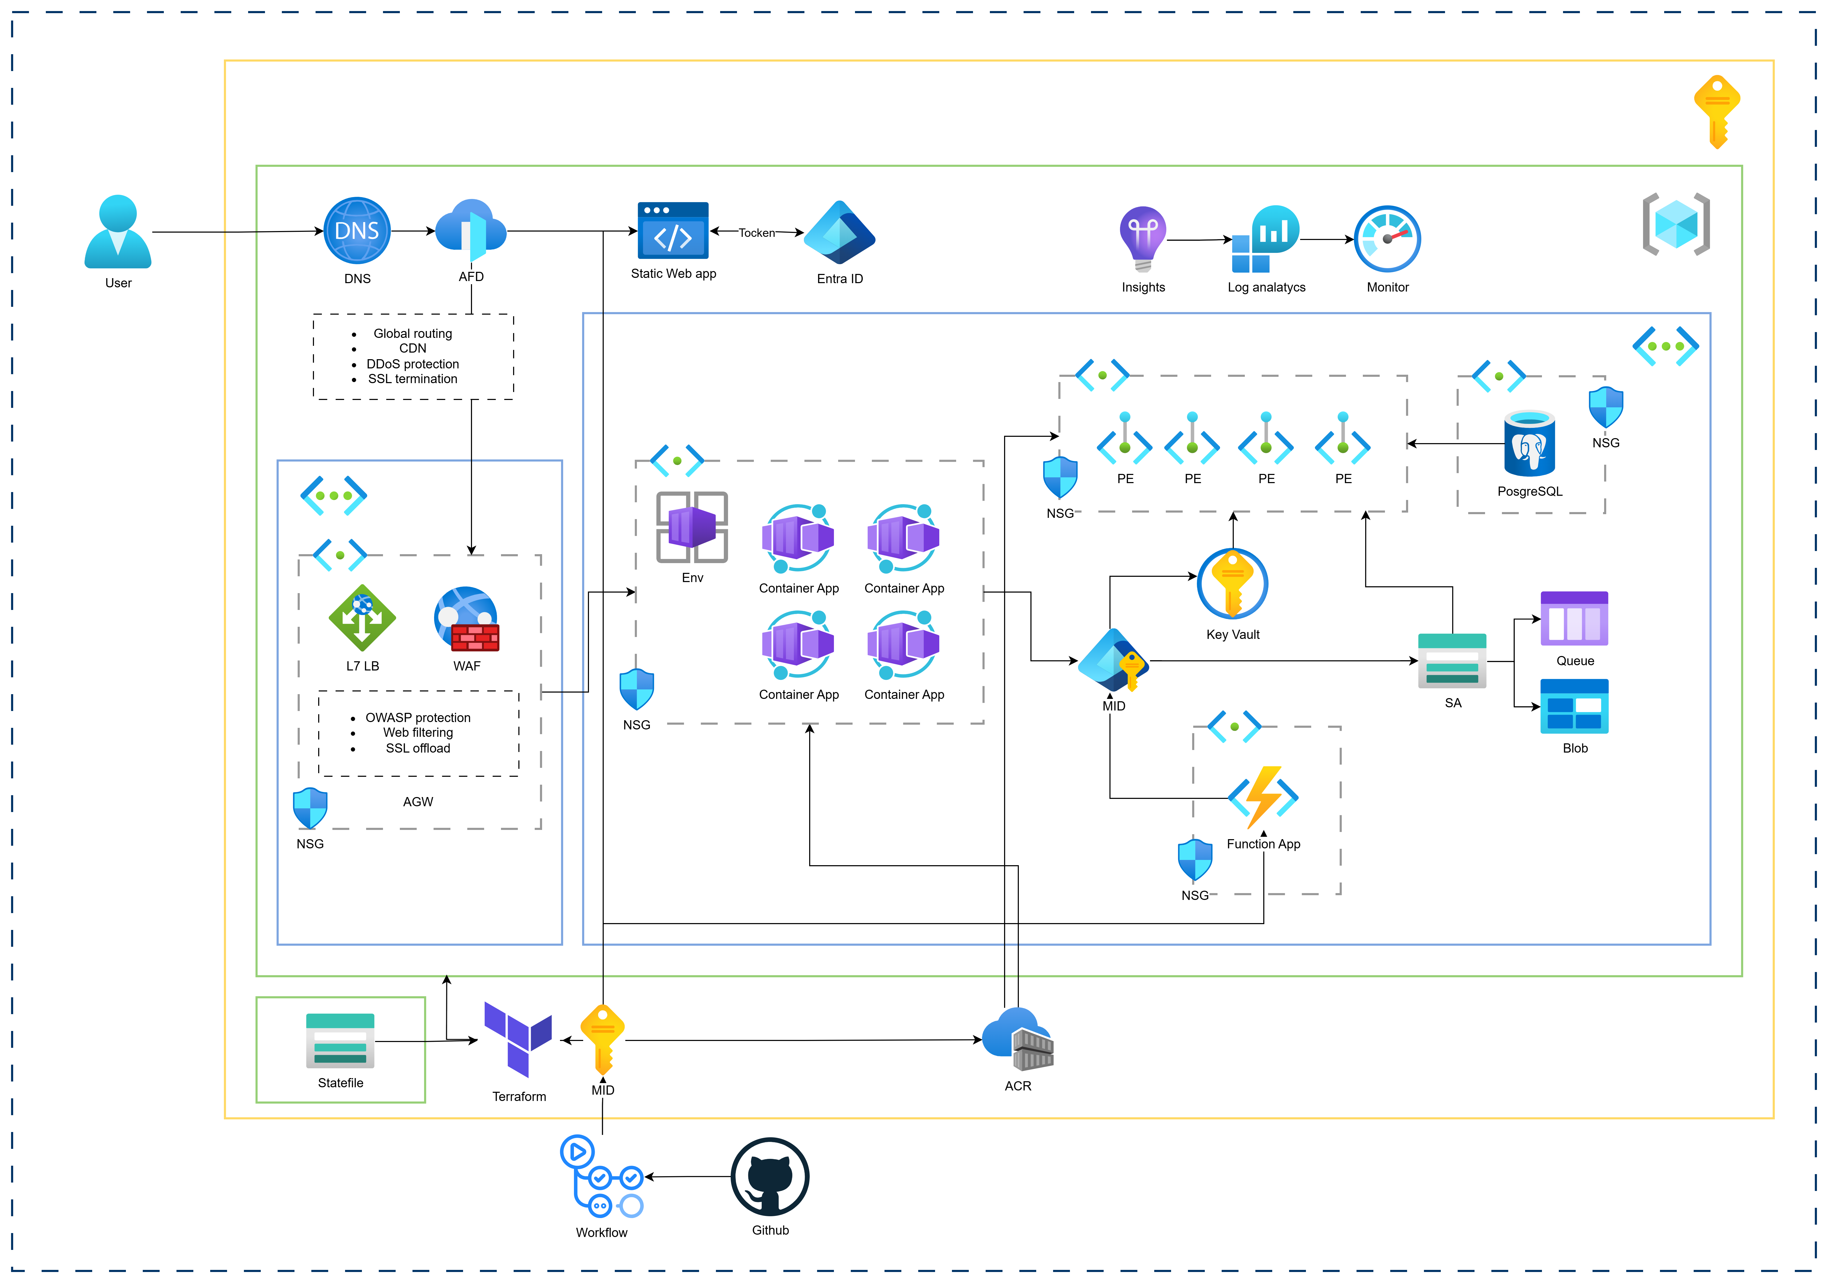
Architecture

Slide 5
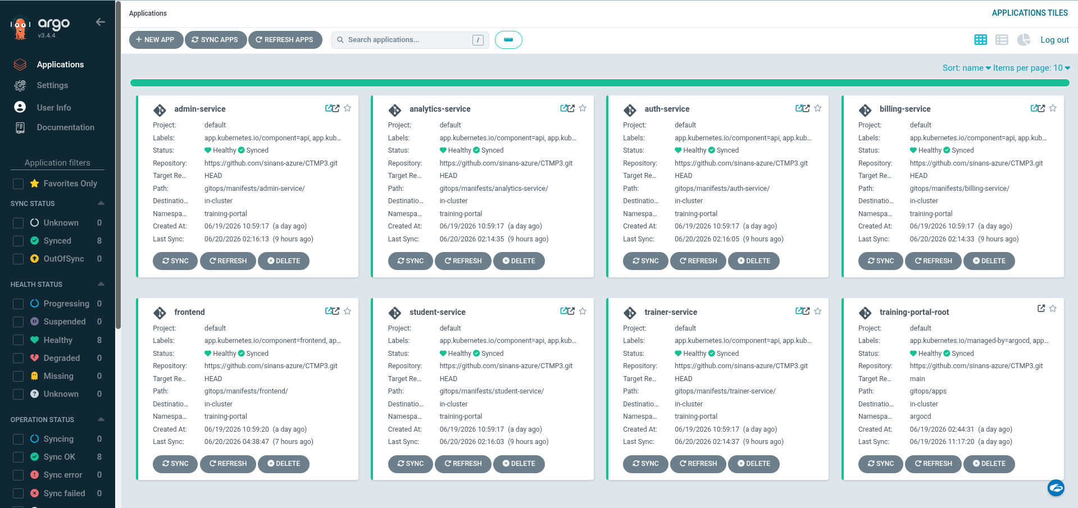

Slide 6
Thank You

