Slide 1
7 Segment
Rotating Display

Slide 2
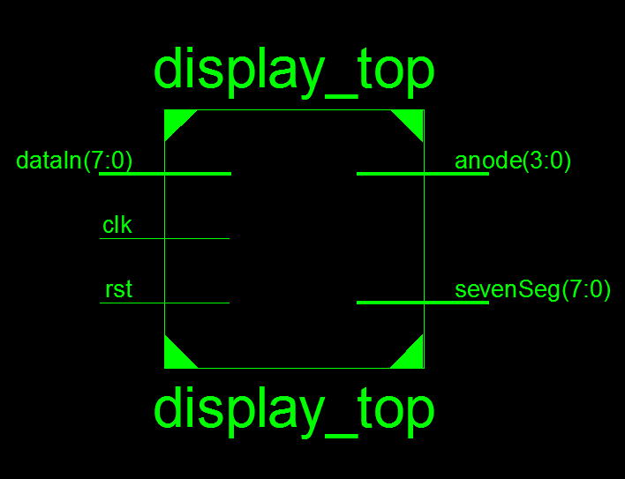
Design Top Level:

Slide 3
Design Top Level:
Inputs
dataIn[7:0] will be tied to the switches (SW7-SW0) on the board.
clk will be connected to the clock pin.
rst will be connected to the button BTN0 on the board.
Outputs
anode[3:0] will be connected to 7 segment anode pins.
sevenSeg[7:0] will be connected to each of the seven segment displays.

Slide 4
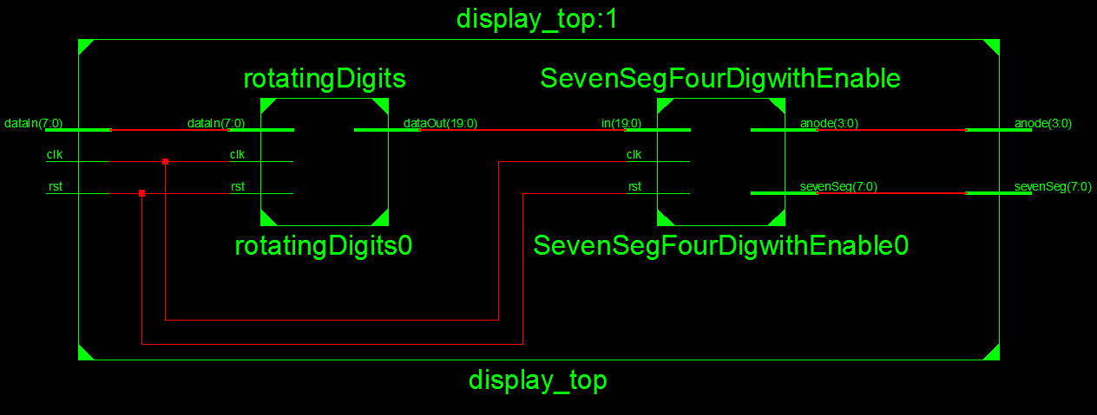
Submodule Connections:

Slide 5
Submodule Connections:
There are two modules inside the topmodule.
Interface module takes input number and output the rotated the number with a little delay.
SevenSegFourDig module takes the output from the interface module and produce anode and sevenSeg outputs for seven segment display.

Slide 6
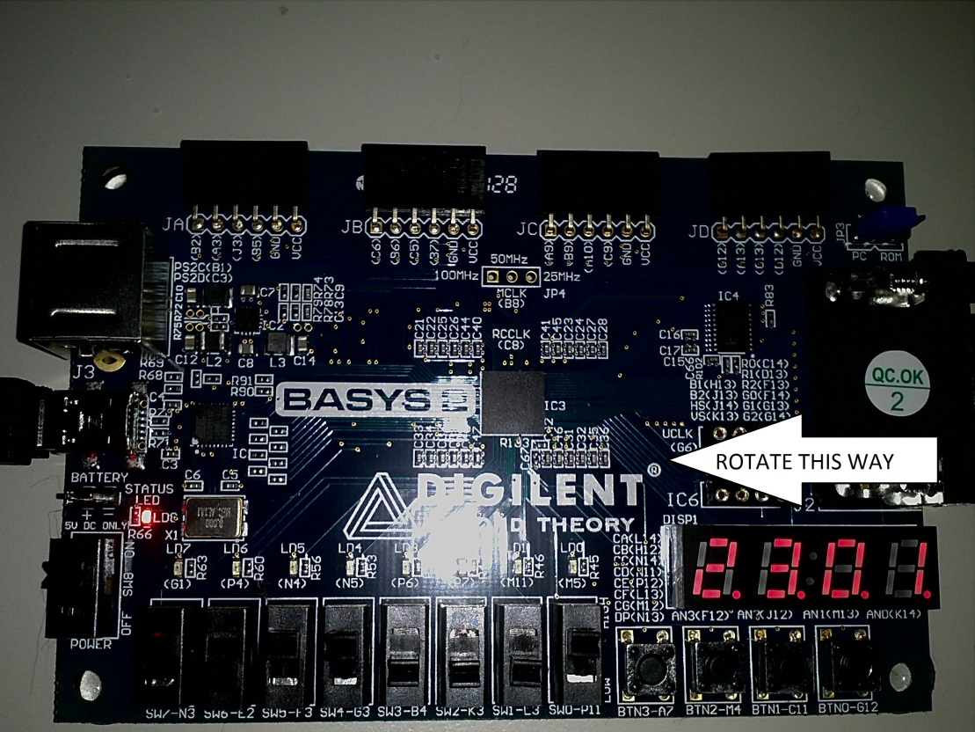
Design Behavior:
Data is taken from 4 different 2 bit input switches at every reset, then the data taken is rotated from right to left. To see where the number starts and ends, 3 empty digits are attached to the output.

Slide 7
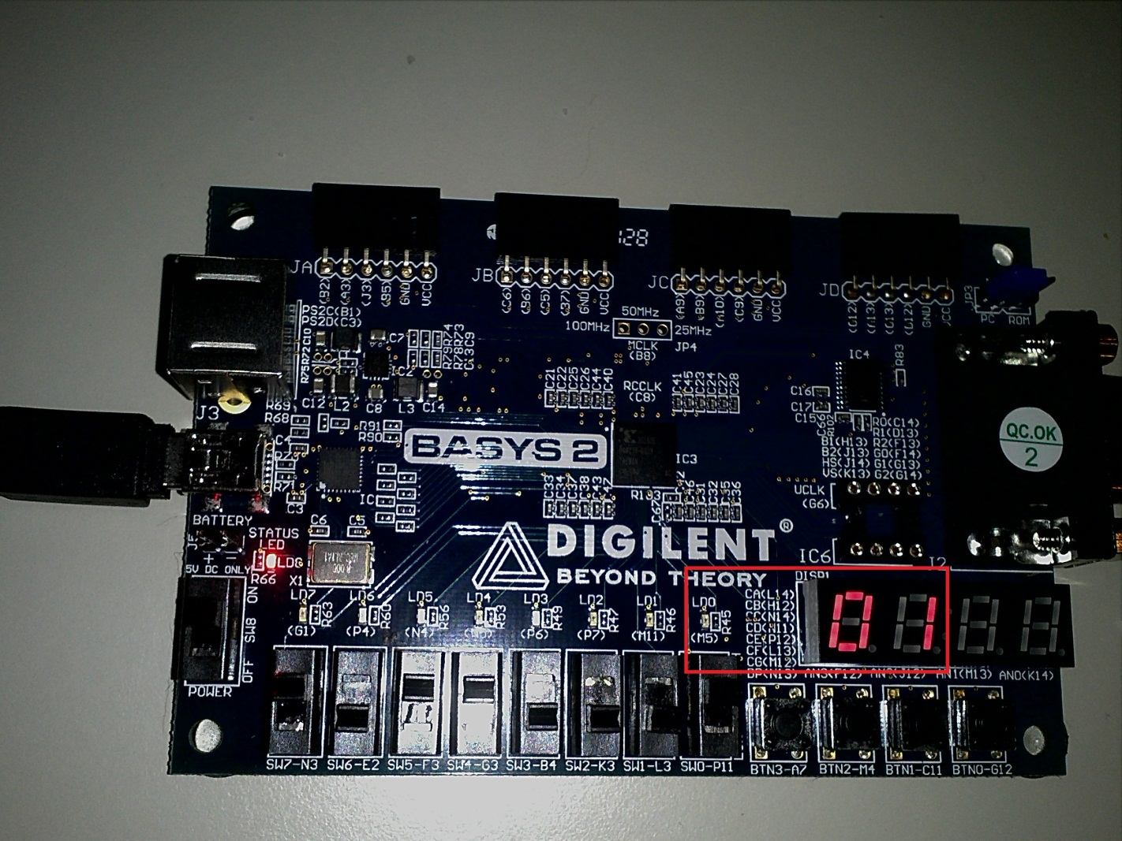
Design Behavior:

Slide 8
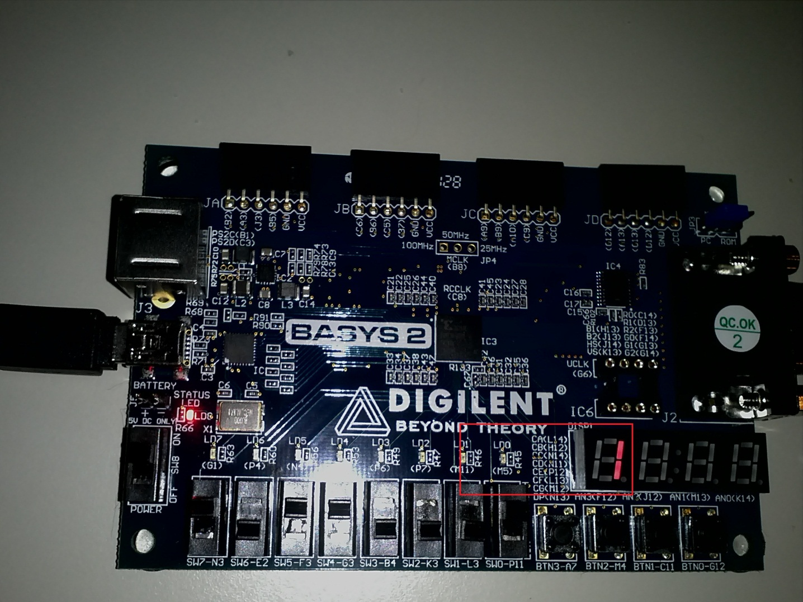
Design Behavior:

Slide 9
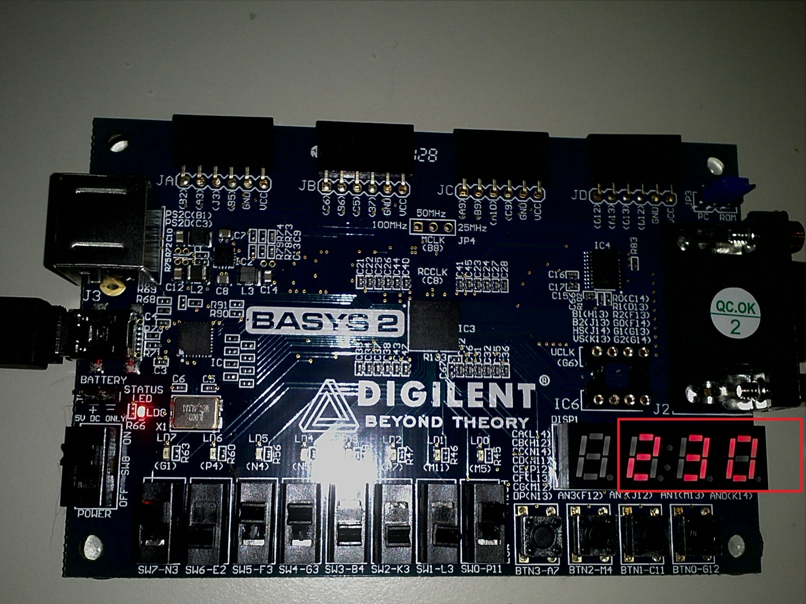
Design Behavior:

